Slide 1
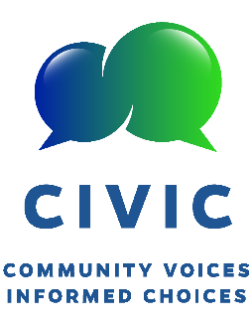
Update from CIVIC
CommunIty Voices, Informed Choices
Florida Cooperative Extension Service
University of Florida and Florida Agricultural and Mechanical University
Martha Monroe, for the CIVIC Leadership Team:
Holly Abeels, Carol Alberts, Alicia Betancourt, Natalie Cooper, Joy Hazell, Kenya Washington Johnson, Ramona Madhosingh-Hector, Lara Milligan, Kenneth Rainer, Linda Seals, Jennison Searcy, Sandra Thompson, Dreamal Worthen

Slide 2
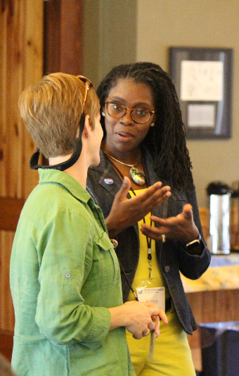
CIVIC Builds on EIF and NIF
Focus on community-level controversial issues
Water quality, sea level rise, affordable housing, disaster preparedness
Builds capacity of Extension faculty to lead deliberative discussions in communities on local controversial issues
Faculty part of NAAEE/Kettering Initiatives
Climate Concerns and Water
Tapping Kettering Fellows Gregg Kaufman, Joy Hazell

Slide 3
And adds 3 twists
Cooperative Extension Service provides scientific research findings
Town Hall meetings, Workshops
CIVIC blends UF and FAMU
Intentionally addressing race and underserved communities
Framing issues to purposely engage Moral Foundations (Haidt) and Worldviews (Kahan)

Slide 4
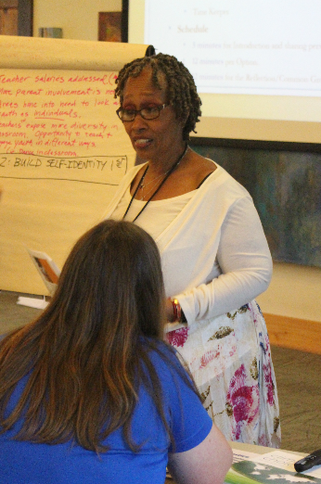
Organizational Progress
2018-19
Who:
CIVIC Core Coordinating Committee (4)
CIVIC Leadership Team (~10)
Strategic Plan, Logic Model
State-wide training with demonstration forum
2019-2020
Comprehensive Evaluations on website
New issue guides with trigger videos
Regional training with projects
CIVIC becomes the community education/outreach arm of some faculty research projects

Slide 5
Pinellas County held 3 forums
Working with the Hispanic Outreach Center enabled us to bring new audiences to our program and provide translation services.
Incentives are not the primary motivator for attendees – those who come want to engage in the topic.
City employees have learned that Extension can help facilitate discussions around issues and have been glad to hear from citizens with such candor.

Slide 6
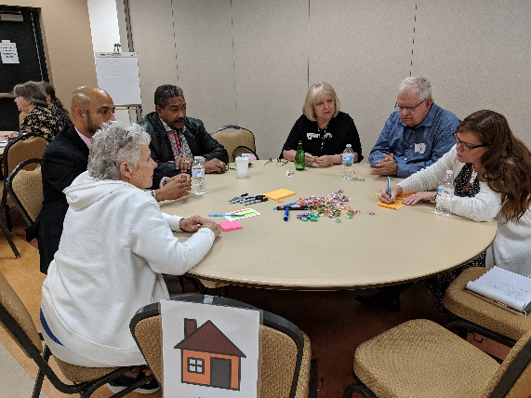
Retreat with Council of Social Agencies in St. Lucie County
Enabled groups to find synergies
Rethink how to be more strategic
Developing common messages for community leaders

Slide 7
Variety of other projects were conducted
Information about new septic system upgrades and funding for conversion to sewer lines. 16 people registered and 35 attended! Marion County
Town hall meeting on Family Heirs’ Property provided information and connected people to resources. Leon County
Local food and beverage providers met to explore a unified approach to reducing plastic pollution and strategies to overcome barriers to providing non-plastic alternatives. Sarasota County

Slide 8
We are learning
I am learning more and getting better at working with our collaborators, and CIVIC has been a huge part of that experience.
I have skills to moderate a forum and use techniques to ensure everyone has the opportunity to contribute without fear of reprisal.
CIVIC helps me meet the needs of more urban and non-traditional audiences.

Slide 9
Questions?
mcmonroe@ufl.edu

