Slide 1
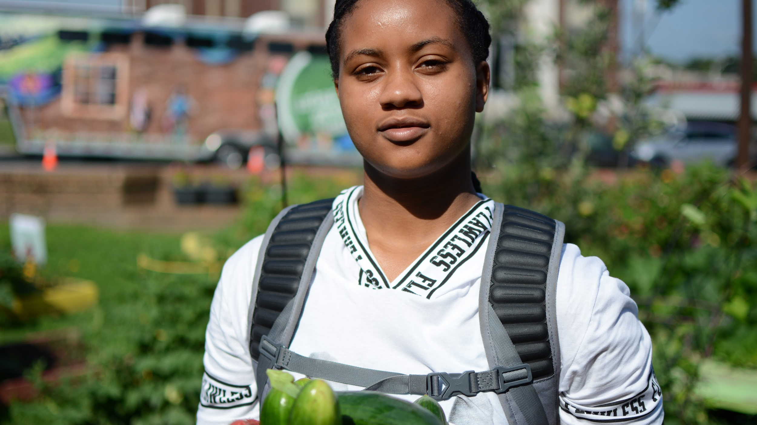
NAAEE
Diana Andrew
Lexington, KY
October 17, 2019

Slide 2
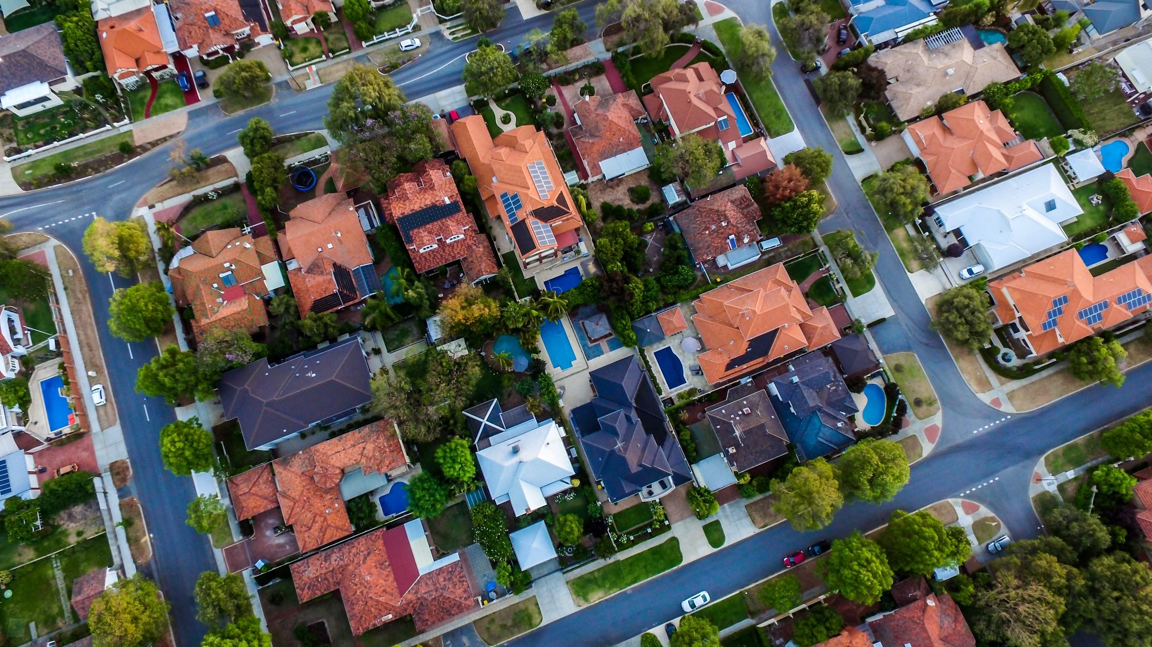
NAME TWO THINGS YOU NEED FOR A HAPPY AND HEALTHY LIFE
Notes:
Ask students to name two things they need for a happy and healthy life (coffee, clean water, good food, healthcare, etc.)
Have them hold onto items until slide 7

Slide 3
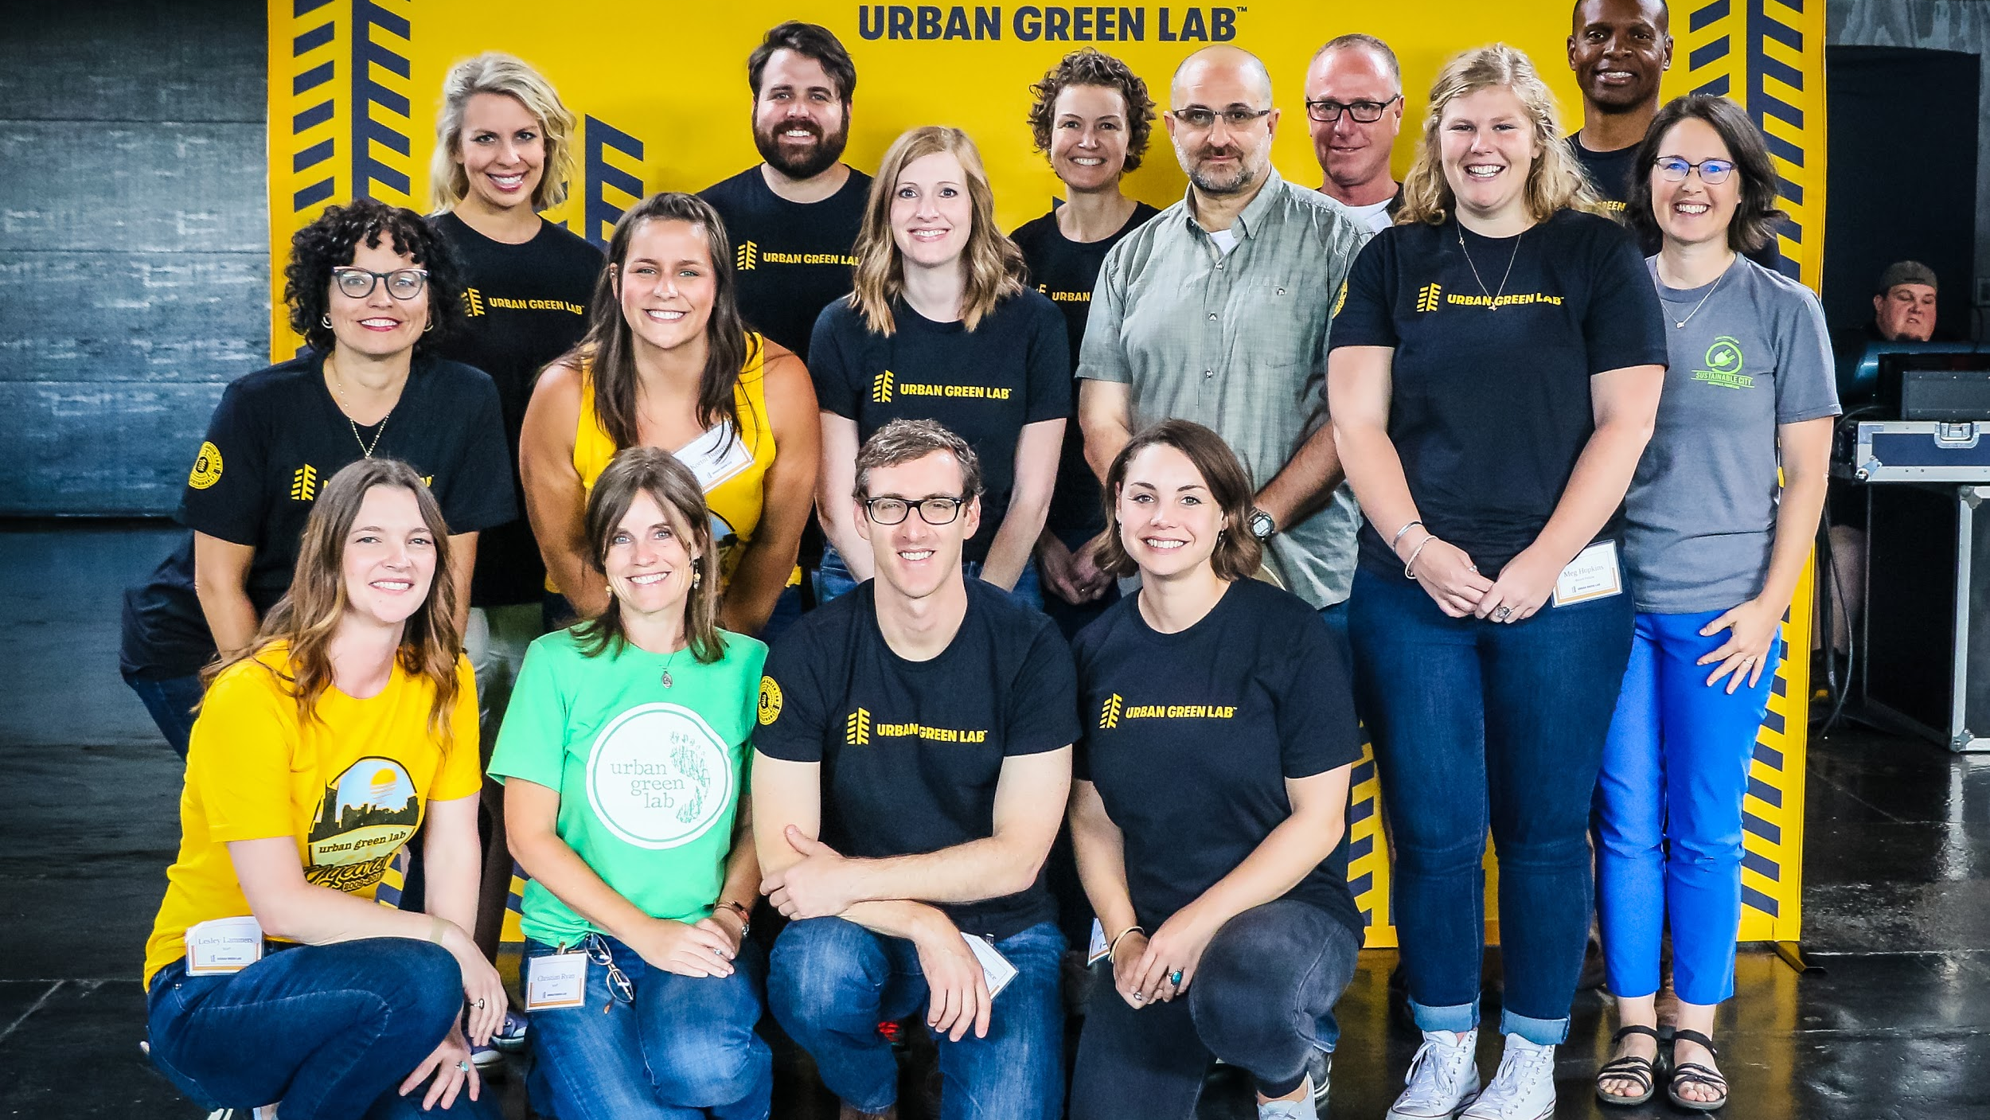
Mission
Teaching Communities to Live Sustainably
Notes:
www.urbangreenlab.org

Slide 4
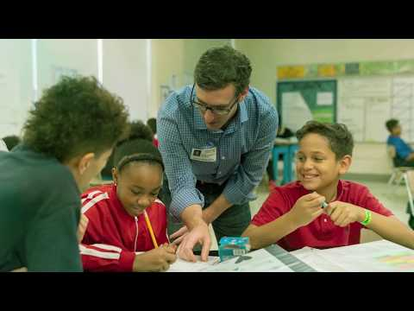
Notes:
Introduction video of Urban Green Lab

Slide 5
What is “sustainability”?
Protecting the environment while also supporting social equity and economic vitality.
Meeting the needs of the present without compromising the future.
Notes:
There are multiple definitions of sustainability, but UGL uses these.

Slide 6
How is “sustainable living education” different?
Behavior Change
Advocate
Reduce Waste Design Solutions

Slide 7
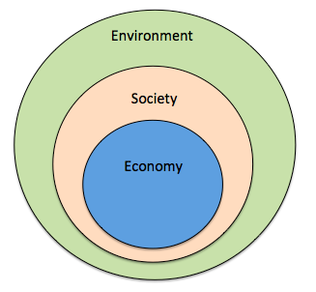
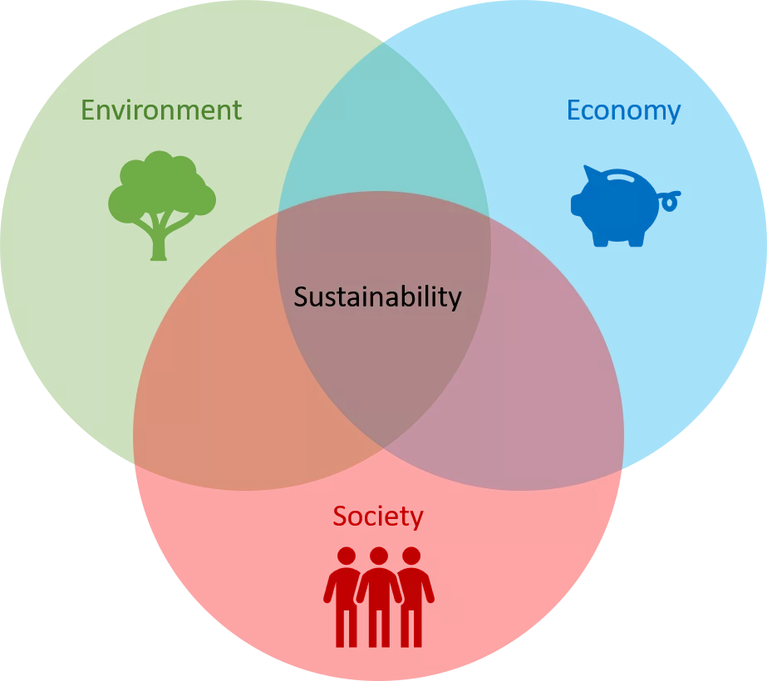
Notes:
Commonly use triple Venn diagram to define sustainability. Now use the nested model to show that there has to be a sustainable environment first, then society, then economy.
Have students look at their items they wrote down and fit into diagram. Discuss each item to determine how to ensure it is sustainable for their entire lives. e.g. how can coffee be sustainable in the way it is grown, the people who grow it, free-trade, cost, etc.

Slide 8
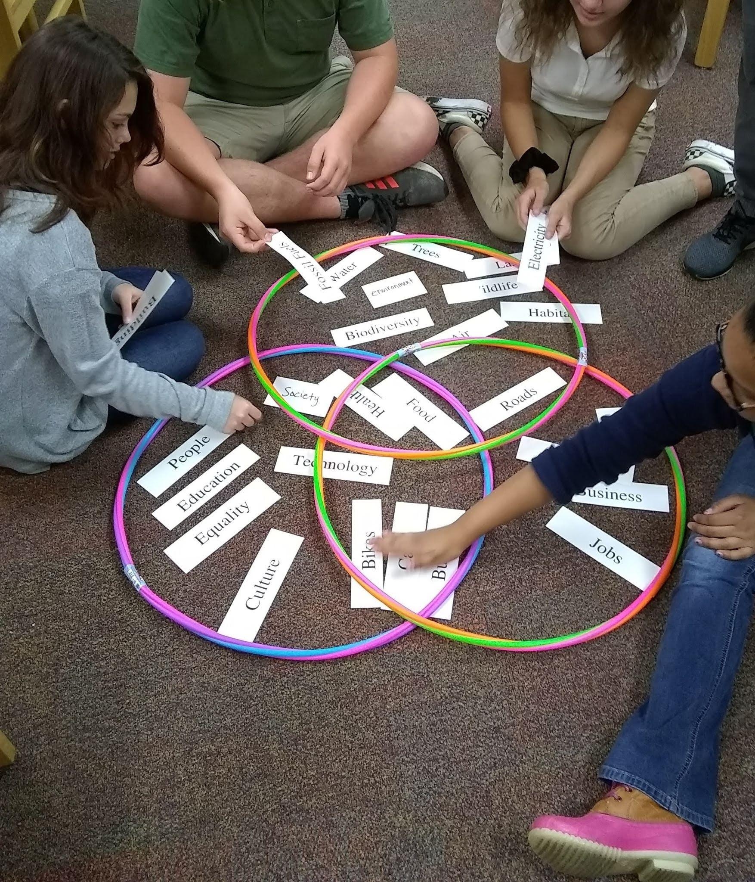
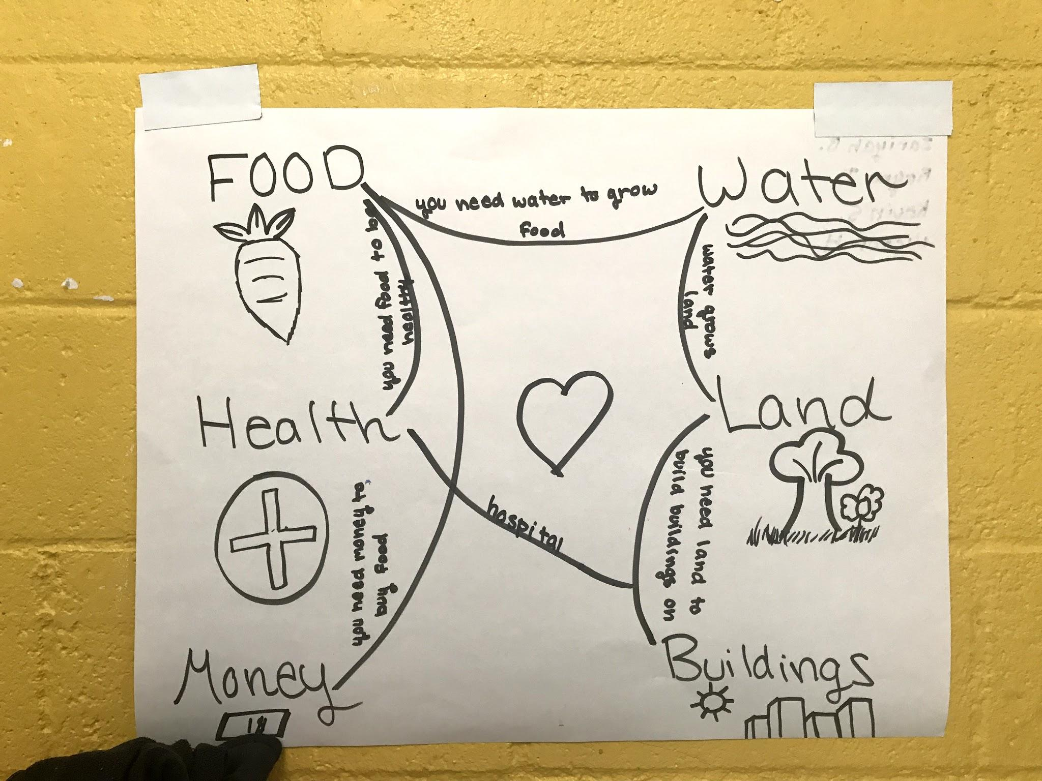
Notes:
Example photos of students doing this activity.
Then, have students choose 6 resources and draw a map/web showing how they are connected.

Slide 9
PROBLEM
SOLUTION
Formal educators lack standards-aligned materials and training to teach sustainable living.
Standards-aligned curriculum
Professional Development
Home Investigations
Project
Notes:
UGL found that teachers wanted training and material to teach sustainability.

Slide 10
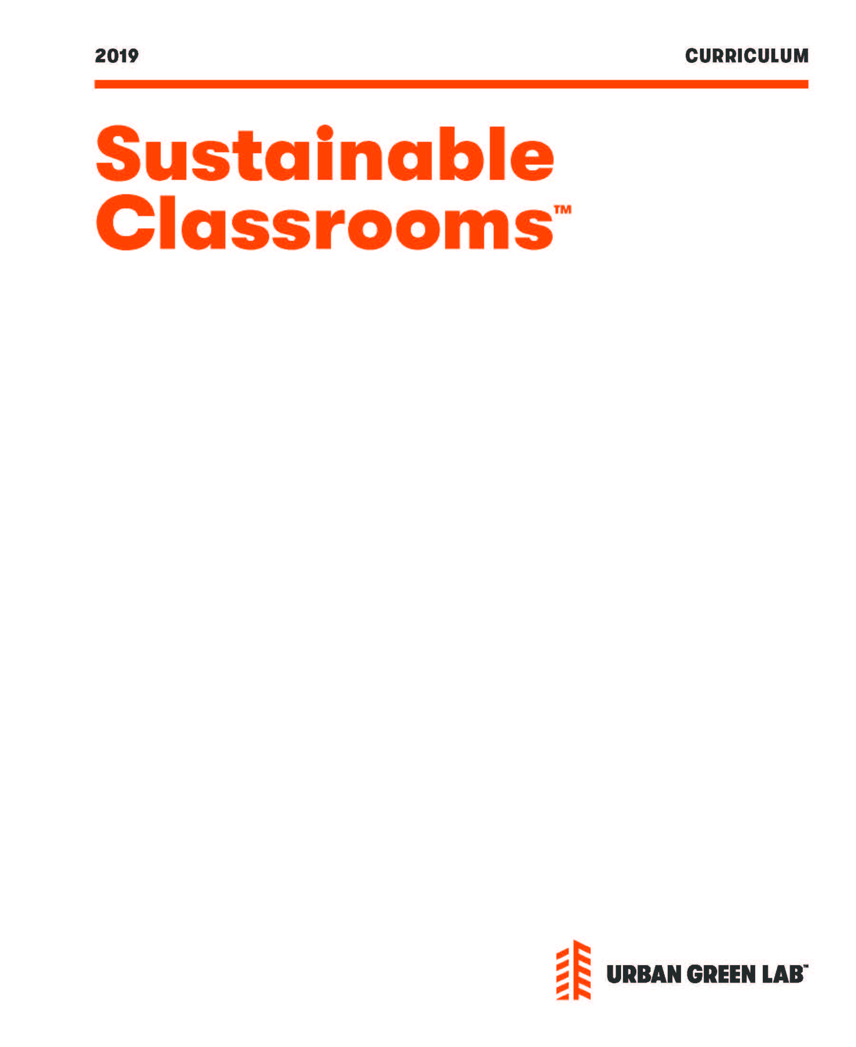
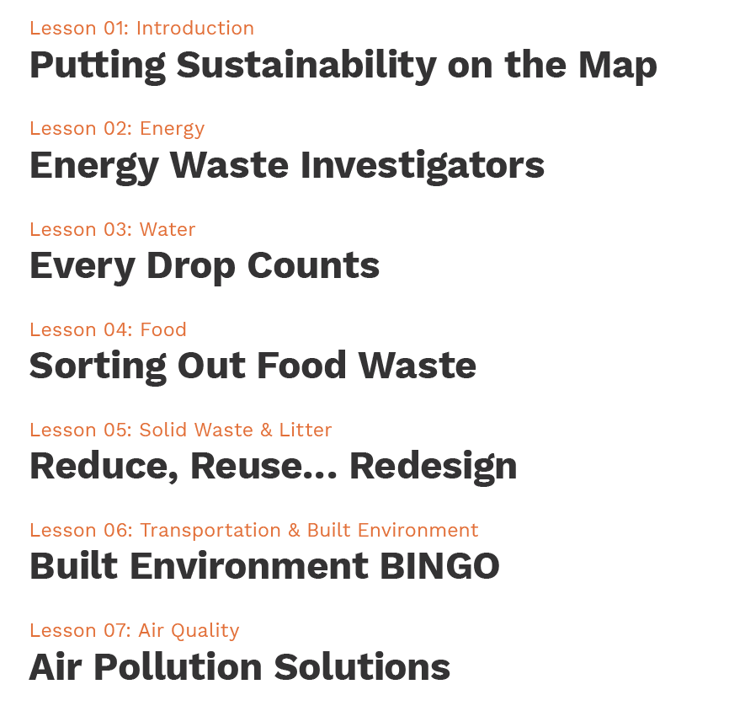
Sustainable Classrooms Curriculum & Home Investigations
Notes:
UGL created this 6th grade curriculum, including these 7 lessons.
Tied to standards:
LS4: Unity and Diversity and ESS3: Earth and Human Activity
ELA:
Vocabulary
Presentations - info in different media formats
Arguments

Slide 11
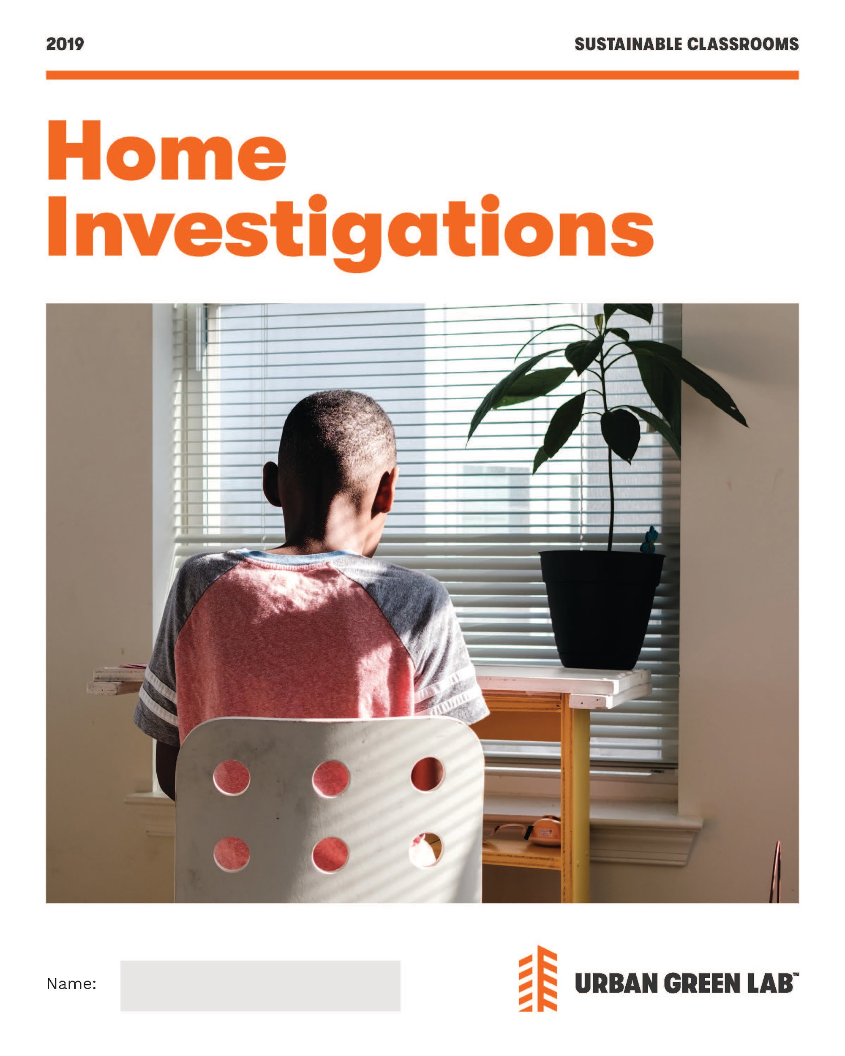
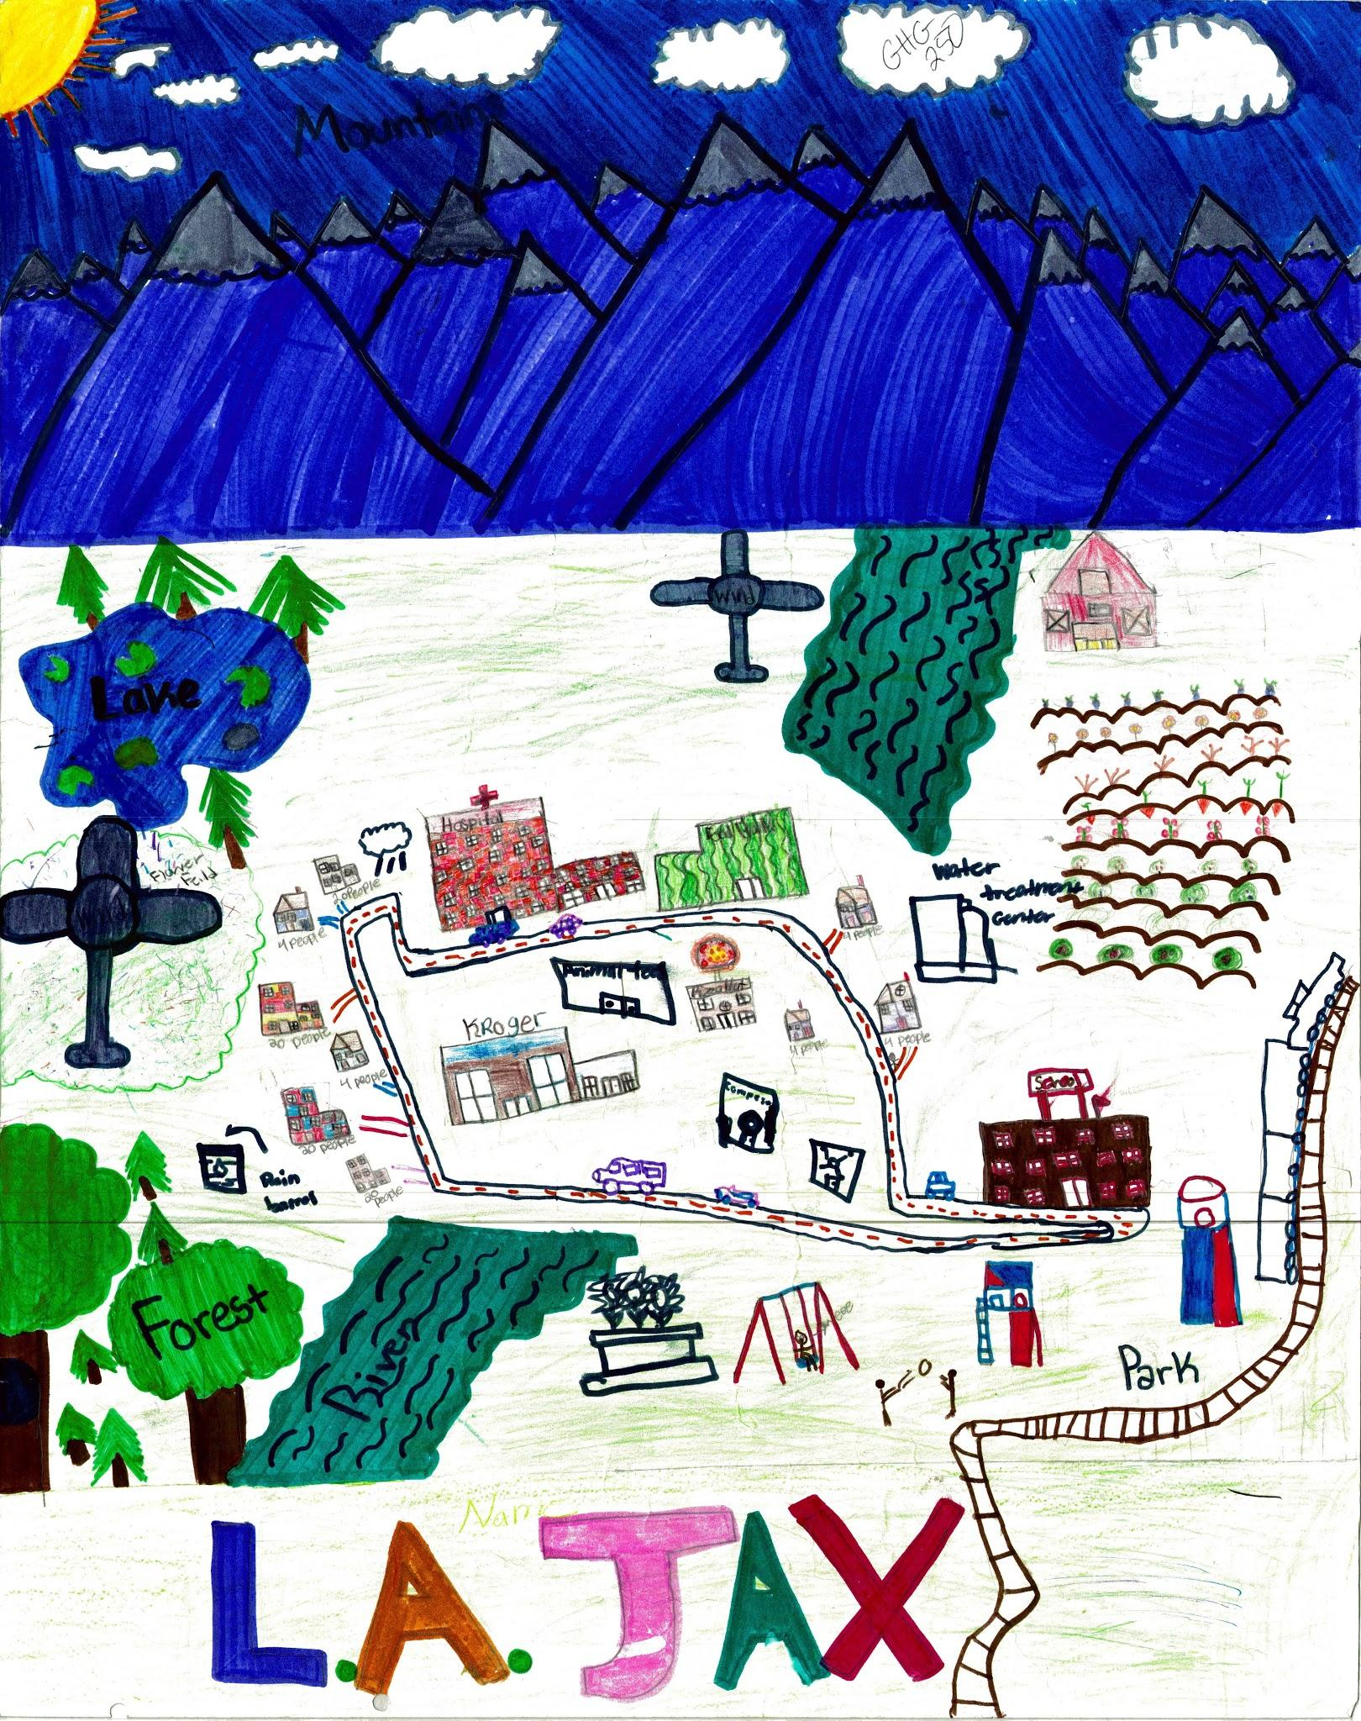
Home Investigations & Sustainable City Challenge
Notes:
Home Investigations allow students to explore sustainability in their own home.
Curriculum also included a project - the Sustainable City Challenge where students designed a future, sustainable city.

Slide 12
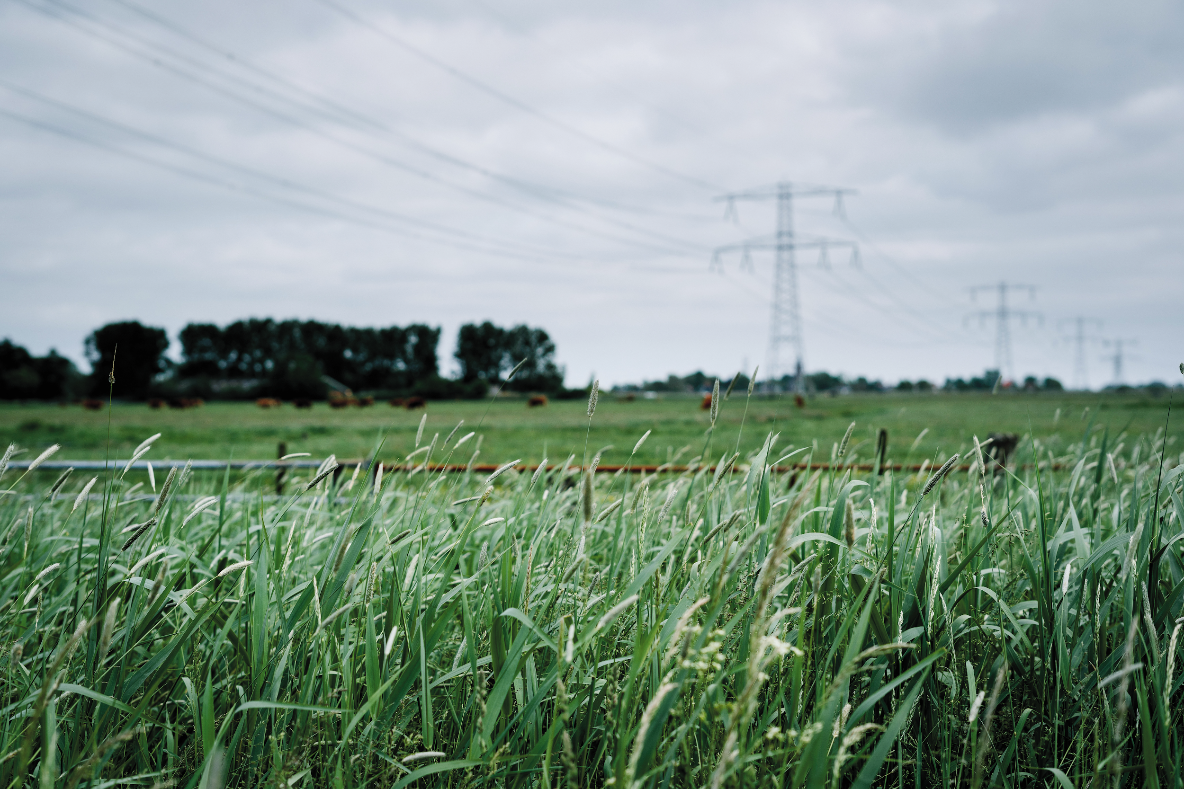
Nuclear
Renewable
Coal
Natural Gas
Hydroelectric
Notes:
Put these sources of energy in order from most used to least used to create electricity nationally.

Slide 13
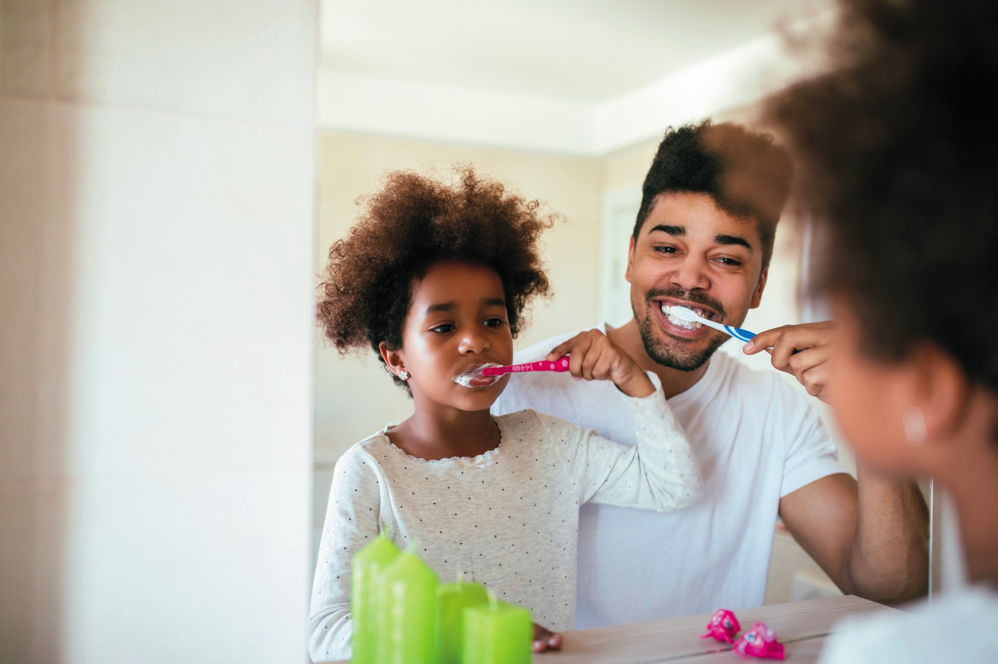
150 gallons
300 gallons
50 gallons
500 gallons
1000 gallons
Notes:
How much water does the average American family use daily?

Slide 14
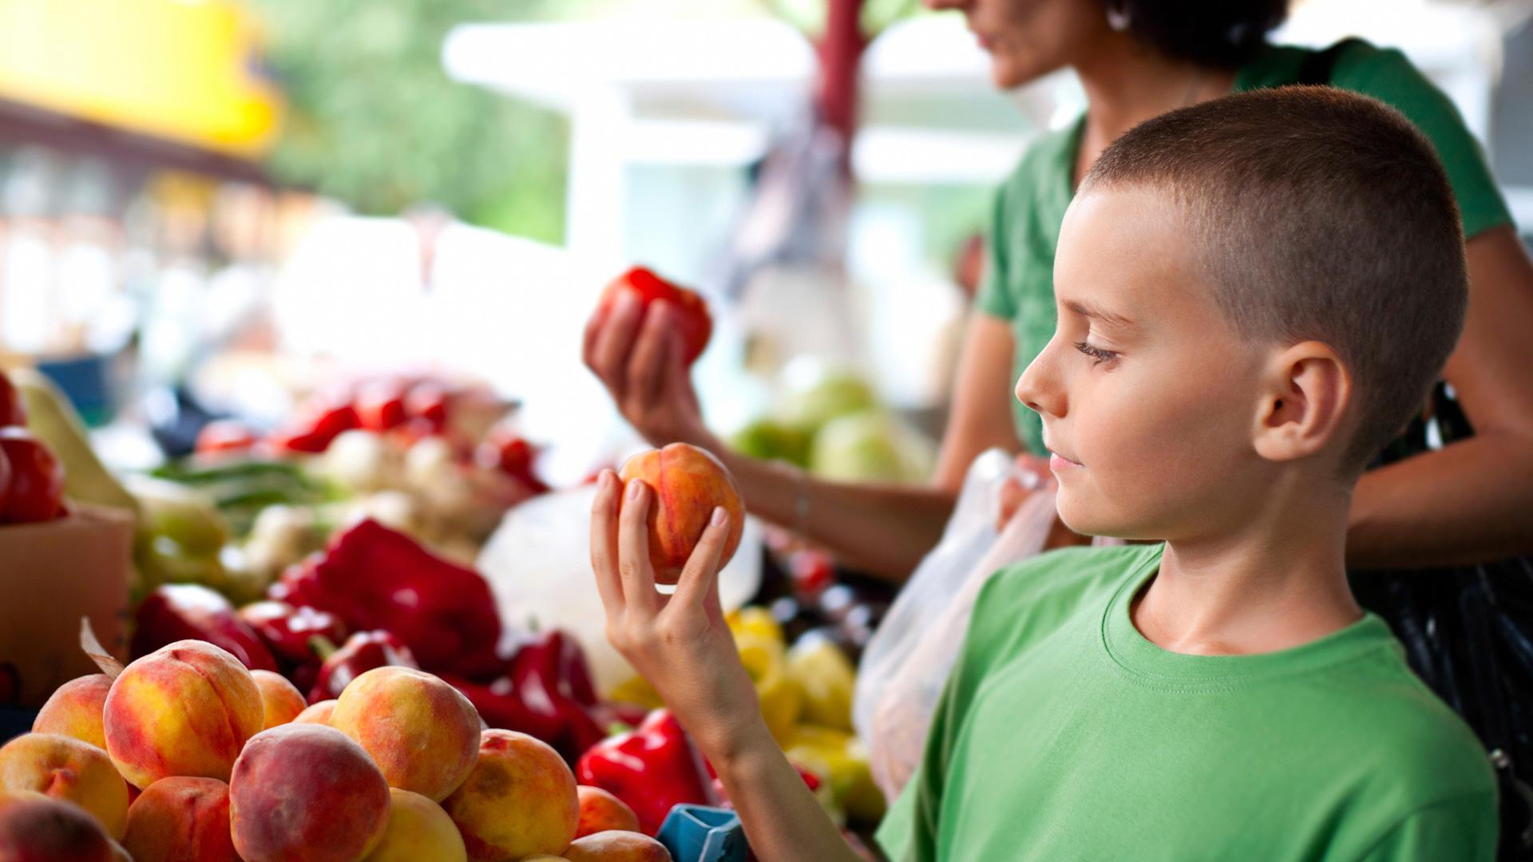
On average, what percentage of food is wasted in the US?

Slide 15
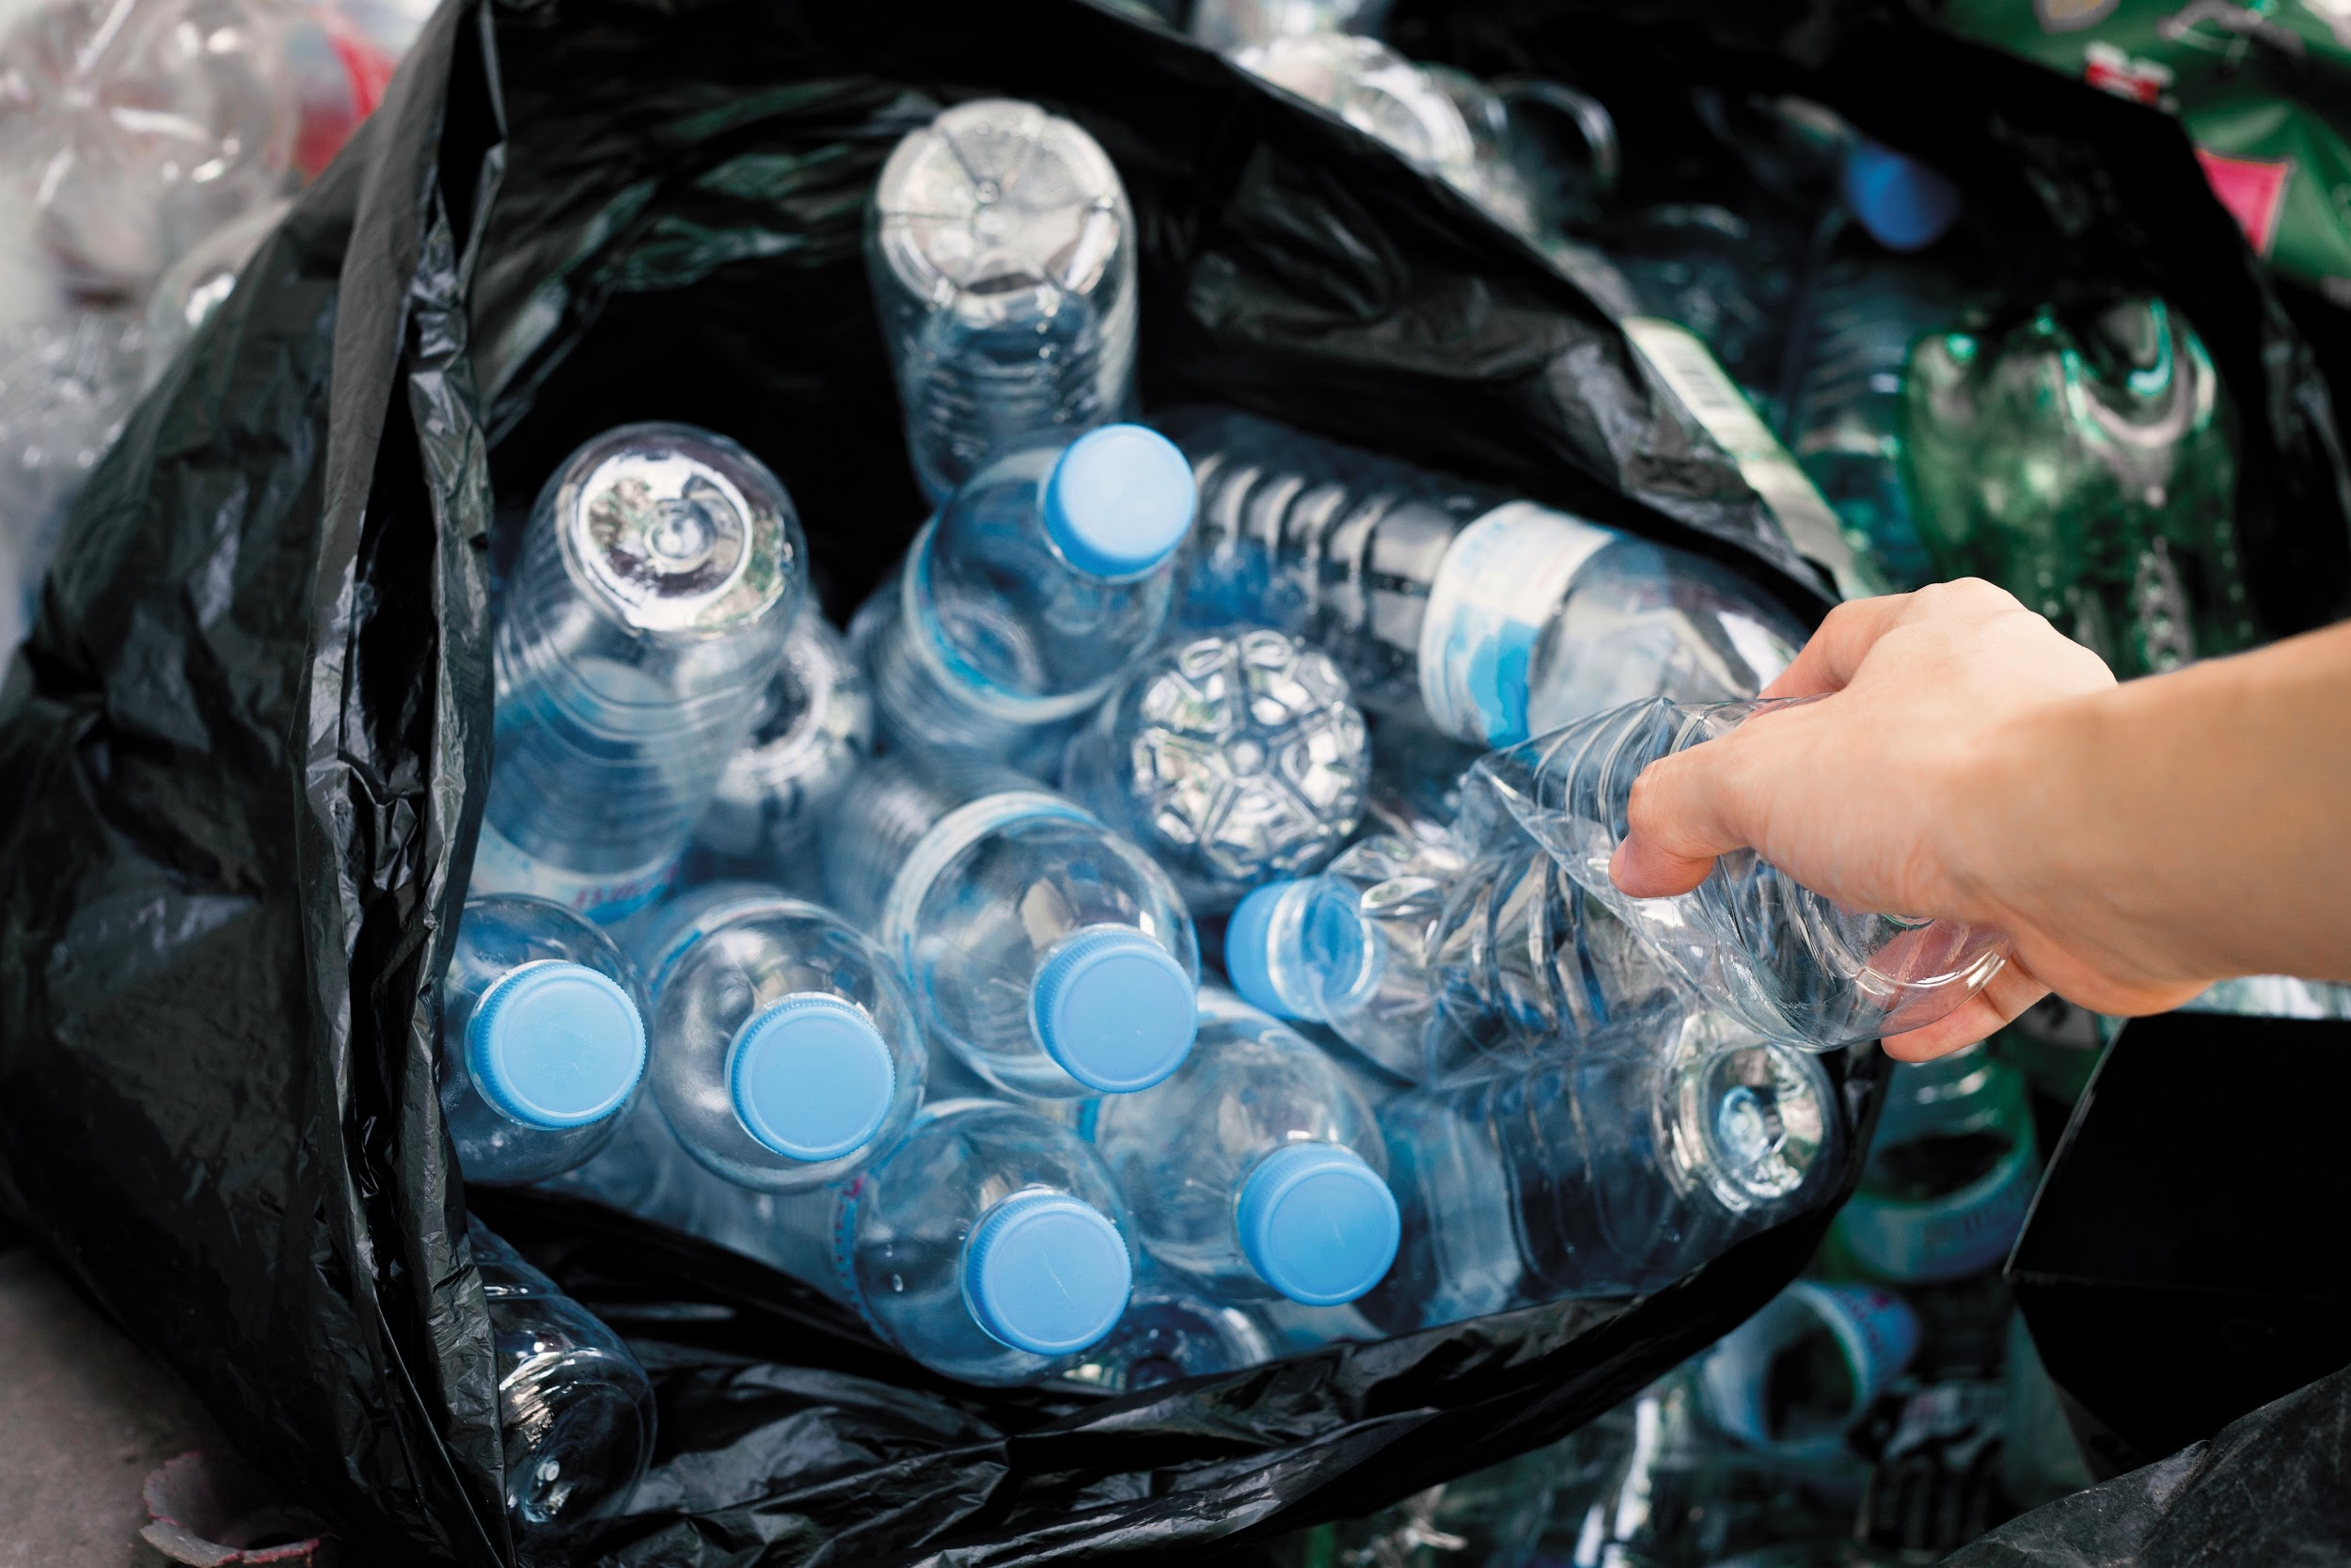
1.3 lb.
3.0 lbs.
4.5 lbs.
10.2 lbs.
Notes:
How much trash do we throw away daily per person?

Slide 16
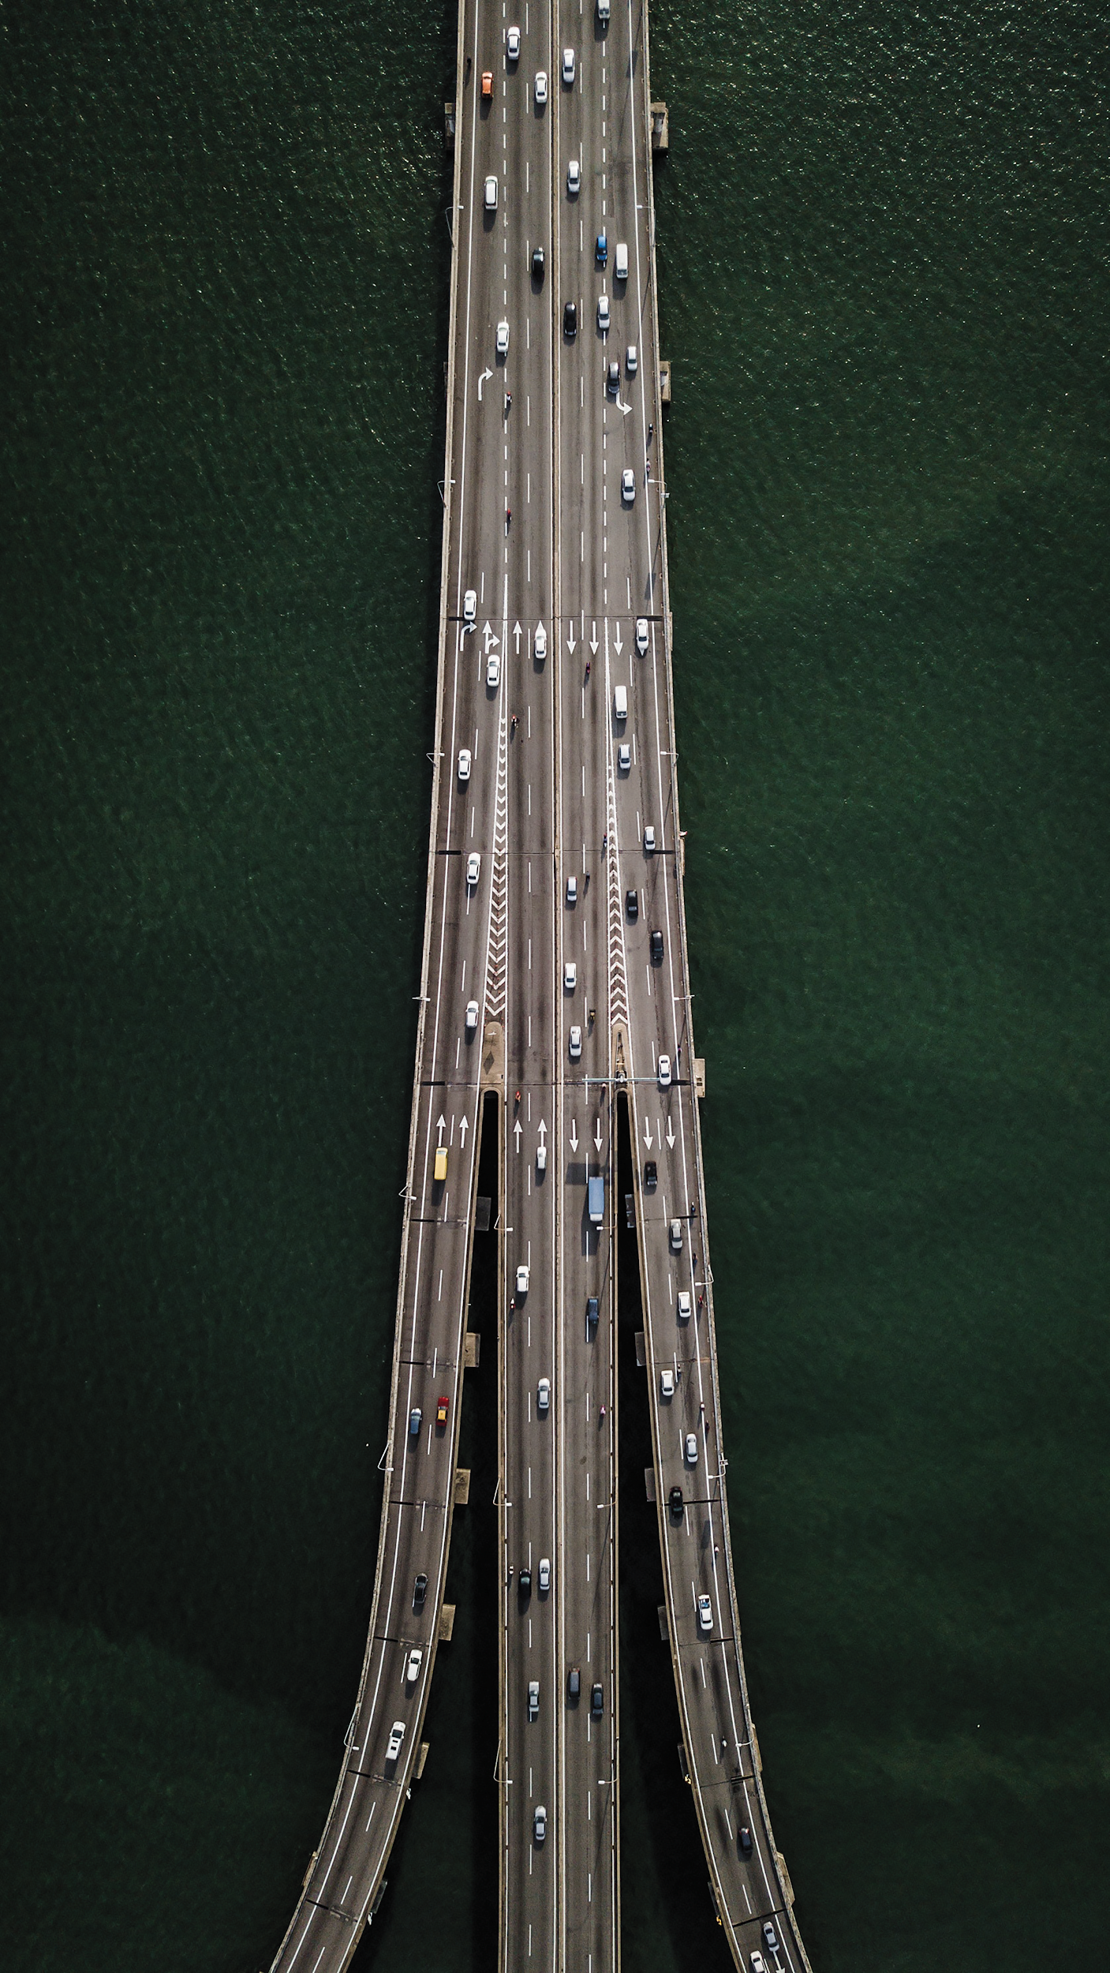
Greenhouse gas emissions person/mile
Hybrid Car
Walk/Biking
School/City Bus
Carpool (3 or more ppl)
Gasoline Car
Notes:
Put these modes of transportation in order from most greenhouse gas emissions per person per mile to least.

Slide 17
Where does the US source energy for electricity?
Natural Gas: 32%
Coal: 30%
Nuclear: 20%
Renewable: 9%
Hydroelectric: 7%
Notes:
ENERGY LESSON
Sources of energy
The Grid
Power plants
Worksheet

Slide 18
How many gallons of water does an average American family use every day?
150 gallons
300 gallons
50 gallons
500 gallons
1000 gallons
Notes:
Watersheds
Water treatment facilities
Cleaning water takes energy
Students capture how much water they use when washing hands
Bring in local river experts to explain watersheds, engineers to show water treatment

Slide 19
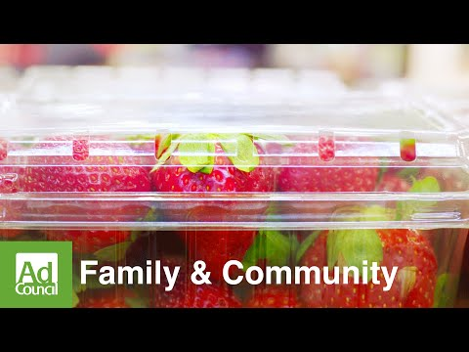
40%
Wasting Food Wastes Everything
Energy Water Money Love
of Food Is Wasted
Notes:
Food waste audits
Share tables

Slide 20
About how many pounds of trash does the average person throw away in one day?
1.3 lb.
3.0 lbs.
4.5 lbs.
10.2 lbs.
Notes:
Solid waste/litter
LESSON
Re-design a single use product

Slide 21
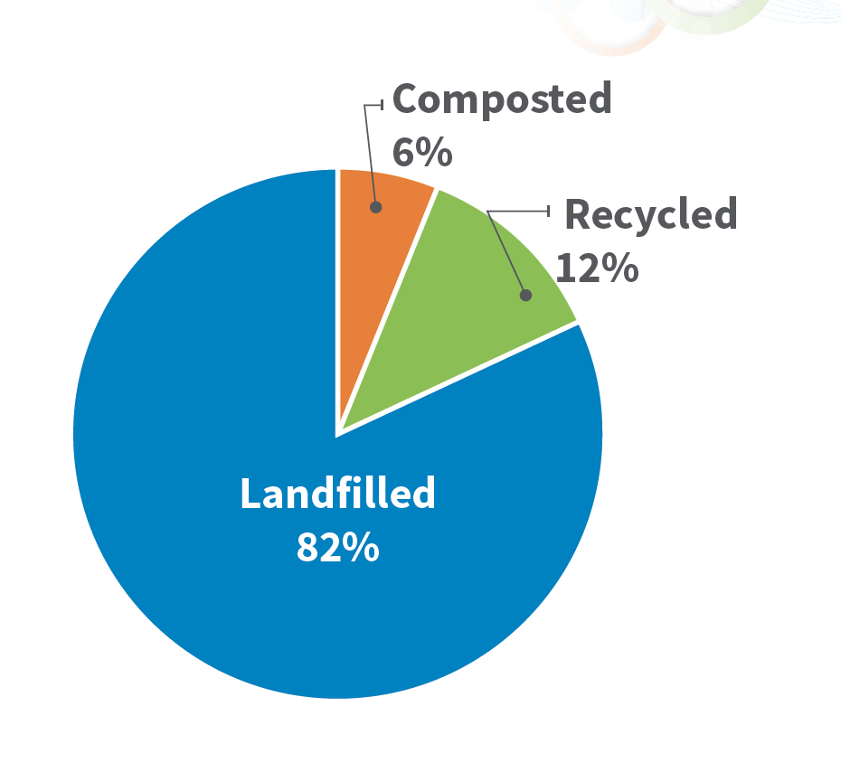
Notes:
Over 84% of waste can be diverted from landfills
In Nashville, only 18% is diverted

Slide 22
Greenhouse gas emissions person/mile
(CO2 lbs)
Gasoline Car, 1.1
Hybrid Car, 0.55
Carpool, 0.37
School/City Bus, 0.21
Walking/Biking 0.0
Notes:
Lesson:
Modes of transportation
Built environment
Bingo cards identifying built environment components such as sidewalk, bike rack, hybrid car, bridge, etc.

Slide 23
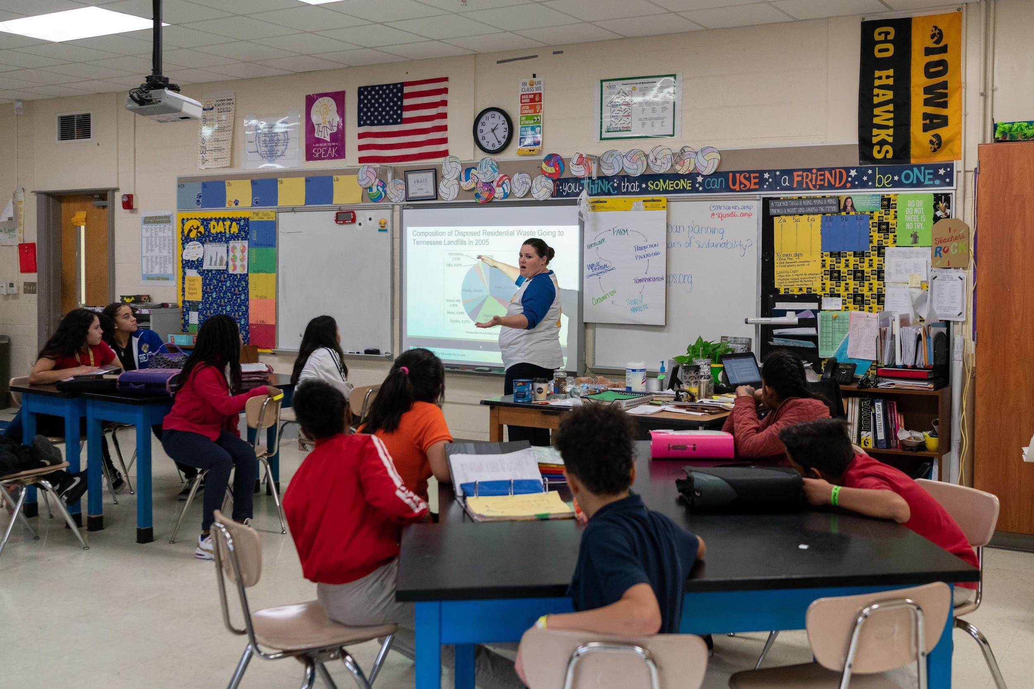
RESULTS
73 Teachers Trained
^ teaching strategies, content knowledge confidence, everyday practices
^ student knowledge

Slide 24
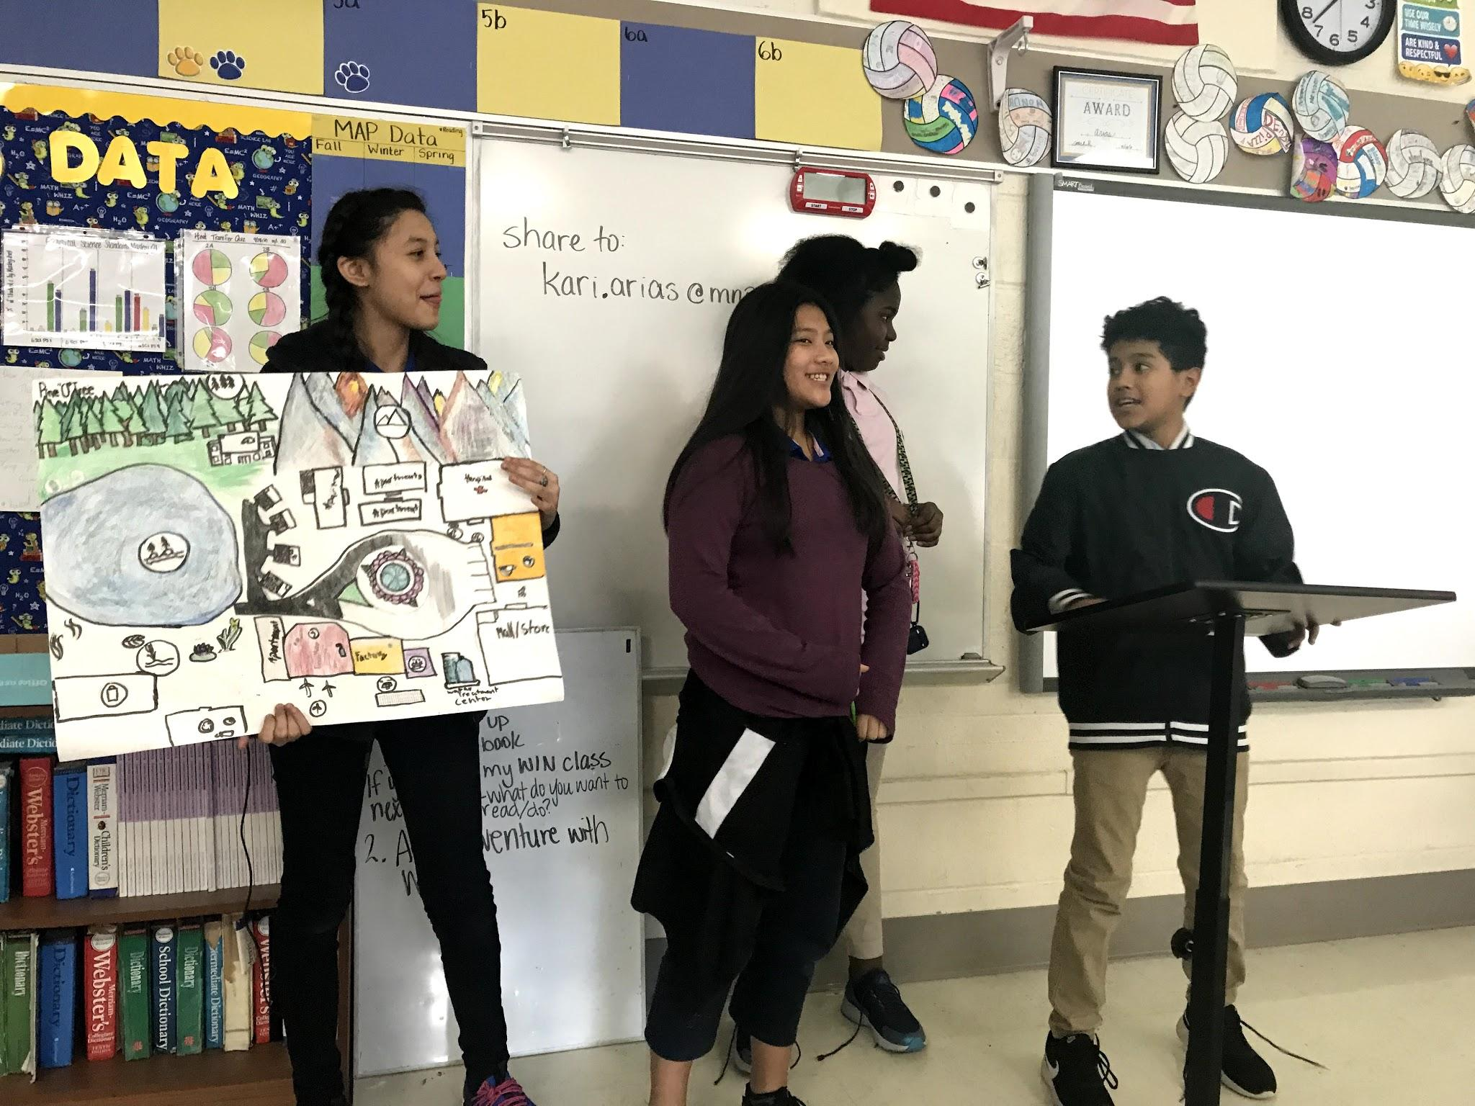
Getting Sustainable Living Into the Classroom
Standards alignment and 3D learning for Science
Explore STEAM careers
Practice in the classroom and school
Encourage community involvement
PBL and SEL
Notes:
Math: water lesson, graphing
SS: how ancient civilizations used energy, water, and food
ELA, Art, tech, eng: project
Urban Planner - Sustainability Manager - Solar Technician - Engineers- Hydrologists - Farmer - Waste Manager - Found Materials Artist - Contractor - Environmental Lawyer - Air Quality Technician
PBL: Students design solutions for meeting the needs of humanity without depleting natural resources.
Hydroponics, product design, routes to schools,
water filtration, composting, city design
SEL: SEL:
Responsible decision making
Awareness of personal impact on self & others
Social awareness
Communication and teamwork

Slide 25
Take Home
Putting Sustainability on the Map Lesson
Online Student Home Investigations
Teacher Resources Page
www.urbangreenlab.org/classrooms
www.urbangreenlab.org/teacherresources
Diana Andrew
Sustainable Classrooms Manager
diana@urbangreenlab.org
urbangreenlab.org
(615) 442-7072

Slide 26
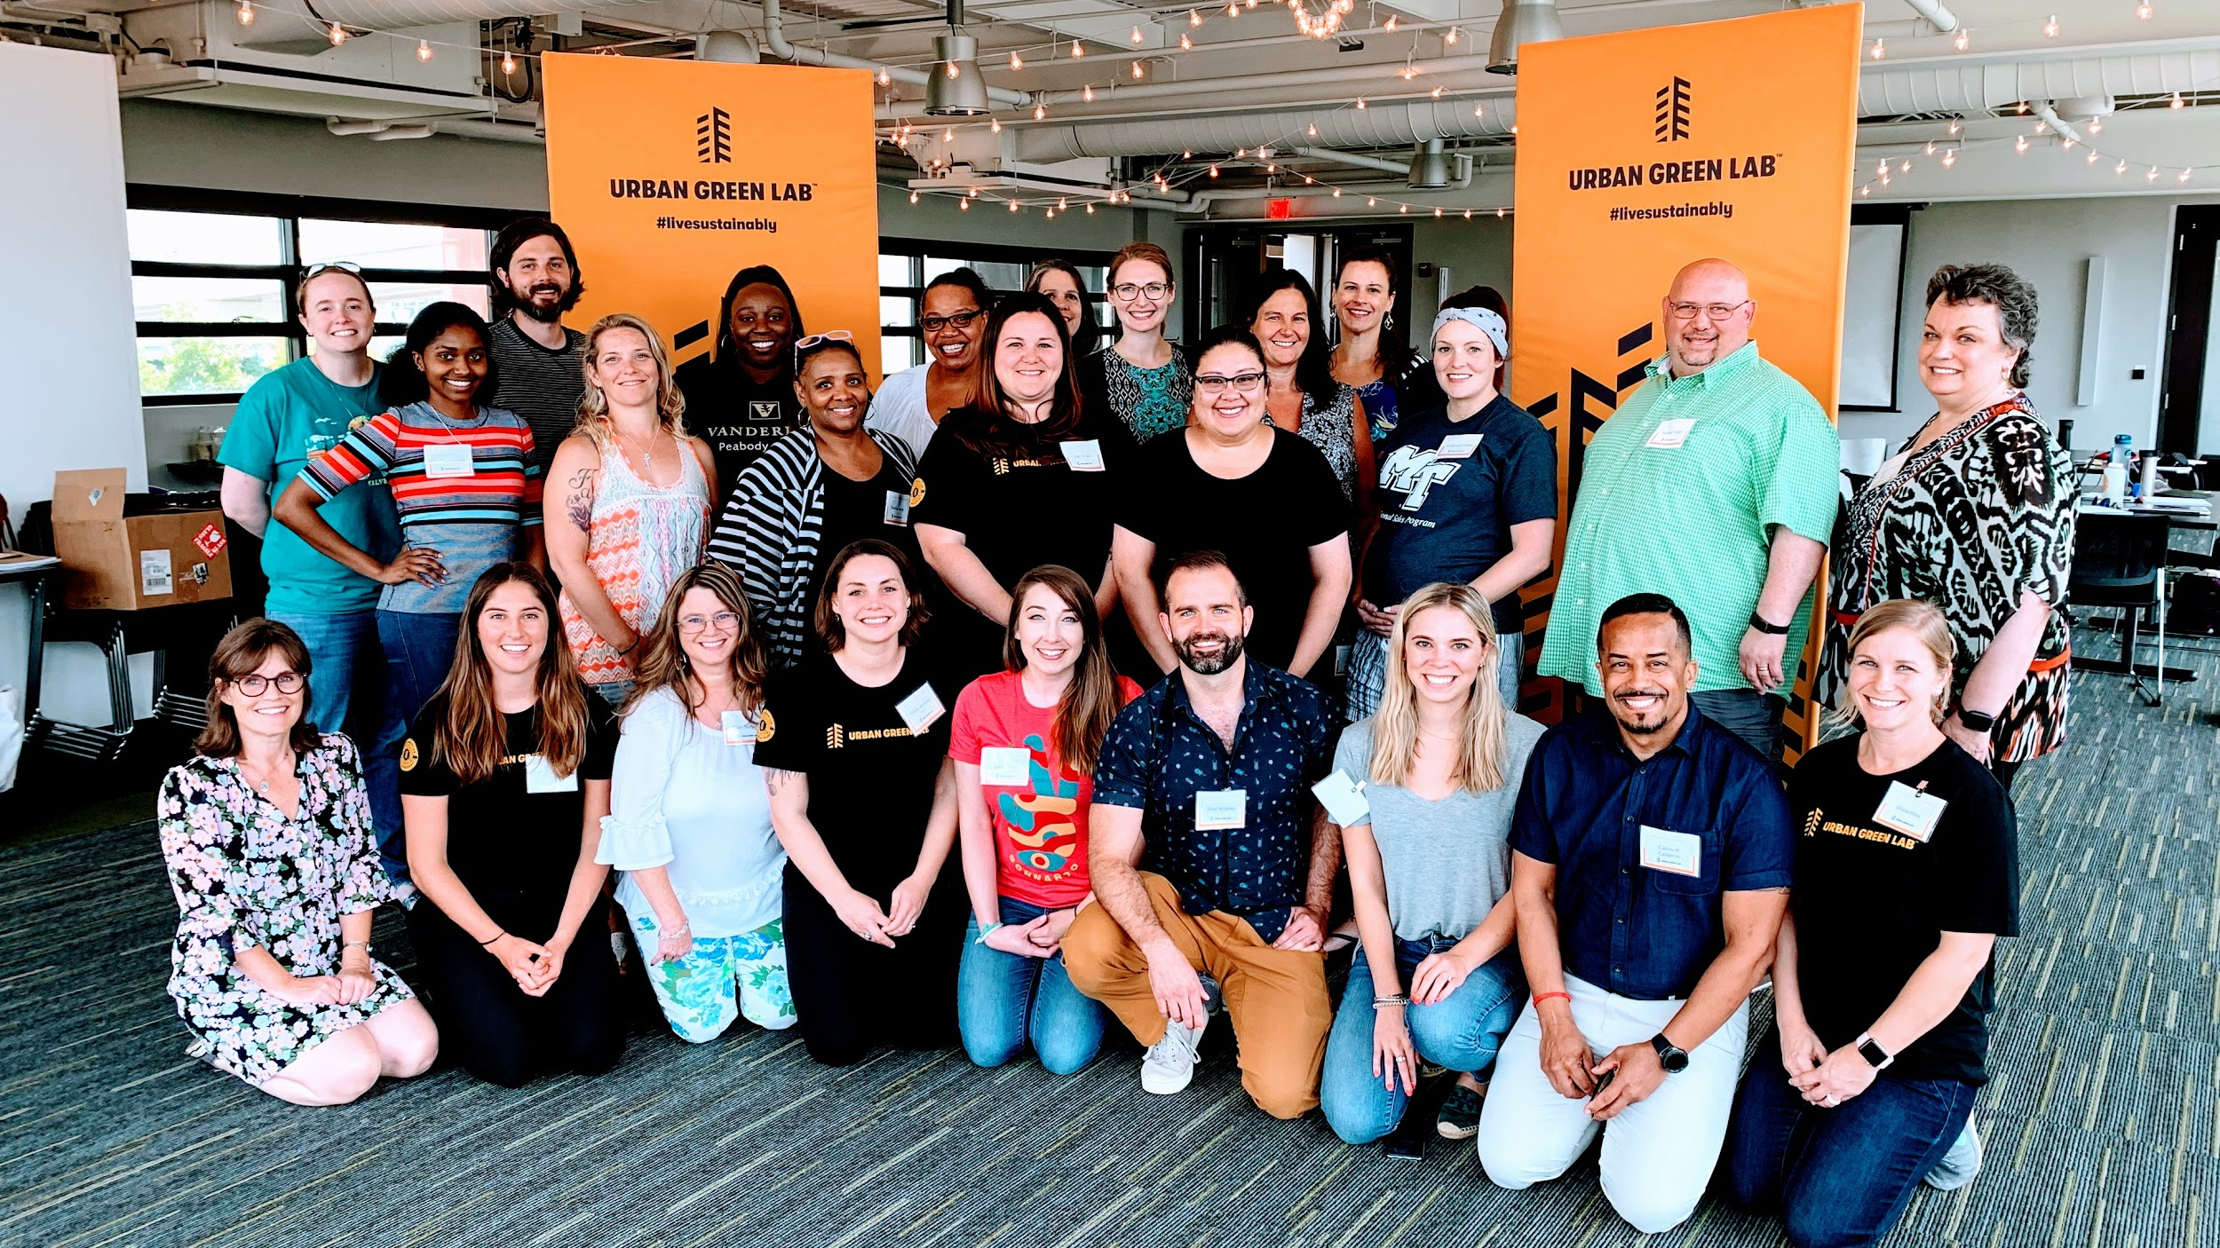
THANK YOU

