Slide 1
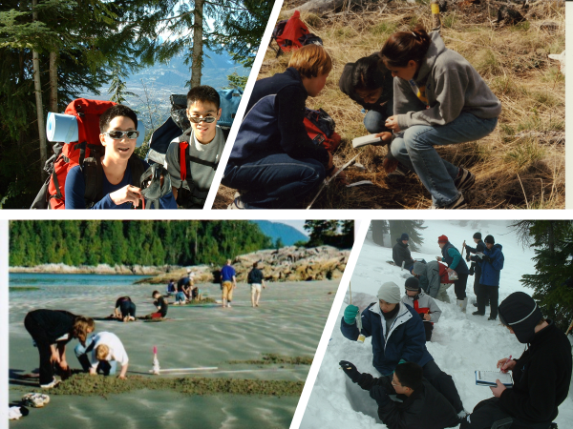
School Learning Environments and Long-term Outcomes related to Community and Civic Engagement

Slide 2

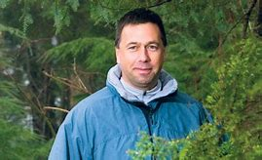
Your Presenters
David Zandvliet (PhD)
Simon Fraser University, Burnaby, BC
Canada
dbz@sfu.ca
Gordon Sturrock (PhD)
Douglas College, New Westminster, BC
Canada
sturrockg@douglascollege.ca

Slide 3
Research Problem
How should 21st century youth be educated to meet the challenges of work, life and citizenship that will lead to environmental, social and economic sustainability?
This presentation shares research describing features of the learning environment linked to the long term learning outcome of active citizenship. It tells the story of how the learning environment in a high school integrated studies program contributed to the development of citizens that embrace environmental stewardship and are active contributors to a healthy, sustainable society.

Slide 4
Overview of Methods
Consistency of PLACES instrument
Description | Retrospective Study
Methods | Mixed Methods (open ended questions, ISSP survey, PLACES survey, group interview)
Group | ES 10 (2003, 2004 cohort) (min: 8 yrs out)
PLACES Survey
ES 10 (2007 cohort) actual learning environment results collected in 2007 at the end of the program (from Koci’s (2013) study), compared to actual learning environment results measured five years later (from my study)
Comparison

Slide 5
PLACES
A key part of this study was the use of a learning environment survey tool called the Place-Based Learning and Constructivist Environment Survey (PLACES) that describes research on learning environments as both ‘descriptive of classroom contexts’ and ‘predictive of student learning.’

Slide 6
Learning Environments Research
The form of learning supported, and conceptual models held by students are an important prerequisite for learning in all its forms …
Learning environment studies acknowledge first - that learning takes place within the social realm and social conditions contribute to the quality of learning and experience …

Slide 7
Influences on Learning Environments
People
Places
Practices

Slide 8
Results - PLACES
ES 10 (2003,2004 cohorts) (post 9-10 years)

Slide 9
Results – PLACES (demonstrates persistence of survey tool)
ES 10 (2007 cohort from Koci’s (2013) study)

Slide 10
Alignment between PLACES Survey Constructs and Active Citizenship Outcomes
Related PLACES scale and Description | Major theme(s) that the ES 10 graduates identified as being influences on their current activities and lives between high school and the present. (Relating to advertised goals of the ES 10 and PLACES program constructs) | Active citizen related outcomes (including skills, beliefs, and attitudes) as demonstrated in the review of literature.
Relevance/integration: Extent to which lessons are relevant and integrated with environmental and community- based activities | Theme: Active Citizenship The program showed us concrete examples of community commitment and activism. In university, I founded the non-profit organization: Africa Canada Accountability Coalition (Sarah) | Being an active citizen An active citizen embraces social responsibilities and takes it upon themselves to play a civic role of being informed, maintaining and developing critical perspectives while becoming actively involved in social, political and/or environmental issues (Klincheloe, 2005).
Critical Voice: Extent to which students have a voice in the classroom procedures or protocols. | Theme: Confidence using voice ES allowed me to voice my opinion, the teacher cared and listened and would act upon those thoughts. Coping with ambiguity and decision making in the classroom helped me to work with others in the future. Today I am confident in using my voice and self-advocacy which is important in my field of study (Marine Biology). (Lucas) | Having a voice and demonstrating leadership in education programs Empowerment and ‘giving people a voice” as well as taking responsibility and leadership. (European Commission Directorate General for Education and Culture (2007).

Slide 11
Related PLACES scale and Description | Major theme(s) that the ES 10 graduates identified as being influences on their current activities and lives between high school and the present. (Relating to advertised goals of the ES 10 and PLACES program constructs) | Active citizen related outcomes (including skills, beliefs, and attitudes) as demonstrated in the review of literature.
Group Cohesiveness: Extent to which the students know, help and are supportive of one another | Theme: Importance of community building We were successful at creating a strong internal community…. this made a very strong impression on how important a support network is in life – as this is something that I seek out later in life which contributes to my success. (Mike) ES encouraged a sense of caring for each other and the greater community. (Sharon) | Key factor(s) identified in school and daily life to foster and sustain active citizenship. Sense of community and belonging to include the desire to be part of strong, safe communities based on networks and friendships that foster trust, concern for well-being, a sense of self-worth and encouragement towards individual and collective social responsibility (Ireland, Kerr, Lopez & Nelson, 2006).
Student Involvement: Extent to which students have attentive interest, participate in discussions, perform additional work and enjoy the class | Theme: Self discovery To this day, I believe that ES10 was an innovative and engaging program that allowed students to not only learn through activities but also encouraged students to explore their natural curiosities in life and find something to care about. (Alex) | Importance of connecting experiences in a variety of settings to help foster active citizenship. Linking experience to opportunity; young people made connections between their opportunities and active citizenship experiences in various contexts (Ireland, Kerr, Lopez & Nelson, 2006).

Slide 12
Related PLACES scale and Description | Major theme(s) that the ES 10 graduates identified as being influences on their current activities and lives between high school and the present. (Relating to advertised goals of the ES 10 and PLACES program constructs) | Active citizen related outcomes (including skills, beliefs, and attitudes) as demonstrated in the review of literature.
Shared Control: Extent to which teacher gives control to the students with regard to curriculum/activities | Theme: Democracy in the classroom and future expectations I remember appreciating the decision-making powers that our instructor granted us, and feel that the trust he placed within our group allowed us to achieve some things well beyond our years at the time… I believe we should have democratic control as to how we learn and work. This is instilled in ES. (David) | The importance of having a voice at school to foster active citizenship. Having a voice; young people believed that they should have a voice on matters that affect them especially at school (Ireland, Kerr, Lopez & Nelson, 2006).
Open Endedness: Extent to which the teacher gives freedom to students to think and plan own learning | Theme: Flexibility in schedule and curriculum leading to critical thinking and decision making Big one for me was the freedom of creativity, the flexible structure allowed the ability for one to expand on one’s creative outlet. Coping with ambiguity was difficult but helped in critical thinking and decision making... Being pushed out of our comfort zone, helps in today’s challenges. (Celeste) | Important skills necessary for active citizenship. Creativity, critical thinking skills, coping with ambiguity and informed decision making (Hoskins, 2006). Providing students opportunities to plan and implement actions that address real environmental problems in local communities is a powerful way of enhancing civic literacy (Orr, Strapp et al. in McClaren & Hammond, 2005).
Environmental Interaction: Extent to which students are engaged in field or community-based experiences | Theme: Willingness to make a difference ES helped me desire to better the world from an environmental perspective, through all the outdoor experiences and seeing what nature was all about. ES planted a seed to give to the greater community, to think outside yourself. (Emily) | Importance of engaging in community based experiences. Student involvement in place-based activities and communities of practice helps foster social and environmental action and responsibility (O’Connor & Sharp, 2013).

Slide 13
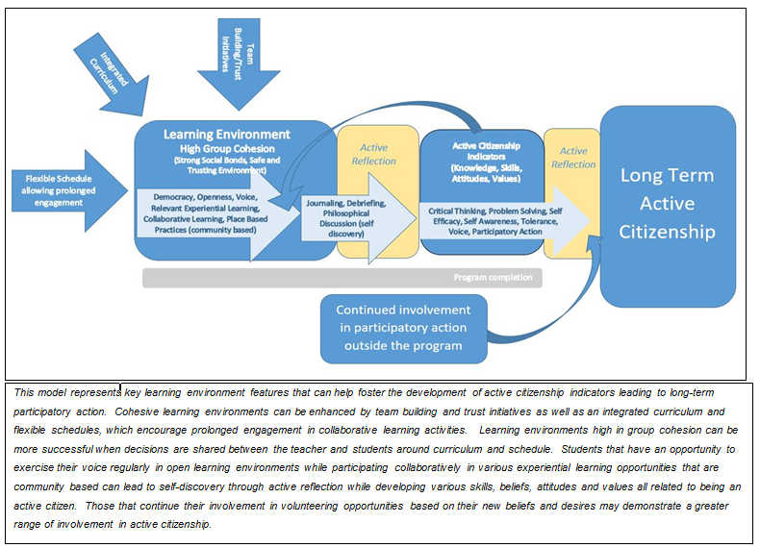
Major Findings (key learning features identified as important)

