Slide 1
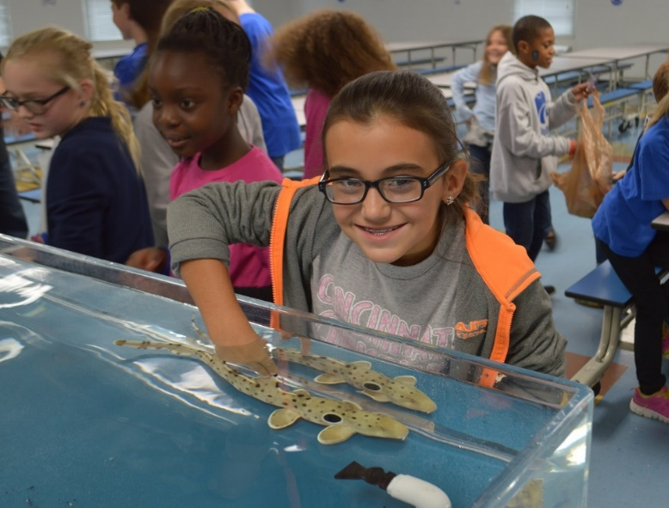
Utilizing Stakeholder Input to Maximize Environmental Education Effectiveness
Erin Shultz
WAVE Foundation at Newport Aquarium

Slide 2
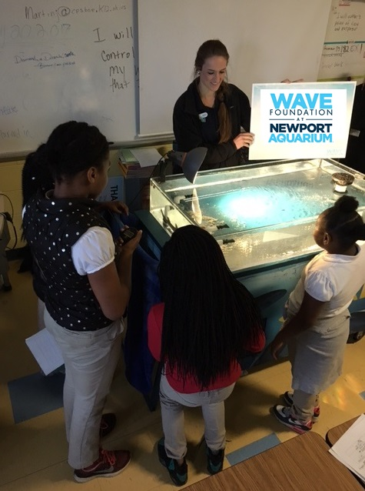
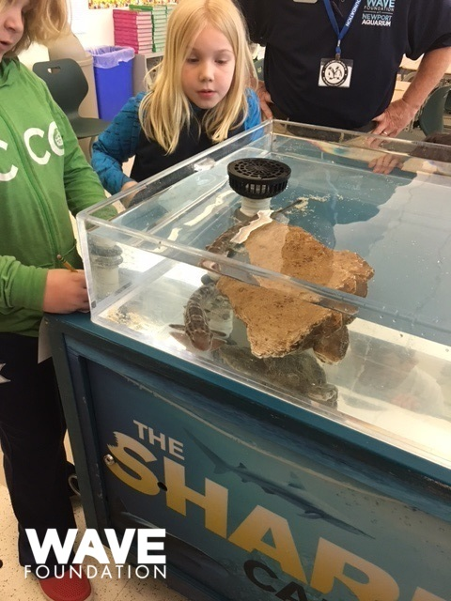
Living Curriculum Initiative
Notes:
Tell you a little bit about the program that we run. Describe pictures. Write up their evidence and reasoning after running their experiment. But none of this would be possible without the complete support of many stakeholders. I am going to talk about how we utilized the voice of each stakeholder to get to this exceptional program. But how did we get here?

Slide 3
From the Beginning
Problems of note:
35% of CPS students pass 5th grade science test (Ohio Dept. of Ed, 2016)
Teachers state they don’t have time to focus on science in grades 3-4
WAVE Foundation Goal: revolutionize how science is introduced to elementary school students in public schools throughout Cincinnati, utilizing our live animals
We got funding to support this program, now we needed schools to work with.
Notes:
35% compared to 60% state wide

Slide 4
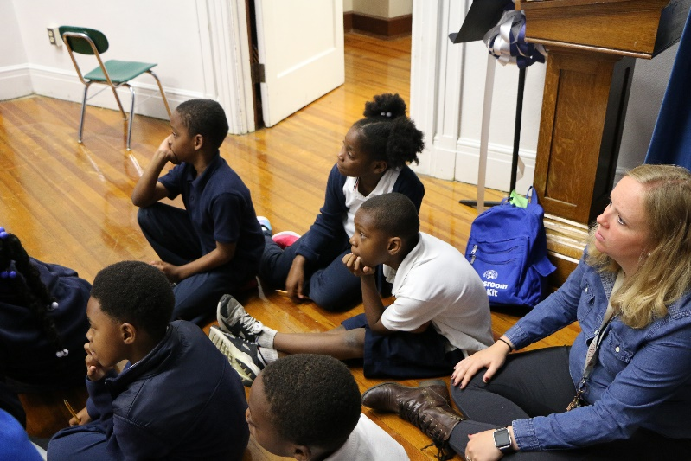
Top down or Bottom up?
Started Bottom Up – Science teachers, reading coaches, principals, science curriculum meeting
Teacher supporters taught us the CPS language that would align LCI with district goals and curriculum
Vision 2020 Initiative
Question – Claim – Evidence – Reasoning: model of inquiry
3rd grade reading and writing promise
WAVE incorporated all of this into our
curriculum and planning discussions
Notes:
We talked about our program idea to anyone who would listen and offered to pilot test it in any class that was willing to host us.
Remain flexible to allow for greater mutual benefit
Listening to the teacher voice solidified their support – surveyed teachers after pilot programs to identify important parts and areas for change

Slide 5
Top down or Bottom up?
Next, Top Down – CPS District Leaders
We took our revised curriculum and plan to the district science curriculum chair
Presented an integrated curriculum and program plan
Yes from the district
Came in with the educational content aligned, allowing us to discuss logistics of program delivery
Identified 15 schools in need that would partner with us
District support and connection to the schools
Has lead to a 4 year partnership with 2 cohorts of students
Notes:
This allowed all the school principals and teachers to accept programs

Slide 6
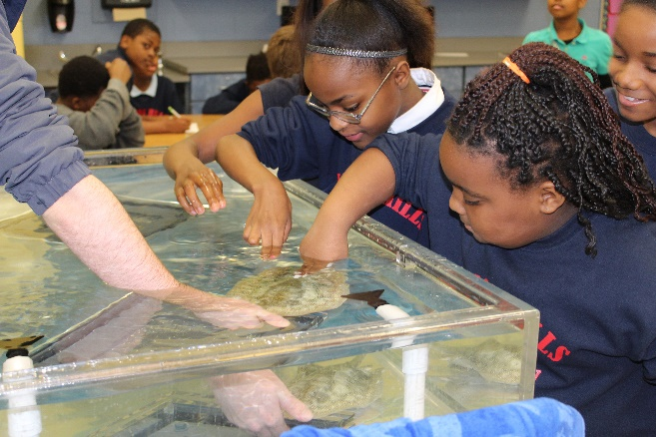
Results
45 teachers involved in Professional Development
60 teachers surveyed in program
Nearly 2,000 students engaged and surveyed
694 additional students surveyed for a control group
25% increase in students identifying that animals help them to do science (Significant increase from 37 to 62%)
81% of students in post-test analysis can identify ways people can help our local ecosystems
95% of teachers reported that the LCI program helped them to better understand and teach the QCER (inquiry) method

Slide 7
Results
80% of teachers noticed an increased understanding of QCER/scientific method from students who participated in LCI the previous year as compared to students who did not participate
“The [ones] students returning already know how to work through QCER and taught the students who were new and give real life examples.” 4th Grade Teacher
Notes:
None of his would be possible without the voices of each stakeholder

Slide 8
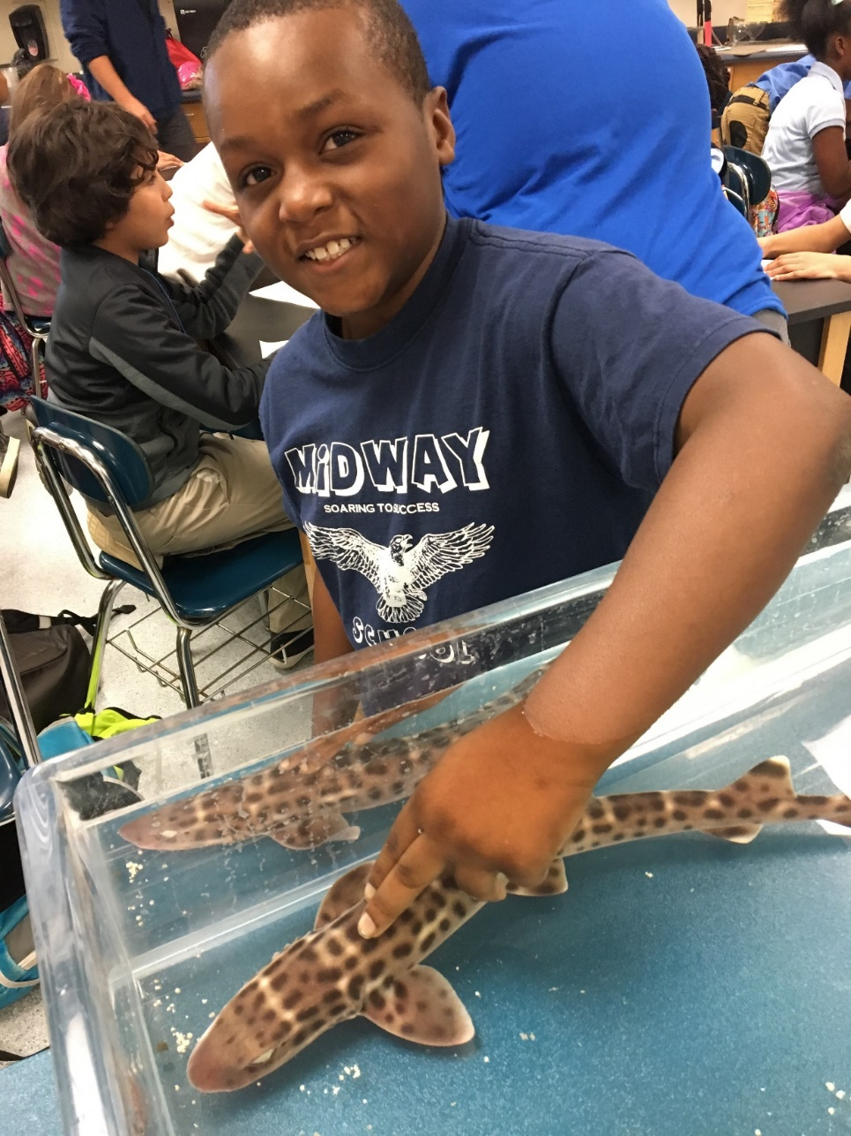
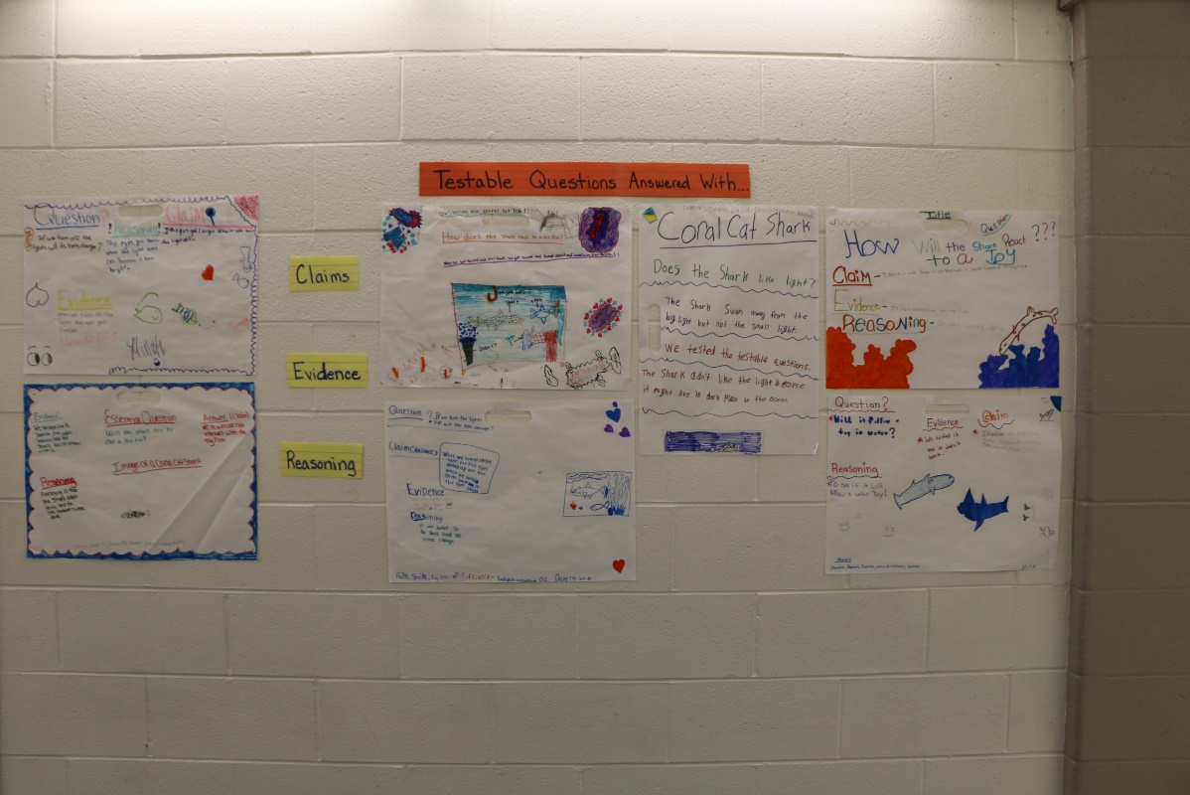
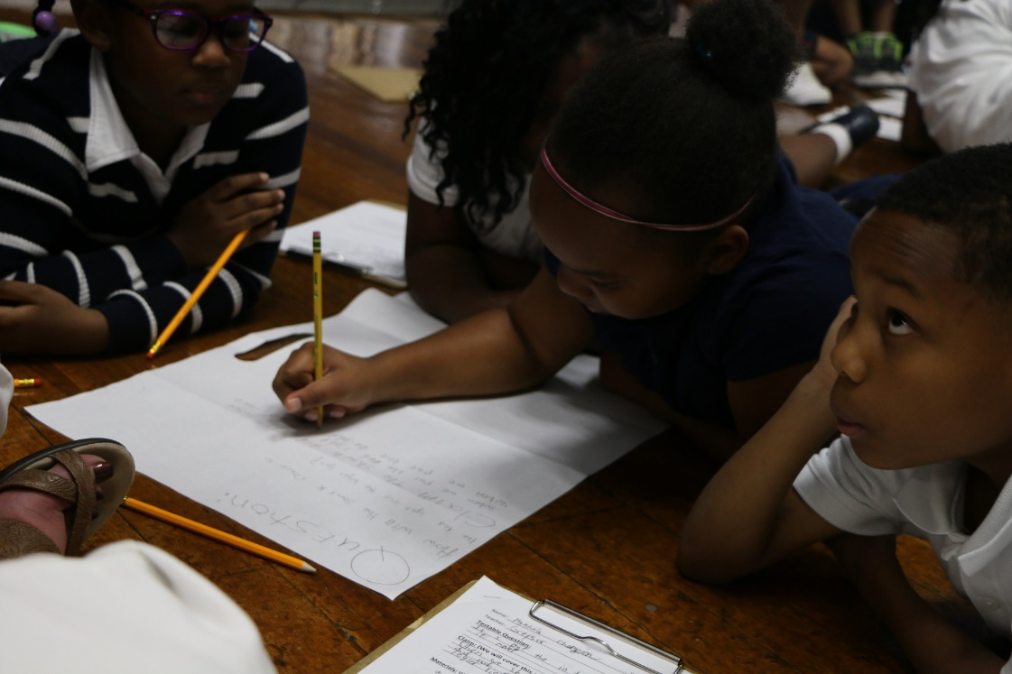
Questions?

