Slide 1
Cultivating Outdoor Leadership through Storytelling
Darren Gruetze
Student Conservation Association
DGruetze@theSCA.org

Slide 2
Goals of the Presentation
Be able to craft and tell stories of connection in order to foster a more cohesive community
Be able to identify and challenge stories of separation
Be able to share resonance with stories of connection
Be able to lead a ritualized story telling practice

Slide 4
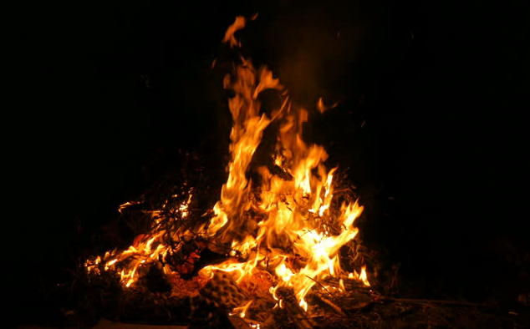

Slide 5
My Story
What in my story resonated, or struck a chord with you?
How do you feel about me as a person?
Do I seem trustworthy? Competent? Relatable? Abrasive? Distant?
Notes:
Michael clemmens, renee jennings, demarquis clarke

Slide 6
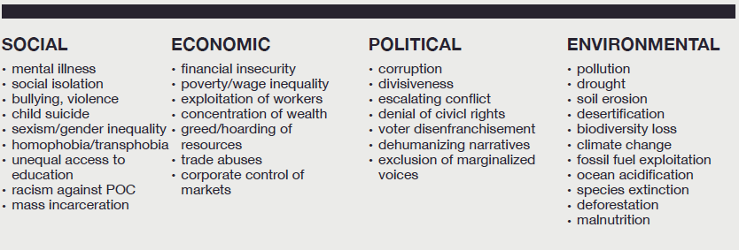

Slide 7
Open ended sentences:
The thing that I am most concerned about is…….
When I think about it I feel……
Ways that I avoid feeling this are……
Notes:
Michael clemmens, renee jennings, demarquis clarke

Slide 8
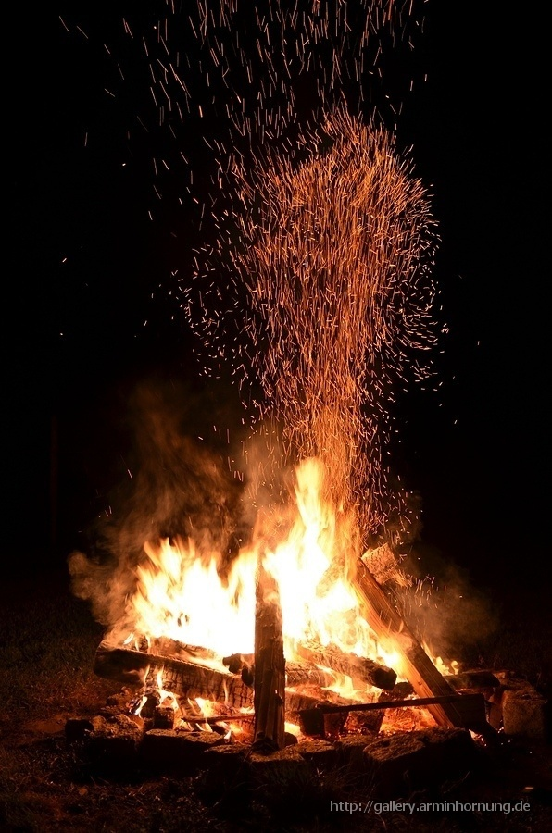

Slide 13
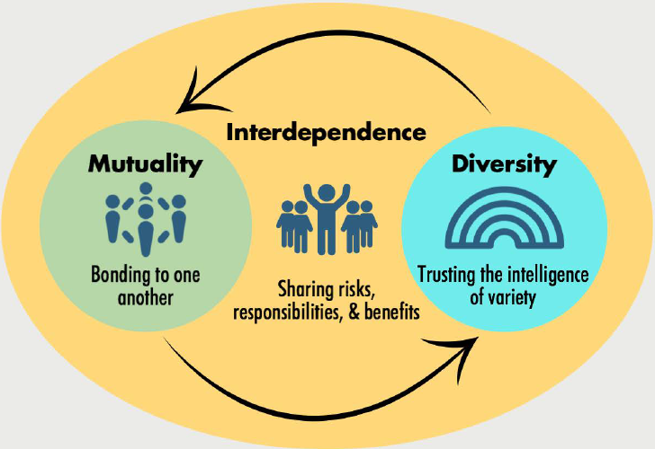
REMEDIATION:
STORIES OF CONNECTION

Slide 14
Coherence
Challenge
Supports
Choices
Outcome
Values
What did you struggle with?
Who supported you, how did they support you, what effect did this have on you?
What agency did you find? What leadership did you take?
What was the result? Where are things now because of the decision made?
What was reclaimed that you now see as precious to your survival?

Slide 15
What to do….
Say: “I was right there with you when _______”
What NOT to do….
Interpret, Tell your own story, Ask Questions, Share Opinions, One-Up, One-Down
***If you notice someone drifting interrupt by asking:***
***When were you right there with them?***

Slide 16
Your Stories
How did it feel to tell a story like that?
How did it feel to receive resonance?
When could you use this in your program?
Notes:
Michael clemmens, renee jennings, demarquis clarke

Slide 17
Additional Resources
The Relational Center : RelationalCenter.org
Mark Fairfield (founder of RC): MarkFairfieldlCSW.com
Healing Justice Podcast, Episode 20 and 32
October 23rd Wilderness Risk Management Conference
Packet at the front of the room
Darren Gruetze
DGruetze@theSCA.org

