Slide 1
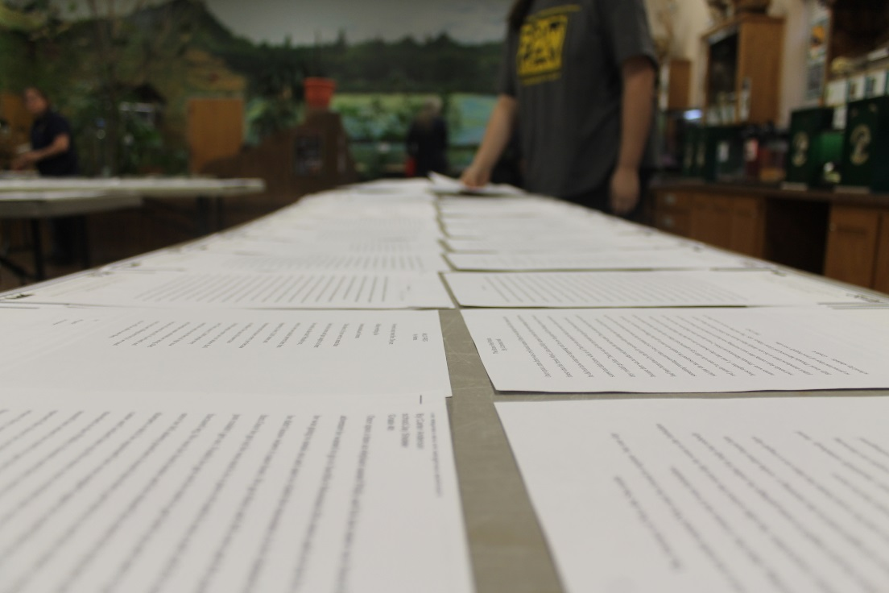
The Power of Words: How to Launch a Conservation Storytelling Contest
Rachael Rost, Education Specialist, Topeka Zoo and Conservation Center

Slide 2
How it Started: Galápagos Islands

Slide 3
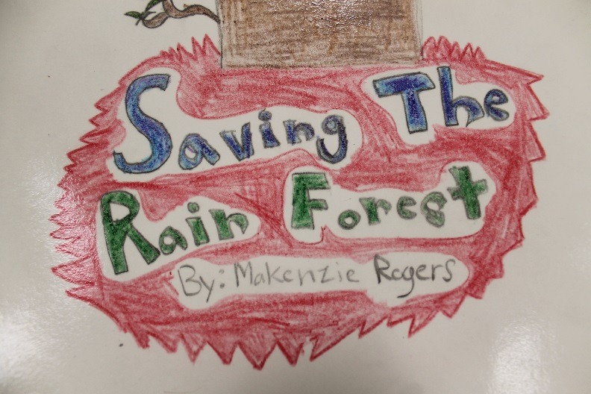
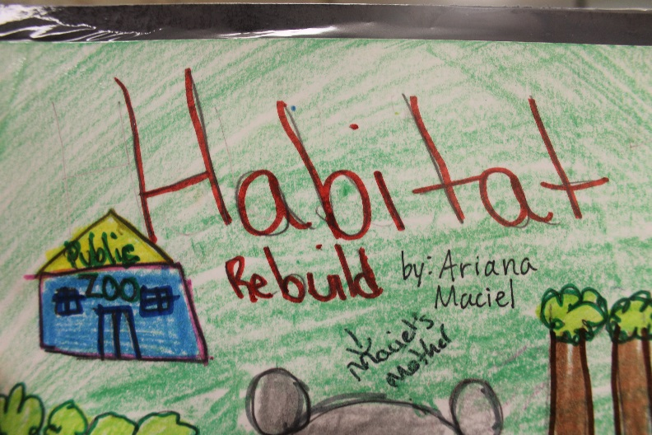
Conservation Storytelling Contest
Write a fictional story about a real-life conservation issue for any plant/animal
Poaching, habitat loss, climate change, invasive species, illegal pet trade, etc.
Examples: Sea turtle caught in pollution; elephant who has encountered poachers; orangutan who lost its home
Goal: Must raise awareness of the issue but does not need to be sad
Can be written from any POV—including the animal’s perspective
No minimum/maximum page limitations
Can be in different forms (comic book style, with illustrations, chapter book)
Age categories (winner and honorable mention)
Kindergarten-2nd grade; 3rd-5th grade; 6th-8th grade; 9th-12th grade; Adult

Slide 4
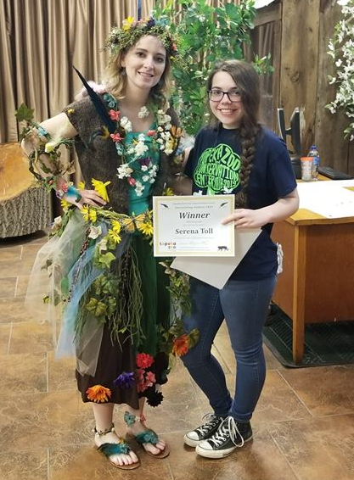
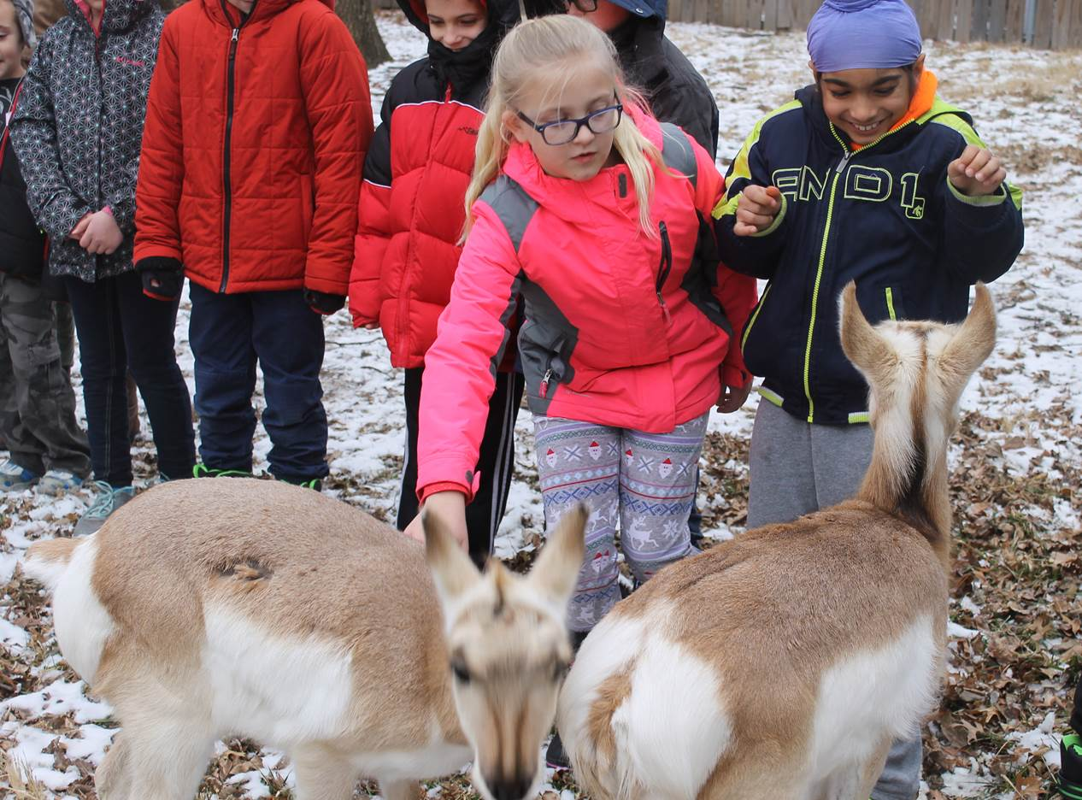
Conservation Storytelling Contest
Contest! Deadline: April 5th, 2020
Prizes (each winner chooses one):
Painting done by an animal of winner’s choice
Behind-the-scenes tour with an animal of winner’s choice
EVERY author gets in free for Earth Day celebration and all stories on display for public to read
Winners announced at 2:00pm on Earth Day
Can read their stories to the public
2018: 222 authors
2019: 496 authors
2020: Expecting even more
Winning stories posted online! http://topekazoo.org/explore/clubs/
Advertise through multiple outlets

Slide 5
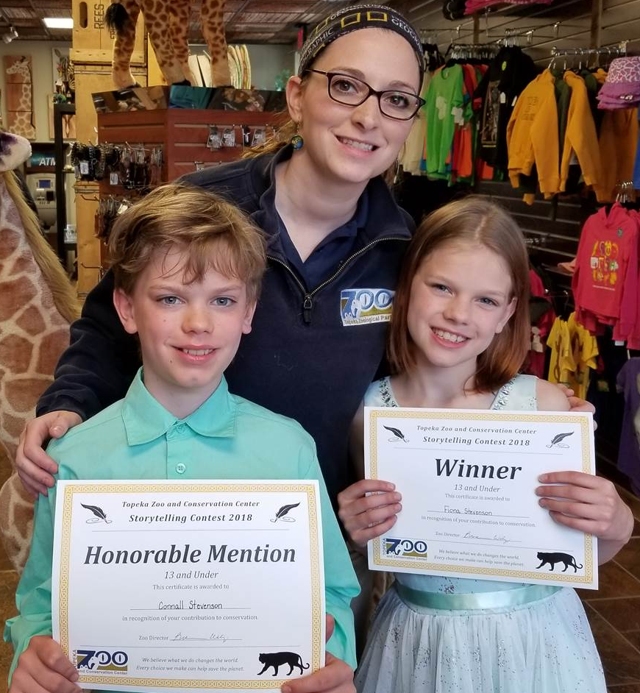
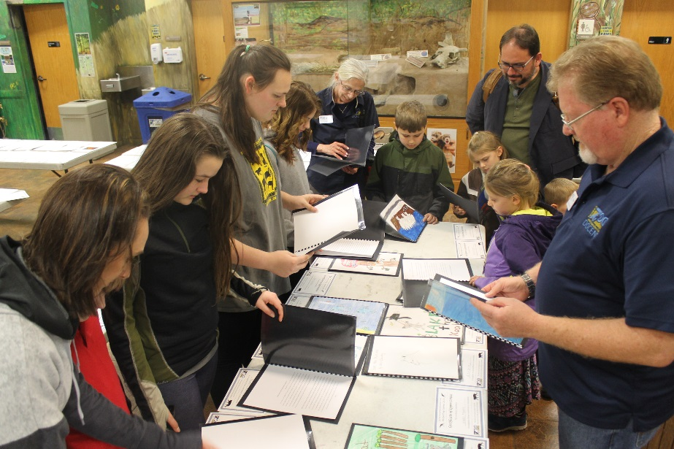
Contest Impact
Over 20 conservation issues represented in 2018 alone
In 2019, 33 different schools submitted stories—including many from underserved communities
Provides the opportunity for whole families to get into the zoo free
In 2019, had over 100 authors attend Earth Day
Teachers love it—fits in perfectly with curriculum for numerous grade levels
Donors love hearing the stories—from the funny ones to the heartfelt ones!
Allows students to use their voice to speak up for threatened and endangered species
Sawtooth Oak Tree
Two Moons

Slide 6
Story Quotes
“Pollution doesn’t just affect animals, it also affects humans. Imagine if 80% of your house was polluted. How would you feel?”
From the point of view of a polar bear: “It’s getting hotter and hotter every day.”
“In her head, Emma knew that the fishermen probably didn’t mean to get the poor sea turtle in the shrimp net, but she also knew that they could be more careful.”
“Now that you’ve heard what pollution does to the environment, I hope this inspired you to recycle, because you’re affecting the whole world when you throw a little piece of trash on the floor.”
“Now things weren’t always happy for the Bee family because a lot of them were getting sick, dying, and also going to bed hungry at night. They were endangered because of habitat loss and pesticides.”
“The pandas need trees more than you do. They are endangered; you aren’t.”
“Animals have a meaning to life, just like we do!”
They spoke up. Will you?

Slide 7
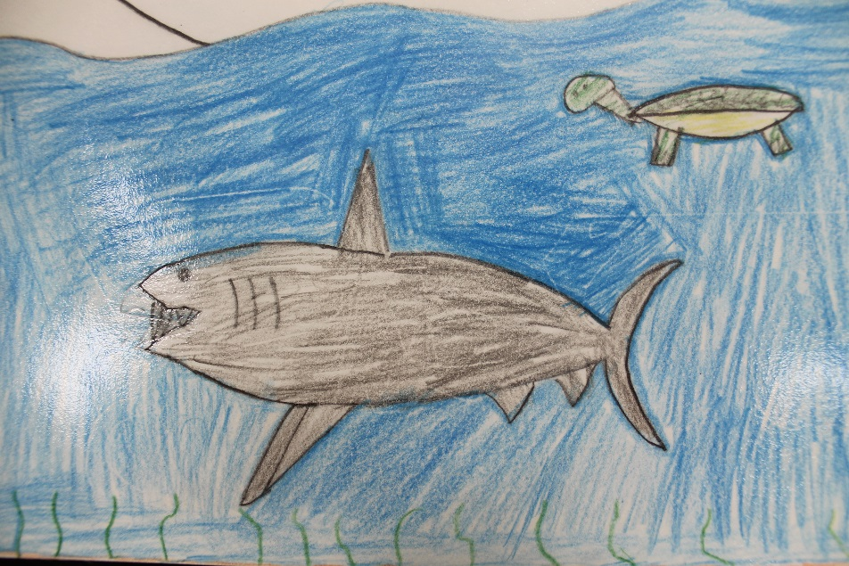
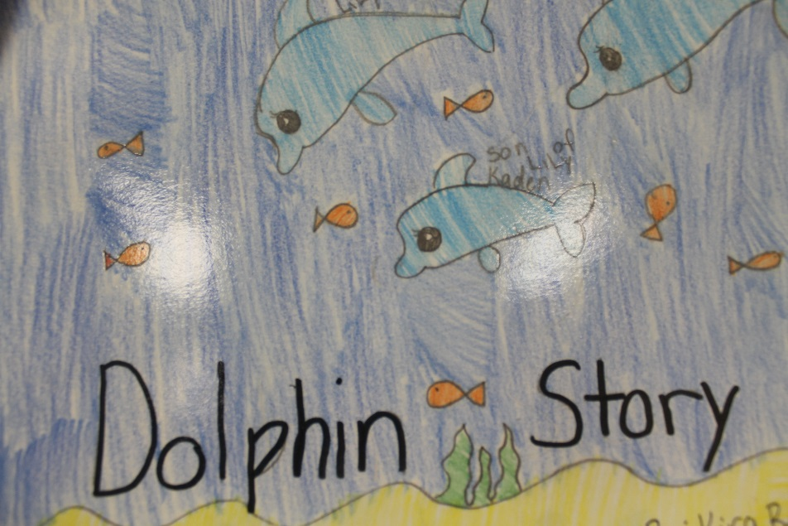
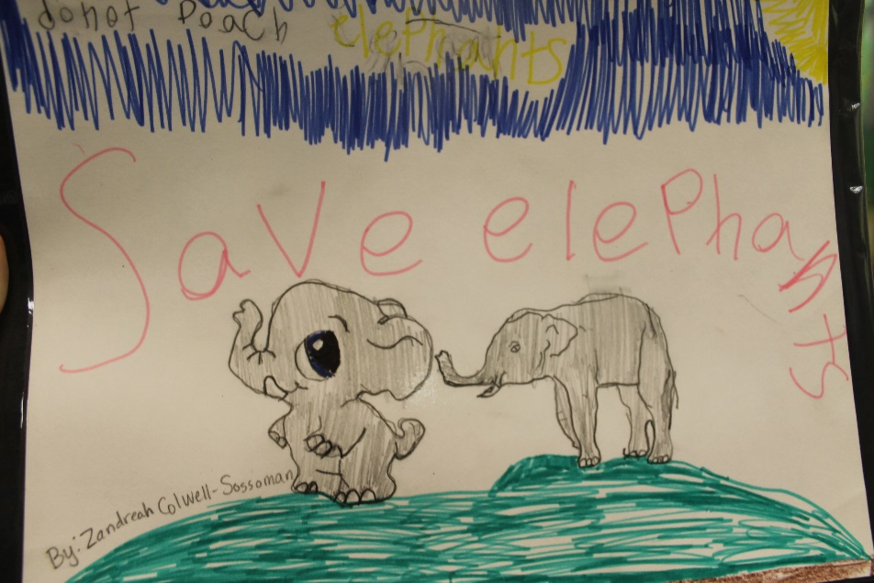
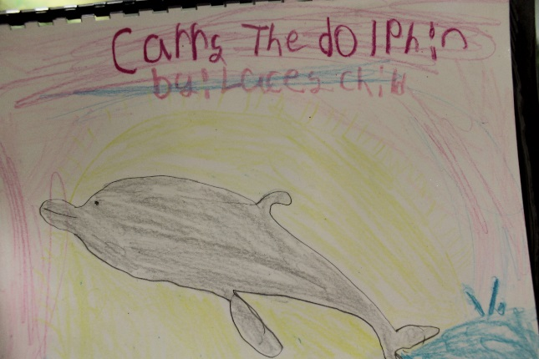
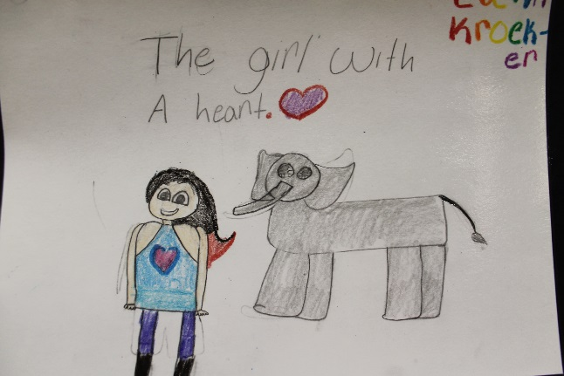
Thank You!
Rachael Rost
Education Specialist
Topeka Zoo and Conservation Center
785-368-9137
RRost@Topeka.org

