Slide 1
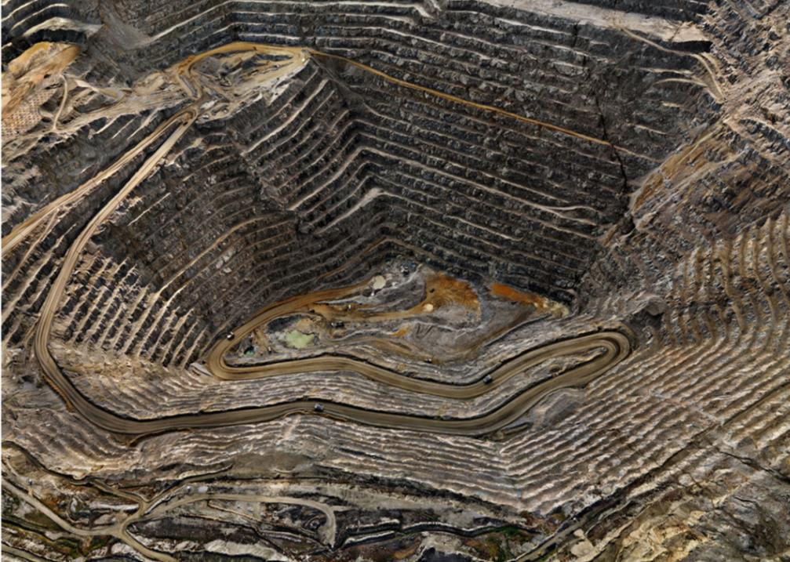
Confronting the unspoken place of violence in environmental education
Dr. Richard Kool
School of Environment and Sustainability, Royal Roads University
Victoria BC Canada

Slide 2
C.S. Lewis, Mere Christianity, 1952
Progress means getting nearer to the place you want to be. And if you have taken a wrong turning, then to go forward does not get you any nearer. If you are on the wrong road, progress means doing an about-turn and walking back to the right road; and in that case the man [sic] who turns back soonest is the most progressive man…

Slide 3
Is this violence? (might be disturbing)
https://www.youtube.com/watch?v=INcW26-iyqU
“Violence, which implies the conscious intent of the perpetrator to harm its victim, is not part of nature, humans notwithstanding. Violence in nature is in the eye of the beholder, the human observer.”
de la Cueva Salcedo, H. (2015). Environmental Violence and Its Consequences. Latin American Perspectives, 42(5/204), 19–26.

Slide 4
Is this violence? (might be disturbing)
https://www.youtube.com/watch?v=FVBGUc84Xwo

Slide 5
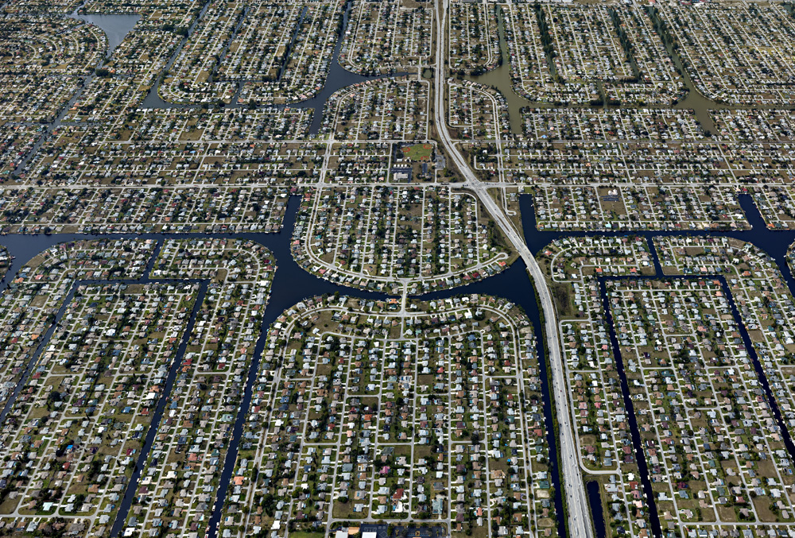
Is this violence?

Slide 6
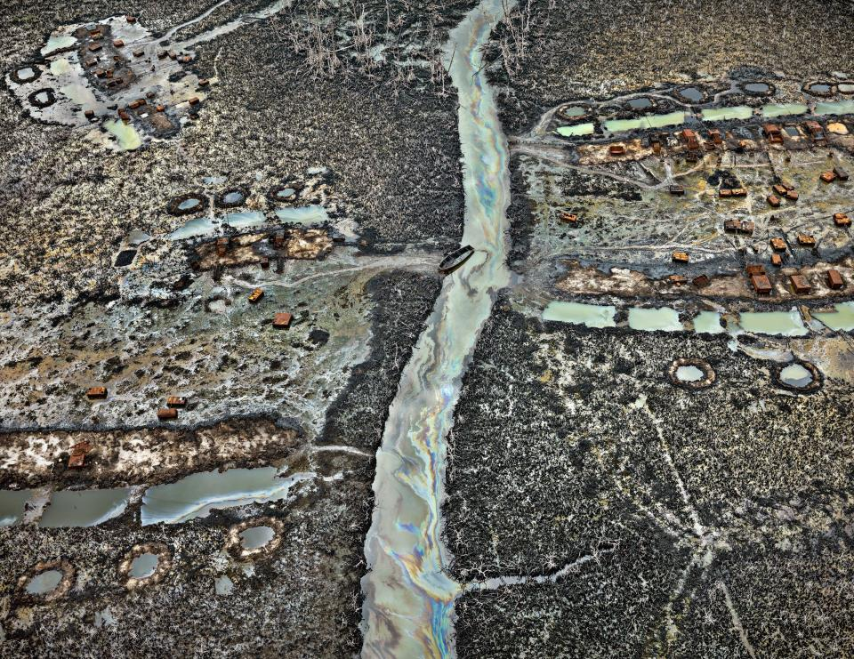
Is this violence?
Notes:
visit to the artificial lake in Baotou in Inner Mongolia - the dumping ground for radioactive, toxic waste from the city’s rare earth mineral refineries.

Slide 7
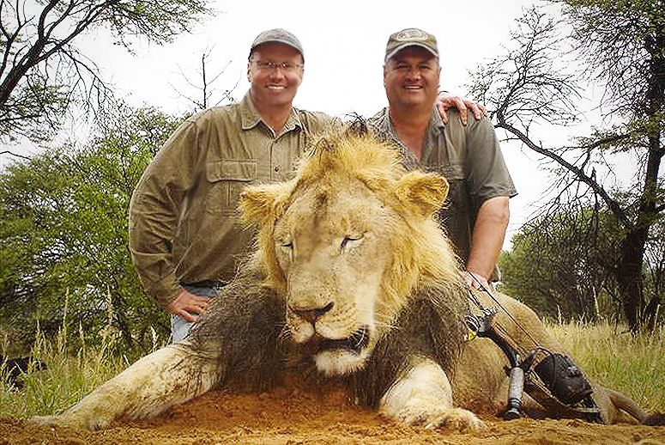
Is this violence?

Slide 8
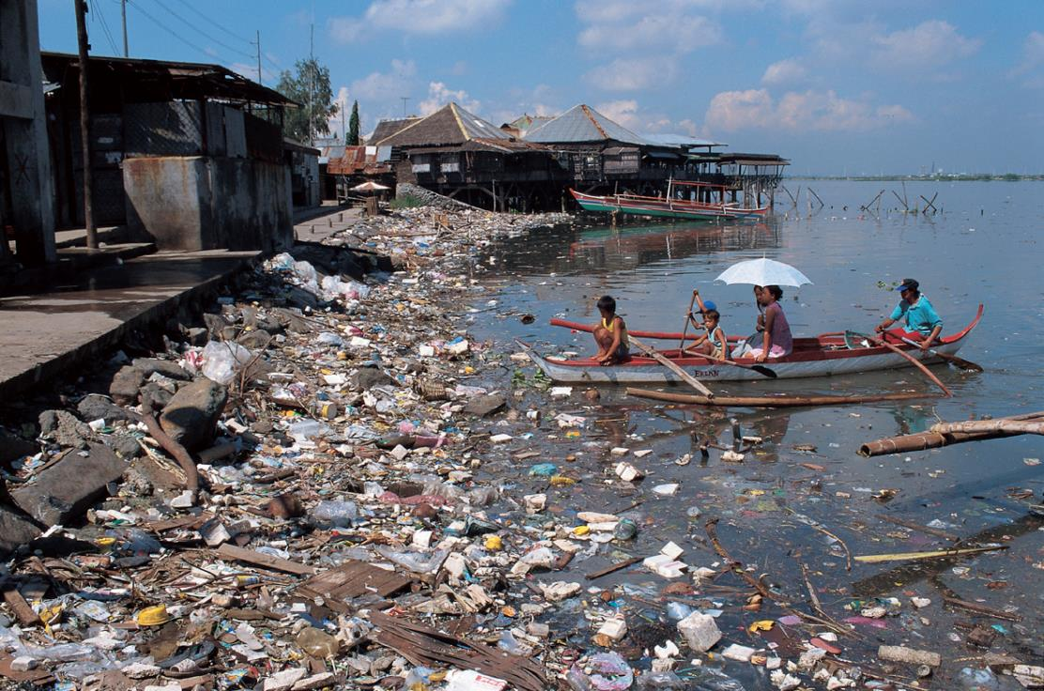
The spirit of the seventies is a spirited concern for environmental quality. We are figuratively and literally sick and tired of a mis-development of America that diminishes daily the quality of the human experience…
Environmental Education grows out of a sense of loss and of violence
… a not so quite crisis of decreasing beauty and increasing contamination that threatens not only the pursuit of happiness but life itself. (Schoenfeld, 1971, p. 1)

Slide 9
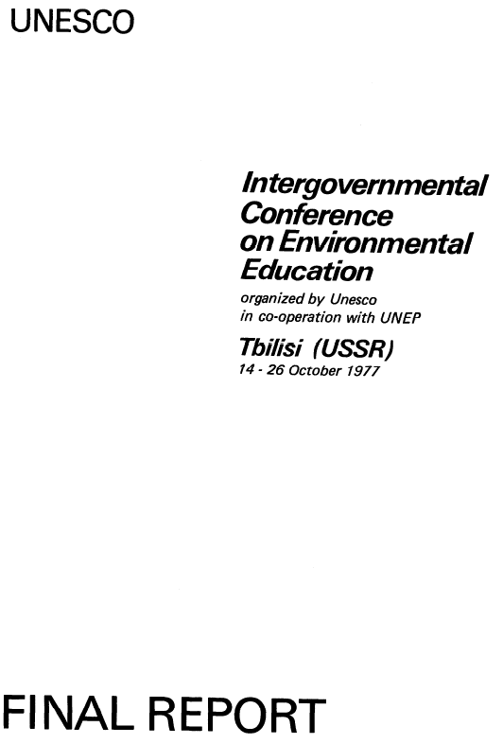
No mention of violence

Slide 10
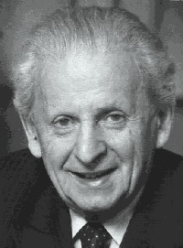
Emmanuel Levinas
“Violence is to be found in any action in which one acts as if one were alone to act: as if the rest of the universe were there only to receive the action…”
Levinas, E. (1990). Difficult freedom: Essays on Judaism (S. Hand, Trans.). Baltimore: The Johns Hopkins University Press.
Violence occurs when people “… behave as if they are the only one’s who matter- ignoring other people, other creatures, and the rest of the world.”
O’Brien, K. J. (2017). The Violence of Climate Change: Lessons of Resistance from Nonviolent Activists. Washington DC: Georgetown University Press.

Slide 11
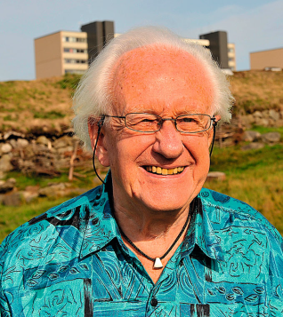
Johan Galtung, ‘father’ of Peace Studies
Violence: any avoidable insult to basic human needs, and, more generally, to sentient life of any kind, defined as that which is capable of suffering pain and can enjoy well-being, lowering the real level of needs satisfaction below what is potentially possible.
Galtung, J. (2013). Violence: Direct, structural and cultural. In J. Galtung & D. Fischer (Eds.), Johan Galtung: Pioneer of Peace Research (Vol. 5). New York: Springer.

Slide 12
Needs satisfaction
any avoidable insult to basic human needs…, lowering the real level of needs satisfaction below what is potentially possible. (Galtung)
Violence negates possibility of…
Survival | Wellness | Freedom | Identity/meaning
negation is death | negation is misery | negation is repression | Negation is alienation

Slide 13
The perpetrator of violence can be…
… any actor who can cause direct violence
…a structure or system at work, churning out harm, causing basic human needs deficits; as in unintended, indirect, or structural violence
…or, a culture who legitimizes direct and structural violence… cultural violence

Slide 14
Direct violence
Visible
What is obvious and what we focus on
Invisible
Invisible
Cultural violence
Structural violence

Slide 15
Direct or personal violence…
… the outcome of an actor with intent to commit violence; Direct violence is intentional, directed against a specific group or person,
and involves hurting or killing people, but it may also includes verbal violence.
Survival needs | Wellness needs | Freedom needs | Identity/ meaning needs | Needs of non-human Nature
Killing | Illness | Repression | Alienation | Destruction of biota
Maiming | Misery | Detention | Desocialize | System destruction
Siege |  | Expulsion | 2nd class citizenship
Sanctions
Adapted from Galtung, J. (1990). Cultural violence. Journal of Peace Research, 27(3), 291-305.

Slide 16
Visible and invisible effects of direct violence
Space | Material, visible effects | Nonmaterial, invisible effects
NATURE | Depletion and pollution; damage to diversity and symbiosis | Less respect for non-human nature, reinforcing ‘man over nature’
HUMANS | Somatic effects: numbers killed, numbers wounded, numbers raped, numbers displaced | Spiritual effects: bereavement traumas, hatred revenge addiction, victory addiction
SOCIETY & WORLD | The material damage to buildings, infrastructure | The structural and cultural damage
TIME | Delayed violence; land-mines transmit violence; genetic | Structure and culture transfer; points of trauma and glory
CULTURE | Irreversible damage to human cultural heritage | Violence culture of trauma, glory; deterioration of conflict-resolving capacity
Adapted from Galtung, J. (2013). Violence: Direct, structural and cultural. In J. Galtung & D. Fischer (Eds.), Johan Galtung: Pioneer of Peace Research (Vol. 5). New York: Springer.
Notes:
structural damage, the verticalization of structures organized for violence with hidden chains of command that easily become permanent features of countries liberated through violence;
cultural damage, the rapid growth of a culture of violence to justify all the direct violence, with long lasting impact.

Slide 17
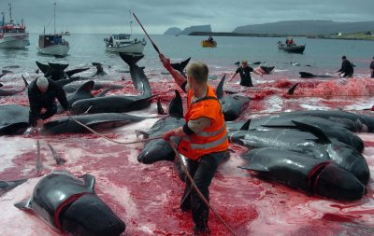
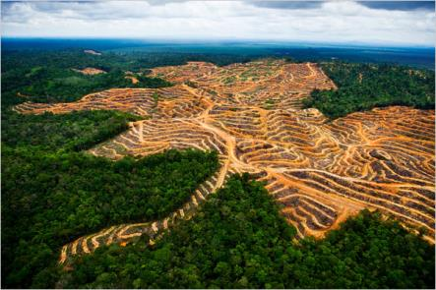
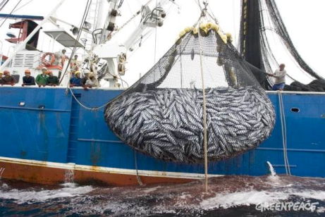
Direct violence … the outcome of an actor with intent to commit violence
http://www.ibtimes.co.uk/worlds-top-10-whaling-countries-after-japan-ban-1443370
https://fli.institute/2015/08/22/tropical-deforestation-releases-large-amounts-of-soil-carbon/
http://www.greenpeace.org/international/en/news/Blogs/makingwaves/skipjack-tuna-is-cheap-and-plentiful-or-is-it/blog/33506/
http://www.takepart.com/article/2015/07/28/american-dentist-killed-zimbabwe-famous-lion/

Slide 18
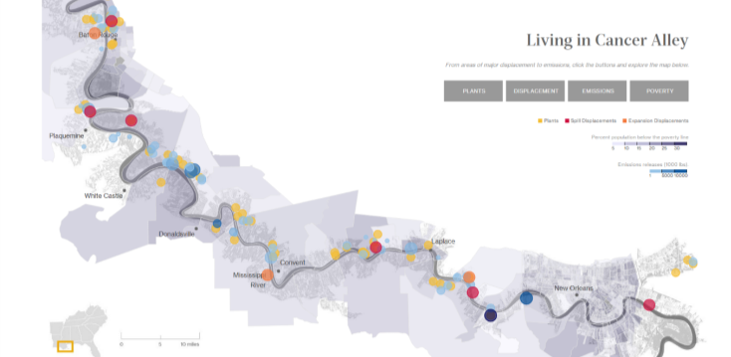
Structural violence: Indirect, unintentional
Living in Cancer Alley
Who is the perpetrator here?
… the result of human systems that cause violence unintentionally, through what we do or what we fail to do…

Slide 19
Structural violence
“Violence with a clear subject-object relation is manifest [direct] because it is visible as action. . . Violence without this relation is structural, built into structure…
…when one husband beats his wife there is a clear case of personal [direct] violence, but when one million husbands keep one million wives in ignorance there is structural violence.”
Galtung, J. (1969). Violence, peace and peace research. Journal of Peace Research, 6, 167-191.
Notes:
Correspondingly, in a society where life expectancy is twice as high in the upper as in the lower classes, violence is exercised even if there are no concrete actors one can point to directly attacking others…”

Slide 20
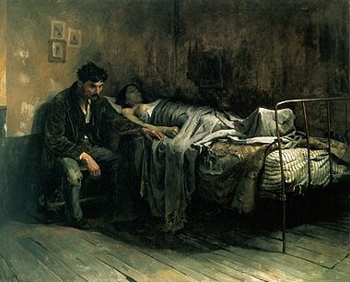
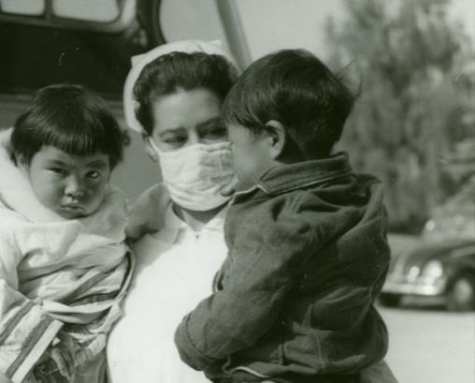
Structural violence
18th Century
1950s
… any avoidable insult to basic human needs…, lowering the real level of needs satisfaction below what is potentially possible. (Galtung)

Slide 21
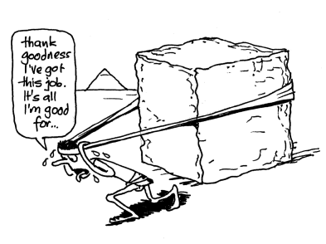
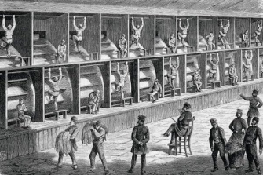
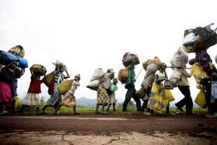
Indirect or Structural violence
… keeping the
underdogs away from each other
…implanting the top-dog mind inside the underdog
Survival | Wellness | Freedom | Identity
Disadvantaged die, starve, or wither away from avoidable disease | “…alive in a permanent, unwanted state of misery including malnutrition or illness | Fragmentation Marginalization | Penetration
… keeping the underdogs on the outside

Slide 22
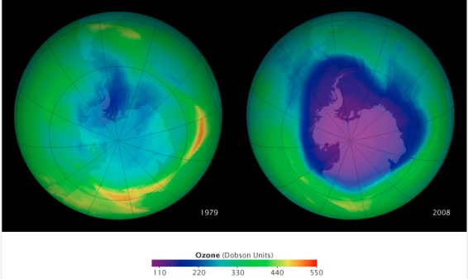
Structural violence
“…not intending to destroy nature but nevertheless doing so by the pollution and depletion associated with modern industry, leading to dying forests, ozone holes, global warming etc. What happens is transformation of nature through industrialization, leaving non-degradable residues and depleting nonrenewable resources,
combined with a world-encompassing commercialization that makes the consequences
non-visible to the perpetrators.” (Galtung)
http://earthobservatory.nasa.gov/IOTD/view.php?id=38835

Slide 23
Structural violence

Slide 24
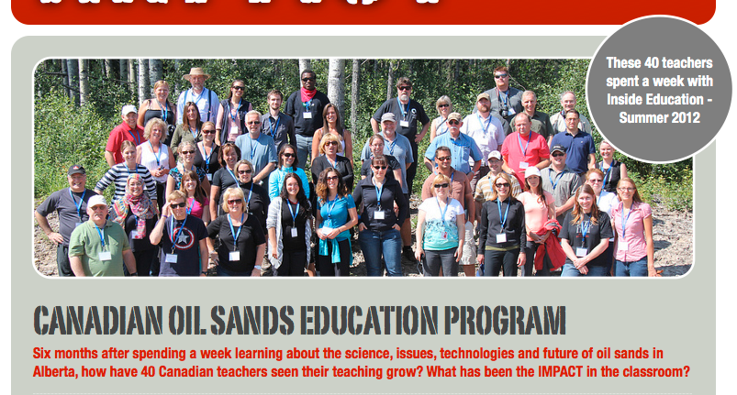
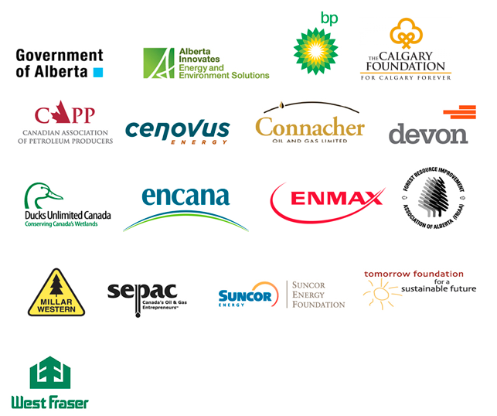

Slide 25
“we‘re committed to being a responsible developer of one of Canada’s most valuable resources – the oil sands.”
“we are poised to become Canada’s leader in the discovery and responsible development of our oil and gas assets”
“a leading North American energy producer that is focused on growing its strong portfolio of diverse resource plays producing natural gas, oil and natural gas liquids”
“A Canadian integrated energy company... It specializes in production of synthetic crude from oil sands”)

Slide 26
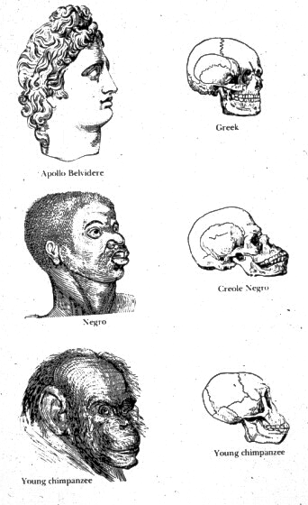
Cultural violence
“‘Cultural violence’ are those aspects of culture, the symbolic sphere of our existence exemplified by religion and ideology, language and art, empirical science and formal science (logic, mathematics) that can be used to justify, legitimize direct or structural violence.”
Galtung, J. (2013). Violence: Direct, structural and cultural. In J. Galtung & D. Fischer (Eds.), Johan Galtung: Pioneer of Peace Research (Vol. 5). New York: Springer.

Slide 27
Cultural violence
“the buzz-word ‘sustainable economic growth’ may turn out to be only a more refined form of cultural violence.”

Slide 28
Cultural violence
“…the result of social legitimization and justification of direct or structural violence…”
“Cultural violence makes direct and structural violence look and feel right, or at least not wrong.”
“One way cultural violence works is by changing the moral color of an act from red/wrong to green/right or at least to yellow/acceptable…”
Wrong: killing in one’s own name
Right: killing in the name of country
http://forexsignals365.com/what-you-need-to-know-about-wall-street

Slide 29
https://keepcanadaworking.ca/

Slide 30
Environmental education and violence…
Environmental non-violence
Environmental anti-violence
Environmental contra-violence

Slide 31
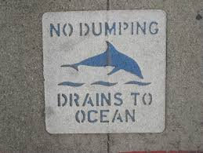
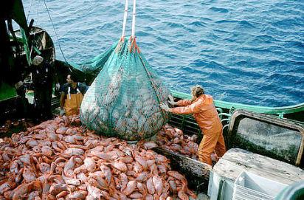
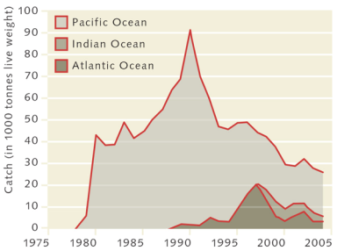
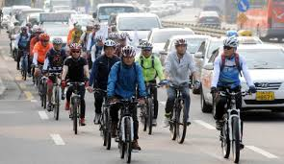
Environmental non-violence
What might be some forms of environmental non-violence?
http://www.wwf.org.au/our_work/saving_the_natural_world/oceans_and_marine/marine_threats/overfishing/
http://obrag.org/?p=50625
http://www.koreaherald.com/view.php?ud=20111118000522

Slide 32
We can do, with our students, environmentally non-violent things like…
getting out of our cars
More active transportation like walking and cycling,
eating lower on food chain,
using less stuff,
buying more local and organic (no pesticides etc.),
using fewer fossil fuels and energy derived from fossil fuels…
How else can we, as educators, help to reduce direct environmental violence through increasing non-violence?

Slide 33
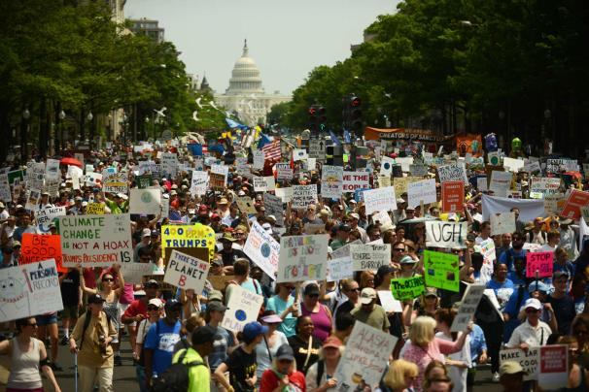
Environmental anti-violence
What might be some forms of environmental anti-violence?
http://www.apano.org/programs/community-organizing/

Slide 34
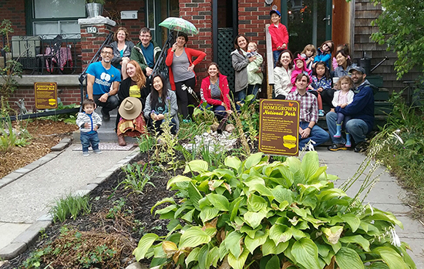
We can do, with our students, environmentally anti-violent things like…
engaged active citizenship,
community organizing and awareness building,
planning, collaborating with and engaging in civil actions…
What else can we, as educators, help to reduce environmental violence through increasing anti-violence?
Toronto, ON Rain Gardens United

Slide 35
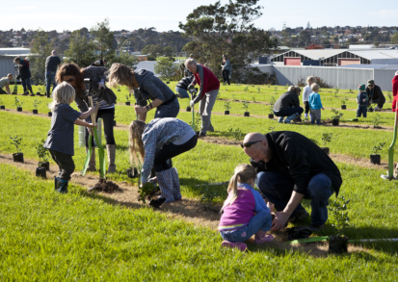
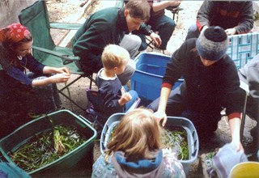
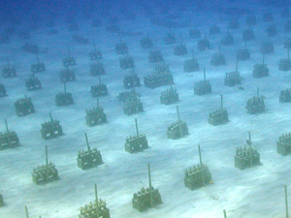
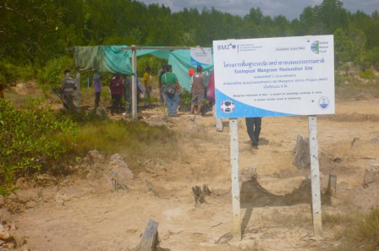
Environmental contra-violence
contra-
(prefix)
1. against; opposite; contrasting.
What might be some forms of environmental contra-violence?
http://www.victoriafoundation.bc.ca/blog/seachange-tod-inlet
http://www.mangroveactionproject.org/cbemr/tag/ban-thung-gor/
http://www.reefresilience.org/coral-reefs/management-strategies/ecological-restoration/

Slide 36
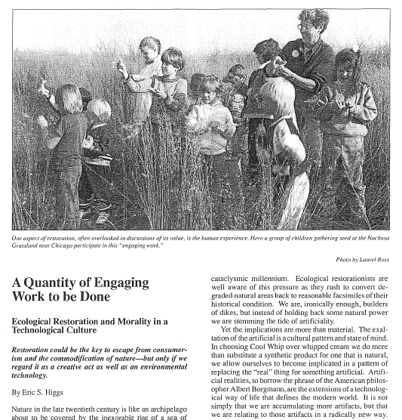
Higgs, E. S. (1991). A quantity of engaging work to be done: Ecological restoration and morality in a technological culture. Restoration & Management Notes, 9(2), 97-104.

Slide 37
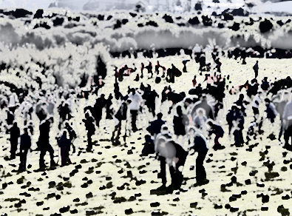
Why should we engage in the contra-violent work of restoration ecology?
Prudential considerations: If we accept the need to preserve and protect existing natural areas, and we recognize that they are subject to continual encroachment, it is prudent to undertake careful programs of ecological restoration and re-creation...
Notes:
Buying insurance!!

Slide 38
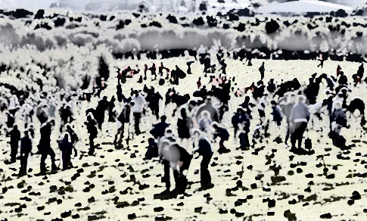
Why should we engage in the contra-violent work of restoration ecology?
Prudential considerations: If we accept the need to preserve and protect existing natural areas, and we recognize that they are subject to continual encroachment, it is prudent to undertake careful programs of ecological restoration and creation...
Compensatory justice: Human beings continue to engage in a systematic denaturalization of the planet. Nature ought to exert a strong claim to compensatory justice in the form of human assistance in the recovery and re-creation of natural diversity and other attributes of the natural landscape.

Slide 39
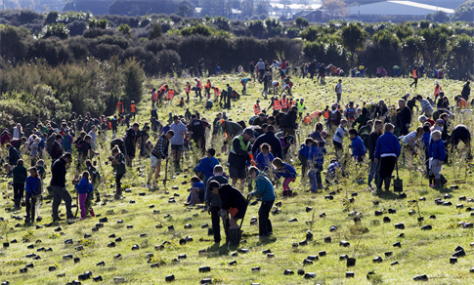
Why should we engage in the contra-violent work of restoration ecology?
Prudential considerations: If we accept the need to preserve and protect existing natural areas, and we recognize that they are subject to continual encroachment, it is prudent to undertake careful programs of ecological restoration and re-creation...
Compensatory justice: Human beings continue to engage in a systematic denaturalization of the planet. Nature ought to exert a strong claim to compensatory justice in the form of human assistance in the recovery and re-creation of natural diversity and other attributes of the natural landscape.
Obligations to future generations: Human beings have an obligation toward future generations, both human and non-human. This obligation can be met, at least in part, through ecological restoration and re-creation.
Notes:
Compensatory justice refers to the provision of resources to a victim of injustice with the goal of minimizing or reversing the impact of harm done by the injustice.

Slide 40
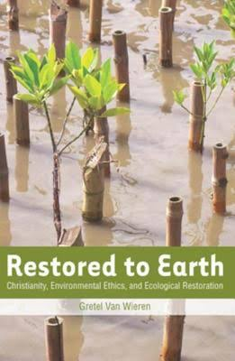
we can do, with our students, things like
sharing in ecological and community restoration,
planting and re-wilding
gardens for wildlife
What else can we, as educators, help to reduce environmental violence through increasing contra-violence?

Slide 41
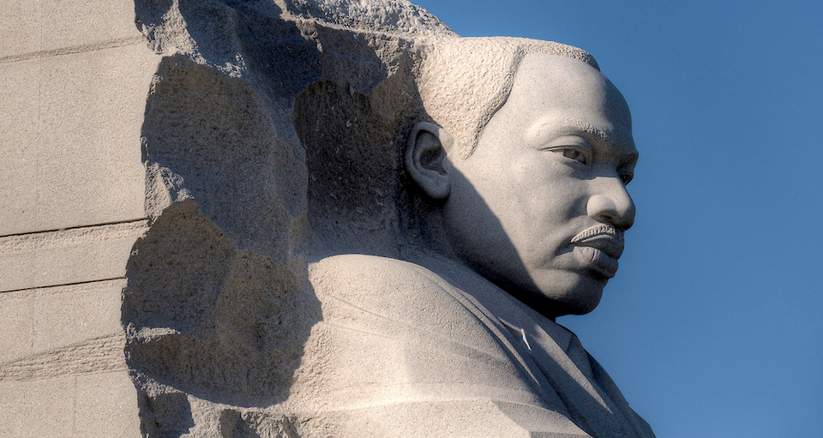
“We are now faced with the fact that tomorrow is today. We are confronted with the fierce urgency of now. In this unfolding conundrum of life and history there is such a thing as being too late... We may cry out desperately for time to pause in her passage, but time is deaf to every plea and rushes on. Over the bleached bones and jumbled residue of numerous civilizations are written the pathetic words: ‘Too late.’” Dr. Martin Luther King. Jr. April 1967
Notes:
There is much work to do… “despair is not our business”

Slide 42
#OceanOptimism
https://www.youtube.com/watch?v=QiqH_i-lhRk

Slide 43
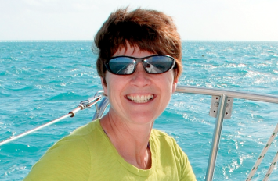
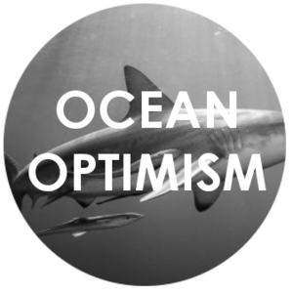
#Dr. Elin Kelsey
Elin Kelsey, “The Rise of Ocean Optimism,” Hakai Magazine, June 8, 2016, accessed June 8, 2016, http://bit.ly/1sZLBH8.

Slide 44
Environmental education and violence…
We need words to accurately describe what we see:
• Direct violence
• Structural violence
• Cultural violence
• Environmental non-violence
• Environmental anti-violence
• Environmental contra-violence

