Slide 1
Keeping EE Programs Fresh: Aligning with Next Generation Science Standards
Presented by: Next Step Adventure
Nextstepadventure.com

Slide 2
Session Summary
Naturalists' interactions with school groups have a major impact on the next generation. By tweaking programs as school curriculum evolves, naturalists can expand their outreach.
Why are the Next Generation Science Standards (NGSS) good for environmental educators?
Check out this blog post by the National Wildlife Federation.
Learn about the Next Generation Science Standard and online tools that are useful in modifying your EE programs.

Slide 3
Next Generation Science Standards - nuts and bolts:
What is NGSS?
Check out this great video explanatiion
What is a standard?
How does NGSS differ from previous standards?
How many states have adopted NGSS?

Slide 4
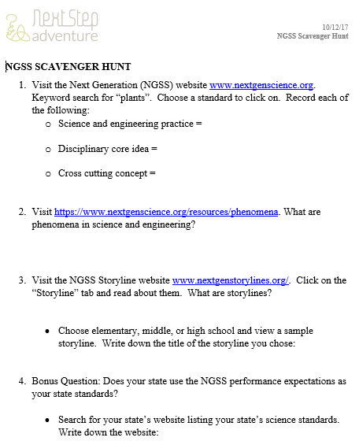
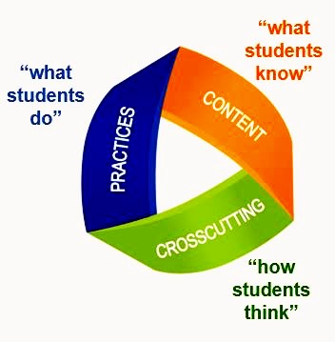
Activity: Scavenger Hunt

Slide 5
Strategies for aligning current programs…
Do a key word search on nextgenscience.org to determine standards that could possibly pertain
Unpack the standard
How can your activity enrich students’ storyline?
Could your activity provide a phenomena to anchor student learning?
Make simple tweaks to current activity to strengthen its connection to the standard
Using key terms from the standard, add prompting questions the leader can use while working with the students
Include a journal prompt at the end of the activity to assess students learning
Write up the activity and use it as a starting point for a collaboration with classroom teachers

Slide 6
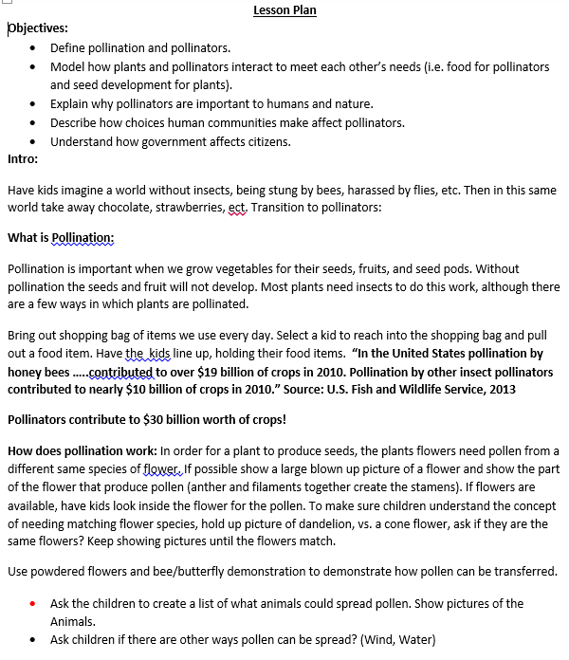
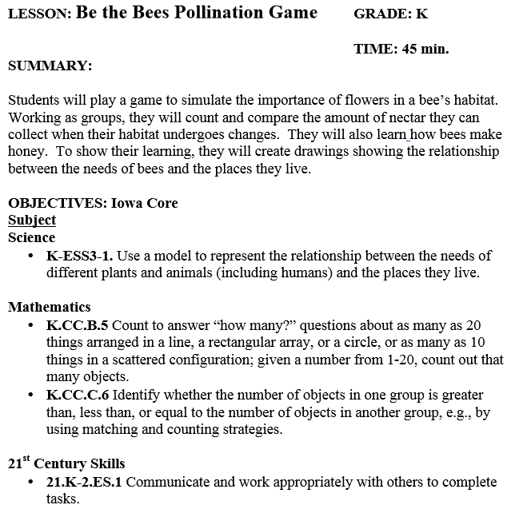
Comparing “old” to “new”
Old
New
“Be the Bees Pollination Game” can be viewed in its entirety here.

Slide 7
Ideas to remember:
You may need to break a program into individual activities to match with standards
Remember, the activity is one of many lessons for student learning on this standard. The activity does not need to teach it fully. The performance expectation states what students must able to do after the unit of teaching, not the learning activities.
Consider students from many communities, ELL, cultural groups underrepresented in STEM fields
One activity may be tweaked for many applications in multiple grade levels – change questions, keywords, journal prompt
Do the work, write it up and use it as a starting point for collaboration with teachers

Slide 8
Example of NGSS realigned program
*see next slide for blank template to help with realigning your current activities

Slide 9
Template to Realign your current activities
*let us know how we can help you:
nextstepadventure@mac.com
515.979.3311

Slide 10
Next Step Adventure Des Moines, Iowa nextstepadventure@mac.com 515.979.3311
*Contact us for help realigning your current EE programs to meet NGSS
Nextstepadventure.com

