Slide 1
NATURE IS OUR CLASSROOM

Slide 2
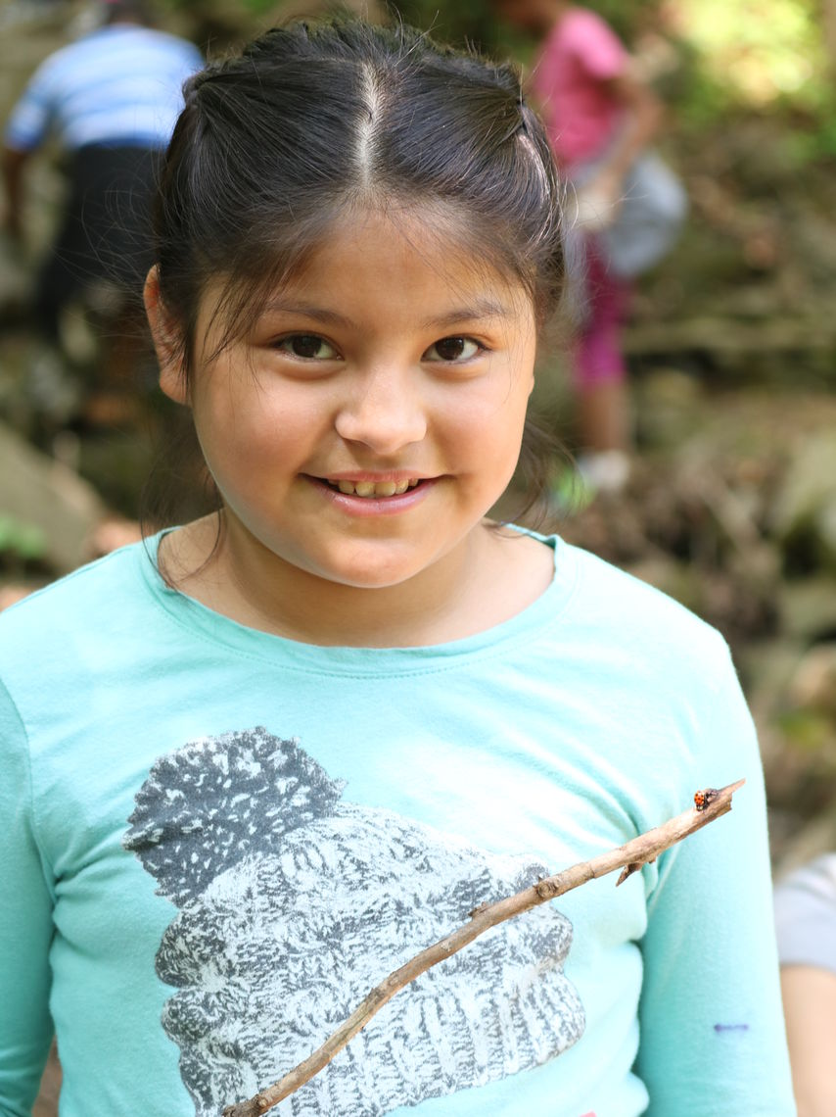
Riverbend: Uniquely Positioned
Notes:
Environmental Education Center in Gladwyne, PA
Programs serve local communities (camp) as well as region and underserved communities
Feature program PCAN has been working in Philadelphia for more than 10 years, serving XX of students and teachers
Program is iterative and changes with the needs of EE and schools.
Latest model has been studied by UPENN in 2017-2018 school year
Changing conditions make it imperitive that we stay ahead of the curve.

Slide 3
Change Through Environmental Education

Slide 4
Why does it matter?
World is facing complex environmental problems.
Global population growth, food scarcity and water scarcity will become more prevalent in the future.
To build a resilient society, it is critical to prepare students to tackle these problems.
Photo by Karsten Würth (@inf1783) on Unsplash
Notes:
EE is more relevant now than at any time in recent history
Climate change is widely accepted as the most pressing environmental problem that will impact food availability, public health, ecosystems, economies, etc. Environmental issues go beyond “saving wildlife”

Slide 5
When students learn through authentic experiences, inquiry and productive discussion, they direct their own learning.
They build skills that are transferrable to EVERY. OTHER. SUBJECT.
National Frameworks for education (Common Core and NGSS) point to skills in finding evidence, argumentation and reading complex texts as critical for success.
Notes:
Science education is experiencing a revolution after a period of stagnancy (no child left behind)
National Academic standards emphasis on solving environmental problems
Elementary teachers teach 30 minutes per week of science
Schools are being asked to implement STEM in advance of receiving support
Environment lends itself to conceptual real world vision for 3 D science
Authentic opportunities for asking questions, investigations, explaination and argumentation

Slide 6
Goals for this session
Share a successful model for school partnership:
Teacher professional development and direct student experiences.
Collaboration with multiple partners
Aquaponics as a vehicle for STEM learning in the elementary school classroom.

Slide 7
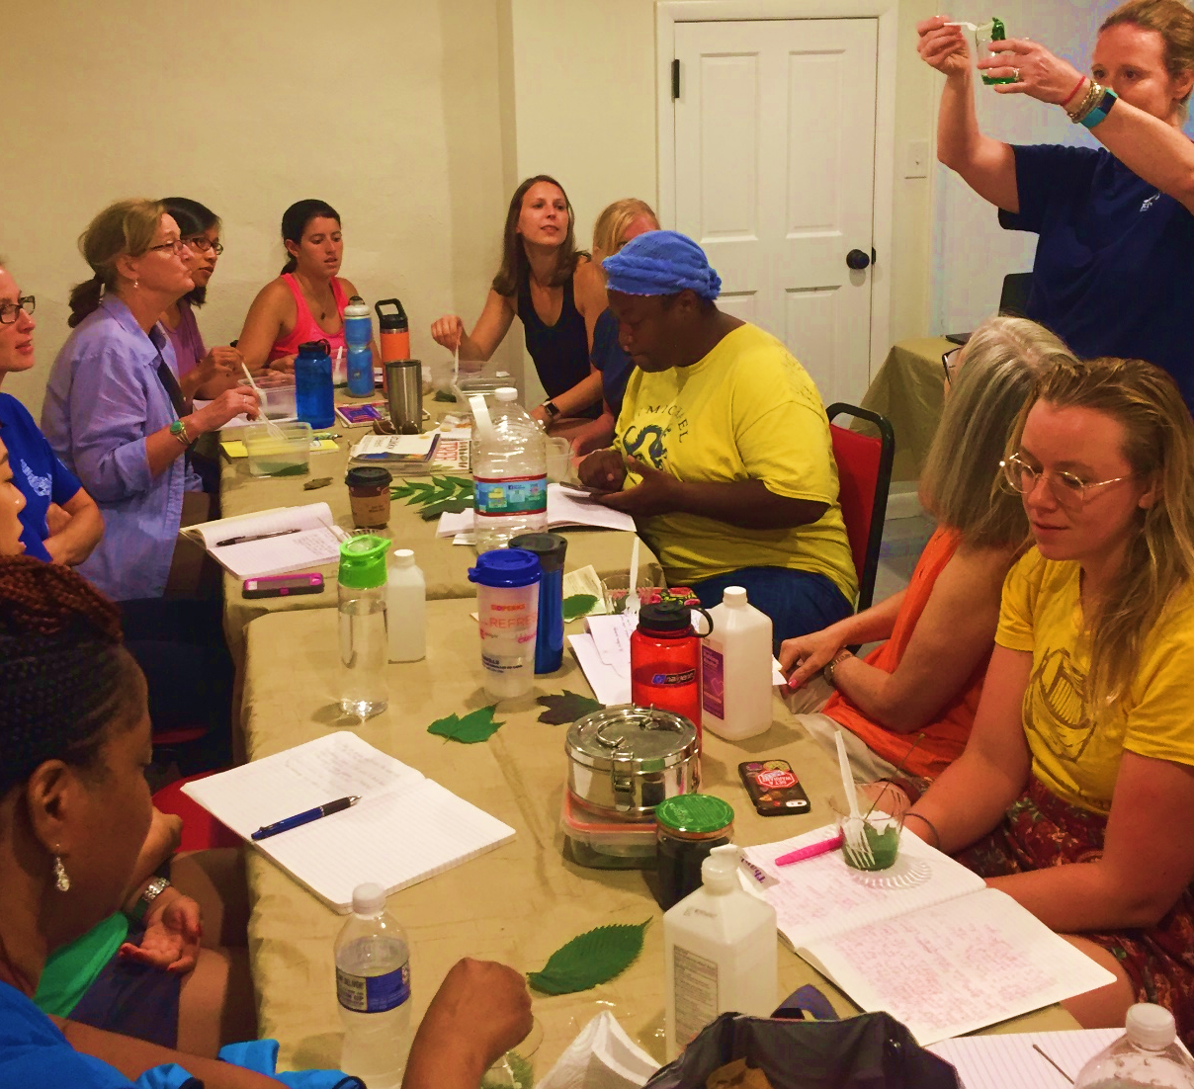
Philadelphia Children Access Nature (PCAN)
1. Build Environmental Literacy
2. Improve/Increase Elementary School Science Instruction
3. Prepare students for STEM in middle and high school
4. Bring authentic EE experiences to school

Slide 8
PCAN Collaborating Organizations
Notes:
Partnerships are key to this program. We have been fortunate to maintain a consistent group of partners who support the program each year. Goal is to demonstrate the wealth of resources available to teachers for science education in the city.

Slide 9
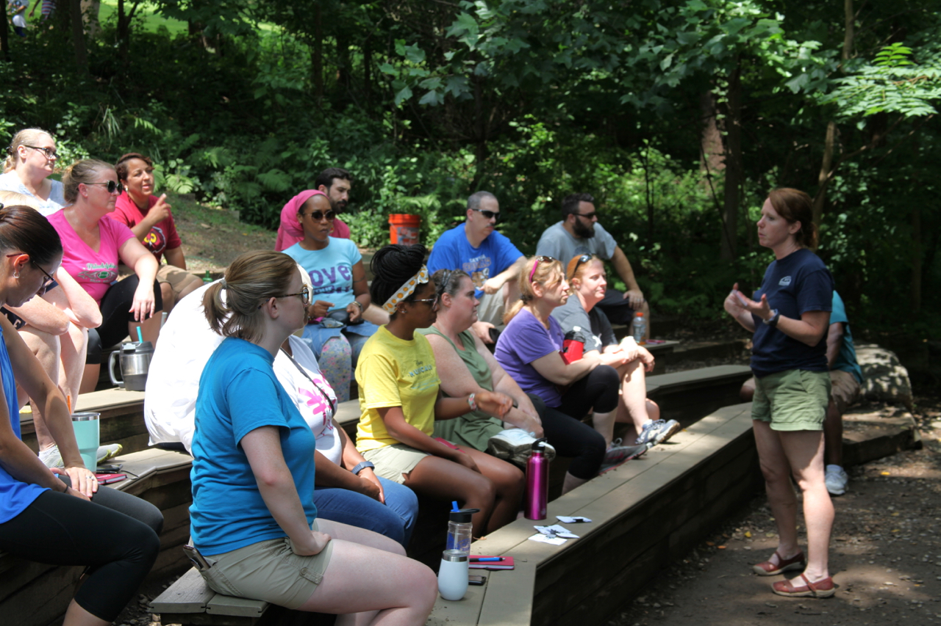
Summer Science Inquiry Institute
5 days of professional development
Introduction to 5E cycle of inquiry
Experiential learning-visit 5 different sites
Collaborative-teachers building lessons together
Themes include water, food and the environment

Slide 10
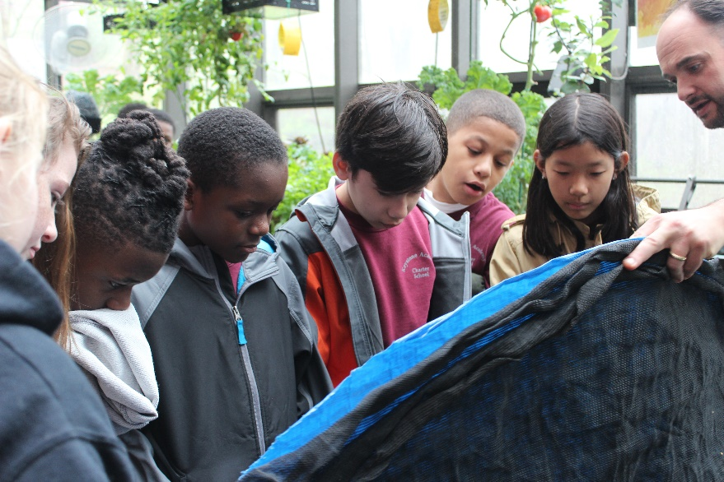
Teacher Fellowship
Ongoing professional development
Community of Practice
Classroom Aquaponics system
STEM based classroom visits
Field trip to Riverbend

Slide 11
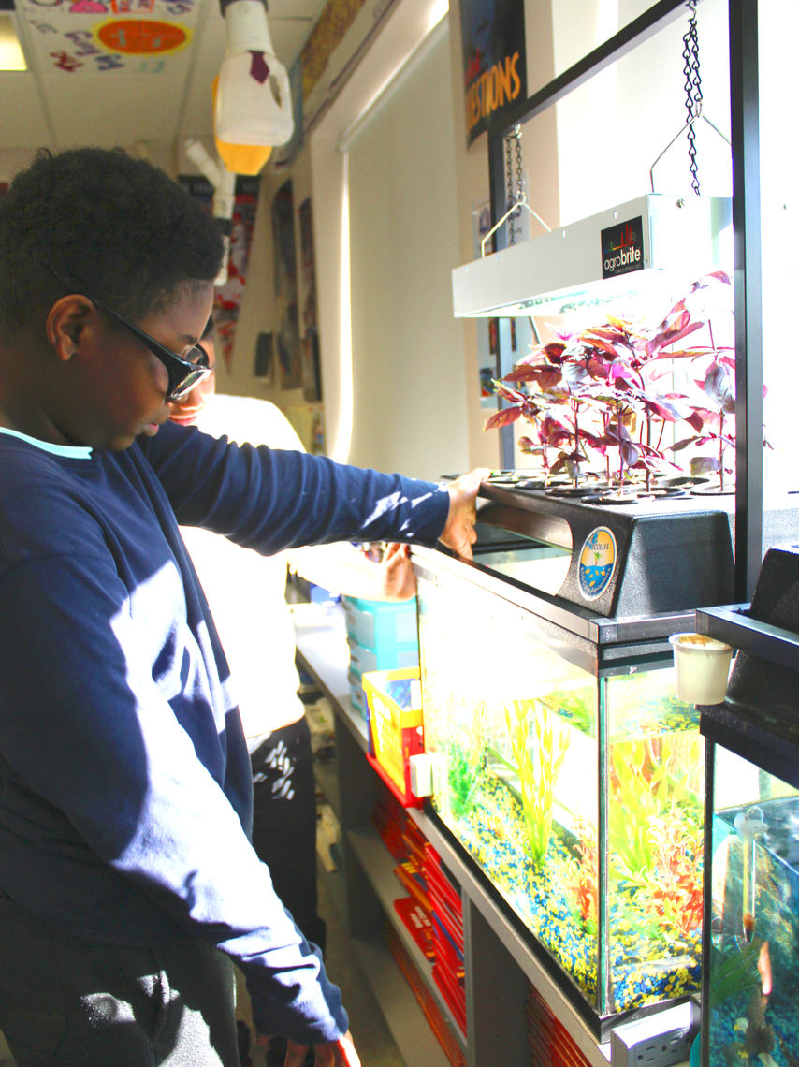
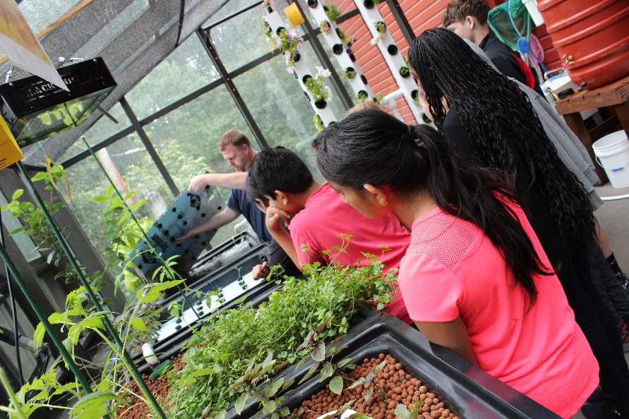
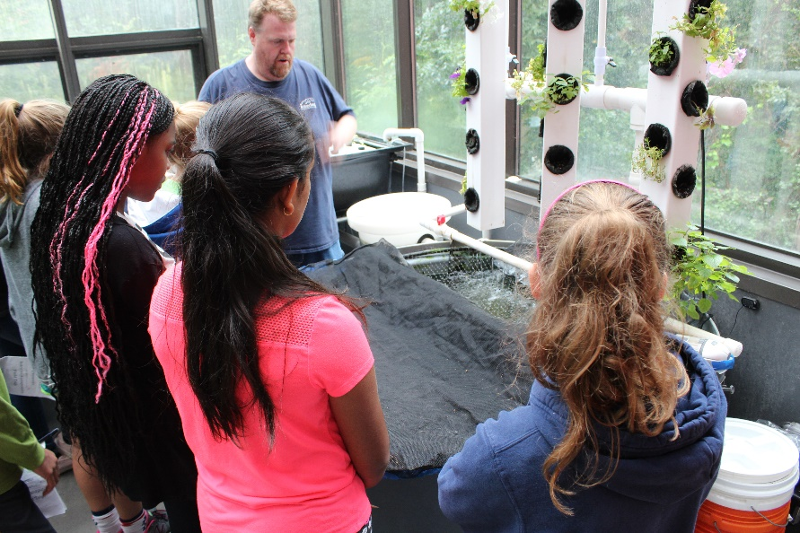
Building STEM Skills through Aquaponics
Notes:
PCAN teachers receive a 20 gallon aquaponics system for their classroom along with inquiry based curriculum. The goal is to provide a platform for students to practice science and for teachers to build inquiry based science lessons.

Slide 12
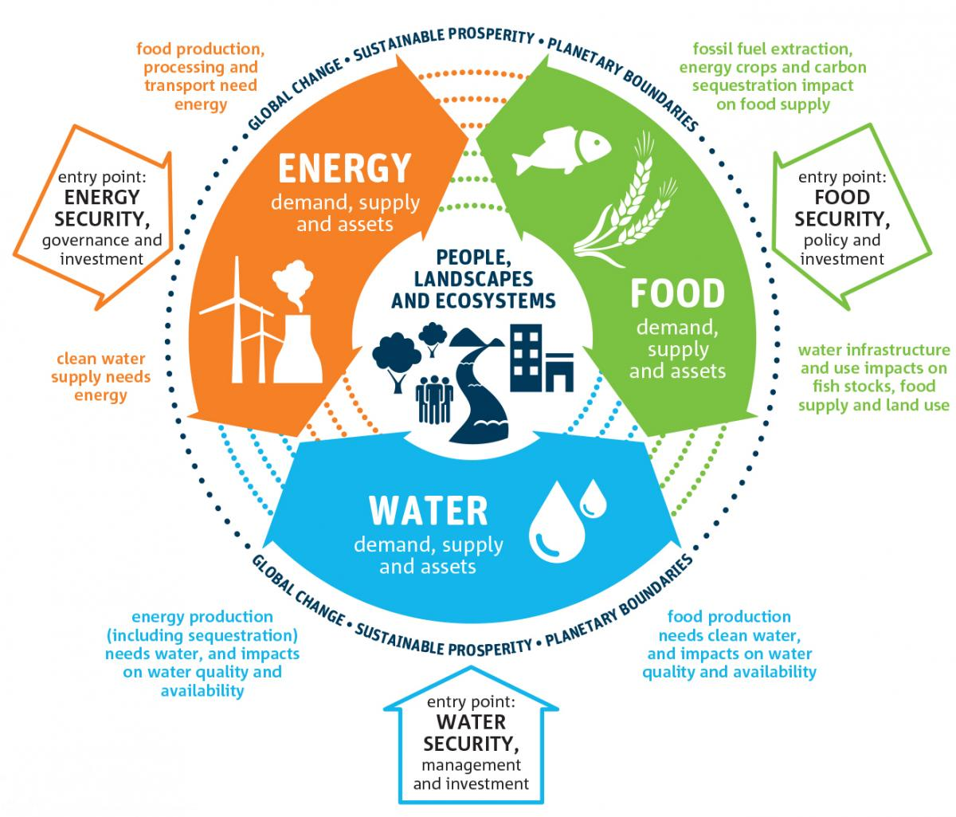
Authentic Purpose-Food Sustainability
Food systems significantly impact the environment at every level.
Food, water and energy systems are inextricably linked.
Modern food systems must adapt to support global population growth
Notes:
All students can connect to food in some way

Slide 13
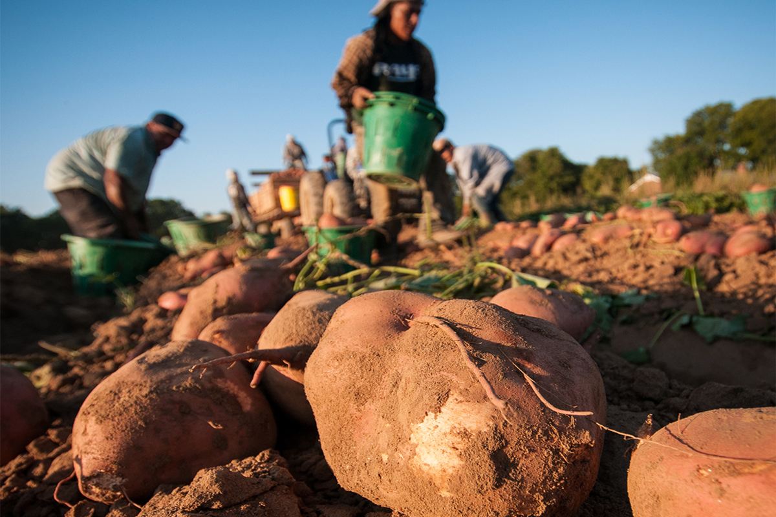
Environmental Literacy for Justice
Experience productive struggle and failure in farming.
Learning experience that is relevant and meaningful.
Systems thinking
Notes:
When students learn how to grow food and how agriculture works, they can make better choices and actions. It is not our job to tell them what to eat, where to buy food or how to feel about policies. Our job is to equip them with knowledge in a manner that is relevant to their schools and communities.
Students develop systems thinking which is important to understanding complex environmental challeges like climate change.

Slide 14
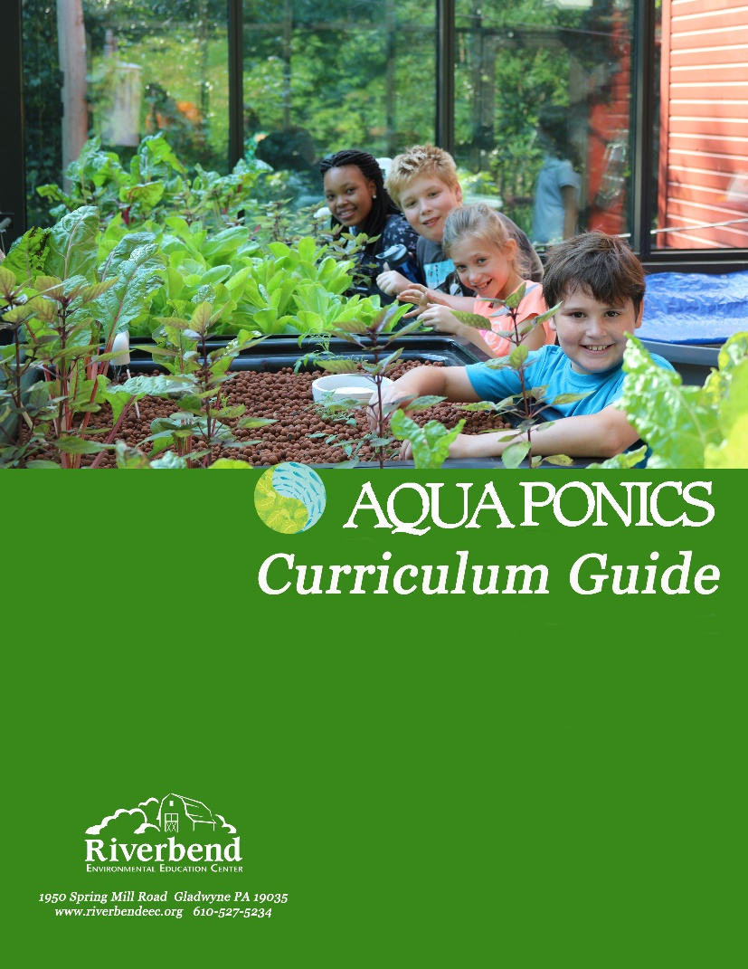
Building STEM skills through aquaponics
Classroom systems with technical support
Activity guide
Classroom programs
Field trips
Teacher professional development

Slide 15
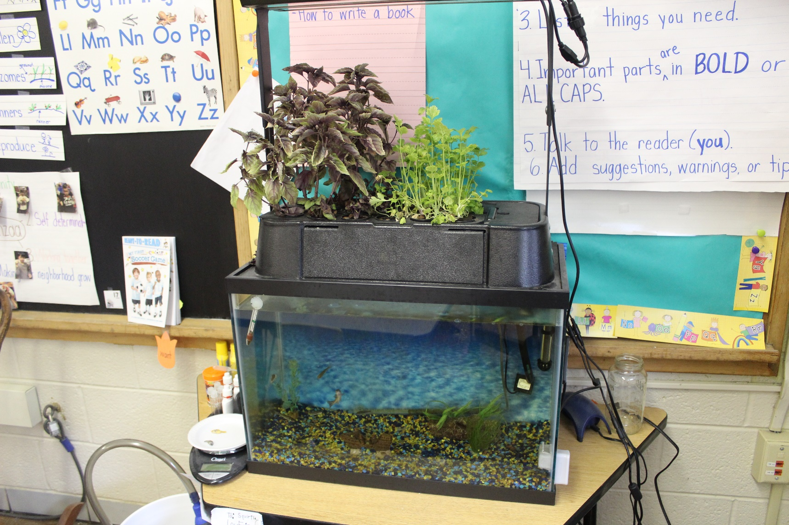
Integrating Aquaponics
Adapted curriculum to 3-5th grade
Aquaponics specialist spends 8-10 hours with each teacher.
System needs to be functional to support lessons.
Teacher is supported in student led maintenance

Slide 16
Next steps
Seek out sustainable funding for research and program scale
Challenges to recruitment and retaining teachers
Address challenges identified in research
Greater alignment to eligible content/curriculum
More examples of inquiry based instruction
Great support for social network building (online platform)

Slide 17
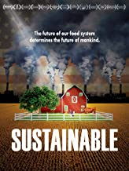
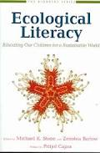
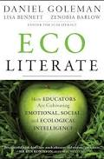
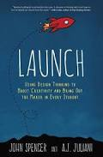
Environmental Education Resources
www.riverbendeec.org
NAAEE.org
www.beetlesproject.org
http://www.foodspanlearning.org/
https://www.un.org/sustainabledevelopment/sustainable-development-goals/
https://www.theatlantic.com/education/archive/2013/09/study-students-really-do-learn-stuff-on-field-trips/279720/
Erin McCool
Director of Education and Strategic Initiatives
emccool@riverbendeec.org
@emccooldelong
@riverbendenviro
#riverbendeec
#naturebasedSTEM
#RBaquaponics

