Slide 1
Applying the Meaningful Watershed Education Experience in Support of Community Resilience
Bart Merrick & Elise Trelegan | NAAEE 2019
Source: High Tide In Dorchester
Notes:
Bart

Slide 2
Big Ideas
Resilience is an emerging topic in EE and EE educators can play a key role in helping folks understand the topic as well as support individual and community resilience
The Meaningful Watershed Educational Experience is an approach to EE programming that supports resilience education
Both mitigation and adaptation are necessary given the pace of climate change and the magnitude of impacts.
Notes:
Bart

Slide 3
“Strategies for mitigation and for upscaling adaptive risk management are necessary going forward. Neither is adequate in isolation given the pace of climate change and magnitude of its impacts.”
Future Earth, 2019
Notes:
Bart

Slide 4
What is Resilience?
- Resilient young people feel a sense of control over their own destinies. They know that they can reach out to others for support when needed, and they readily take initiative to solve problems. ... They also help by being resources, encouraging student decision-making, and modeling resilient competencies.
- Emotional resilience is defined as how you roll with the punches, how you handle and adapt to stressful situations. Emotionally resilient people understand what they're feeling and why. They persevere and believe that they are in control of their lives, and they are optimistic and believe in their own strength.
- Academic resilience means students achieving good educational outcomes despite adversity. For schools, promoting it involves strategic planning and detailed practice involving the whole school community to help vulnerable young people do better than their circumstances might have predicted.

Slide 5
Defining Resilience
From the Climate Resilience Toolkit:
Resilience is the capacity of a community, business, or natural environment to prevent, withstand, respond to, and recover from a disruption.
Example: Installation of backflow preventers in the stormwater systems of a coastal city increased their resilience to flooding from extreme high tides.
NOAA Environmental Literacy Grants Program
Social-ecological resilience implies a system can adapt and transform in order to maintain processes in response to steady and small-scale shifts or in the face of overwhelming change. Enhanced social-ecological resilience allows communities to more effectively anticipate environmental hazards and to better plan to reduce losses.
Notes:
Bart
From the Climate Resilience Tool Kit: Resilience
The capacity of a community, business, or natural environment to prevent, withstand, respond to, and recover from a disruption.
Installation of backflow preventers in the stormwater systems of a coastal city increased their resilience to flooding from extreme high tides.
NOAA Env. Lit. Grants
Social-ecological resilience implies a system can adapt and transform in order to maintain processes in response to steady and small-scale shifts or in the face of overwhelming change. Enhanced social-ecological resilience allows communities to more effectively anticipate environmental hazards and to better plan to reduce losses.
Edutopia:
Resilient young people feel a sense of control over their own destinies. They know that they can reach out to others for support when needed, and they readily take initiative to solve problems. ... They also help by being resources, encouragingstudent decision-making, and modeling resilient competencies.
Emotional resilience is defined as how you roll with the punches, how you handle and adapt to stressful situations. Emotionally resilient people understand what they're feeling and why. They persevere and believe that they are in control of their lives, and they are optimistic and believe in their own strength.
Academic resilience means students achieving good educational outcomes despite adversity. For schools, promoting it involves strategic planning and detailed practice involving the whole school community to help vulnerable young people do better than their circumstances might have predicted.

Slide 6
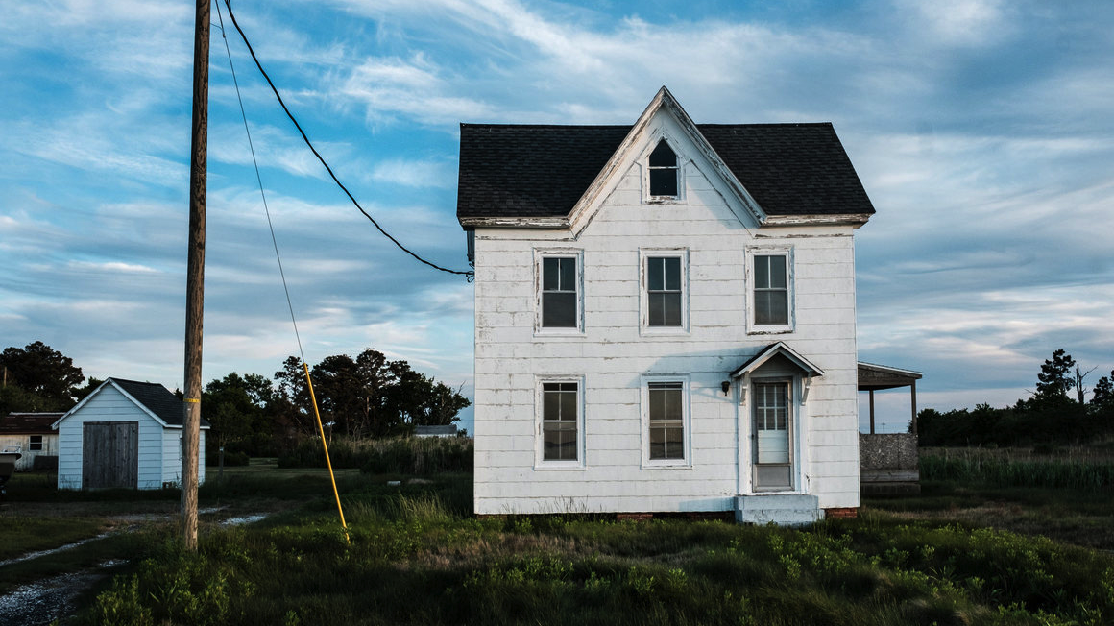
Smith Island, Maryland
Source: Atlas Obscura
Notes:
Bart

Slide 7
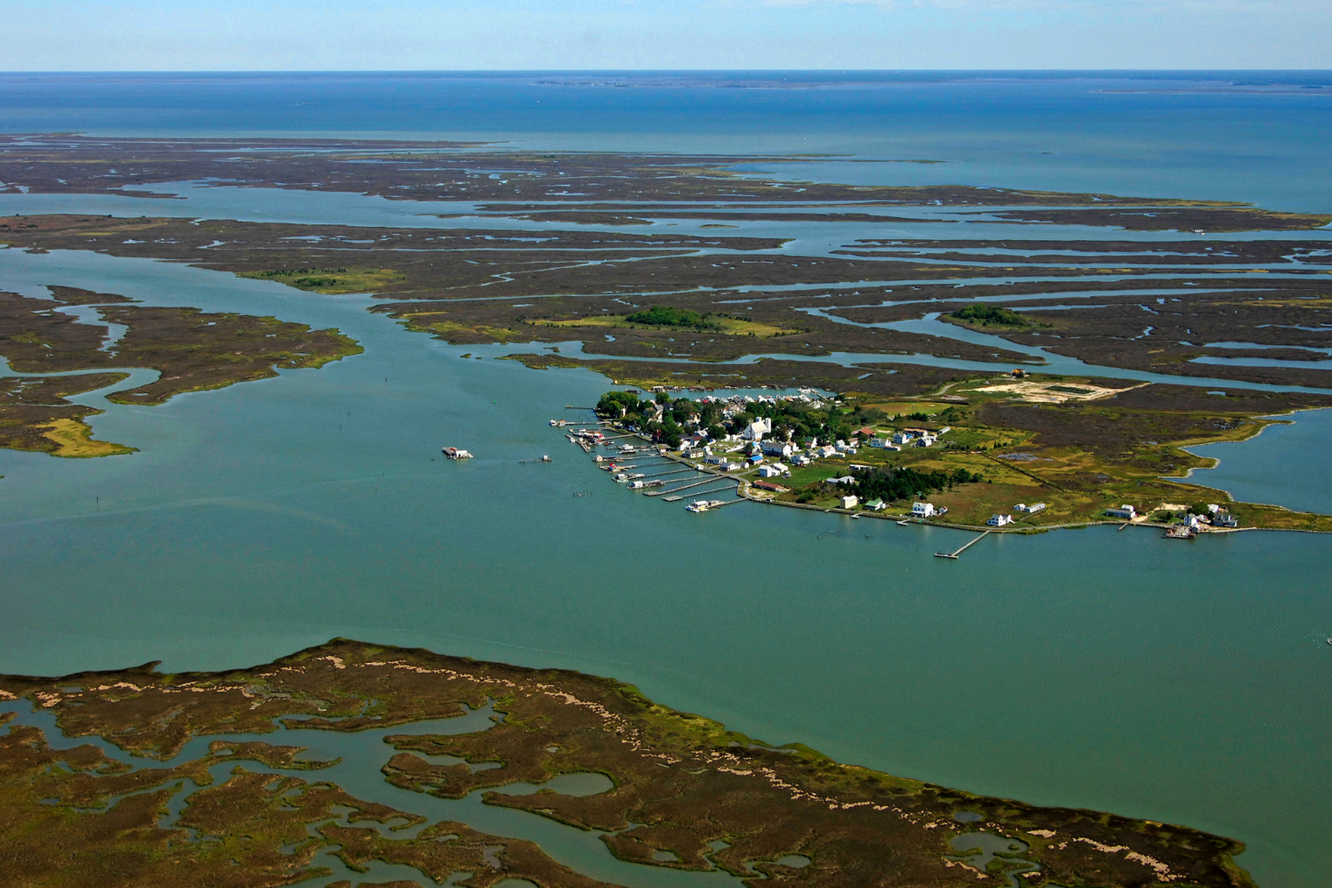
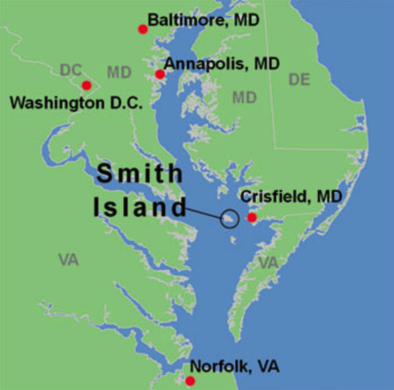

Slide 8
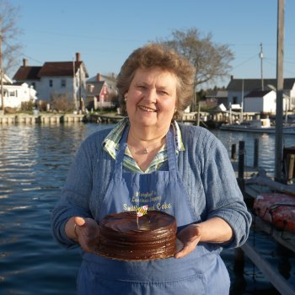
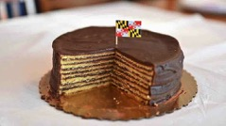
Mary Ada Marshall
Lifelong resident of Smith Island
Family makes a living off the water and cakes
Raised her children on the island, church is on the Island, friends are on the Island…
But...life is not easy on the island

Slide 9
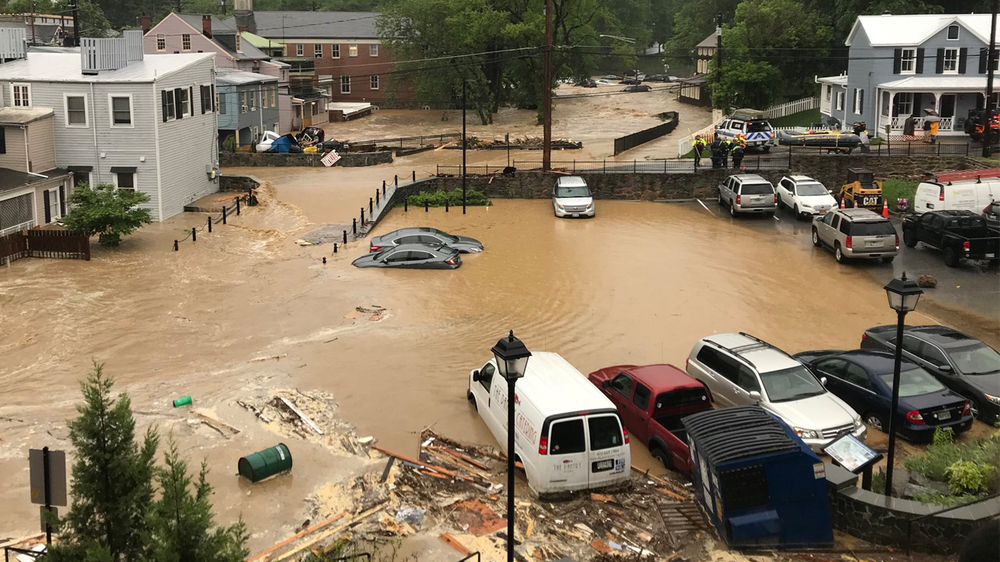
Ellicott City, Maryland
Source: KTVU News
Notes:
Elise

Slide 10
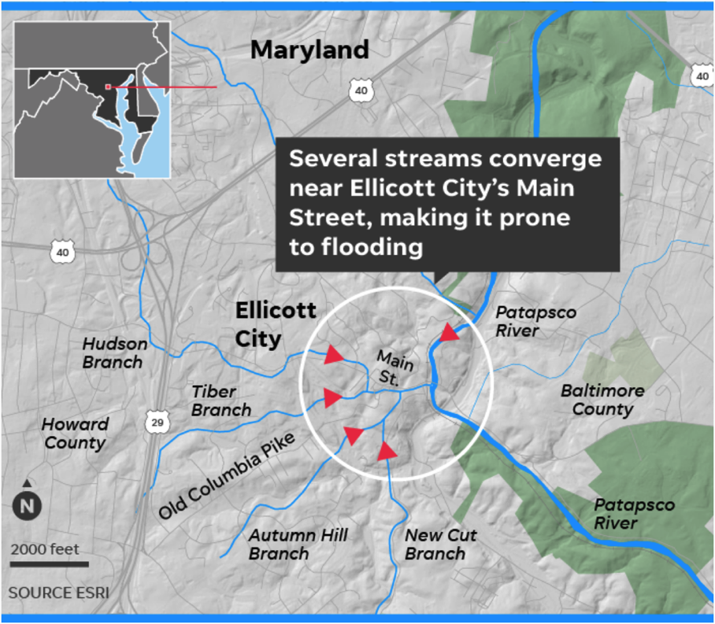

Slide 11
Calling the issues what they are. $3.4 million in the state capital budget
Notes:
Elise

Slide 12
“I’m really sad, but I genuinely think that by taking my house down that the people who are upstream from me are going to be safer… And then the logical reaction is, all right well, my son will need less therapy if we’re not living on top of this river all the time.”
NPR Interview, October 9, 2019
Notes:
Elise https://www.npr.org/2019/10/09/768697825/how-a-proposal-to-reduce-flood-risk-in-ellicott-city-nearly-destroyed-the-commun

Slide 13
What’s your resilience story?
Notes:
Elise

Slide 14
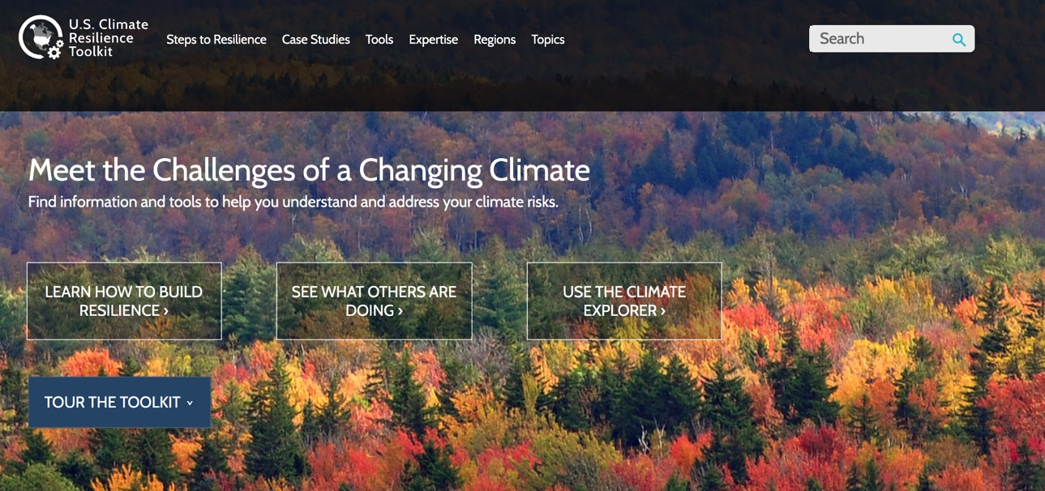
US Climate Resilience Toolkit
https://toolkit.climate.gov/

Slide 15
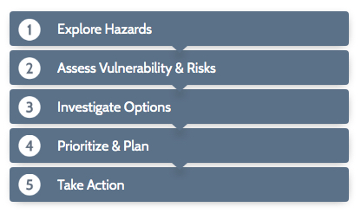
About the Steps to Resilience
A framework to discover and document climate hazards, then develop workable solutions to lower climate-related risks.
Notes:
Bart

Slide 16
Explore Hazards
Gather a team of people who want to protect local assets
Check past weather events and future climate trends
List the things you value that could be damaged
Determine which of your assets are exposed to harm
After this exploration, you’ll discover if weather and climate represent a hazard to the things you value.
Notes:
Bart
“If you want to go fast, go alone. If you want to go far, bring others.”

Slide 17
2. Assess Vulnerability & Risks
Evaluate potential impacts to your assets
Assess each asset’s vulnerability
Estimate the risk to each asset
When your assessment is complete, decide if you can accept the risk that climate presents to your assets
Notes:
Bart

Slide 18
3. Investigate Options
Consider possible solutions for your highest risks
Check how others have responded to similar issues
Reduce your list to feasible actions
By the end of your investigation, you’ll have a list of solutions that stakeholders are willing to support.
Notes:
Bart

Slide 19
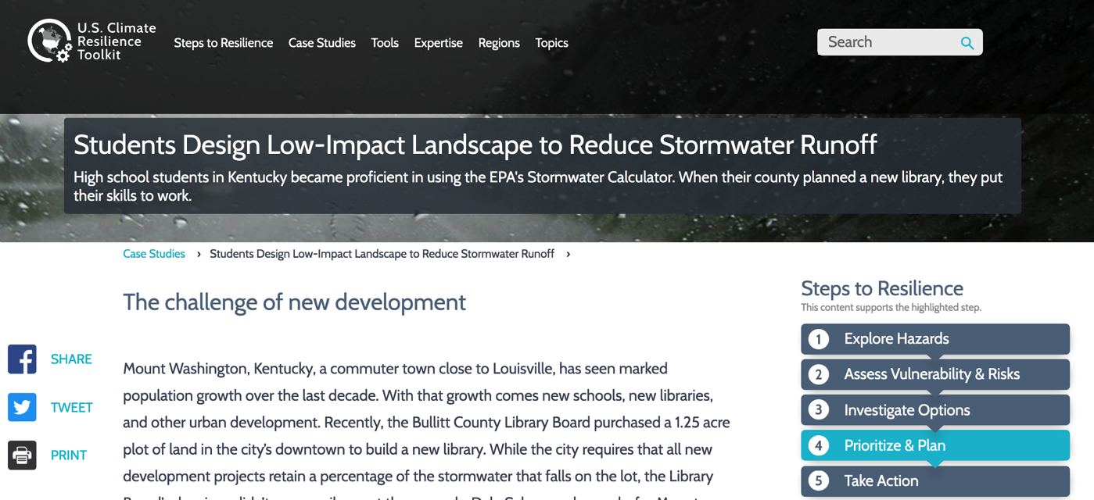
Kentucky Case Study Example?

Slide 20
4. Prioritize & Plan
Evaluate costs, benefits, and your team’s capacity to accomplish each action
Rank the expected value of each action
Integrate the highest-value actions into a stepwise plan
The result will be a comprehensive plan to implement your favored solutions.
Notes:
Bart

Slide 21
5. Take Action
Move forward with the stakeholders who accept responsibility and bring resources to take action
Check to see if your actions are increasing your resilience
As you move forward, you’ll monitor, review and report on your project.
Notes:
Bart

Slide 22
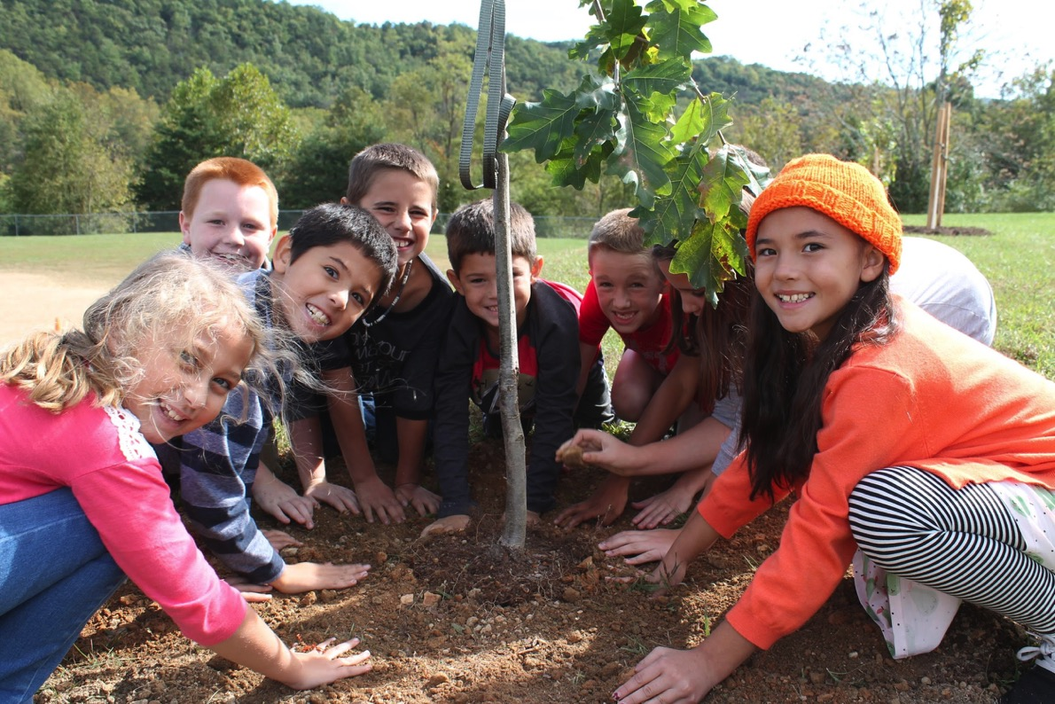
Meaningful Watershed Educational Experiences
Notes:
Elise

Slide 23
Issue Definition
Students focus on an environmental issue, problem, or phenomenon requiring background research and investigation.
Notes:
Elise

Slide 24
Outdoor Field Experiences
Students participate in one or more outdoor field experiences sufficient to investigate the issue. This may include collecting data or making observations. They may occur on school grounds or at an off-site location.
Notes:
Elise

Slide 25
Synthesis & Conclusions
Students identify, synthesize, and apply evidence from their investigations to draw conclusions and make actionable claims about the issue.
Notes:
Elise

Slide 26
Stewardship & Civic Action
Students brainstorm and evaluate solutions to the issue and then take action! Action comes in many forms but it should be student-driven.
Notes:
Elise

Slide 27
Steps to Resilience + MWEEs

Slide 28
Environmental Literacy Model - MWEE Example
Curriculum Anchor
Learning Objectives
Local Context
Driving Question
Issue Investigation
Ask Questions/ Identify Problems
Plan and Conduct Investigations
Analyze and Interpret Data
Construct and Communicate a Claim
Stewardship and
Civic Action
Identify Solutions
Plan and Take Action
Evaluate Action

Slide 29
Environmental Literacy Model
Curriculum Anchor
Learning Objectives
HS-ETS1-3. Evaluate a solution to a complex real-world problem based on prioritized criteria and tradeoffs that account for a range of constraints, including cost, safety, reliability, and aesthetics, as well as possible social, cultural, and environmental impacts.
Local Context
Regular flooding in Dorchester County (Cambridge)
Driving Question
How is SLR impacting the people and environment in Dorchester County, MD (Cambridge) and how can students help to build a more resilient Dorchester County?
Notes:
HS-ETS1-1. Analyze a major global challenge to specify qualitative and quantitative criteria and constraints for solutions that account for societal needs and wants.
HS-ETS1-3. Evaluate a solution to a complex real-world problem based on prioritized criteria and tradeoffs that account for a range of constraints, including cost, safety, reliability, and aesthetics, as well as possible social, cultural, and environmental impacts.
HS-ESS3-5. Analyze geoscience data and the results from global climate models to make an evidence-based forecast of the current rate of global or regional climate change and associated future impacts to Earth’s systems.
NGSS Practices (Multiple Opportunities)
NGSS Core Ideas (Patterns, Cause and Effect, Stability and Change)
C3 Framework for Social Studies:
Dimension 1: Developing Questions and Planning Inquiries
Dimension 2: Applying Disciplinary Concepts and Tools
Participation and Deliberation: Applying Civic Virtues and Democratic Principles ( Analyze the impact and the appropriate roles of personal interests and perspectives on the application of civic virtues, democratic principles, constitutional rights, and human rights.)
Dimension 3: Evaluating Sources and Using Evidence
Dimension 4 Communicating Conclusions and Taking Informed Action

Slide 30
Environmental Literacy Model
Issue Investigation 1
Asking Questions/Identify Problems
Using a variety of maps and data students learn about and consider how sea level rise and flooding impacts the natural and community resources in Dorchester County
Plan and Conduct Investigations
Students use available data to determine what natural and community are or will be impacted by flooding
Analyze and Interpret Data
What can be said about SLR impacts in Dorchester County
Constructing and Communicating a Claim
Student draw conclusions based on evidence for impacts and communicate these claims to teachers and community members

Slide 31
Environmental Literacy Model
Stewardship and Civic Action
Identify Solutions
Students use the Resilience Toolkit to learn about how other communities have addressed sea level rise and flooding issues and consider what might apply in their context
Students discuss action options with the community
Students determine what action they will pursue (decision making process)
Plan and Take Action
All students involved in planning and implementation process
Evaluate Action
Communicate about project with the broader community

Slide 32
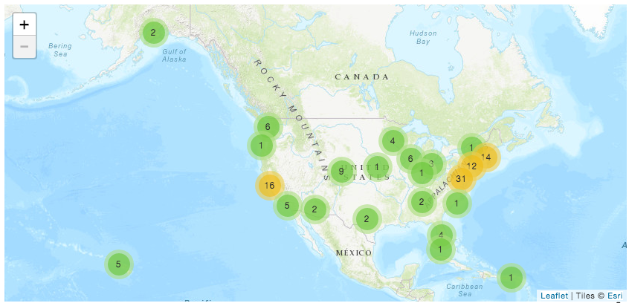
NOAA Environmental Literacy Grants and Resilience Education
Supporting Education program that use NOAA science to promote stewardship and informed decision making.
Notes:
Bart

Slide 33
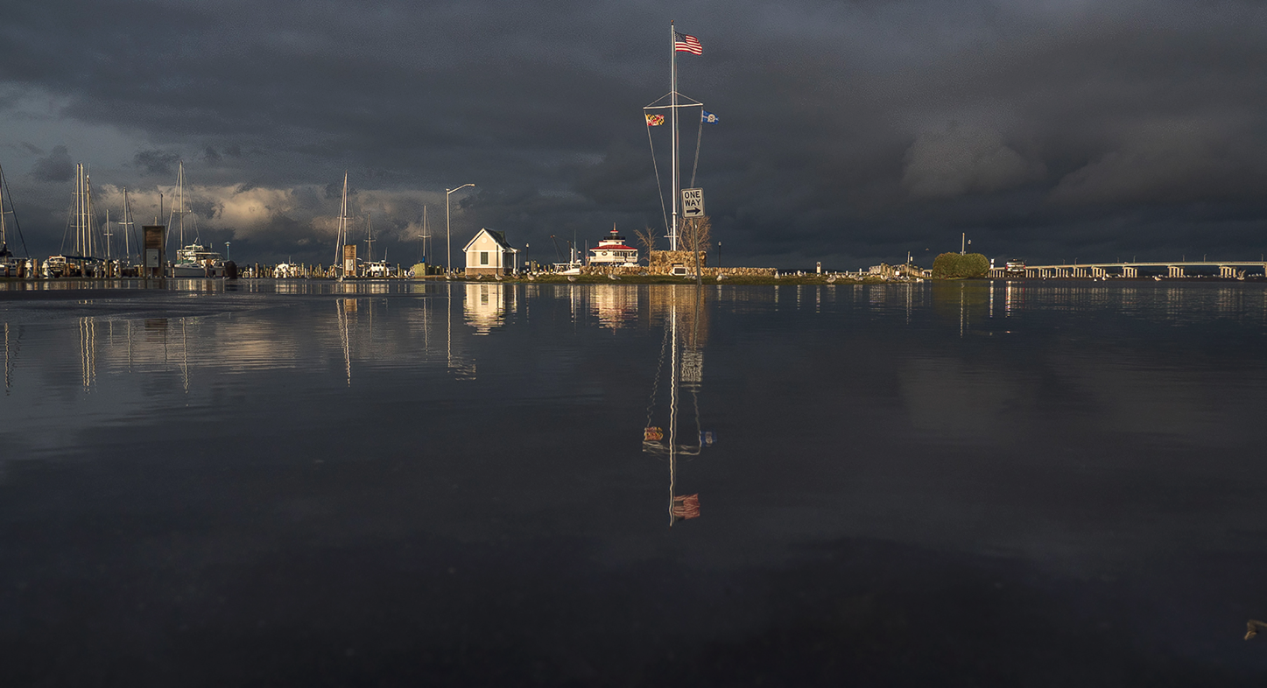
Source: High Tide In Dorchester
Notes:
Bart/Elise tag team

Slide 34
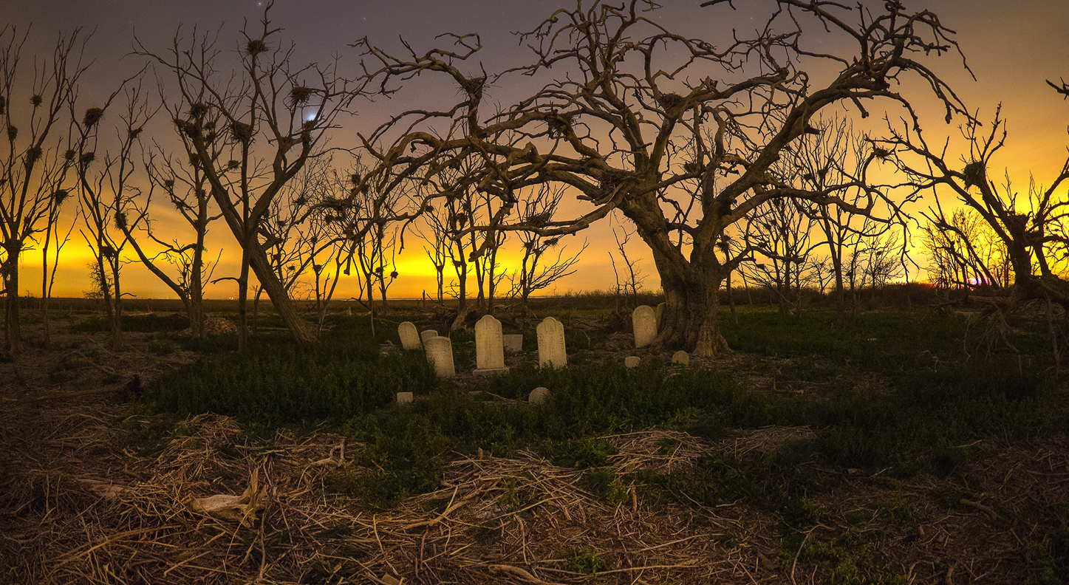
Source: High Tide In Dorchester
Notes:
Bart/Elise tag team

Slide 35
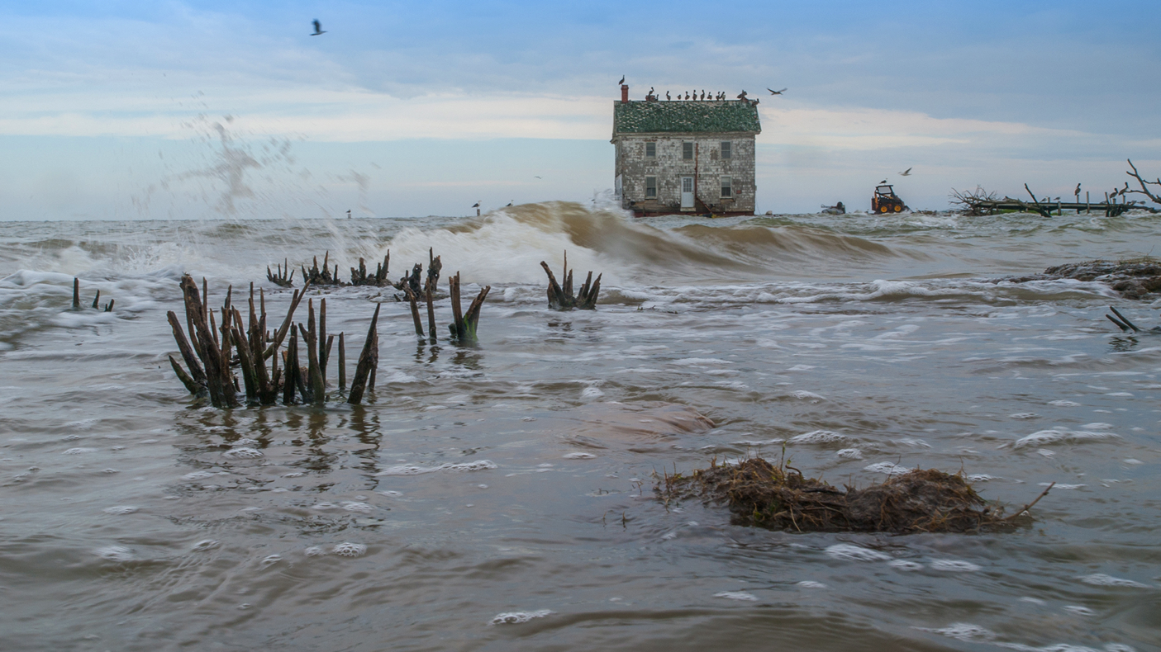
Source: High Tide In Dorchester
Notes:
Bart/Elise tag team

Slide 36
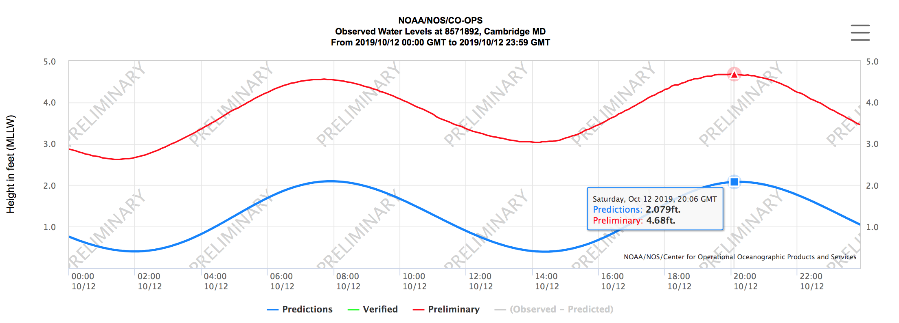
Last Weekend Tides Were 2.5’ Above Normal

Slide 37
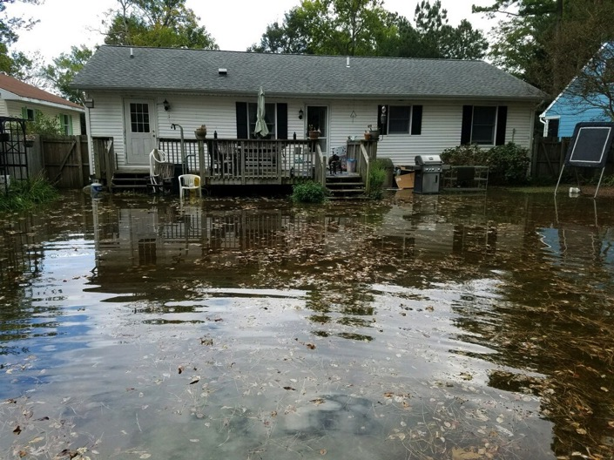
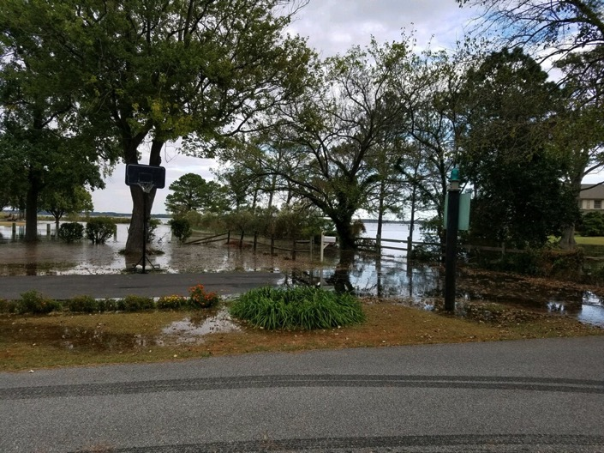
Last Weekend Tides Were 2.5’ Above Normal
Worst Flooding Since Hurrican Isabel in 2003

Slide 38
Based on the data sets provided (and other sources of knowledge/data) what problems or issues can you identify?
What claims could you make based on the data provided?
What might you be interested in investigating further?
What opportunities might there be for outdoor field experiences and investigations?
Opportunities for stewardship and/or civic action?
Notes:
Bart/Elise tag team

Slide 39
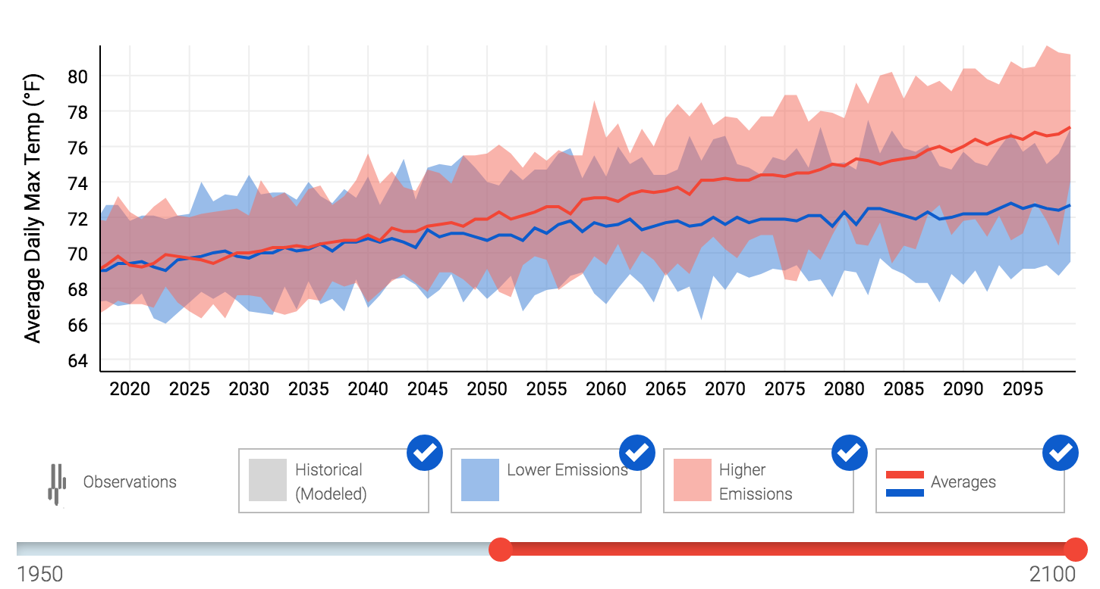
https://crt-climate-explorer.nemac.org/location/?county=Dorchester+County&city=Cambridge,%20MD&fips=24019&lat=38.56317440000001&lon=-76.07882919999997

Slide 40
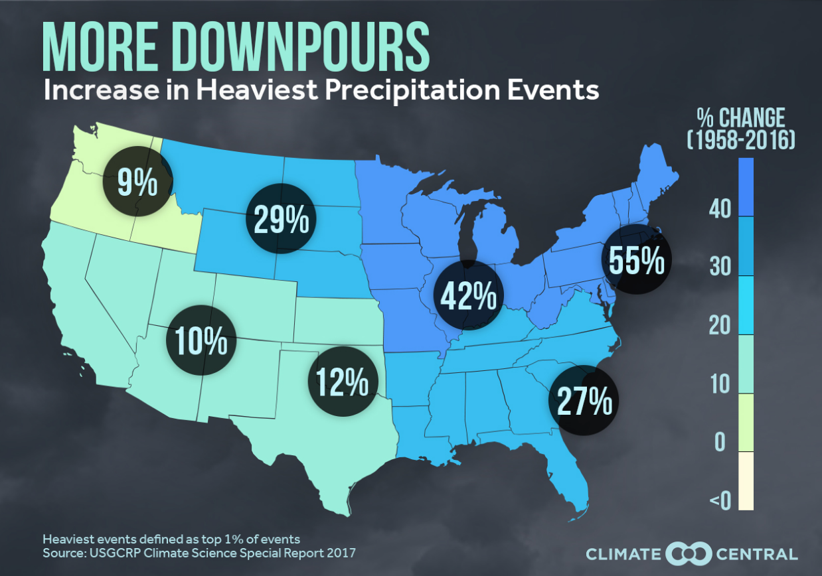
https://wxshift.com/news/graphics/more-downpours-increase-in-heaviest-precip-events

Slide 41
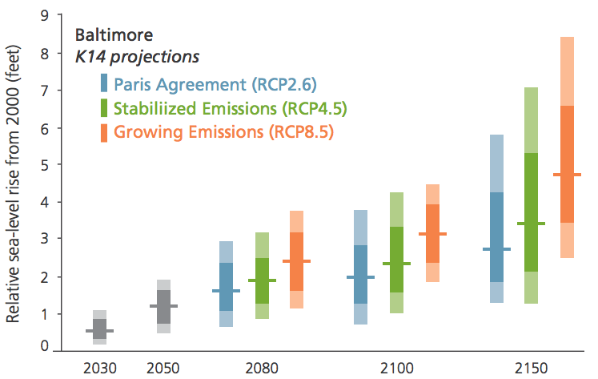
Sea Level Rise Projections

Slide 42
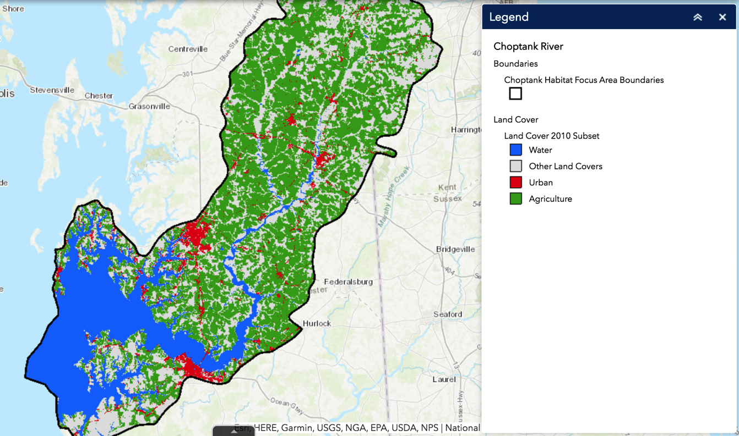
https://noaa.maps.arcgis.com/apps/webappviewer/index.html?id=54850fb8f903412da6cedd8f14ac96c8#

Slide 43
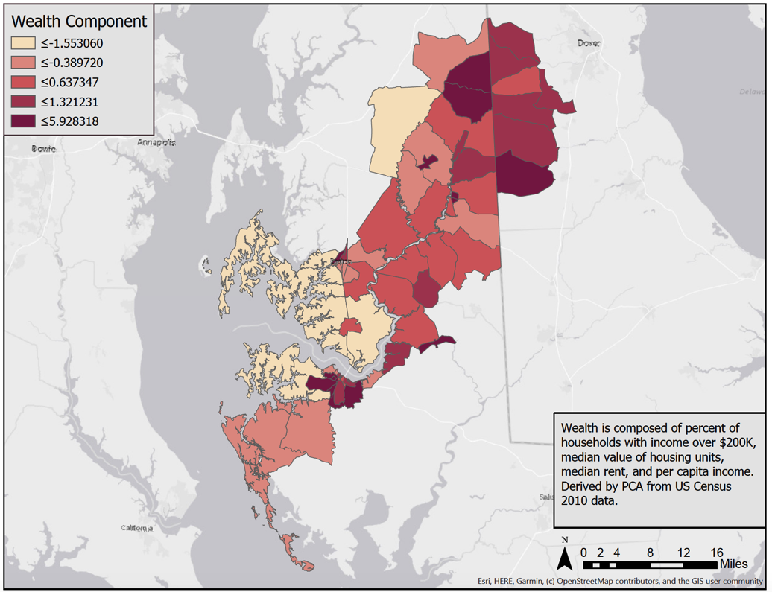
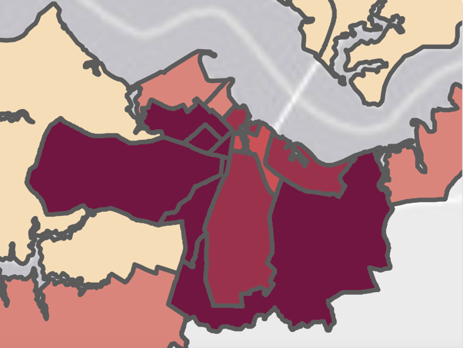
Cambridge, MD
Least Vulnerable
Most Vulnerable

Slide 44
Wrap up
How have you or how might apply some of these resources in your programming?
Notes:
Bart

Slide 45
NOAA Support for Resilience Education and MWEEs
NOAA Office of Education - Competitive funding opportunity designed to build environmental literacy of K-12 students and the public so they are knowledgeable of the ways in which their community can become more resilient to extreme weather and/or other environmental hazards.
Priority 1: New Projects in Southern and Western Regions of the US
Pre-applications due November 25.
Informational webinars today and October 21.
NOAA B-WET Program - Varies by region but all regions support MWEE programming
Chesapeake Region - Proposals due in February 2020

Slide 46
Resources:
Bart Merrick
bart.merrick@noaa.gov
Elise Trelegan
elise.trelegan@noaa.gov
Resilience Toolkit:
https://toolkit.climate.gov/#steps
MWEEs: www.baybackpack.com/mwee/what-is-a-mwee
MWEE 101 Online Course: http://bit.ly/MWEECourse

