Slide 1




Improving Climate Change Education
Dr. Martha C. Monroe, University of Florida
With:
Annie Oxarart, Alison Bowers, Willandia Chaves, &
Richard Plate

Slide 2
Climate change education is challenging
Invisible problem
Distant and global impacts
Political dimension
Embedded into every aspect of modern civilization
Controversy over solutions
Notes:
Educators have a lot of experience teaching about recycling, photosynthesis, and other aspects of environmental science, but this may not help us teach about climate change. The issue is different. It is hard to see and understand. The impacts vary around the world and may not be evident in some places. The issue is political, with a few leaders denying that it is a problem. And even for those who accept the scientific consensus on the causes of the problem, thinking about mitigation is overwhelming because fossil energy underpins almost everything in our society.

Slide 3
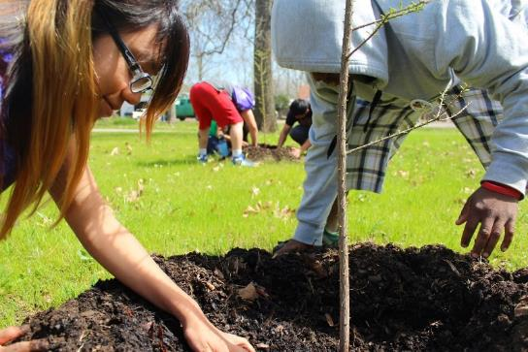
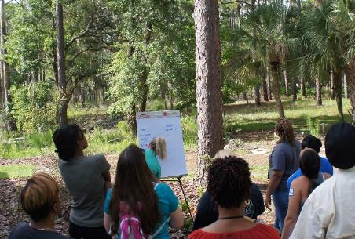
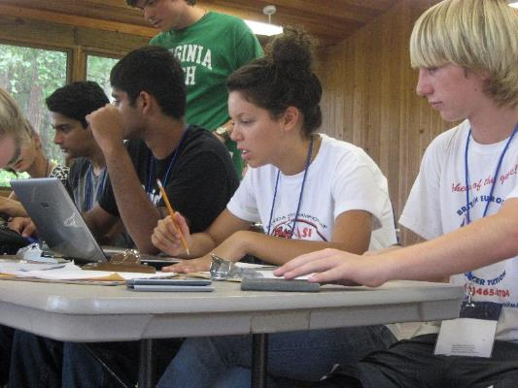
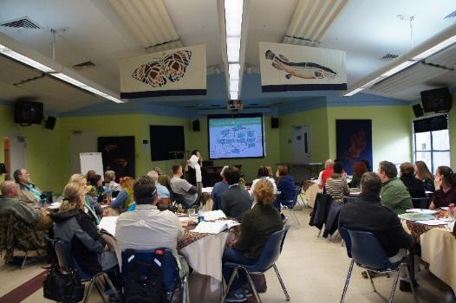
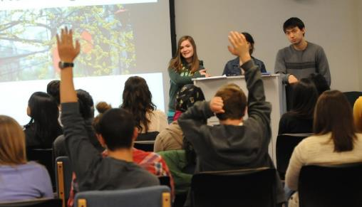
Climate Change Education
Notes:
Many educators are recognizing the importance of teaching about climate change and are engaging learners in lessons about climate science, mitigation, and adaptation strategies. This occurs in classrooms, workshops, nature centers, zoos and other community facilities around the world. There is a great deal of diversity in HOW information is conveyed, and also in WHAT information is conveyed.

Slide 4
Increasing Interest in Climate Change Education
Rise in research articles
Searched in Academic Search Premier with terms “climate change” and “education”
Notes:
Despite, or because of these challenges, we have seen a huge and recent interest in research on climate change education. If you search on the terms “climate change” and “education” and limit the articles to the decade between 1990 and 1999, you will only find 12 peer-reviewed research articles. But in the six years between 2010 and 2015, those same terms will get you nearly 1500 articles. That is a lot of new information!

Slide 5
Our Project – A Systematic Review
The Search
In or Out
“What aspects of climate change programs are working?”
1,019 abstracts
49 Papers
Common Themes
Notes:
I led a project to identify and review articles that provided evidence of the impact of climate change education. Our initial search turned up over 1000 English, peer-reviewed articles. We only looked at articles in research journals – because those are searchable. We know there is a lot of wisdom in other places, such as program evaluation reports, conference proceedings, and in other languages. So this is not the whole story, just one chapter.

Slide 6
Decision Tree
Meets basic format requirements? (i.e., exclude book reviews, dissertations, unpublished conference paper, papers not in English, etc.)
Yes
Focus on climate change education?
No, 51
No, 475
Yes
Education intervention assessed?
No, 311
Exclude
Total: 893
Yes
Outcomes empirically measured and results reported?
No, 56
Yes 66
Upon full review:
17 excluded
(14 failed decision tree
3 questionable quality)
Final sample of 49
6 themes
3 categories
Notes:
Here is the decision tree that enabled us to select those 49 papers. Within our team of 5 people, two people read each abstract and decided if it met our search criteria. Our criteria included four questions: peer reviewed paper? About climate change education? Testing an intervention? Reporting outcomes? Most of the abstracts were excluded because they said education was important, as in a policy statement, or described what climate education ought to achieve. We selected only those that evaluated some type of program. Those 49 articles helped us identify 6 themes, which I will explain through three broad categories.
This was a systematic review of the literature, which means others should be able to use the same terms and criteria and come up with the same findings. It can be a robust process to synthesize the literature.

Slide 7
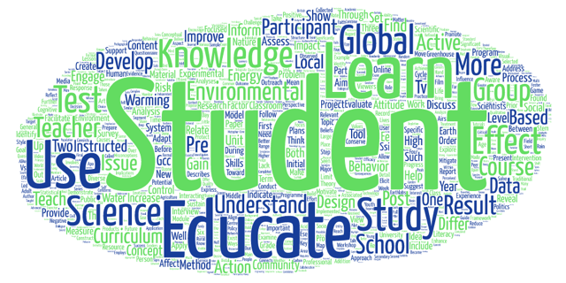
Context Varied
Schools (28) or universities (11)
  Classroom-based (26/28)
  Elementary programs not typical
Youth outside of school, training programs, non-formal settings (7)
Just over half in the US (26); 12 other nations represented
Positive outcomes in changes knowledge, attitudes, behavior
Word cloud created from 49 article abstracts
Notes:
Most of the papers reported on learning in classrooms with youth 13 to 20 years old. Some involved teacher training programs, and some were out-of-school programs. About half occurred in the U.S. and the rest were from 12 different nations. They all reported increased knowledge, attitudes, or actions. We didn’t subdivide the group to compare papers, we kept them together in one group of 49 papers.

Slide 8
And Goals Varied Too
Most focus on climate science and climate literacy
  Understand Earth’s climate system, greenhouse effect, evidence of change
  Impact of change on ecosystems and human systems
  Assess credible information, Communicate meaningfully, Make informed decisions
Some programs empowered learners to affect change
  Community action projects
And some use climate change as a tool to help learners envision a new world
  Personal and societal transformation, Community engagement (Kagawa and Selby, 2010)
Notes:
The purposes of the educational programs also varied. Most focused on explaining climate science, but some went beyond the science to engage learners in projects, behavior change, or working toward social change.

Slide 9
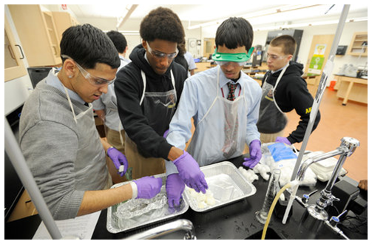
1. Effective climate science education is relevant, interesting, and engaging
Notes:
The first category reflects the ways teachers conveyed climate science. It was most effective when it was relevant to the learners, interesting, and engaging.

Slide 10
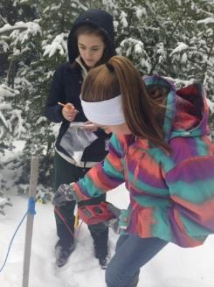
Find relevant impacts
Water availability
Invasive exotic species range
Sea level rise
Native species range elevation
Agricultural crops
Fire risk
Collect and analyze local data, meet with scientists, download their data
Notes:
As we know, relevance and interest are essential for learning. But because climate change may be distant, global, and hard to measure, it is more challenging to make relevant and engaging. In these papers educators found ways to link climate change to impacts and risks to agriculture and ecosystems. They didn’t just talk about carbon and temperature, they talked about water and food. In many cases students collected data, analyzed it, and looked at trends. Sometimes this enabled them to interacted with local scientists.

Slide 11
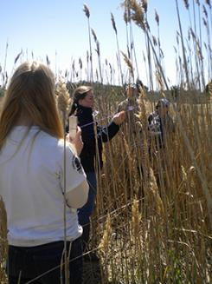
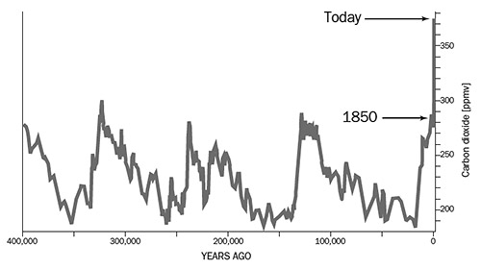
Help students review the data and come to their own conclusions
Notes:
This approach to learning science by doing science enabled learners to come to their own conclusions about climate trends.

Slide 12
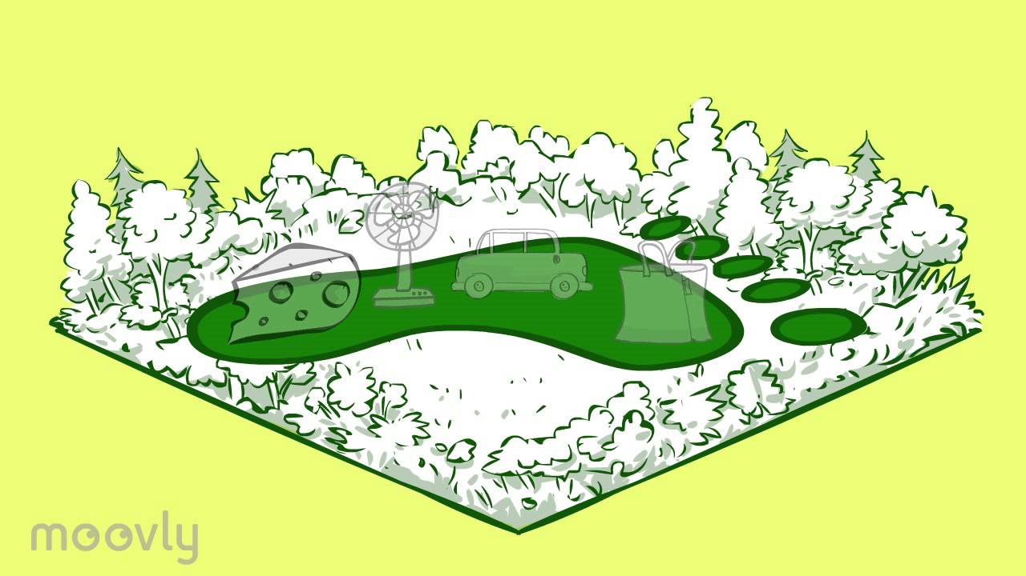
Cordero et al. (2008) Climate Change Education and the Ecological Footprint
Example:
Explore personal lifestyle
Ecological footprint activity
  increased knowledge of connections between energy use and greenhouse gas emissions
  Increased personal and social understanding of climate change
Notes:
In one example, students looked at their ecological footprint and realized their energy use created carbon emissions and affected the climate. This helps make climate change personal and relevant and encouraged them to think about personal choices, such as meat consumption.

Slide 13
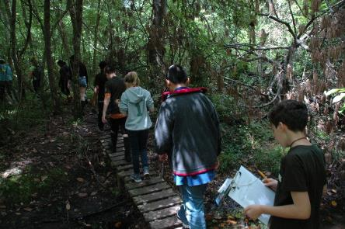
Active and engaged teaching methods
Simplify complexity, engage learners, and create enjoyable activities
  Video, role play, cartoon worksheets, simulations
  Computer-based visualizations
  Complex system interactions
Debates, small group discussions, worksheets to process and reflect on what was experienced
Notes:
Teachers used a variety of strategies to make lessons experiential and engaging, like role plays, videos, debates, worksheets, and computer models.

Slide 14
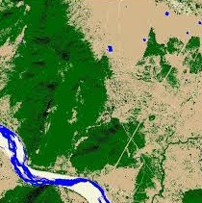
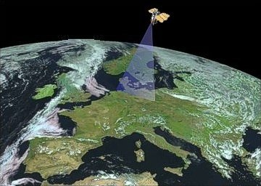
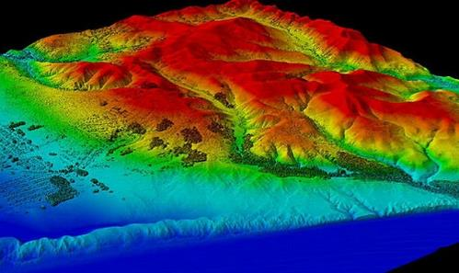
Example: Geospatial Technology
Undergraduate and graduate students
Used GIS, remote sensing, and satellite data:
  Learn about climate change
  Understand how scientific knowledge is created
Results indicated an increase in students’:
  Content knowledge
  Self-reported awareness, confidence, and understanding
Cox et al. (2014) - Using remote sensing and geospatial technology for climate change education
Notes:
In another example, this time an evaluation of university classes in remote sensing, the instructor taught students to use data from GIS programs and satellites to map snow cover and deforestation. Pre and post tests showed that students’ content knowledge increased significantly. Students also reported increases in their awareness, confidence, and understanding about climate change.

Slide 15
Good climate science education
Personal
Local
Engaging
Experiential
Collecting data
Analyzing data
Is relevant
Is interesting
Uses data
Notes:
So to summarize our first theme of relevant, interesting, and data-based education, educators used a variety of strategies to meet these goals. They used personal and local impacts, engaging and experiential activities, and collected or analyzed their own data to help learners draw their own conclusions.
ADD ARROWS
Of course these strategies work together! Collecting your own data makes the activity relevant, Local topics tend to be interesting, and analyzing and making sense of relevant data is interesting.

Slide 16
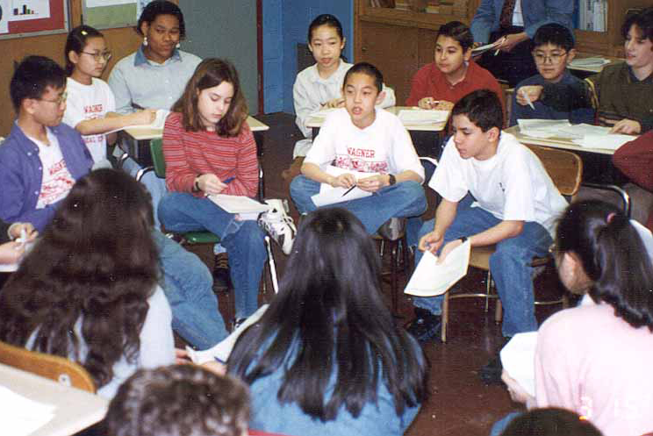
2. Effective climate change education builds problem solving skills to create solutions
For the classroom
In the community
Notes:
And here is our second category. In our review, some papers stressed that it wasn’t enough to convey climate science, educators should empower learners to work toward change. This tended to involve learning skills, debating options, and doing projects. Projects could be class assignments or community activities. And this is good environmental education or education for sustainable development – just a bit more challenging in the context of climate change.

Slide 17
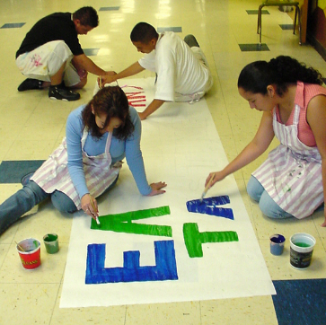
  School projects
Help learners identify and address problems and solutions at the same scale
Build problem solving, action taking, and leadership skills
Notes:
Classroom projects included assignments like writing short messages for a radio station or making videos to convey climate change implications. They even showed the videos to the public. These projects helped learners gain skills and understand the impact of scale so that they will use their efforts to affect an appropriately local problem.

Slide 18
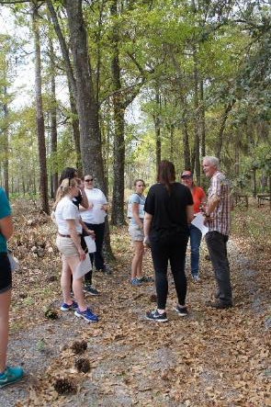
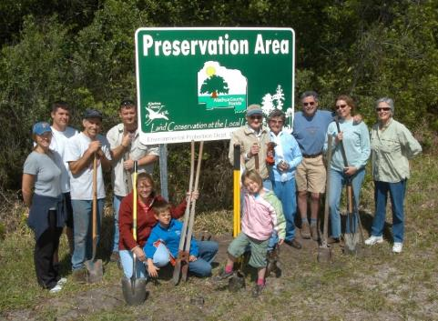
  Community projects
Engage learners with community members to mitigate or adapt to climate change
Notes:
Some educators used field experiences to connect learners with those at risk of impacts of climate change. Students worked with these farmers to help them adapt. Completing a community project increased confidence and efficacy as learners gained skills.

Slide 19
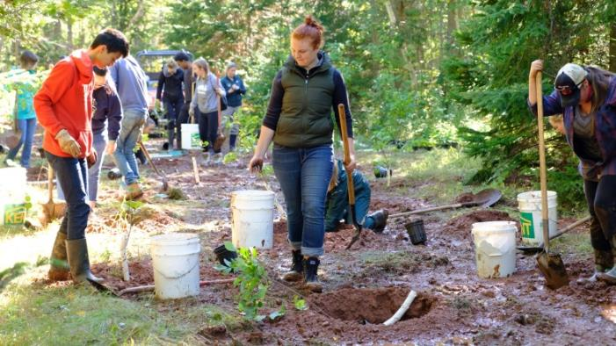
Example:
Community Action Program
13-14 year old students
Climate change research in community
Create videos to educate other students
Planned and implemented action projects
“Encouraged the emergence of feelings of empowerment relating to the capacity to make a difference” Pruneau
Pruneau et al. (2003) – Experimentation with a socio-constructivist process for climate change education
Notes:
In Canada, for example, educators helped 13 and 14 year old students research local climate change impacts and share their findings with others through pamphlets and videos, then implement action projects. These included a “lunch without waste” project and planting tree with signs of their value to the ecosystem. The authors measured changes in students’ ideas about many aspects of climate change, including impacts to the local region and their personal lives, and the noted that the action projects “encouraged the emergence of feelings of empowerment relating to the capacity to make a difference.”

Slide 20
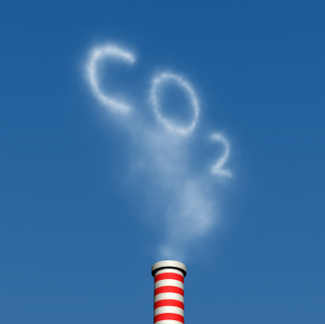
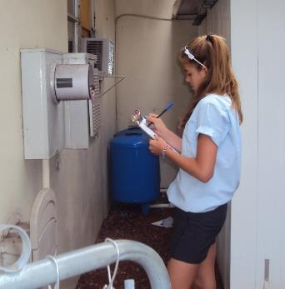
Example:
Energy conservation at school and at home
Collecting data and monitoring energy use in classrooms
Sharing information with parents, conserving energy at home
Leigh (2009) – Energy busters: Norfolk schools fight climate change
Zografakis et al. (2008) – Effective education for energy efficiency
Notes:
In England youth tackled school energy efficiency, and in Greece students took the message home to help conserve energy and reduce greenhouse gases. Pre and post surveys showed changes to energy efficient behaviors for both students and parents after participating in the program.

Slide 21
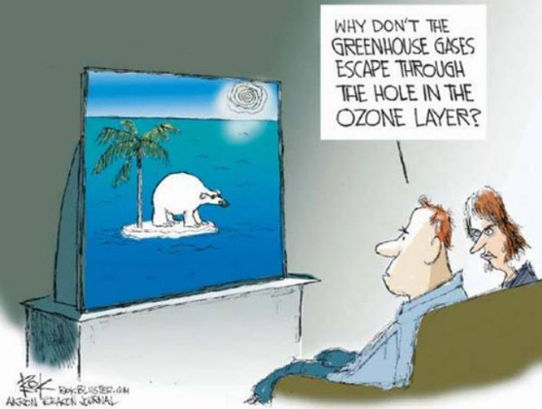
3. Effective climate change education helps learners construct and critique their own ideas
Notes:
The third category refers to misconceptions and conflicting worldviews – two things that make climate change education challenging. The papers suggest educators can help learners think about the way they think and generate more sufficient understandings. I don’t know if this is common practice for educators; it might represent an area where we could improve. Let me show some examples of what we included in this category.

Slide 22
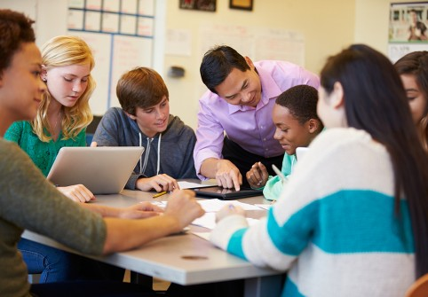
Example:
Teachers guide thinking with questions
When interpreting a graph, teachers ask:
  What does this graph show?
  How do you know?
  What is the evidence?
  Is that a claim or a generalization?
Students worked with data, examined the evidence, and discussed the scientific consensus
Content knowledge increased
Opinions about climate change shifted
Holthuis et al. (2014) - Supporting and understanding students’ epistemological discourse about climate change
Notes:
In this study from California researchers explored the nature of student conversations. The teachers were trained to facilitate the discussion with questions such as “How do you know?” or “What is the evidence for climate change?” The more students engaged and interacted with other students or the teacher the more they learned and changed their level of concern. What I find interesting is that environmental educators have a strong history of respecting others’ values and opinions about topics that involve ethical dilemmas, and here educators are applying some of those same strategies to factual science. Because it is possible to construct different ideas than what the communicator intended. It may be that issues that bring worldviews into conflict are best addressed with these teaching strategies.

Slide 23

Example:
Students critique their own ideas
Prompts from teachers help students explore reasons and evidence
Maybe the Earth’s core is heating up and change climate?
But that would not explain atmospheric carbon…
Mason and Santi (1998) - Discussing the greenhouse effect: children's collaborative discourse reasoning and conceptual change
Notes:
These teachers used discussions, questions, to guide students’ thinking so they realizes what they know, don’t know, and how they might better know what they know! In Italy, 5th grade students in discussion groups used their knowledge and reasoning to assess their own hypotheses about climate change. With some prompting from the teacher, students actually overcame their misconceptions about the causes of climate change. For example, they reasoned that global warming can’t be caused by volcanoes because the rate of eruptions has not changed much.

Slide 24
Example:
Worksheets can help simplify concepts and generate discussion
Simple drawings and cartoons convey information about the greenhouse effect
  Integrate previous knowledge
  Consider misconceptions
  Promote active cognitive processing
Requires understanding misconceptions and scientific explanation
Reinfried et al. (2012) - Improving students’ conceptual understanding of the greenhouse effect using theory-based learning materials that promote deep learning
Notes:
Worksheets were used in one study to simplify concepts and guide students through discussions. While this sounds easy, it only works when educators understand both the underlying cause of the misconception and the scientific explanation so well that they can convey the concept simply.

Slide 25
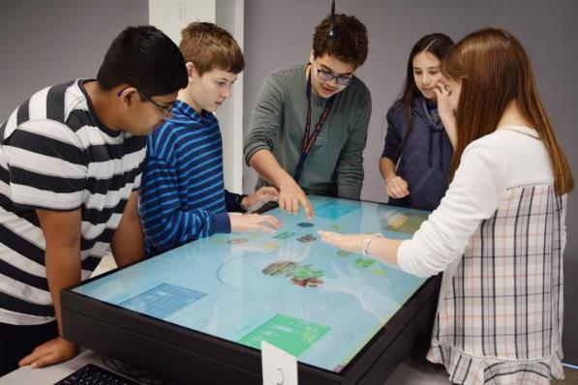
In Summary
49 papers from systematic review synthesized into 6 themes and 3 categories
Good climate change education is good education --
  Relevant, meaningful, engaging, experiential, social
It includes project-based work
It engages learners in exploring what they know, how they know it, and why
Notes:
In summary, our review of 49 papers that detailed evidence for effective climate change education suggest that three broad goals and a variety of strategies.
Climate science is conveyed with relevant impacts, engaging activities, and data collection or analysis.
Climate change education includes project work, in the classroom or community to build skills for solving problems and taking actions.
Educators can model their thinking and help students explore what they think and why to overcome misconceptions and critique perspectives.
It is worth considering whether any of these goals will be successful independently from the others. It may be that quality climate change education must endeavor to include all three components.

Slide 26
Looking for good climate change education…
Focuses on impacts of climate change on local, meaningful valued things
Uses activities that are engaging and experiential
Collects data, analyze data, interact with scientists
Plans a class project to share information, change actions, demonstrate change
Reflects on and discuss what they know, how they know it
Reflects on what it means
Notes:
Let’s think what would happen if we convert these themes into characteristics that we could use to create or critique climate change education programs.
Of course any one program may have difficulty using all of these strategies, but in general, if the topic focuses on local, meaningful impacts with engaging activities; if the students can collect some data or interact with scientists; if students can plan a project to share their knowledge or demonstrate change; and if the process of doing these things enables students to reflect on what they know, and how they know it, and what that means… it might be worth doing!

Slide 27
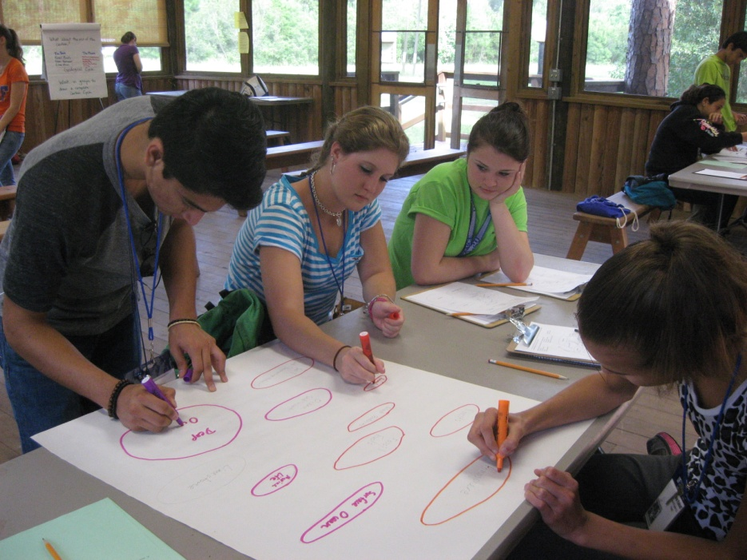
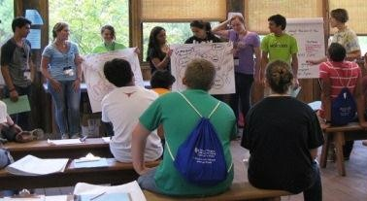
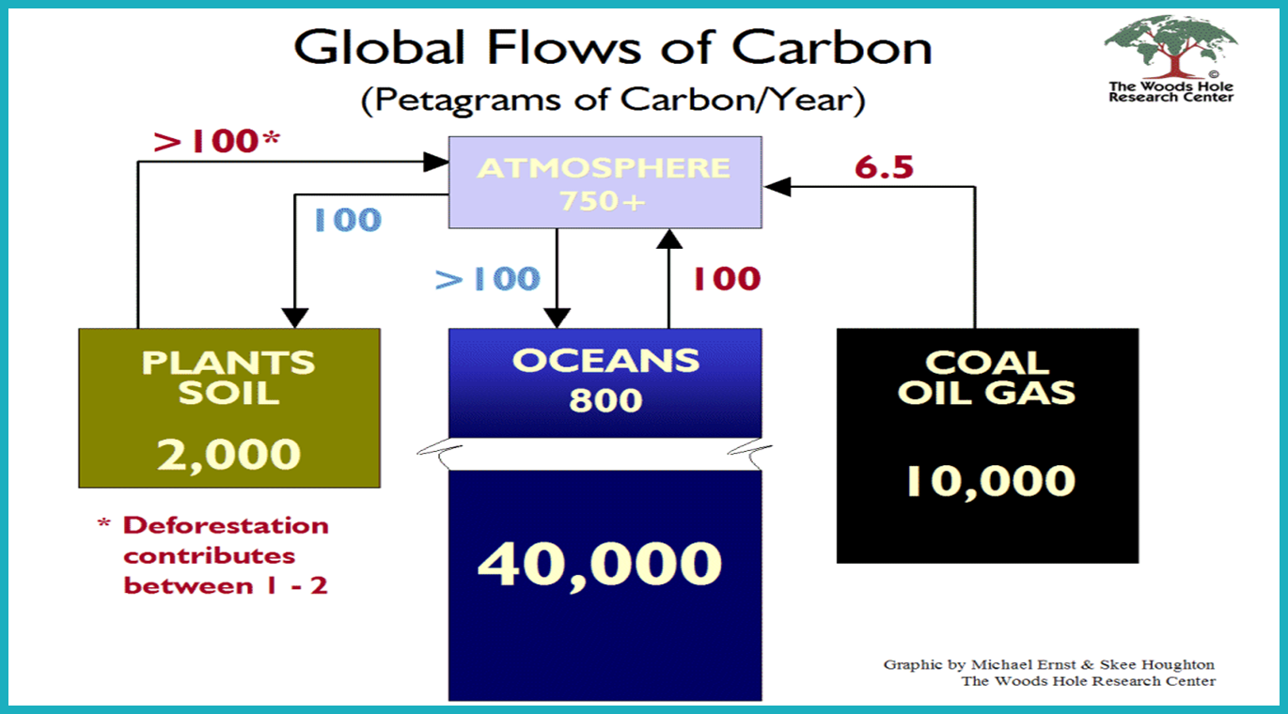
Carbon, Trees, and Consumer Actions
Students learn about the carbon cycle
Notes:
Here is one example – it is a program that I was involved with, Southeastern Forests and Climate Change. Students first learned about the carbon cycle.

Slide 28
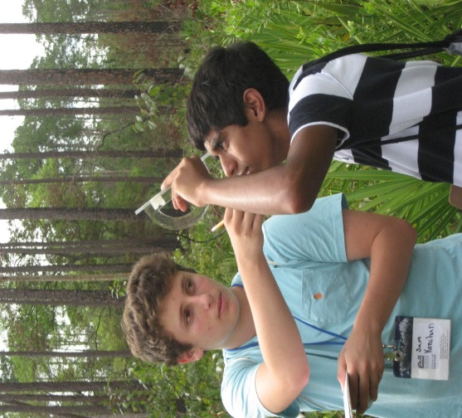
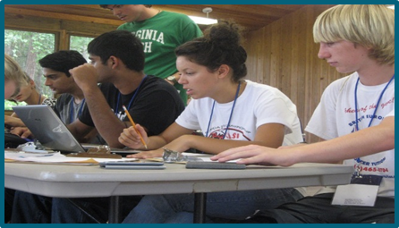
They measure the height and diameter of trees, calculate carbon in the forest, and convert that to carbon sequestration capacity for their state.
Notes:
And then measured carbon in trees and calculated how much carbon is sequestered each year in landscapes in their state and compared that to how much atmospheric carbon is generated by the people in their state.

Slide 29
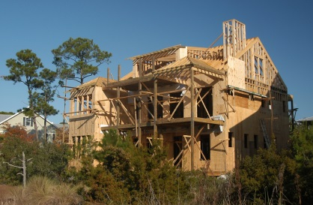

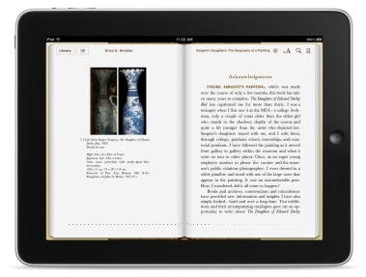


?
Paperback book
E-book
Students explore wood products, their life cycle and carbon emissions, and consider their choices as consumers
?
Plastic Bottle
Aluminum Can
Notes:
They also explore carbon in various products and think about the opportunities they have as consumers to make choices to reduce atmospheric carbon.

Slide 30
Was it good enough?
Goal | Quite good | Could be better | It all depends
Local, meaningful, valued | 
Engaging and experiential | 
Collect & analyze data | 
Interacts with scientists |  | 
School or community project |  | 
Discuss what and how they know it |  |  | 
Reflect on what that means |  |  | 
Notes:
How well might these activities score on our potential climate change education goals? It is definitely local, meaningful, relevant and engaging and experiential. There’s no project here, but there could be. And whether students discuss what they know and what that means depends on how the educators teach.

Slide 31
Was it good enough?
Goal | Quite good | Could be better | It all depends
Local, meaningful, valued | 
Engaging and experiential | 
Collect & analyze data | 
Interacts with scientists |  | 
School or community project |  | 
Discuss what and how they know it |  |  | 
Reflect on what that means |  |  | 
Instructional Resources
Community Resources
Professional Development and Preparation
Notes:
And if we think about how these elements might be encouraged, we can see that three different strategies could be used to improve climate change education. Some goals might be achieved if they were written into the instructional resources. Other goals probably depend upon teacher preparation and professional development to build teacher efficacy. Community resources could help encourage teachers to engage in community projects. It may take a concerted effort to create quality climate change education programs. And I would love to hear your thoughts about this.

Slide 32
Use the handout included in the virtual conference materials to consider how these themes apply to your climate change education programs

Slide 33
If you would like more information about this study…
Monroe, M. C., Plate, R. R., Oxarart, A., Bowers, A., & Chaves, W. A. (2017). Identifying effective climate change education strategies: a systematic review of the research. Environmental Education Research, 1-22. doi:10.1080/13504622.2017.1360842
And NAAEE is developing resources based on this review and already has a searchable list of the 49 papers: https://naaee.org/our-work/programs/eeworks

