Slide 1
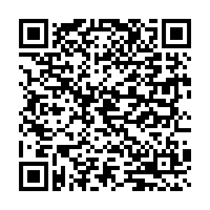
Learning from Nature: STEAM Investigations for the Elementary Classroom
October 18, 2019
Alyson VanAlphen

Slide 2
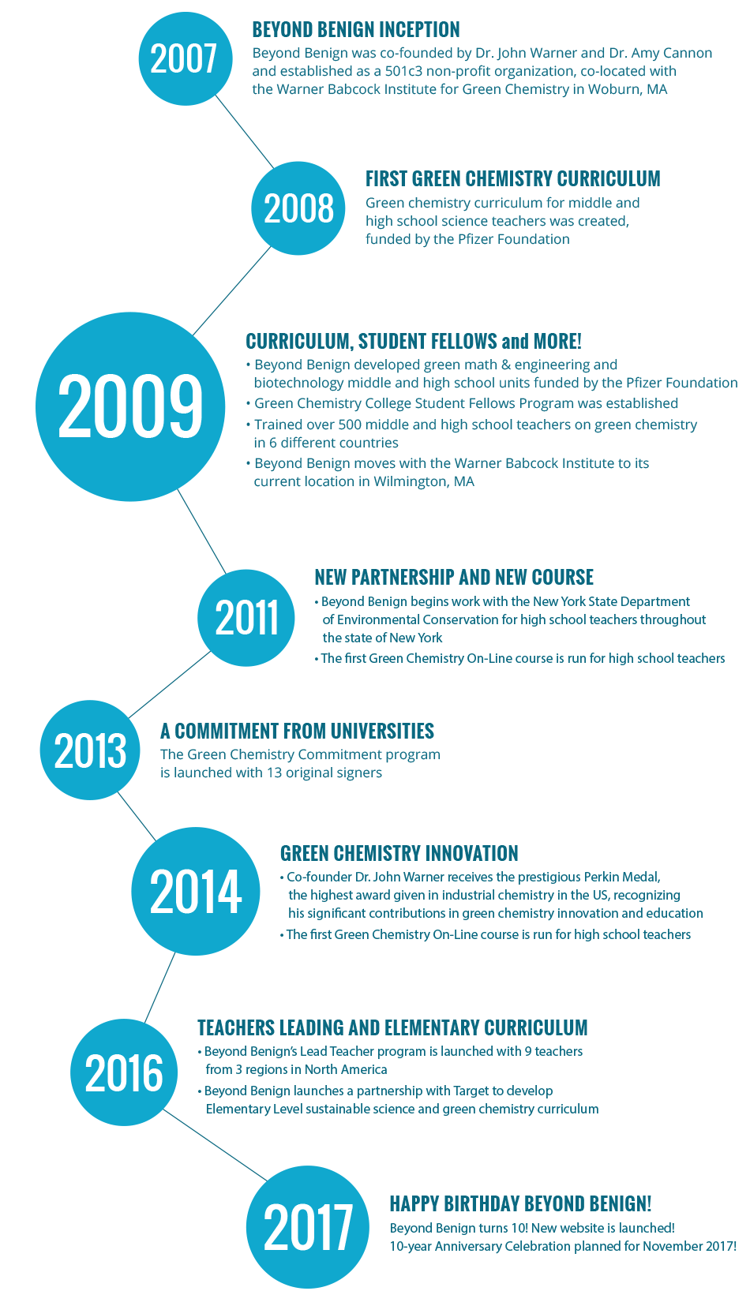
What is Beyond Benign?
Beyond Benign is a non-profit organization founded in 2007 by Dr. John Warner and Dr. Amy Cannon, located north of Boston (Wilmington, MA).
Mission: Beyond Benign develops and disseminates resources that empower educators, students and the community to practice sustainability through green chemistry.
Vision: Beyond Benign envisions a world where the chemical building blocks of products used every day are healthy and safe for humans and the environment.
Notes:
PICK AND CHOOSE WHICH SLIDES YOU PREFER

Slide 3
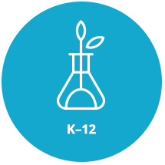
Programs
Notes:
PICK AND CHOOSE WHICH SLIDES YOU PREFER

Slide 4
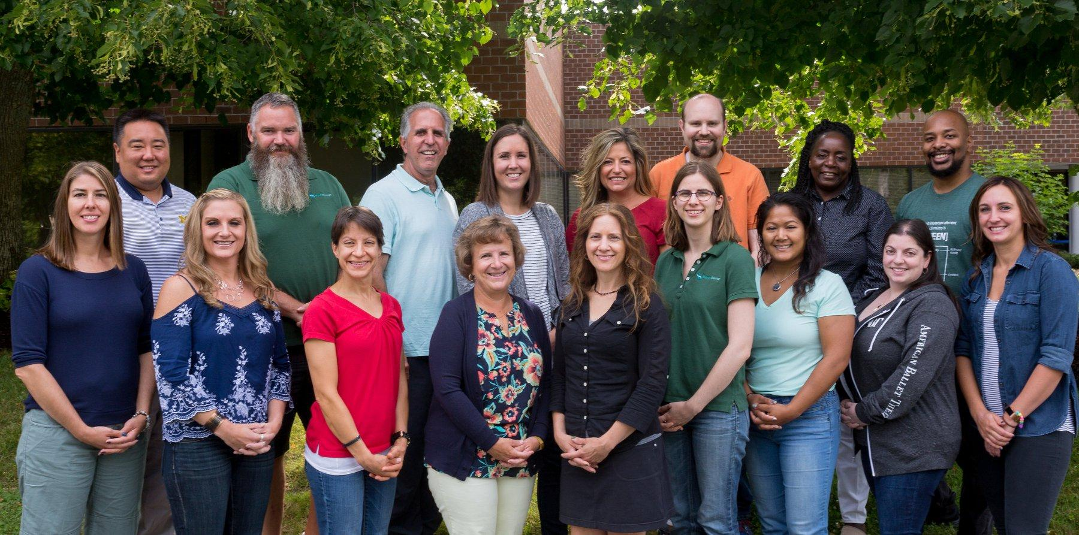

Slide 5
12 PRINCIPLES
of GREEN
CHEMISTRY
1. Reduce Waste
2. Atom Economy
3. Less Hazardous
Chemical Synthesis
4. Designing
Safer Chemicals
5. Safer Solvents
and Auxiliaries
6. Design for
Energy Efficiency
9. Catalysis
7. Use of Renewable
Feedstocks
8. Reduce
Derivatives
10. Design for
Degradation
11. Real-Time Pollution
Prevention
12. Safer Chemistry for
Accident Prevention
Notes:
PICK AND CHOOSE WHICH SLIDES YOU PREFER

Slide 6
3 CRITERIA
of GREEN
CHEMISTRY
SAFETY
COST
PERFORMANCE
Notes:
PICK AND CHOOSE WHICH SLIDES YOU PREFER

Slide 7
Biomimicry Matching Game
Overview

Slide 8
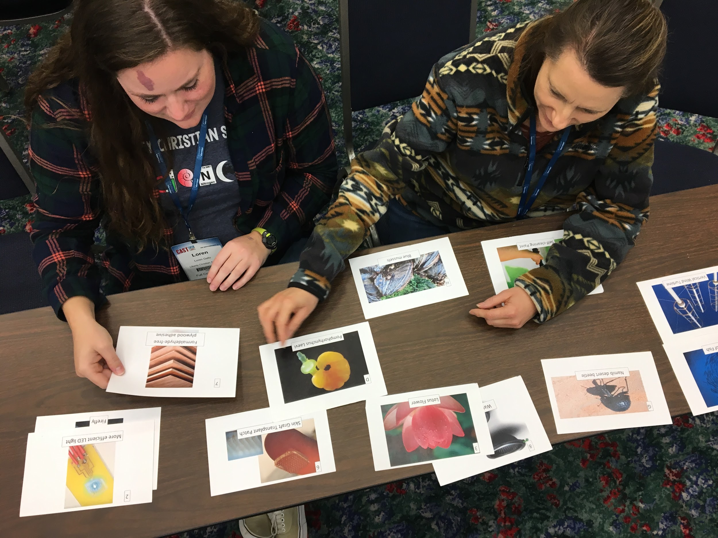

Slide 9
3 CRITERIA
of GREEN
CHEMISTRY
SAFETY
COST
PERFORMANCE
Notes:
PICK AND CHOOSE WHICH SLIDES YOU PREFER

Slide 10
Are Mushrooms the New Plastic?: Ecovative Design Challenge

Slide 11
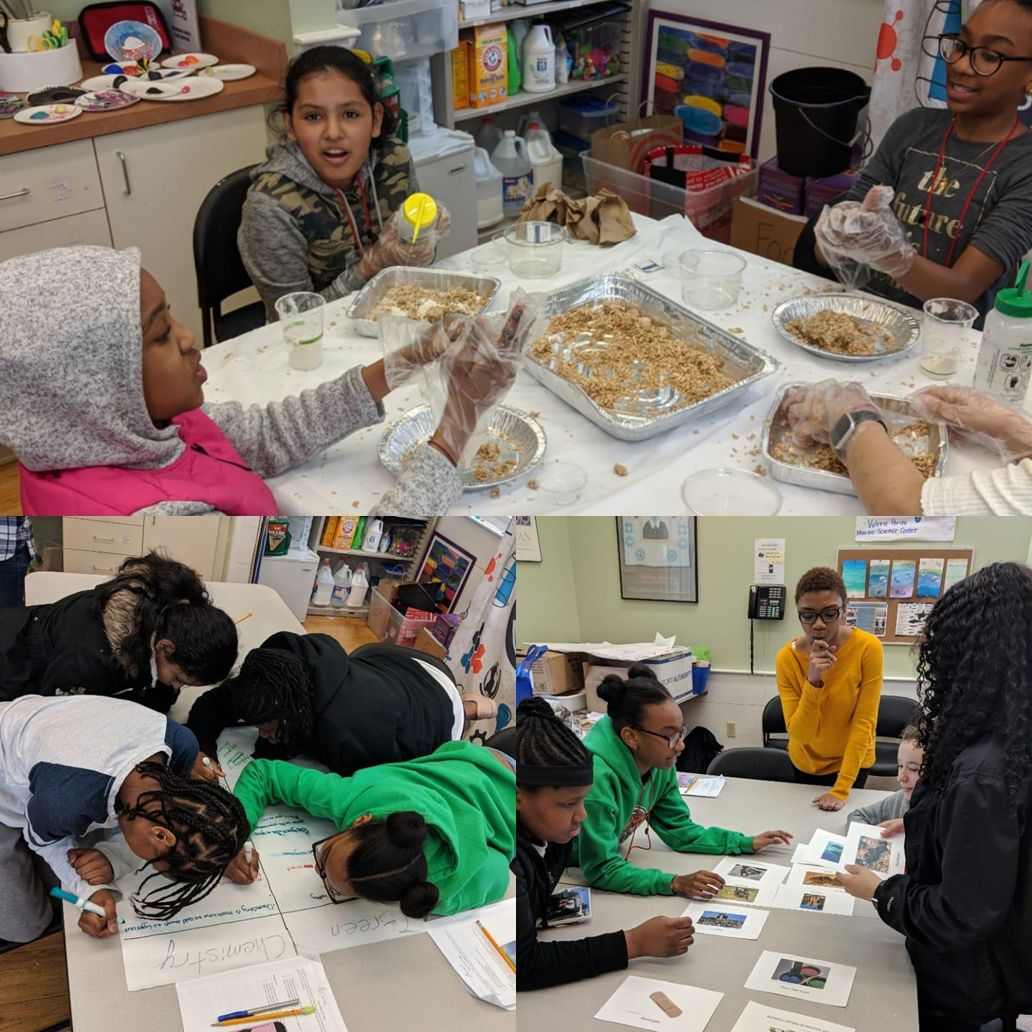

Slide 12
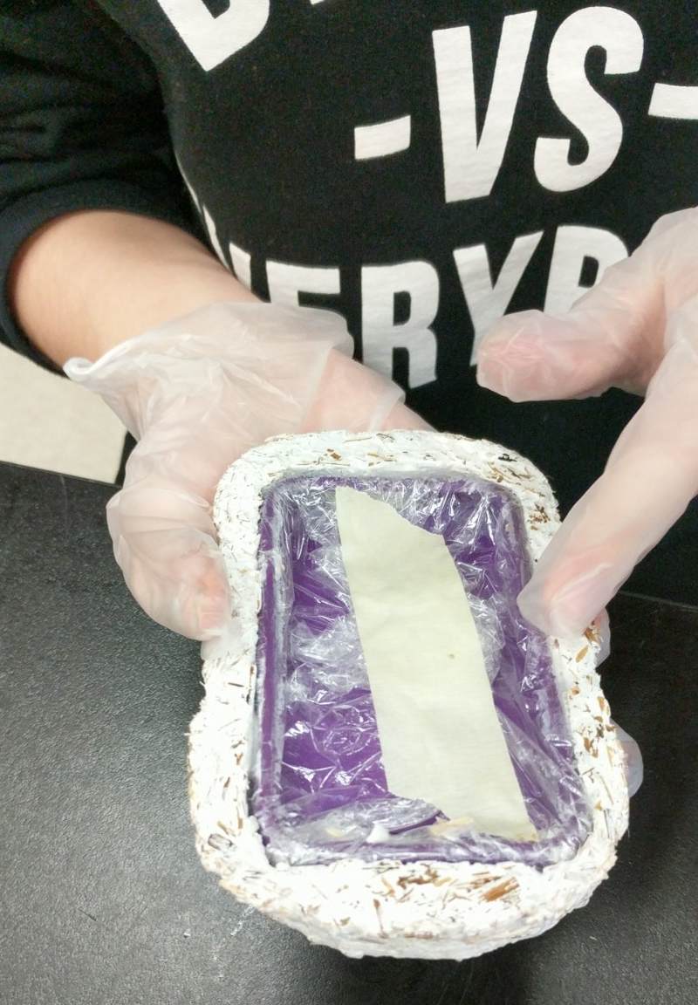
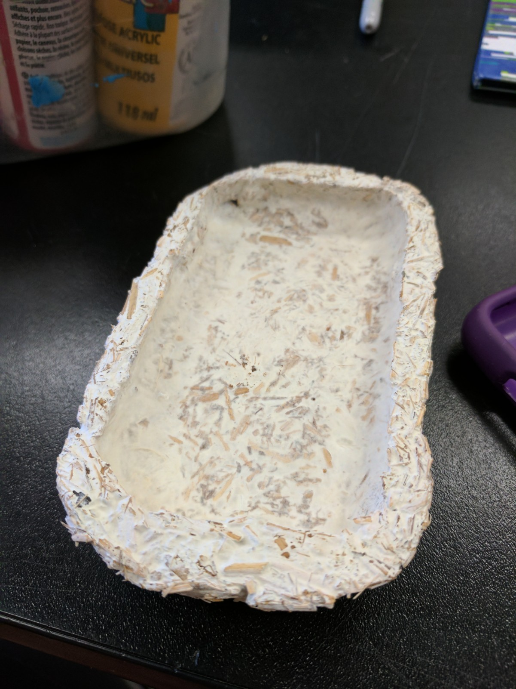
Cell Phone Cases

Slide 13
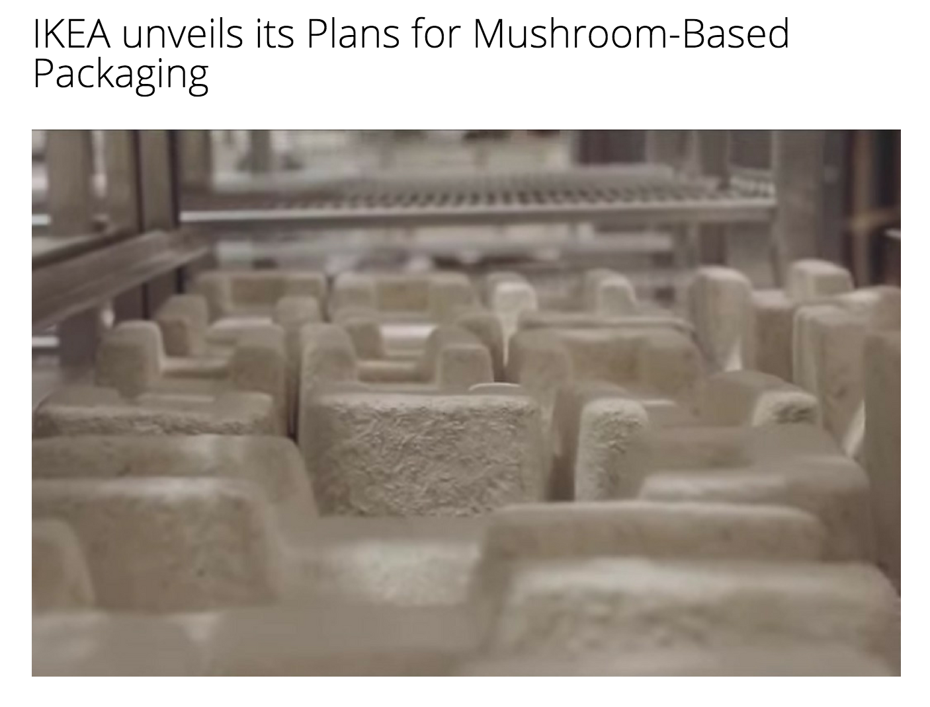
SAFETY
COST
PERFORMANCE

Slide 14
12 Principles of Green Chemistry
1. Reduce Waste
2. Atom Economy
3. Less Hazardous Chemical Synthesis
4. Designing Safer Chemicals
5. Safer Solvents and Auxiliaries
6. Design for Energy Efficiency
7. Use of Renewable Feedstocks
8. Reduce Derivatives
9. Catalysis
10. Design for Degradation
11. Real-Time Pollution Prevention
12. Safer Chemistry for Accident Prevention
Notes:
https://www.acs.org/content/acs/en/greenchemistry/principles/12-principles-of-green-chemistry.html

Slide 15
A Sticky Situation

Slide 16
A Sticky Situation
Adhesives are products that are used to bond materials together.
Glues and other adhesives are an important part of holding our world together, from construction materials to electronics.
However, many of the strongest traditional glues that are used have properties that make them harmful to human health and the environment.
Because of this, manufacturers of adhesives have recently become very concerned with aligning their glues to the 12 Principles of Green Chemistry, with some looking to nature for new ideas.

Slide 17
12 PRINCIPLES
of GREEN
CHEMISTRY
1. Reduce Waste
2. Atom Economy
3. Less Hazardous
Chemical Synthesis
4. Designing
Safer Chemicals
5. Safer Solvents
and Auxiliaries
6. Design for
Energy Efficiency
9. Catalysis
7. Use of Renewable
Feedstocks
8. Reduce
Derivatives
10. Design for
Degradation
11. Real-Time Pollution
Prevention
12. Safer Chemistry for
Accident Prevention
Notes:
PICK AND CHOOSE WHICH SLIDES YOU PREFER

Slide 18
RACHEL CARSON
Awareness of chemicals in the environment
in 2007, Columbia Forest Products won the Presidential Award for Green Chemistry for creating an environmentally friendly wood glue that was inspired by the chemistry that allows blue mussels to stick to rocks.
1960s
POLLUTION CLEANUP/PREVENTION
Clean Air Act
International Involvement
1970s
PRESIDENT NIXON ESTABLISHED EPA
Banned DDT/other pesticides
1980s
ESTABLISHED GREEN CHEMISTRY
1st Green Chemistry PhD Program
1998: 12 Principles Established
1990s
2 NOBEL PRIZES IN GREEN CHEMISTRY
2000s
GREEN CHEMISTRY EXPANDING
Collaboration between chemists and engineers
NOW
Notes:
PICK AND CHOOSE WHICH SLIDES YOU PREFER

Slide 19
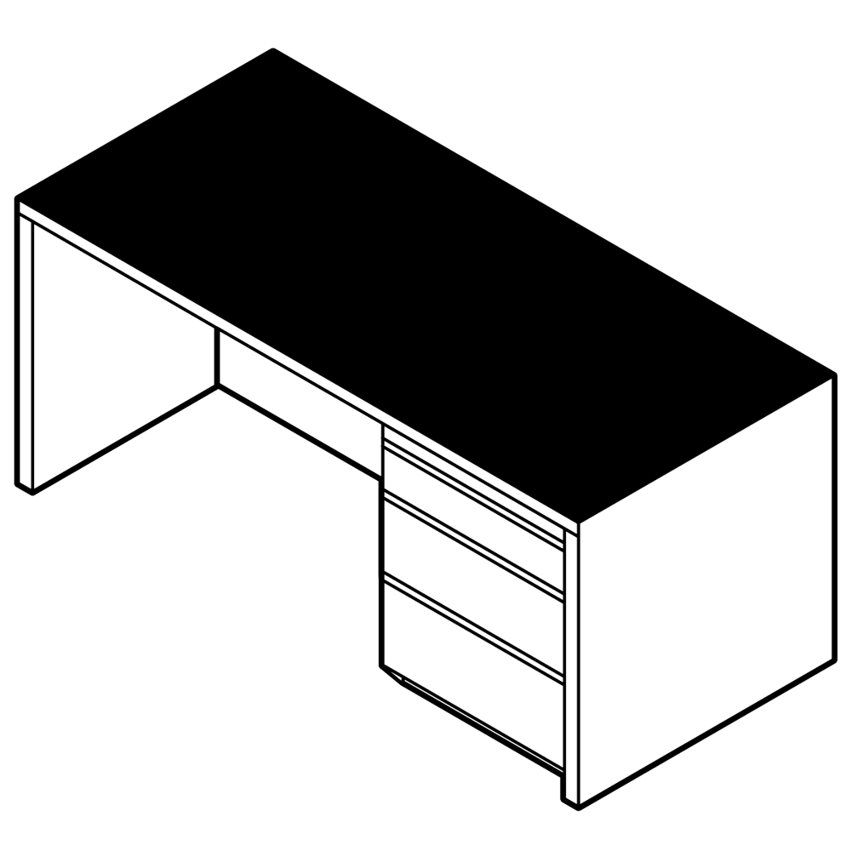
A Sticky Situation
Prepare 30cm length of each tape. Fold over last 5 cm. Tape to desk.
What tape will require the most force to remove it from the desk?
30 cm
25 cm

Slide 20
Additional Information
Website

Slide 21
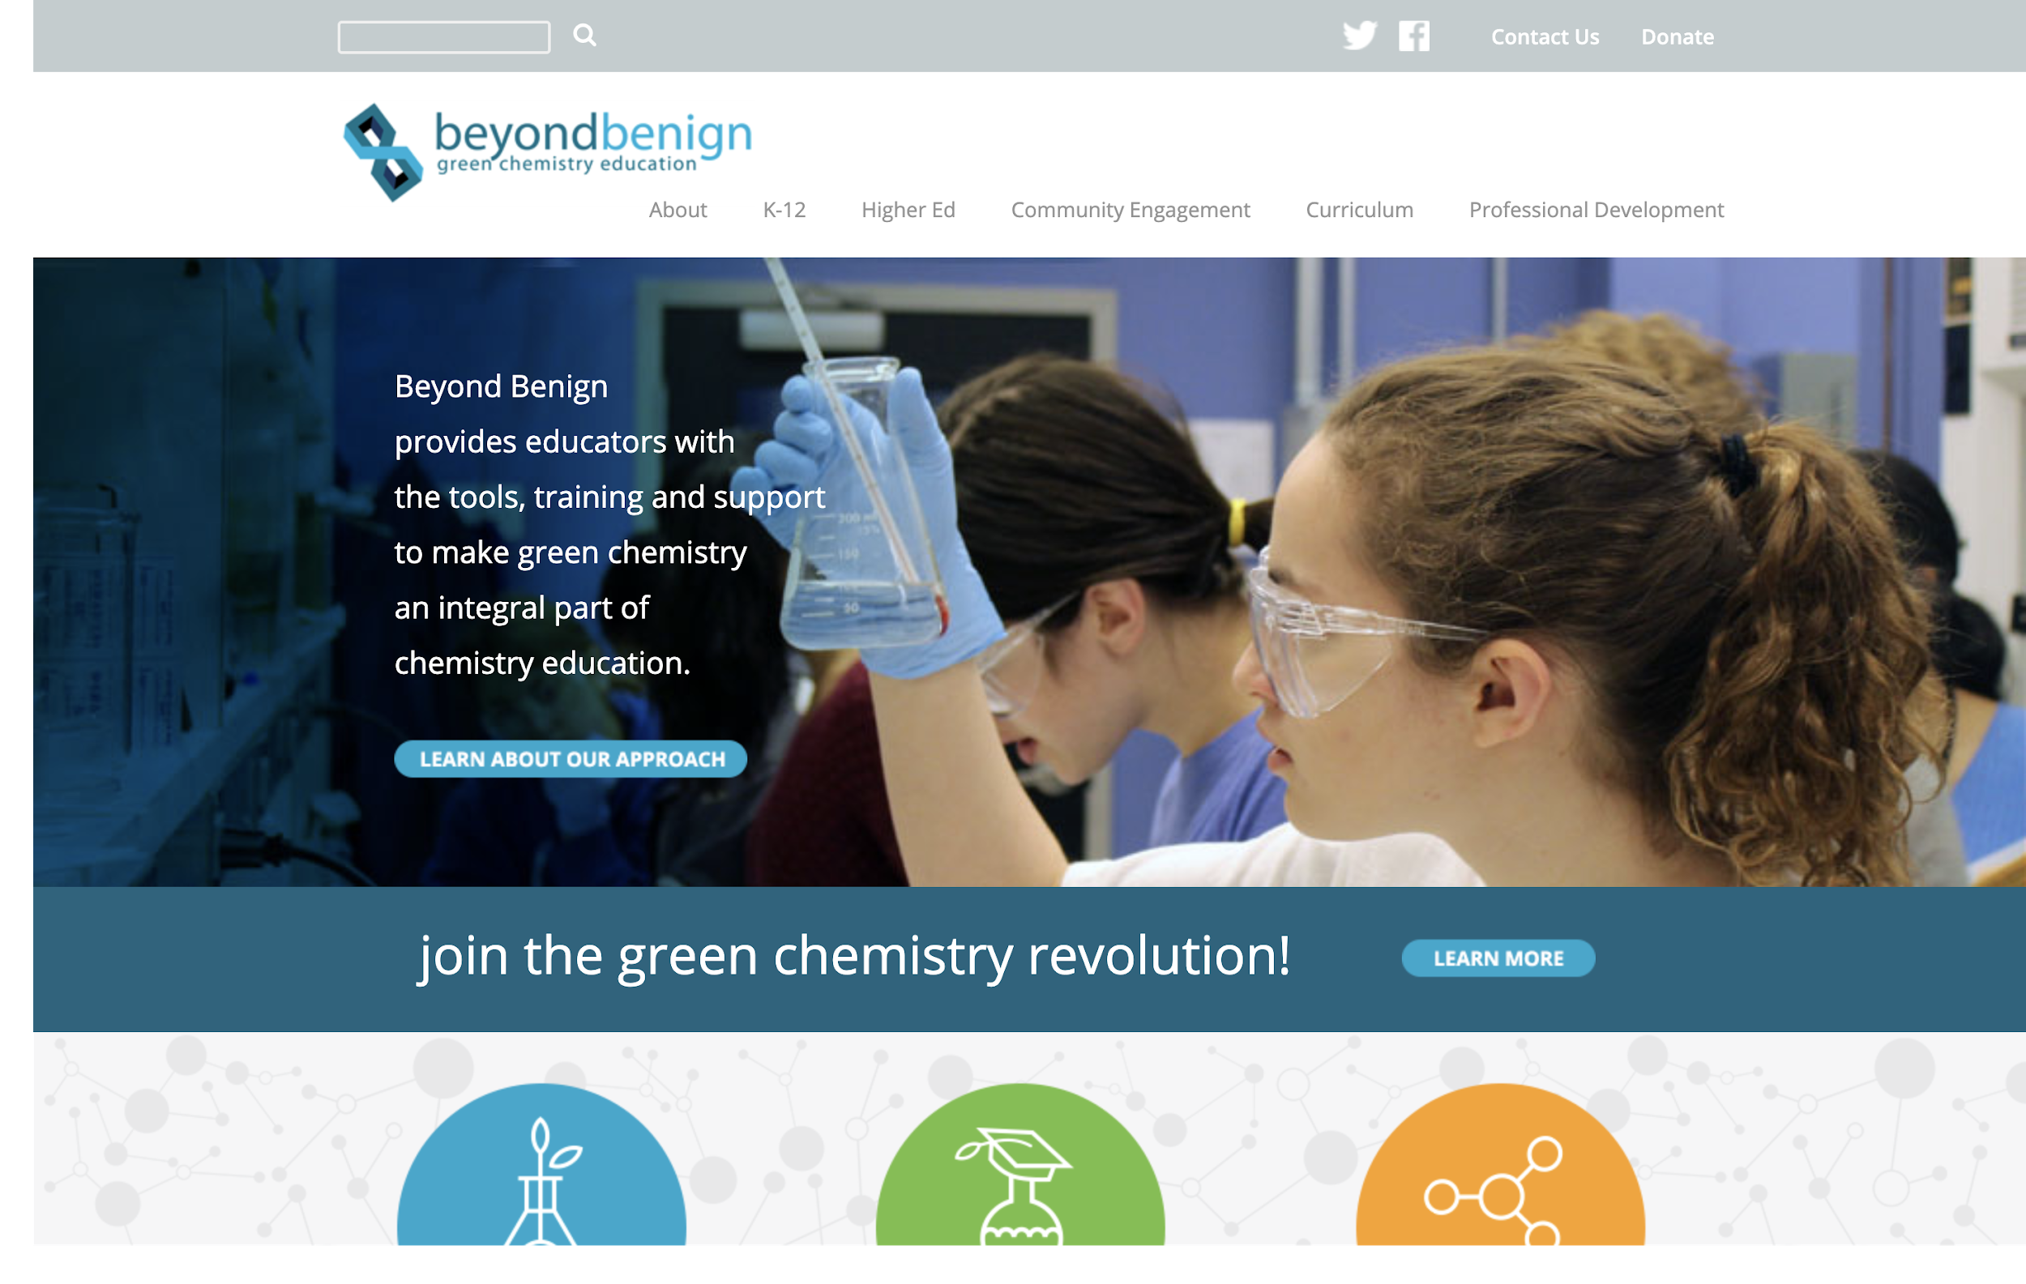

Slide 22
Connect with BEYOND BENIGN!
Website: www.beyondbenign.org
Facebook: Beyond Benign
Twitter: @beyondbenign

Slide 23
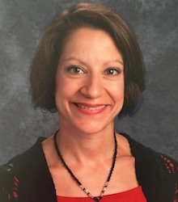
QUESTIONS: ASK NOW OR CONTACT ME LATER!
Alyson VanAlphen
avanalphen@socratesacademy.us

