Slide 1
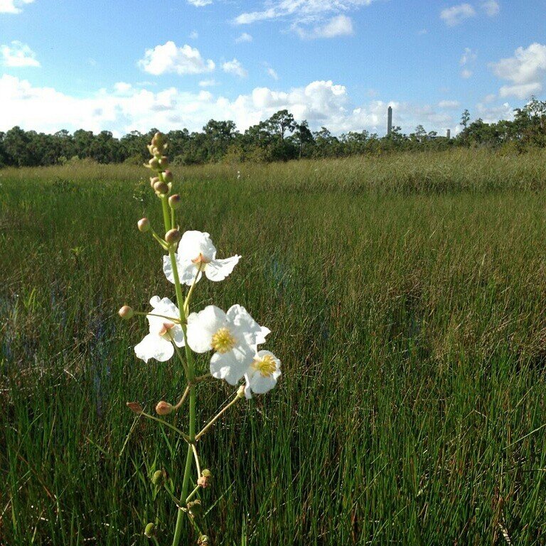
Garbage and Greenways:
Industry and Nature
CAN Coexist
Notes:
**Depending on how many are in room, Ask who and where they’re from?
How many of you have taught about waste and recycling?
Has anyone taken a tour of their county’s waste facilities or recycling facilities?
How many people would think of nature trails when they think of the facilities that handle your garbage?

Slide 2
Overview
How AWAY Works
Education Programs
Trail Signage
5K Run AWAY
Geocache Program
Trail Cameras
Questions?
Notes:
So today, we will be covering the following…

Slide 3
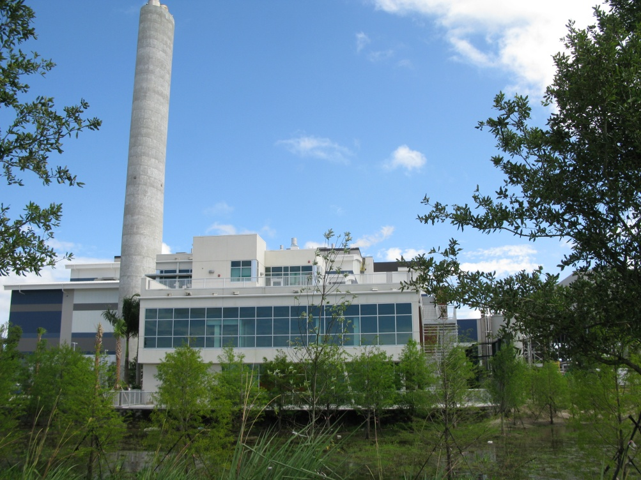
Welcome to AWAY
Whether you throw it, recycle it, or flush it AWAY, we put your waste to work…
Notes:
What happens to your garbage when you throw it away?
At the Solid Waste Authority of Palm Beach County (SWA), Whether you throw it, recycle it, or flush it, we put your waste to work…
Today we will share with you how we manage the waste in Palm Beach County, Florida and how Industry and Nature Coexist.

Slide 4
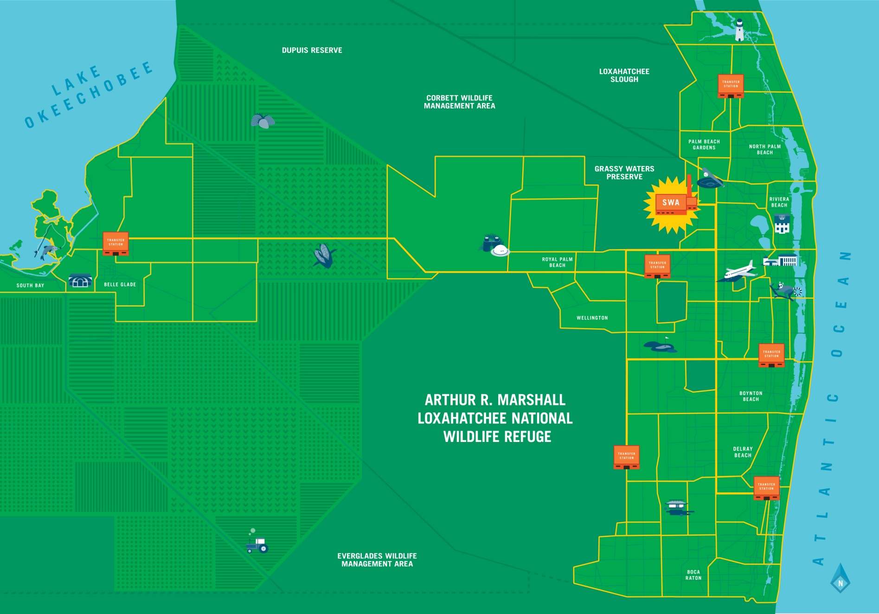
Notes:
The main function of The Solid Waste Authority of Palm Beach County (SWA) is to process all of the solid waste collected in PBC. We are the largest county geographically in Florida and the 3rd largest county population-wise. Palm Beach County extends from Tequesta and Jupiter in the north to Boca Raton in the South, to Belle Glade in the West, near Lake Okeechobee.
The SWA is the local government agency responsible for safe disposal of the county waste.
Since PBC is so large, we developed an integrated solid waste management system. We have 6 transfer stations strategically located around the county, Point them our on the map.
When you put your garbage and recyclables on your curb, the curbside trucks pick up that material. Those trucks are not SWA, they are private haulers contracted out by the SWA to pickup your trash. Those curbside trucks deliver the material to the closest transfer station.
For example your garbage goes from your house to ******* Transfer station located ******. (Find out ahead of time which transfer station is theirs.) There the material is loaded into our SWA tractor trailers. Our 18-wheeler trucks can hold up to 5 loads of the smaller curbside trucks. This reduces the number of trucks on the road saves substantially on carbon dioxide emissions.
Our SWA tractor trailers then bring the material to our headquarters, the Palm Beach Renewable Energy Park.
Transfer Stations (from North to South)
Jupiter
14185 Military Trail (SWA Road) Jupiter, FL 33458
Belle Glade
1701 State Road 15 Belle Glade, FL 33430
Royal Palm Beach
9743 Process Drive Royal Palm Beach, FL 33441
Lantana
1810 Lantana Road Lantana, FL 33462
Delray Beach West
13400 South State Road 7 Delray Beach, FL 33446
Delray Beach
1901 SW 4th Avenue Delray Beach, FL 33444
The SWA was created with the understanding that no person shall operate, maintain, construct, expand, or modify any waste management facility without first having received a valid operating permit from the SWA.

Slide 5
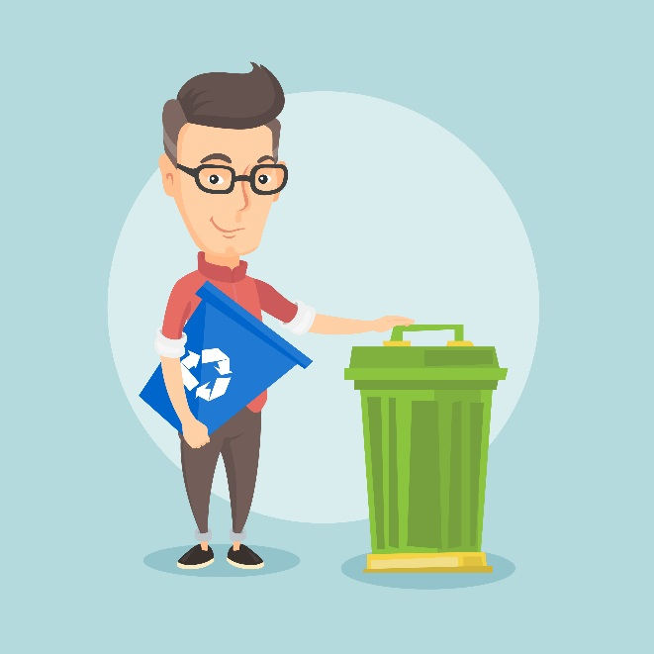
How much solid waste
do you throw away?
Approximately
1,400,000 people in Palm Beach County
X 12* pounds of solid waste per day per capita
16,800,000 pounds of solid waste per day in Palm Beach County
* This number is representing the total amount of solid waste generated divided by the total population.
Notes:
Approximately 1.4 million people live in Palm Beach County.
-Click-
How many pounds of solid waste do you think you produce in 1 day?
In PBC, each person throws away an average of 12 lbs of solid waste per day – explain briefly that this number includes, garbage, and recyclables , Biosolids, and House hold hazardous waste.
-Click-
When you multiply 1.4 million people by 12 pounds of solid waste, you get almost 17 million pounds of solid waste per day.

Slide 6
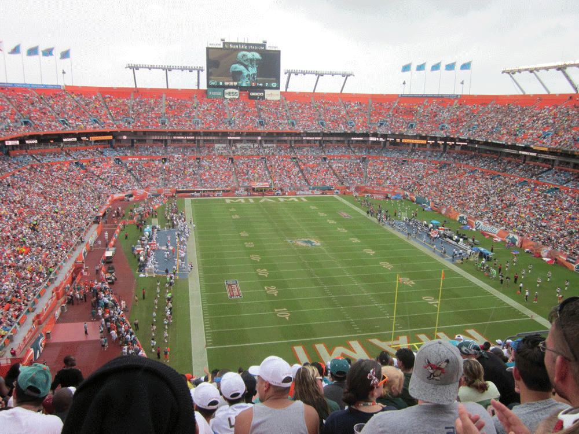
Notes:
That is approximately 17 million pounds of solid waste a day!
That is enough garbage to stack a football field approximately 27 feet high. That is taller than the goal posts, which are 30 feet high.
That’s a lot of trash! Clearly, what we do with it is important. If we don’t take care of it, this could pile up in people’s backyards.

Slide 7
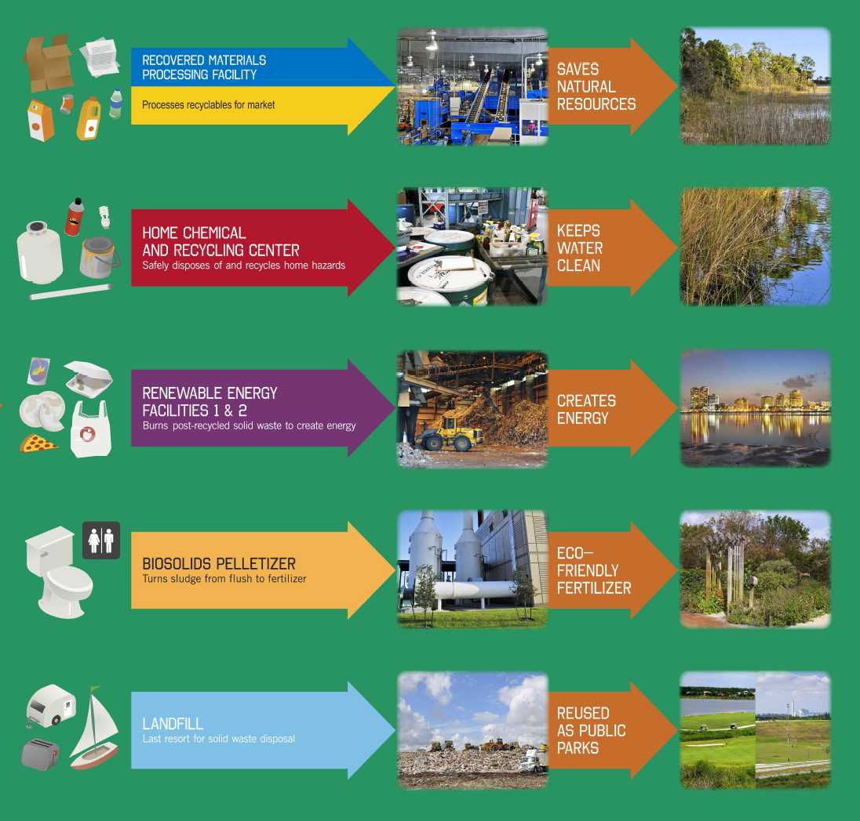
Notes:
Briefly breakdown the different types of waste as an overview.
Recycling reduces the volume of garbage and saves natural resources. Everything in our blue and yellow bins is made of natural resources, which are limited for use.
Hazardous Waste at our Home Chemical and Recycling Center
We ask residents to keep hazardous materials out of their regular garbage bin and recycle bin. Many things under our sinks or in our garages have harmful chemicals in them. We want them dropped off at our Home Chemical and Recycling Centers so that we can have these items recycled and disposed of safely. In addition to protecting our environment, we also want to protect the workers that pickup the garbage. They should not be exposed to harmful materials.
Provide a few examples (depending on the group)
Cooking oil can cause explosions or fires in the garbage.
many electronics are made with rare and toxic metals that should be recycled safely.
Propane tanks can cause explosions in our renewable energy facilities.
Fluorescent light bulbs contain mercury, a toxic heavy metal. Just a few drops of mercury can contaminate an entire lake. Mercury is toxic to people and exposure can be fatal.
Paint: We have an excellent recycled paint program. the SWA collects used paint and we send it to Scott Paints. They recycle all the paint into 12 nice colors for outdoor use, then send it back to use. County residents can apply one time for free paint for the outside of their homes.
Renewable Energy Facilities 1 & 2
The SWA has 2 renewable energy facilities, one built in 1989 and two is our newest just finished in the summer of 2015. We take all of your household garbage (not the recyclables) and burn it and turn it into electricity. We will discuss how we do this in detail.
Biosolids Processing Facility
When residents flush their toilets in palm beach county, it is all sent to each cities water treatment facilities. There they clean the material and separate the liquid from the solid, or sludge. They keep the liquid and treat it further and use it as reclaimed water. The left over sludge is sent to us. We heat it using methane from the landfill to dry it out. This process makes it clean and it is sold as eco-friendly fertilizer.
Depending on the audience you can make it a bit funny or bring it full circle:
This fertilizer is safe to be used on agriculture, or farms, so we can grow more food and then eat it and then make more fertilizer.
This is actually an excellent use of something that we literally had no use for in the past. Before we used this technology, we had to put all of this sludge onto the landfill.
Landfill
This is our last resort. We want to take every measure possible to keep waste out of the landfill.

Slide 8
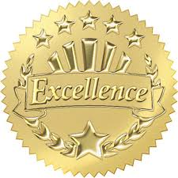
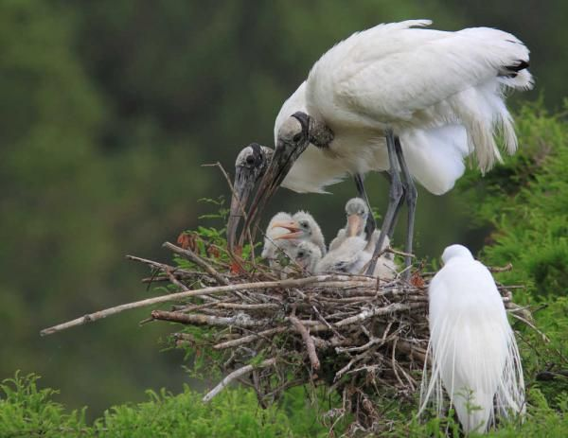
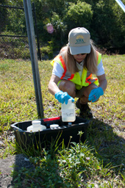
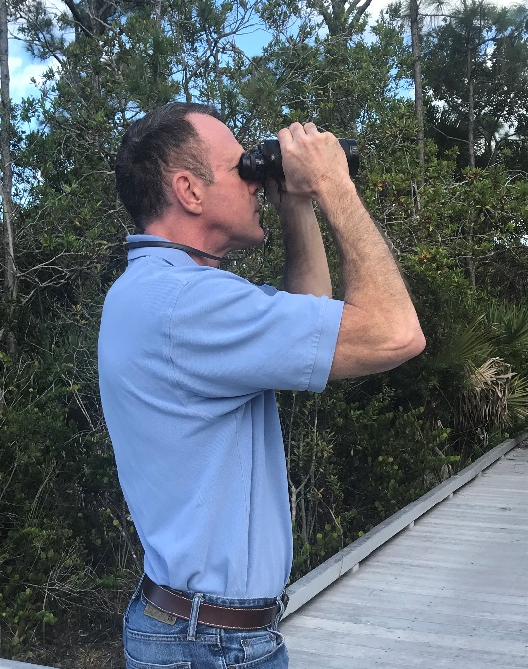
Environmental Stewards
Water monitoring
Monthly bird counts
Landfill gas monitoring
Invasive plant removal
Continuous emissions monitoring
Notes:
So now that you know who we are and what we do, let’s discuss how the Solid Waste Authority of Palm Beach County acts as environmental stewards.
We do the following, plus more:
Water monitoring (surface and ground water wells – over 200)
Monthly bird counts
Landfill gas monitoring
Invasive plant removal (on our Greenway Trail system)
Continuous emissions monitoring (at our Waste-to-Energy facilities)
Our Environmental Programs Department and the SWA goes Above and Beyond!
The SWA has won many awards for our
facilities and environmental efforts from:
· Solid Waste Association of North America
· US Green Building Council
· Florida’s Project Learning Tree, and more!

Slide 9
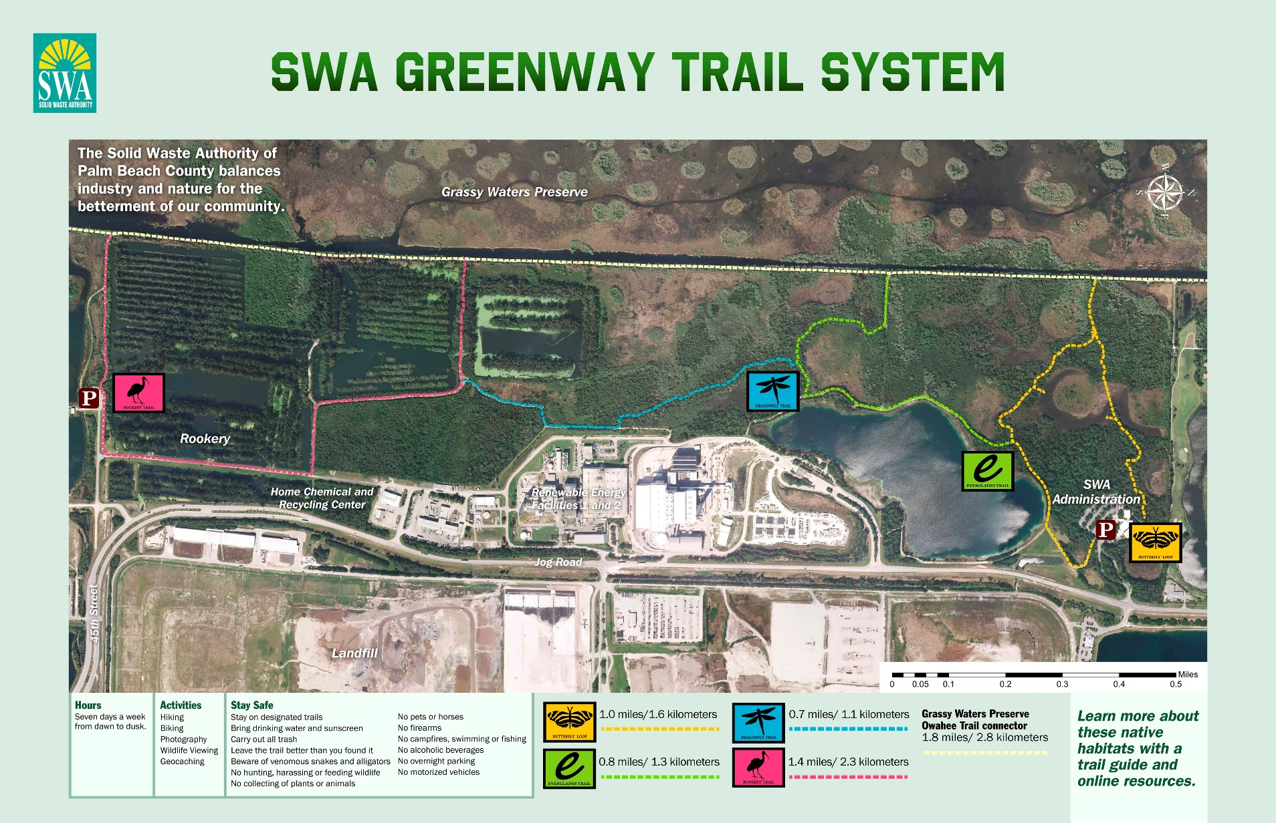
Notes:
The SWA strives to be a good neighbor for people and wildlife. Protecting the balance of industry and nature is necessary today and for future generations.
We have 5 miles of biking and hiking trails on our 300 acre conservation area. These trails are free and open to the public 7 days a week from dawn to dusk. The trails are connected to Grassy Waters Preserve. Many bird species live here including blue herons, threatened wood storks, egrets, ibis, bald eagles and the endangered snail kite. As well as other animals like alligators, bobcats, and deer.
-Click to Next Slide-

Slide 10
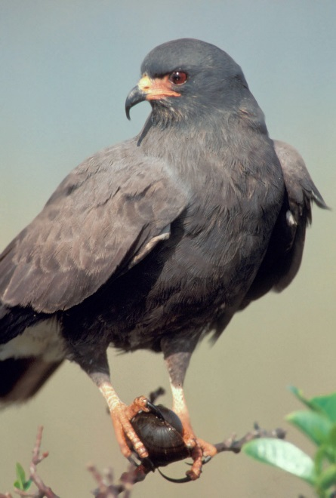
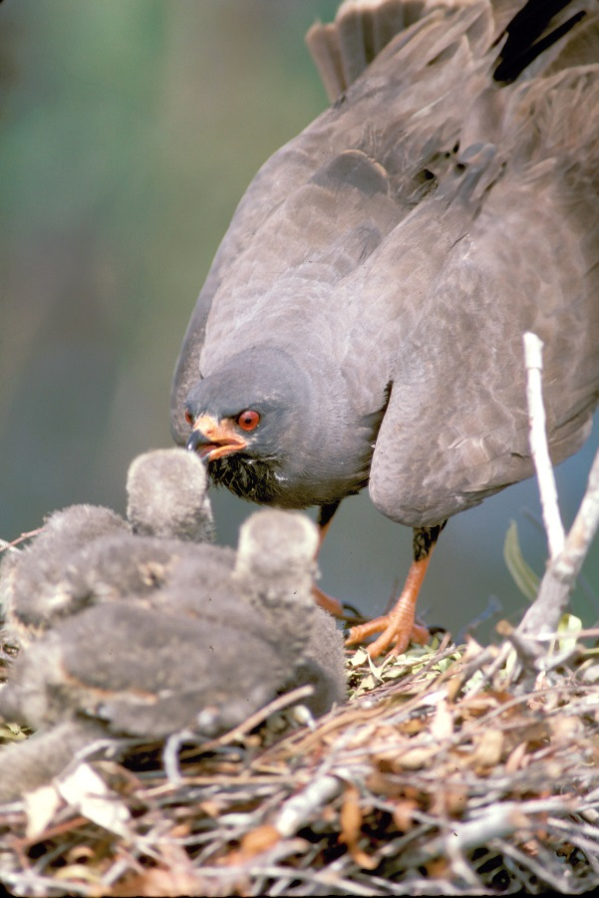
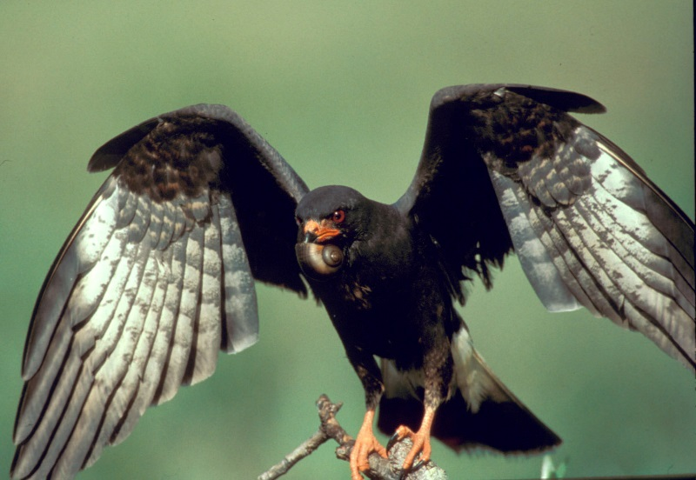
History of the SWA
Greenway Trail System
Notes:
You may not think about nature trails when you think of garbage, right?
The reason we have our trails is because back in the 80’s when we were looking to build our landfills, we had our footprint surveyed by wild life agencies. The wildlife agencies found this bird, the endangered Everglades Snail Kite, using a portion of our footprint. So we moved the landfill development to another area and turned this area into a 300 acre conservation area that now has about 5 miles of trails open to the public.
-Click to Next Slide-

Slide 11
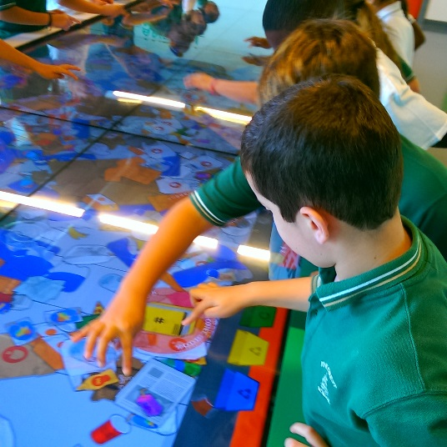
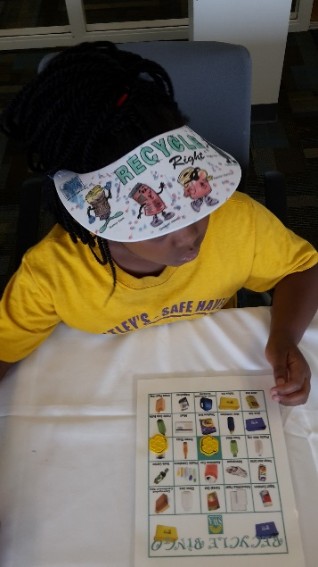
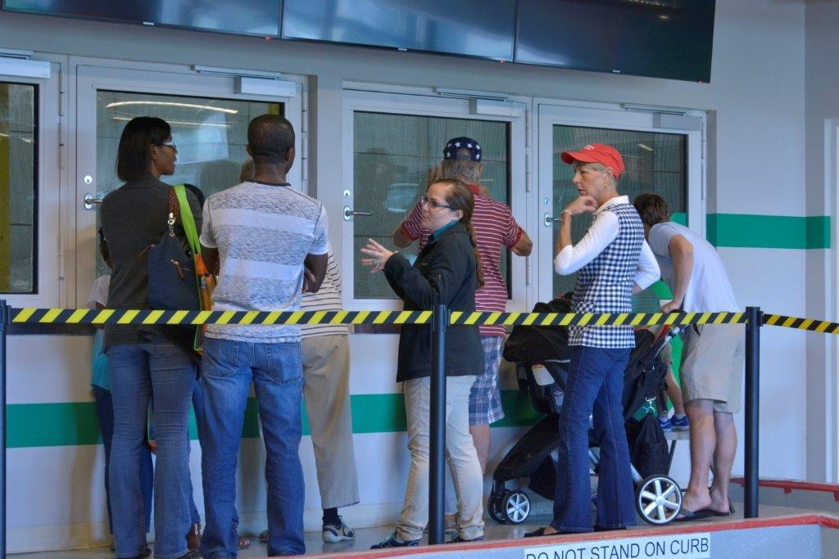
Education Programs
Grade-specific
Align with the Florida state standards
Hands-on Interactive Programs
Available in Spanish
FREE!
Notes:
We offer education programs for:
Grades K through 2 – our in-school programs, where we visit the schools and lead interactive presentations
Grades 3 – 12 – The grades come visit us and get to see our facilities and trails first hand
We also facilitate tours for college groups and the general public
Our programs are:
Grade-specific
Align with the Florida state standards
Hands-on Interactive Programs
Available in Spanish
FREE!

Slide 12
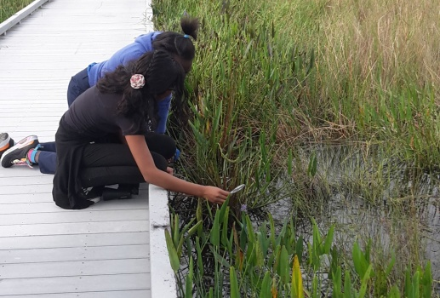
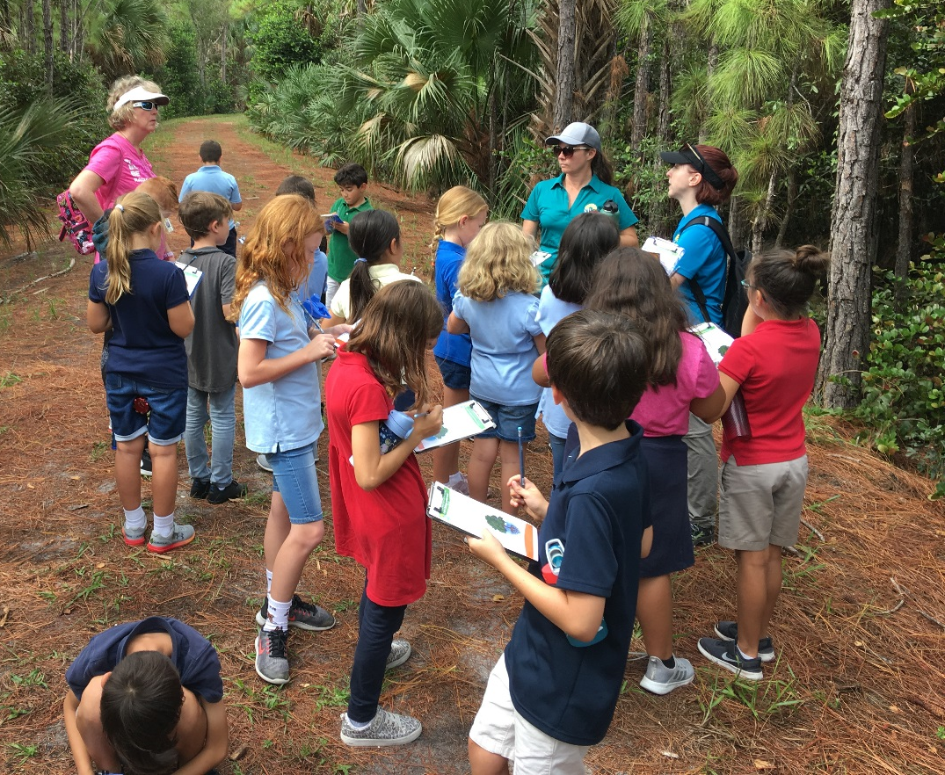
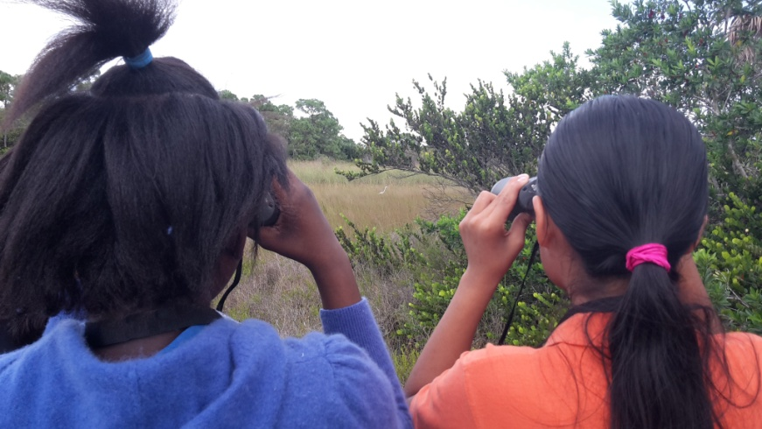
Education Programs
Industry and Nature Coexist
Notes:
Today, we are going to focus on our trails programs that we provide for 3rd and 7th grade….our Industry and Nature Coexist programs!

Slide 13
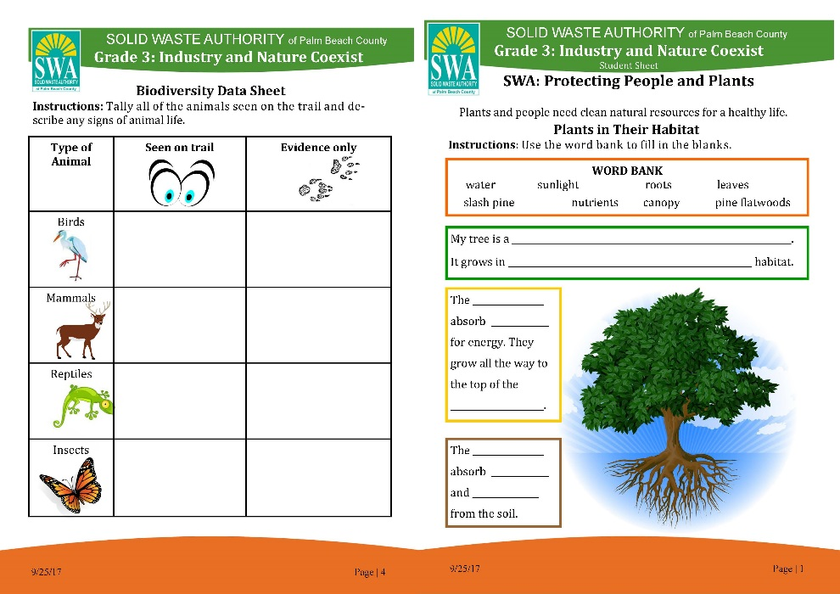
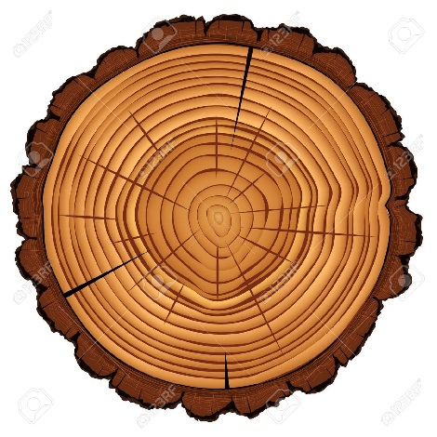
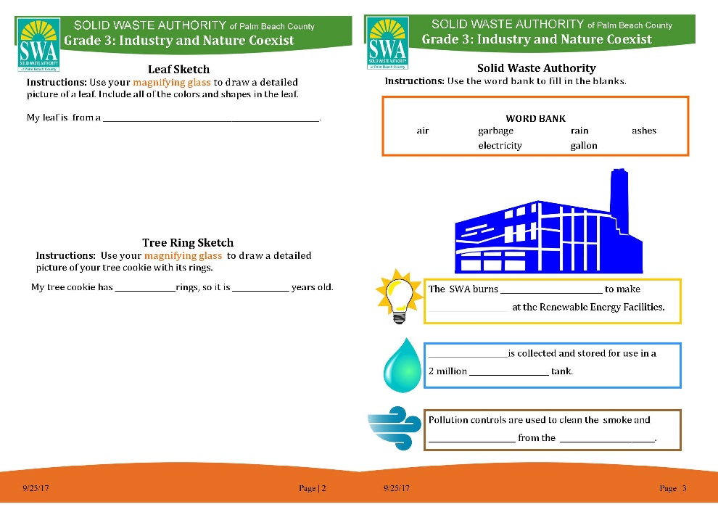
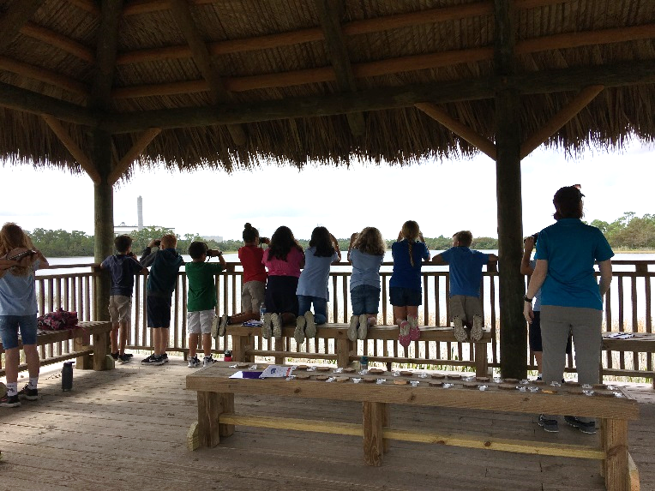
Field, Forest and Stream
Industry and Nature Coexist
Grade 3
Notes:
For our 3rd grade program:
We complete this worksheet while in our Chickee hut and hiking the Butterfly Loop/SWA Greenway Trail System.
Major standards we hit are:
Industry and nature coexist.
Plants and people need clean natural resources for a healthy life.
Plants and people need water, food/energy, shelter/space, and nutrients.
The SWA protects our natural resources in order for plants and people to live in a healthy community (The booklet reviews how the SWA does that).
Plant identification, as well as parts of a plant and layers of the forest.
Animal identification, as well as signs that animals leave behind to show us they have been there.

Slide 14
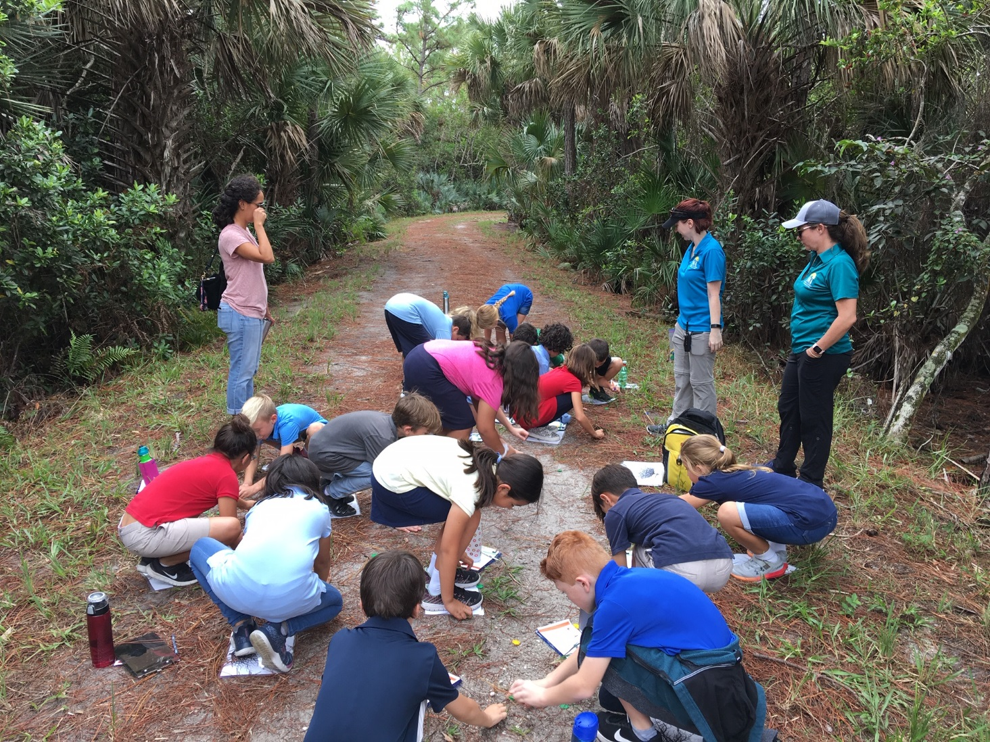
Field, Forest and Stream
Industry and Nature Coexist
Project Learning Tree:
Every Tree for Itself
Notes:
We also play “Every Tree for Itself” while out on trails. Note that we play our version a little differently due to time constraints and with 3rd graders we cannot walk the whole loop and so they do not see all of the habitats. Therefore, instead of comparing habitats we talk about other things that can affect trees (competition and space due to being relocated/development).

Slide 15
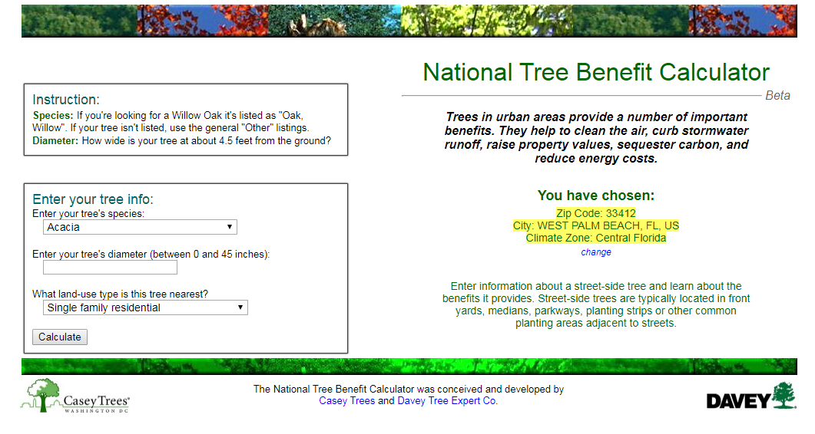

Industry and Nature Coexist
Grade 7
Notes:
For our 7th grade program:
We complete this worksheet while in our Chickee hut and hiking the Butterfly Loop/SWA Greenway Trail System
Major standards we hit are:
Industry and nature coexist.
For survival, humans and animals need to adapt to their environment and foster positive relationships. We review what an adaptation is and later do an activity that explores bird adaptations.
Food web relationships and energy transfers within nature and within the SWA.
Plant and animal identification.

Slide 16
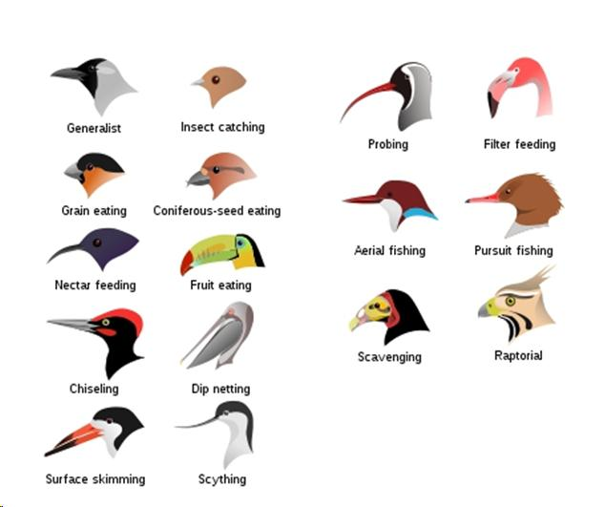
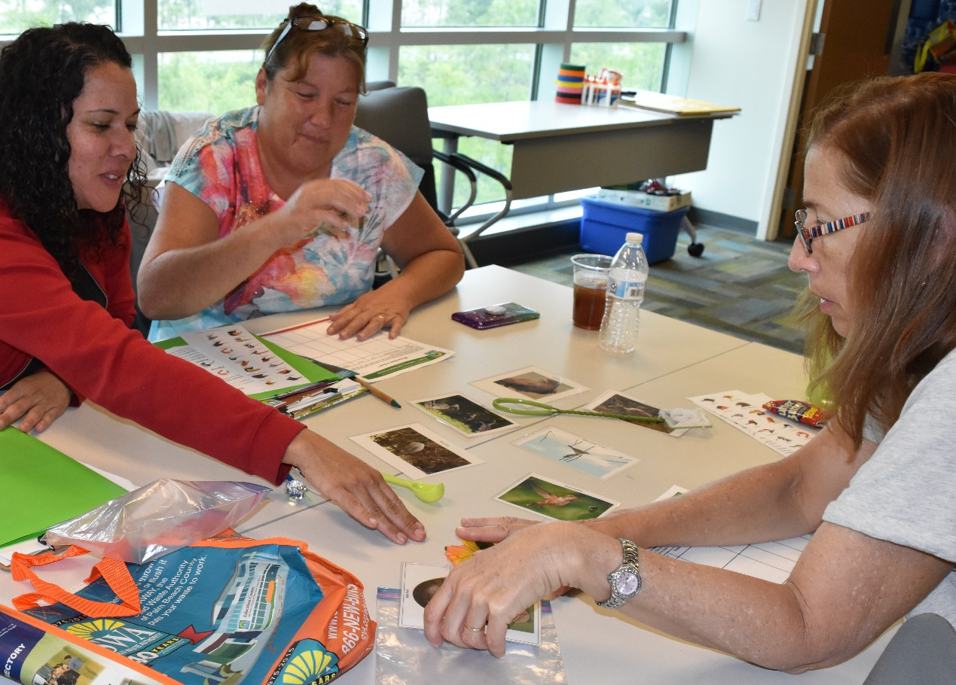
Industry and Nature Coexist
Flying WILD:
Fill the Bill
Notes:
As part of our 7th grade lesson, we do an adapted version of Flying WILD’s “Fill the Bill.” Since we do this in the Chickee Hut, we have changed it so that our version does not have stations. Instead a set of materials is handed out to each group of students (typically 2-3 students in a group). In the main bag, we have smaller bags. One is filled with photos of birds, another with items that represent their beaks/tools they use to get their food, and the last bag is filled with examples of their food.
The students draw a picture of their birds’ beaks, then try to match the beak to the tool. Once they have done that, they match the tool/break with the food the bird eats. Lastly, by using all of the information they have in front of them, they hypothesize what habitat these birds would live in (water, forest, etc.)

Slide 17
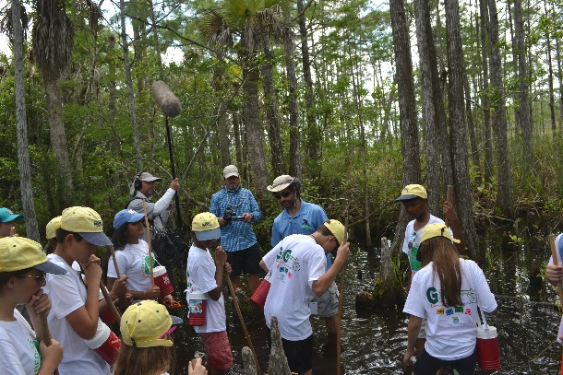
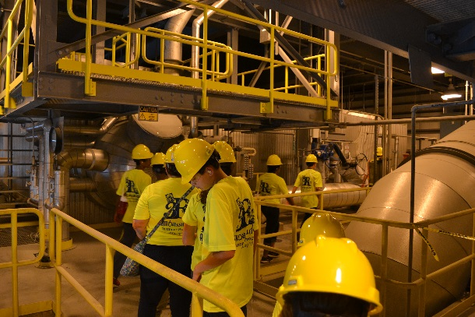
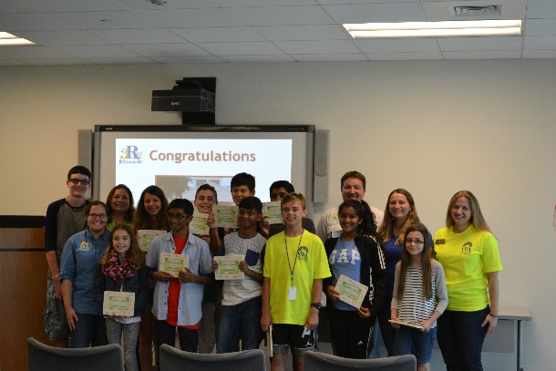
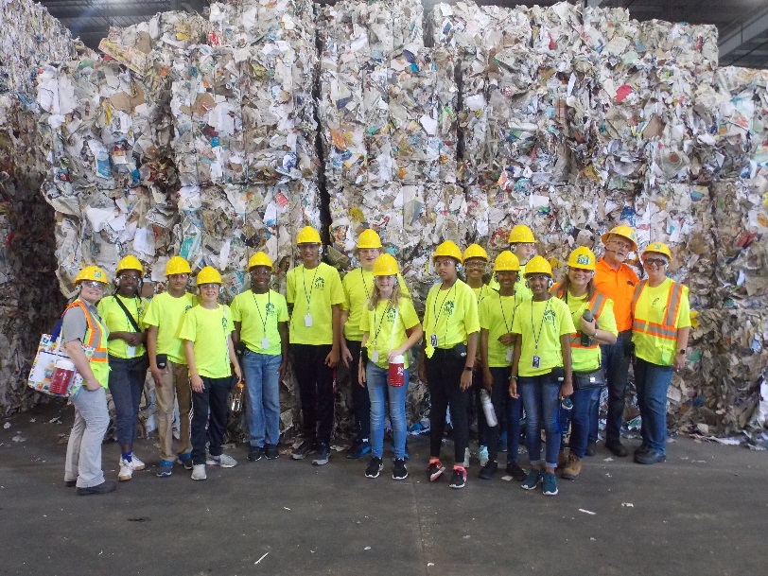
Education Programs
3R Ambassador Program
Notes:
During the summer, we also host a specialized summer program for grades 6th through 8th (our 3R Ambassador Program).
During this week in June, they get behind-the-scenes tours of:
One of our transfer stations
Recovered Materials Processing Facility (recycling)
Home Chemical Recycling Center
Utilities
Landfill
Renewable Energy Facility 2
Butterfly Loop
They also get to participate in some fun activities like:
Canoeing and swamp tromping at Grassy Waters Preserve (which we share a trail with)
Making an edible landfill (which if anyone came to our presentation last year, you may have done with us)

Slide 18
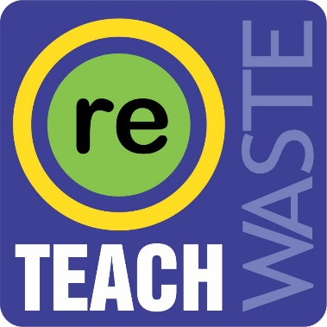
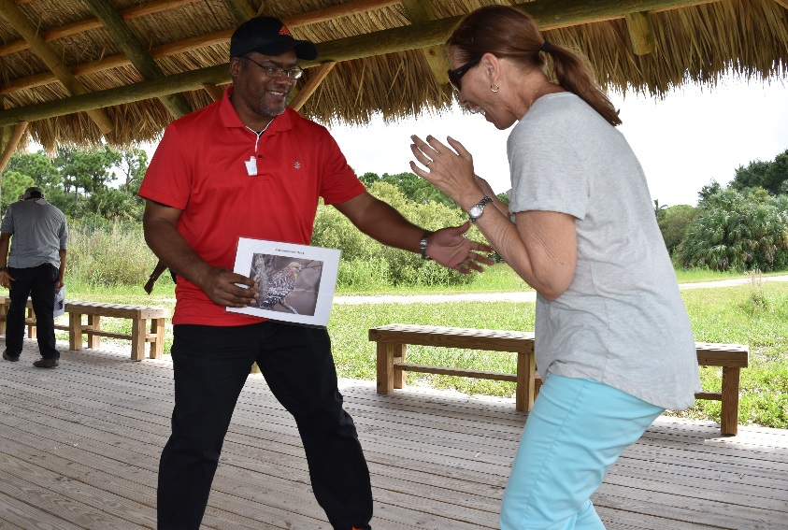
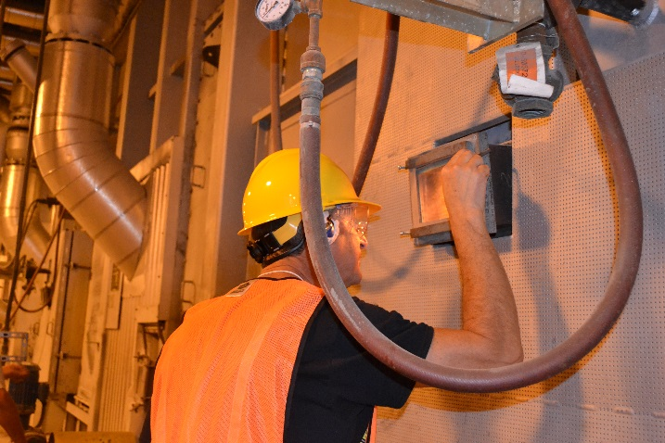
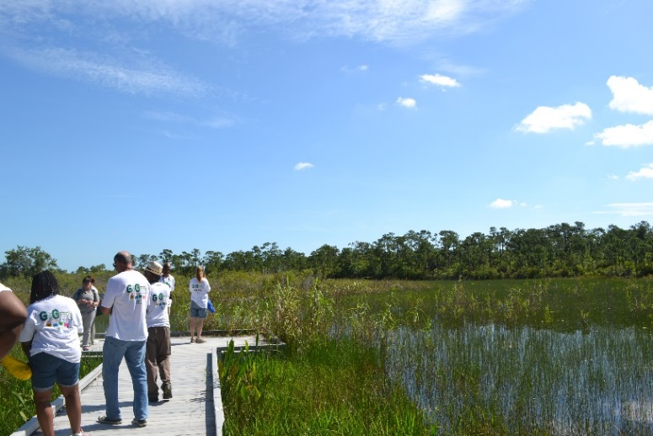
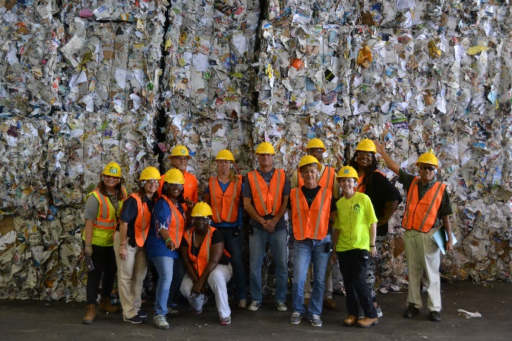
Education Programs
ReTeach Waste Program
https://www.youtube.com/watch?v=yvDgTsh_7MM&t=4s
Notes:
Our ReTeach Waste Program is the educator version of our 3R Ambassador Program! It is a week-long specialized program that provides professional development workshops for the educators using guides and activities through Project Learning Tree, Project WILD and Florida’s Everglades Literacy program.
They also participate in behind-the-scenes tours of:
One of our transfer stations
Recovered Materials Processing Facility (recycling)
Renewable Energy Facility 2
Butterfly Loop
They also get to tour and participate in some fun activities with Resource Depot, which is a reuse center for teachers!
~Show Video!~

Slide 19
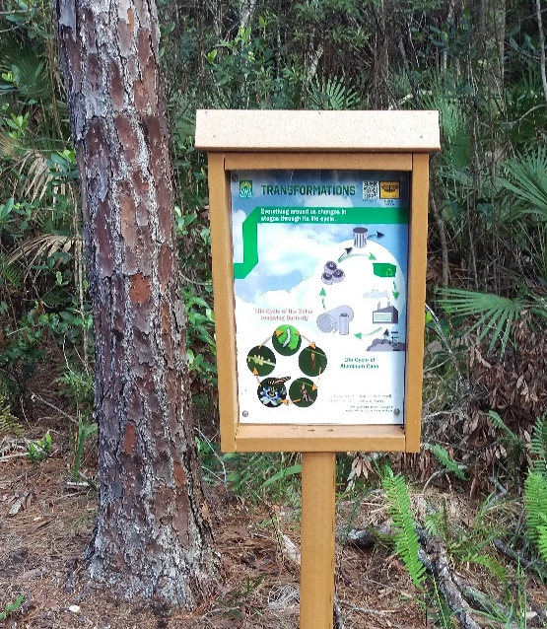
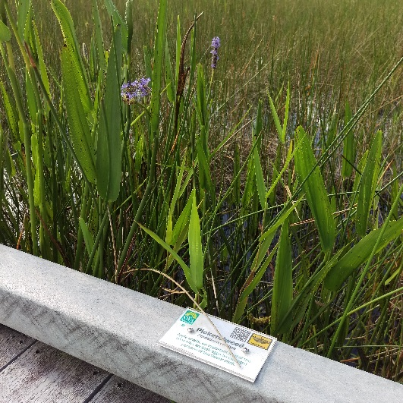
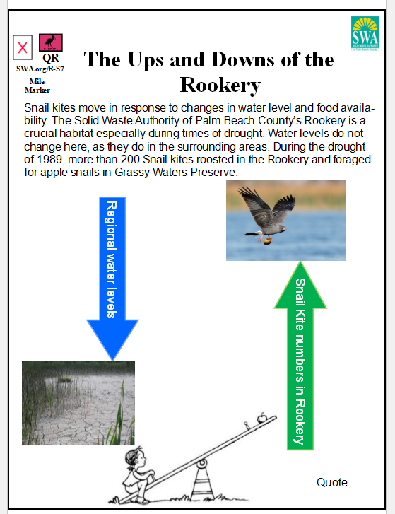
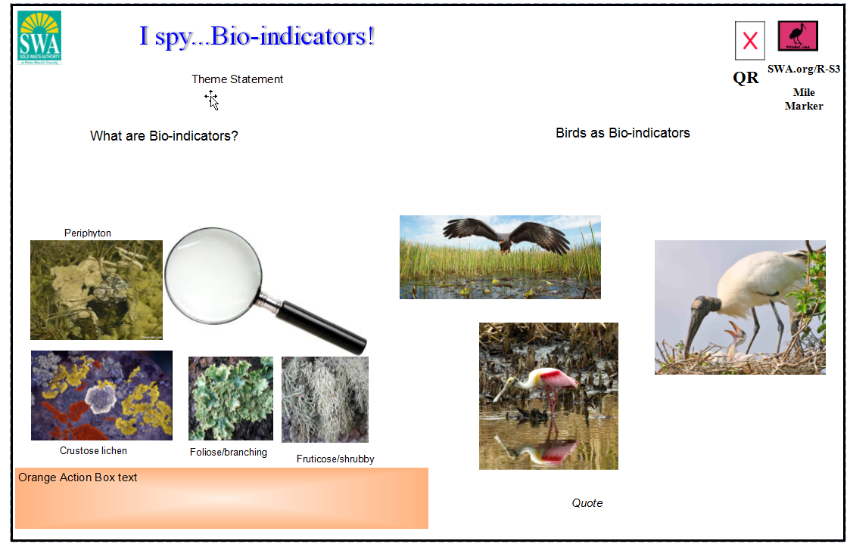
Trail Signage
https://swa.org/Facilities/Facility/Details/SWA-Greenway-Trail-System-10
Notes:
For people who want to learn on their own, we have interpretive signage throughout our trail system:
Signs have QR codes which will direct them towards our website and more detailed information, if they would like it.
Plant Identification signs – they also will have QR codes which direct them to more information about these plants if they would like.
If people cannot make it our to our trails, we offer a virtual tour of our Butterfly Loop on our website.

Slide 20
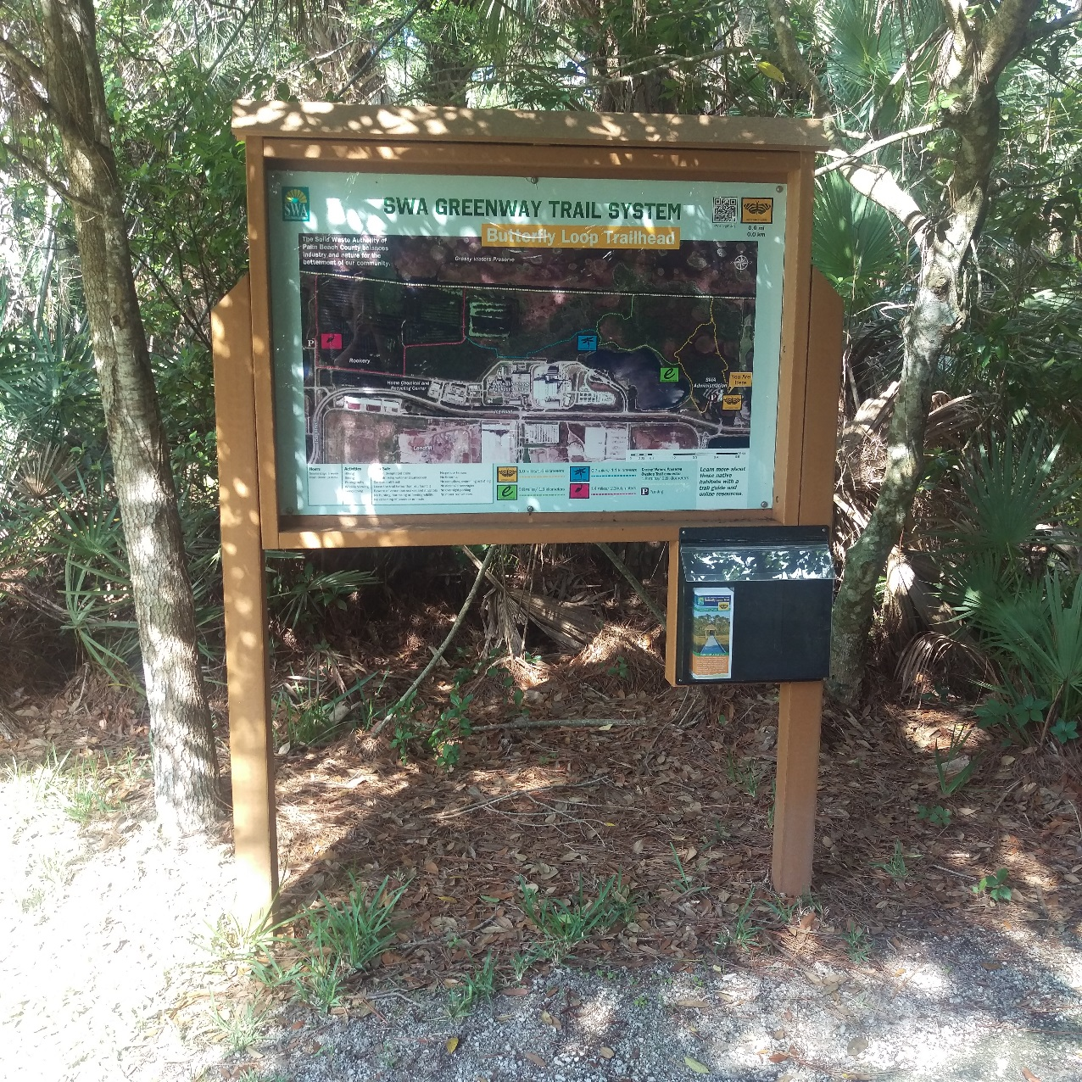
Trail Brochures
Notes:
For self-guided tours, we also provide brochures for the public that can be found underneath our trail head maps!
Each brochure has information on plants and a list of plants to identify. On our newest brochure, our Rookery trail brochure, there is information about 5 of our most common birds found in the Rookery and photos so that people can identify them. Afterwards if you would like, you can come up and take one of our brochures as an example.

Slide 21
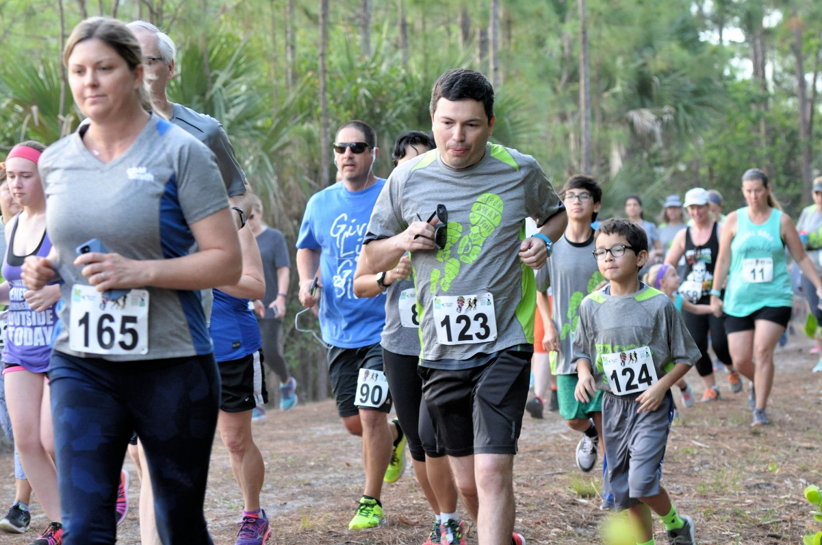
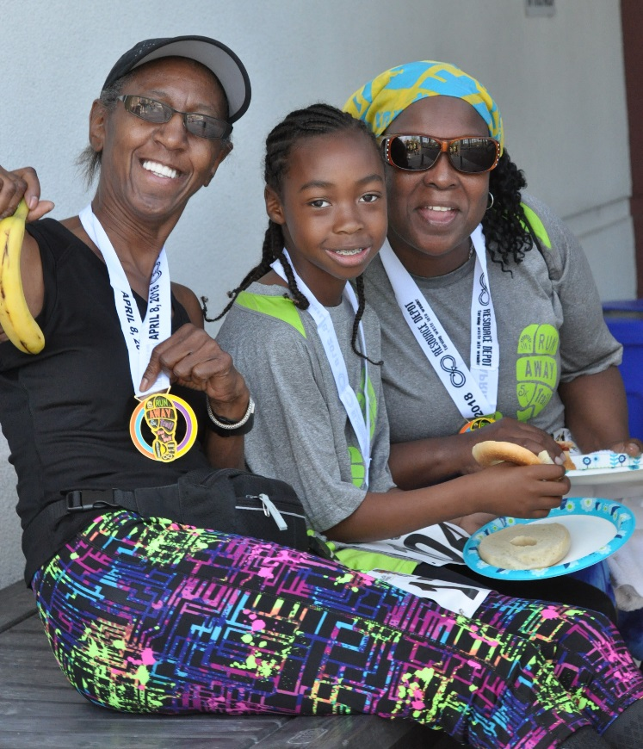
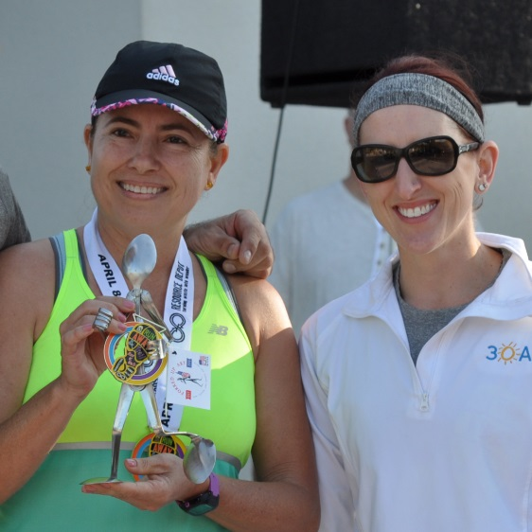

Notes:
The next couple of slides will explore various ways we reach out to the community beyond students and teachers
celebrates the harmony of industry and nature, bringing awareness to recycling and solid waste issues
Proceeds benefit the nonprofit Resource Depot and their efforts to inspire creativity, conservation and community engagement through reuse
Before we started this 5k, our trails were not widely known about or utilized so this was 1 way to bring attention to them
We get about 300 registrants a year
Accuchip
Sunday April 5, 2020 – our 6th annual race

Slide 22

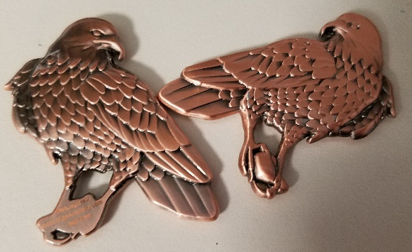
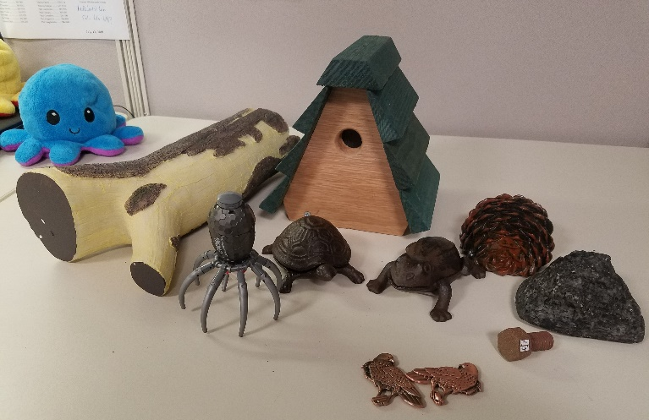
Cache In!
www.geocaching.com
Notes:
Geocaches have been set up for several years
We maintain the geocaches with log books and the ones big enough with geocoins like the new snail kite ones we have
Just purchased new geocache containers with plans to set up new geocache landmarks along the trail wit clues including educational information about the trails, habitats, flora, and fauna

Slide 23
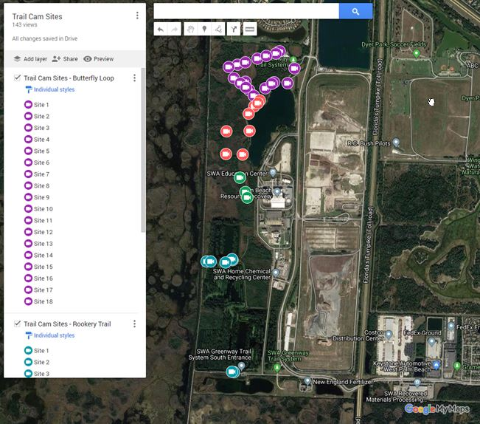
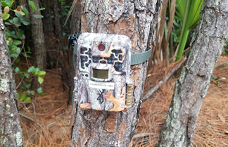
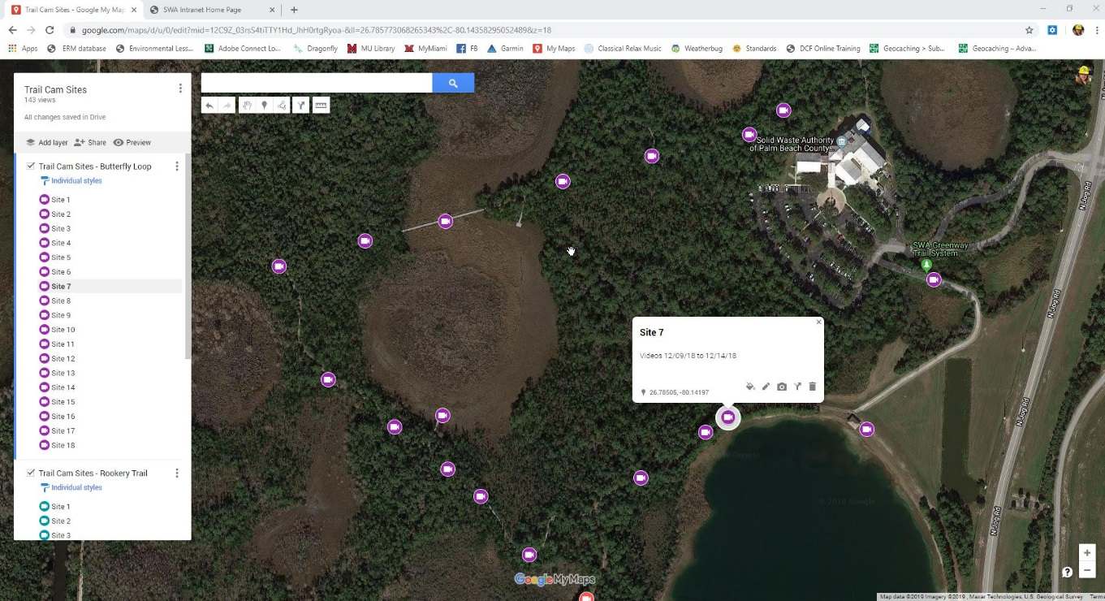
Trail Cam Thursdays
#TrailCamThursday
Facebook: https://www.facebook.com/SolidWasteAuthority/
Instagram:
SWAPBC
Notes:
-Use of google maps to keep track of where cameras go
-Updated every time the camera is placed in a new area
-Screenshots highlighting where the images are from are added into the youtube video clip for the month
-Posted on the 1st or 2nd Thursday of every month #TrailCamThursday
-posted on our Facebook page and Instagram

Slide 24



So You See…
Nature and Industry CAN Coexist
Notes:
As you can see…. Nature and Industry CAN coexist
We use various methods to reach all members of the community from children to adults
How can we follow the 4 Rs?
There is a reason they are in this order. Explain all of the Rs and give some examples.
Reduce & Reuse
Donate old items
Repair items
Reuse bags
Enviro-shop
Compost
Finally, we want to send you home with the most important part of our message. We want you to RETHINK your waste. How can you change one thing in your life today to make less waste. Think about this tonight and tomorrow and try to rethink waste everyday.
So you see….Nature and Industry CAN coexist!

Slide 25
Questions?
Dawn Perez
Education Specialist
dperez@swa.org
Mary Wozny
Education Specialist
mwozny@swa.org
Notes:
Any questions?
E-mail
Cards
Examples of our lessons

