Slide 1
A Quantum Vision for Environmental Literacy
Jordan King
University of Wisconsin-Stevens Point
Central Wisconsin Environmental Station

Slide 2
What is the nature of light?
Particle?
Wave?

Slide 3
Today’s Presentation
Concerning Environmental Literacy
Quantum Physics and EE
Ethics and Responsibilities
Leadership for the Future

Slide 4
A Brief History of Environmental Literacy

Slide 5
“I think the world is precisely what gets lost in doctrines of representation and scientific objectivity.”
Donna Haraway

Slide 6
What is Environmental Literacy?
Cognitive and affective qualities
Components of or linear progression to environmentally responsible behavior
Awareness, Knowledge, Attitudes, Skills, Participation

Slide 7
How has it evolved?
Transdisciplinary and Holistic
Structured paradigm of Western science and knowledge
Ecological Literacy
Ecoliteracy

Slide 8
Fritjof Capra - Ecoliteracy
Relationships, Connectedness, Context
Shift from:
Parts to Whole
Objects to Relationships
Objective knowledge to Contextual Knowledge
Quantity to Quality
Structure to Process
Contents to Patterns

Slide 9
Fritjof Capra - Ecoliteracy
Guiding Concepts
Networks
Nested Systems
Interdependence
Diversity
Cycles
Flows
Development
Dynamic Balance
Nurtured by a Sense of Wonder

Slide 10
NAAEE 2011
Emphasized competencies and context (personal, social, political)
Recognized “growing complexity and interdisciplinary nature of environmental literacy”
Components are “interactive and developmental in nature”
Broadly applicable skills needed
Problem-solving, critical thinking, communicating, collaborating, decision-making

Slide 11
NAAEE 2011 Framework
01
Competencies
Identify, analyze, and investigate environmental issues
Ask relevant questions
Evaluate and make personal judgments about environmental issues
Use evidence and knowledge to defend positions and resolve issues
Create and evaluate plans to resolve environmental issues
02
Knowledge
Physical and ecological systems
Social, cultural, and political systems
Environmental issues
Multiple solutions to environmental issues
Citizen participation and action strategies
03
Dispositions
Sensitivity
Attitudes, concern, and worldview
Personal responsibility
Self-efficacy/locus of control
Motivation and intentions
04
Environmentally Responsible Behavior
Competencies, knowledge, and dispositions enable and are expressed as behaviors in the ultimate expression of environmental literacy

Slide 12
What’s Missing?
Frameworks can obscure personal feelings and values
Difficult to respond to changing ecological/cultural situation
Static conception that can be more abstract than tangible
Ambivalent to the agency of the world it seeks to change

Slide 13
What We Need
“Oriented toward provisionality, dynamic responsiveness, and the future”
Greg Garrard
“A sense of connectedness, implicatedness, and ecological citizenship”
David Orr
Pragmatic, Meaningful, Accessible, Transformative
Inspiration, Creativity, Open-Mindedness, Passion

Slide 14
Quantum Physics and Environmental Education

Slide 15
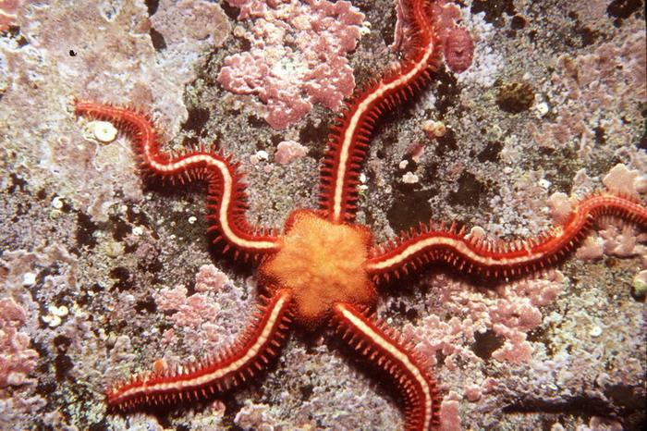
The Brittlestar

Slide 16
Lessons of the Brittlestar
Material agent
Not passive or blank but active and generative
Dynamically engages with changing situations and environment
“Continually reconfigures the boundaries and connectivity that matter to its very existence”

Slide 17
Karen Barad and Agential Realism
Meeting the Universe Halfway:
Quantum Physics and the Entanglement of Matter and Meaning
<iframe width="560" height="315" src="https://www.youtube.com/embed/v0SnstJoEec" frameborder="0" allow="autoplay; encrypted-media" allowfullscreen></iframe>

Slide 18
The Meaning of Agential Realism
Continually entangled and reconfiguring reality and possibility
Meaning and agency emerge from intra-actions
We are ethically responsible because our intra-actions have significant impacts
Because we are entangled, we are accountable for the performativity of reality

Slide 19
Quantum Physics and EE
Changes how we conceive of our interconnectedness with the world
Emphasizes context and relationships
Our intra-actions are boundary making
We can reconfigure dynamic environmental literacy and leadership

Slide 20
Definition of Key Terms
Intra-Action
Agency
Causality
Posthumanist Ethics of Worlding
Diffraction

Slide 21
Intra-action
“The ability to act emerges from within relationships and not outside of it.”

Slide 22
Agency
“Agency is a matter of intra-acting; it is an enactment.”

Slide 23
Causality
“Causality is an entangled affair: it is a matter of cutting things together and apart.”

Slide 24
Diffraction
“Marking differences from within and as part of an entangled state; about differences materialized, differences that matter.”

Slide 25
Posthumanist Ethics of Worlding
“Particular possibilities for (intra-)acting exist at every moment, and these changing possibilities entail an ethical obligation to intra-act responsibly in the world’s becoming, to contest and rework what matters and what is excluded from mattering.”

Slide 26
A Quantum Vision of Environmental Literacy
Diffractive rather than a progression or collection
Dynamically intra-acts through entanglement to create meaning
Bound by ethical responsibility
“Not a thing but a doing...an intra-active becoming”

Slide 27
Posthumanist Ethics

Slide 28
Posthumanist Ethics
“Ethics are not simply about responsible actions in relation to human experiences of the world; it is a question of entanglement and how each intra-action matters in the reconfiguring of these entanglements; it is an ethical call that is embodied in the very worlding of the world.”

Slide 29
Ethics of Worlding
“Values are integral to the nature of knowing and being”
“The becoming of the world is a deeply ethical matter”
“Each moment is alive with different possibilities for the world’s becoming and different reconfigurings of what may yet be possible”
“Responsibility entails an ongoing responsiveness to the entanglements of self and other, here and there, now and then”

Slide 30
Leadership for the Future

Slide 31
Diversity, Equity, and Inclusion
“Responsibility must be thought of in terms of what matters and what is excluded from mattering”
“Differentiating is not about othering or separating but about making connections and commitments”
“Diffraction is not about difference but about what differences matter”

Slide 32
Leadership for the Future
We must be inclusive and dynamic
We must emphasize context, relationships, and responsiveness
We must seek meaning through new ways of knowing, being, and ethicality
We must remember that we always have two things: hope and choice

Slide 33
“Meeting each moment, being alive to the possibilities of becoming, is an ethical call, an invitation that is written into the very matter of all being and becoming. We need to meet the universe halfway, to take responsibility for the role that we play in the world’s differential becoming.”

Slide 34
What is the nature of light?
Particle?
Wave?

Slide 35
In order to be the light of meaningful environmental literacy and leadership, we need to be both a particle and a wave; an individual particle strong and focused on intra-actions and a posthumanist ethics of worlding, and a wave of change, possibility, and hope for the becoming of a more sustainable world.

