Slide 1
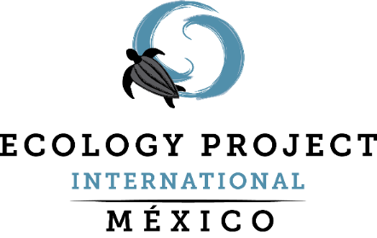
Activating Youth: Building core capacities to participate in the creation of sustainable communities
Presented by: Marlu Robledo
Notes:
How do we generate the greatest impact in our participants?

Slide 2
Environmental education is most effective
when it speaks to local issues, problems, and
priorities. People are more likely to participate
in and benefit from environmental education
if they see the direct link to personal as well as
community well-being.
— U.S. EPA2
In memoriam
Pepe Marcos-Iga

Slide 3
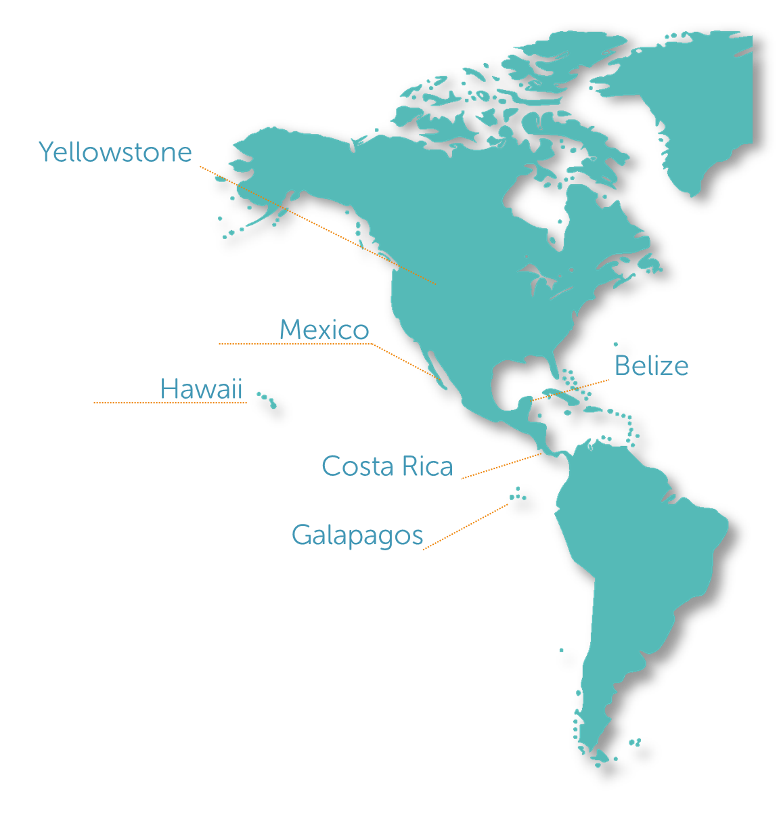
Our Mission
improve and inspire science education and conservation efforts worldwide through field-based student-scientist partnerships

Slide 4
Baja California Sur
Political & Geography
Youngest state in Mexico
Population: 799,849 (0.6% of Mexico)
86% urban/ 14% rural
2,705km of coastline
Wildlife
250 bird species (resident and migratory)
Gulf of California named, “World’s aquarium”
35% of the earth’s marine mammals
800 species of fish
44%
of the state’s surface is dedicated for “conservation”

Slide 5
Socio-environmental
challenges
Major international tourism developments
Landscape modification (mangrove deforestation
Air pollution
High migration rate
Urbanization
Poor water management
Lack of waste management plan
Oil spills
Overfishing
Mining concessions

Slide 6
Education & Youth Participation
in Mexico
Academic achievement average
1st grade of high school
9 of 10 will attend middle school
8 of 10 will attend high school
3 of 10 will attend University
11% is part of a group (Encuesta Nacional de Juventud, 2010)
5% volunteer and community work (ENIGH, 2010)

Slide 7
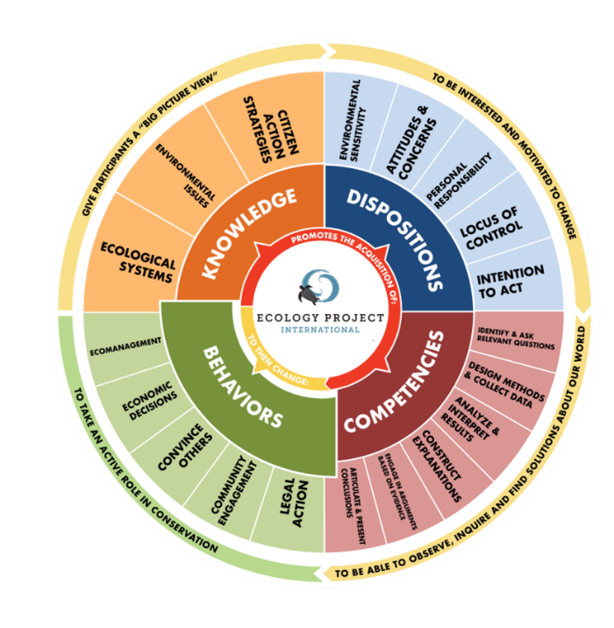
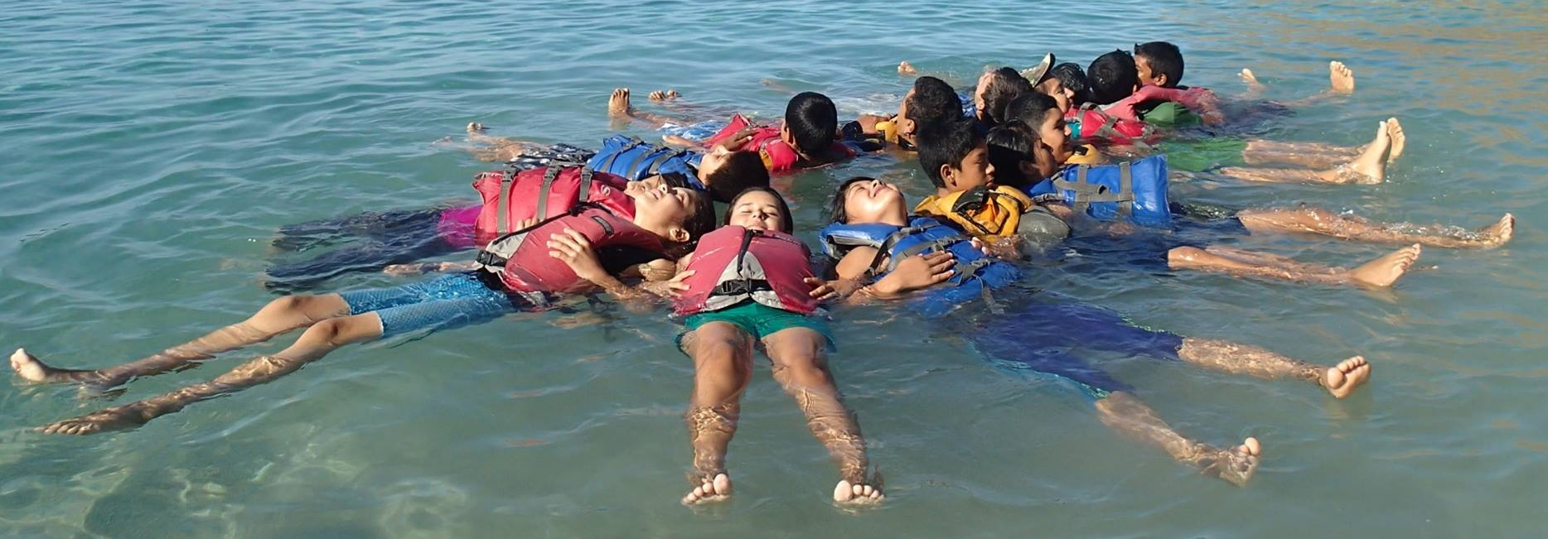
Our Vision
create an ecologically literate society where the world’s youth are empowered to take an active role in building sustainable communities**
**group of people who share the same place and organize themselves to prevent and solve socio-environmental challenges as well as to take action to keep their identity and to improve their life quality
.

Slide 8
Outcomes
400 students
Ecological knowledge
Critical thinking through the scientific process
Some dispositions
New friends!
2005 Everything started as a trip…
“A life change experience”
Field experience
Exploring nature
Scientific protocol
Peer scientific poster presentation

Slide 10
Outcomes
25 students
Ecological and social knowledges
Scientific and social skills
Dispositions
Behaivors
2005
2011 Alumni Program
Youth centered
Design their own projects
Cooperative leadership structure
Interships and awards

Slide 11
Outcomes
800 people
Community engangement
2005
2011
2013 Outreach Program
Water workshops
Festival

Slide 12
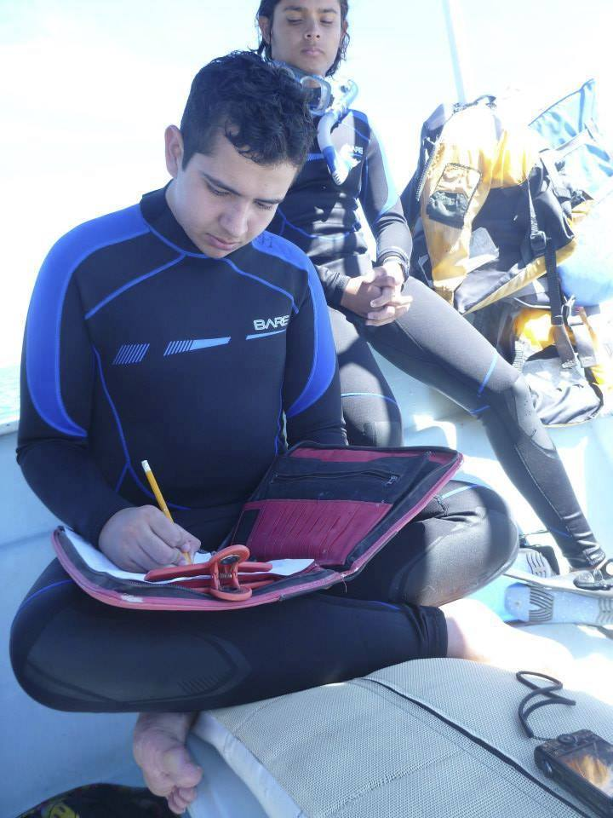
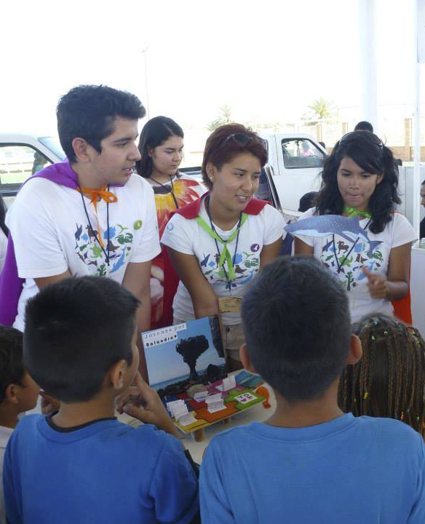
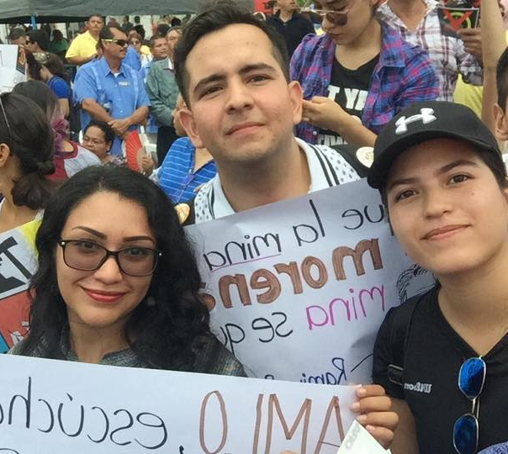
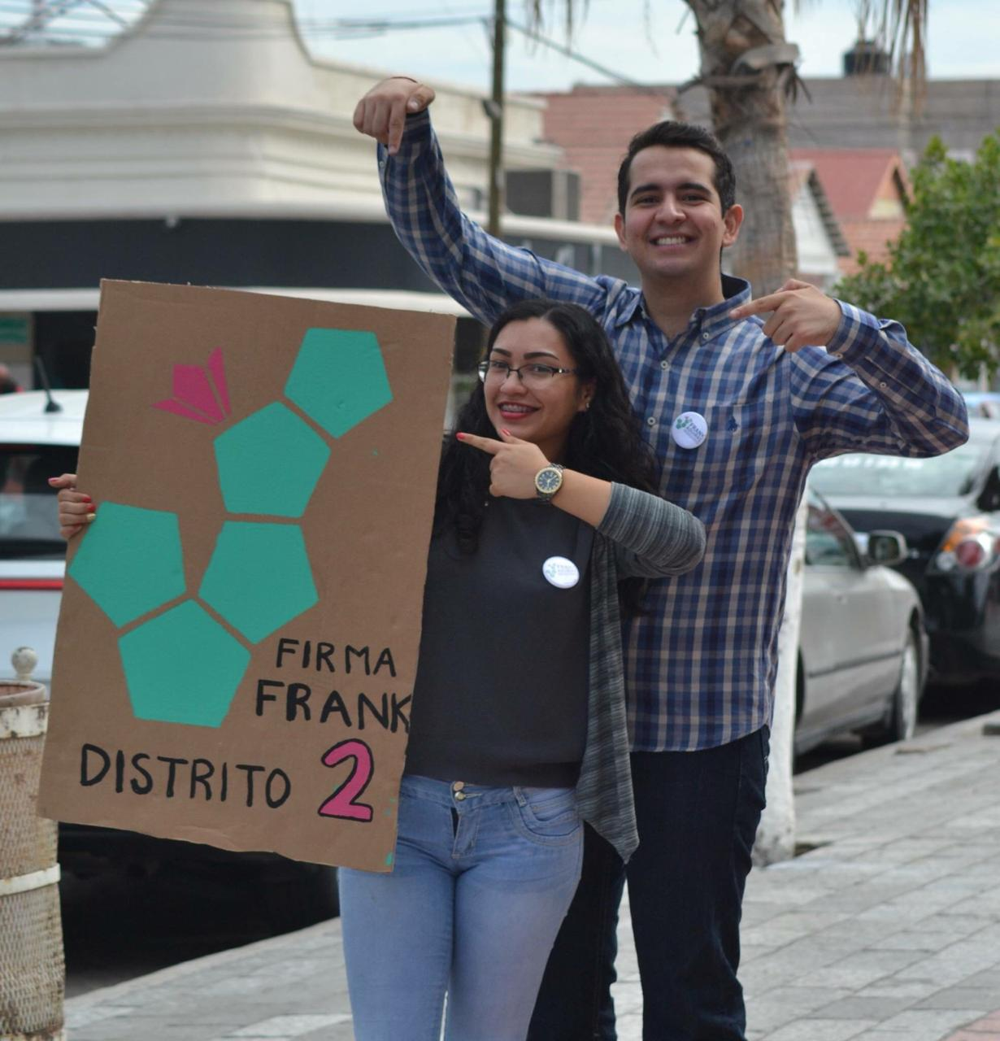
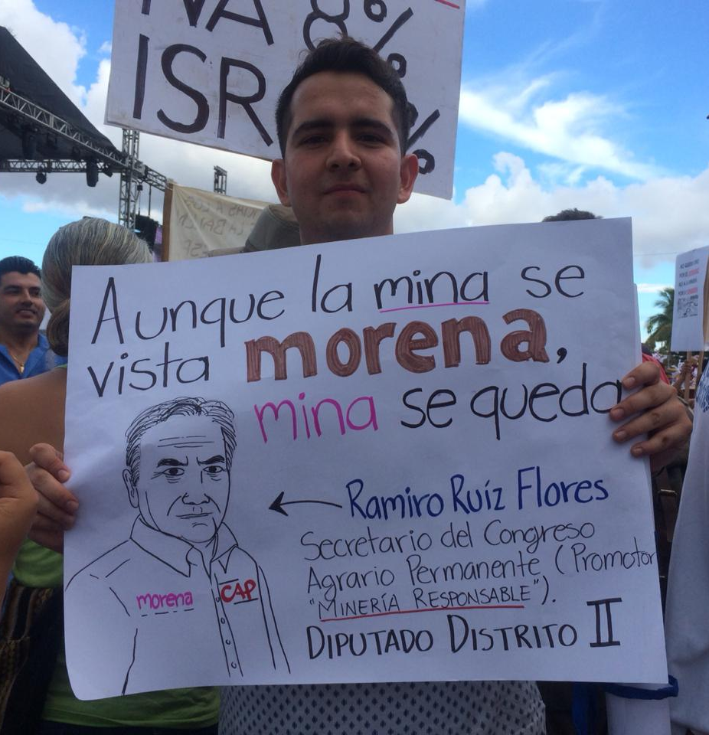
Outcome: traditional approach
3 years last
Scientific and social skills
Community engangement
Cooperative leadership
Design projects
Legal Action
Citizen participation

Slide 13
2005
2011
2013
2016
Innovated model

Slide 14
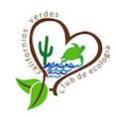
2016 Innovated model
Field trips/field courses
Design projects workshop
Workshops
Systemic approach involving stakeholders:
Formal educaction system
Teachers
Students
Funders
Partners
Festival
Eco-club
Interships
Shcolarships

Slide 15
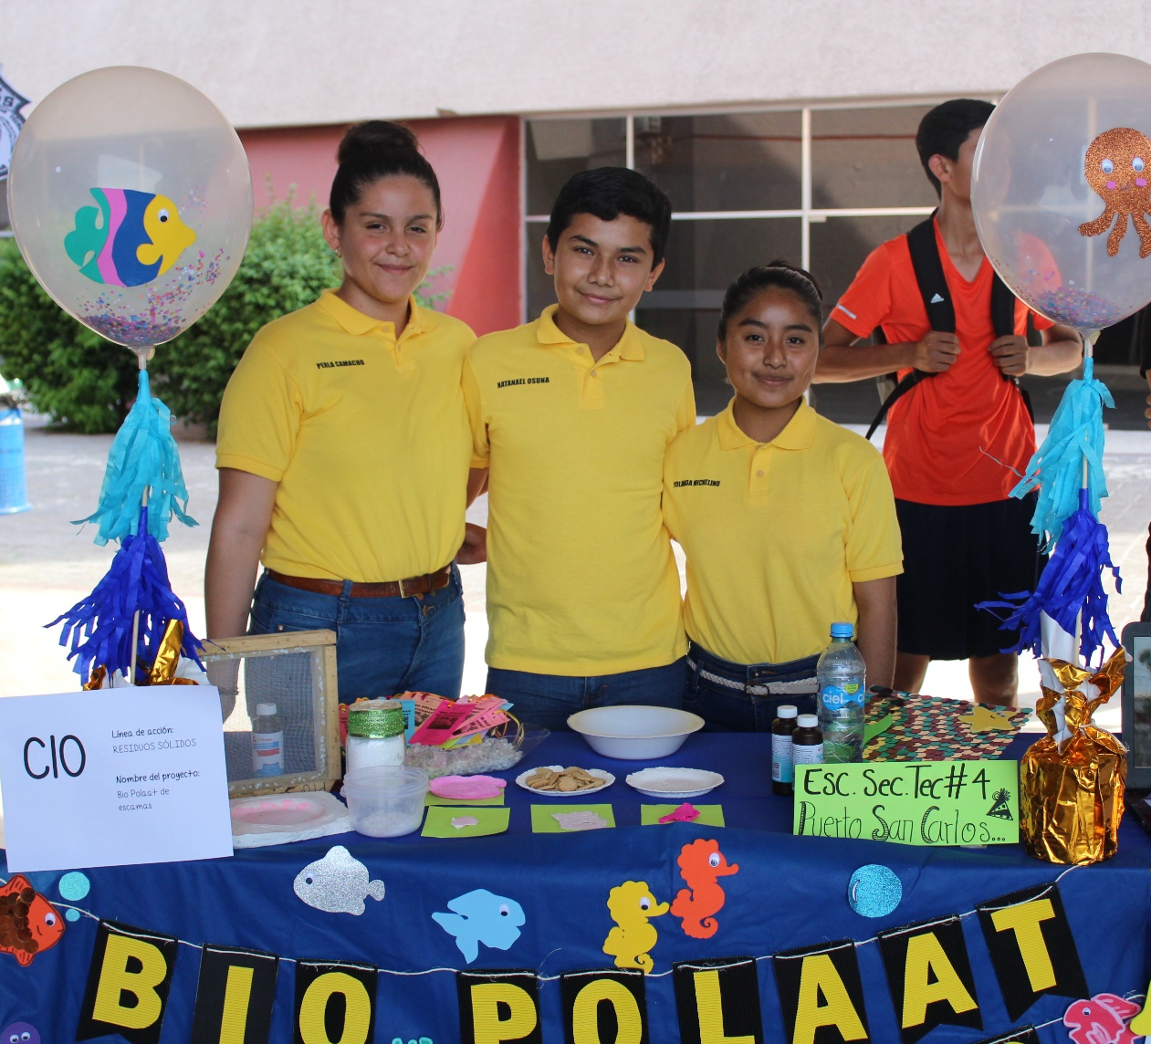
Outcome: Innovated approach
1 year last
Scientific process apply a local issue

Slide 16
Lessons learned
Social-environmental context is important to design educational experiences, also is importa involve th community.
Our role has beeing provide:
Safe space
Support and coaching to developed their own ideas
Connections with a broader network or partners
Long term follow up
It is important to safe spaces for the youth to get together, organize, reflect, dialogue and generate action to solve problems of their community.
Through several contacts with students in a shorter time we were able to maximize the development of knowledge, competences as well as provide more space to develop their own dispositions and behaviors

Slide 18
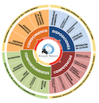
Outcomes
10-12% environmental literacy increasement trhrough the field experience
2005
2006
2011
2012 EPI wheel
PRE-POST evaluation

