Slide 1
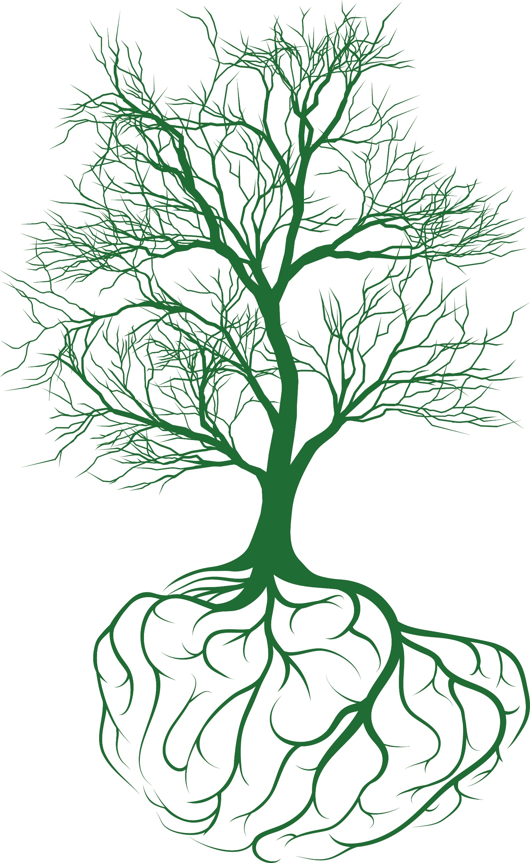
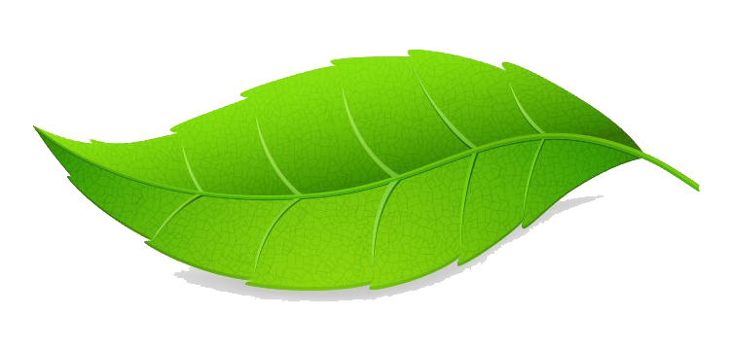
Inviting Nature Back
From School Gardens to Energy Companies
North American Association for Environmental Education
October 18th, 2019
John Steelman
Grow With Trees
scion@growwithtrees.com
Beyond Compliance
Notes:
My name is John Steelman. I work for a consultancy that enhances knowledge and implementation of integrated vegetation management (IVM) on electric and gas utility rights-of-way.
Today it’s my pleasure to talk with you about Inviting Nature Back: From School Gardens to Energy Companies and I’ll talk about one energy company in particular – Columbia Gas.
I began working with Columbia Gas nearly three years ago on a handful of cover type conversion projects. Columbia Gas was interested in exploring ways to convert existing vegetation communities to low-growing insect-pollinator-friendly vegetation. We had some successes and some challenges, and it wasn’t long before we realized that contractors in charge of managing vegetation would benefit from enhanced training programs so that these sites could be maintained and the program scaled up on the larger network of managed lands. So, we began working on training programs to move capacity from a focus on structural vegetation maintenance practices like brushing and mowing to selective individual plant treatments to maintain compatible vegetation on site.
It’s been a rewarding journey through behavior change challenges and leadership development. The goal of the initial program was to invite nature back – not only by managing vegetation more sustainably on their network, but to use it as a springboard for community/stakeholder engagement through outdoor nature programs with collaborative working groups and elementary pollinator gardens. (1:45)

Slide 2
Outline
Natural chaos and human order
Rights-of-way (ROW) across the lower 48
A challenging legacy
Significant opportunity to manage vegetation for secondary benefits
Responsible corporate citizenry
Inspiring the next generation of naturalists
Notes:
I will begin by briefly touching on the disparate relationship between natural chaos and human imposed order. Over the past one hundred years, human beings have superimposed a network of wires, pipelines and roads across the US and indeed the world, and today we have a challenge of legacy in how we manage vegetation within these corridors. This challenge is not without opportunity as there is significant potential to manage vegetation for secondary benefits like wildlife habitat conservation. This is a developing sector of corporate social responsibility that has the potential to reach not only customers and consumers of electricity and natural gas, but to help inspire the next generation of naturalists that will redefine how we manage our natural resources. (2:45)

Slide 3
Natural Chaos
Notes:
The natural world is in a constant state of flux. The availability of information and disinformation is unprecedented. For decades scientists have warned of the collapse of individual species and overall biodiversity and these warnings are becoming increasingly dire.
The western population of the monarch butterfly has experienced a 99% decline in recent history. The eastern population has faired only slightly better. These are not new stories. The passenger pigeon, the California Grizzly Bear, Eastern Elk…the list of extinct and possibly extinct animals in North America is staggeringly long, and many of these extinctions are due to over population, overexploitation of natural resources, and habitat loss and degradation. (3:40)

Slide 4
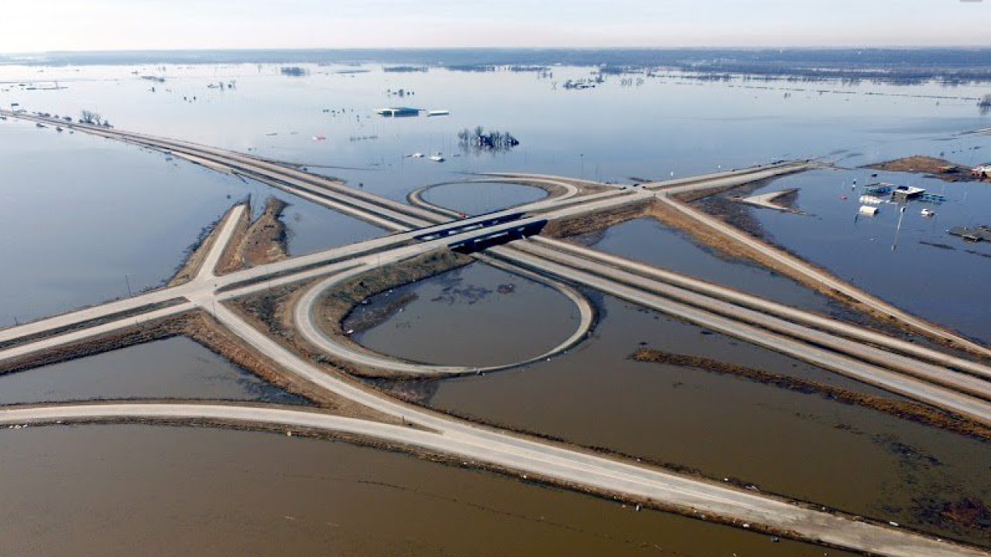
Human Order…
Notes:
Our society creates straight roads to travel by car and straight corridors to transport energy. We even plant our food crops in straight lines…
Our rational minds justify the efficiency of straight-line management, but the challenge we (and the next generations) face is how to overcome this thought process and find mutually beneficial practices for both humans and nature.
Listening to and reading the apocalyptic tales of biodiversity collapse, I sometimes find it difficult to maintain my optimism. With such high rates of habitat loss and degradation, is it even possible to invite nature back? Is it even possible to manage for non-linear living systems on linear human landscapes?
The answer is yes, if we all contribute what we can. Today I’ll talk about one example – managing utility rights-of-way for wildlife conservation - but this is only one piece of the puzzle. To paraphrase Dr. Doug Tallamey, ‘don’t worry about the world. It’s too big. Just worry about what’s happening on your piece of the biosphere. Enough of us own pieces of the biosphere, that we can make a big difference. And I can’t think of a more awesome responsibility than that.” (5:10)

Slide 5
Estimated 21M Acres of Utility ROW
USEPA Level 3 Ecoregions
Electric Power Lines
Notes:
I want to help you envision the potential to manage vegetation for wildlife conservation on rights-of-way in the United States, and I would like to reframe rights-of-way for their potential to connect, rather than bisect, habitats. I’m going to say that again because I want you to keep it mind for the next 30 minutes. I would like to reframe rights-of-way for their potential to connect, rather than bisect, habitats.
Electric and gas transmission and distribution rights-of-way are estimated to occupy 21 million acres and traverse nearly every ecoregion across the lower 48s (and Puerto Rico because I was too lazy to clip it from this map). To put this land area in perspective, 21 million acres, if compressed, would occupy the state of South Carolina or approximately 1% of total US land area.
Certainly not an insignificant amount of land, particularly if we can reimagine it’s potential to connect, rather than bisect, wildlife habitat and even our human communities. (6:30)

Slide 6
A Challenging Legacy
“We cannot solve our problems with the same thinking we used when we created them.”
– Albert Einstein
Notes:
In utility vegetation management, we have two general methods – structural and compositional.
We can manage structurally by focusing on brushing, mowing and broadcasting nonselective herbicides. These methods are indiscriminate. Every blade of grass, every shrub, every tree is treated equally – as the enemy.
Conversely, we can manage for composition – targeting treatments to select against incompatible vegetation, preserving compatible vegetation that will grow and expand it’s footprint. I’ve heard this referred to as managing vegetation with vegetation. This is what’s known as integrated vegetation management or IVM. IVM is the only method we can employ to guarantee the creation and maintenance of wildlife habitat conserving vegetation. The same thing cannot be said for employing the purely structural methods of ‘spray and pray’ or ‘when in doubt, brown it out.’ (7:45)

Slide 7
Tremendous Opportunity
Notes:
IVM grew out of the aftermath of largescale adoption of non-selective herbicides in the 1950’s. During the 1960’s and 70’s utilities began adopting more selective treatments – like low volume and ultra-low volume individual plant treatments – but then in 2003 an event happened that changed the way utility vegetation managers viewed vegetation. In one afternoon and evening, vegetation went from an environmental asset to an operational risk.
On August 14th, 2003, vegetation came into contact with aboveground electric wires and caused a cascading blackout known as the Northeast Blackout. 10 million people lost electricity, contributing to more than 100 fatalities and an unquantified baby boom 9 months later. (I was a Peace Corps Volunteer in Ethiopia for 3 years. I know what happens when the power goes out.) Following the Northeast Blackout, the federal government imposed regulations that could mean $1,000,000 a day fines for subsequent outages. Many utilities quickly responded by cleaning house and many set IVM aside in favor of purely structural vegetation maintenance.
However, IVM was not to blame. The root cause of the Northeast Blackout was mismanagement of minimum vegetation clearance distances. But that didn’t seem to matter at the executive level. So for the last decade, the concept of IVM has appeared too risky for many utilities to engage in.
Remember that 21 million acres. There is tremendous potential to manage for wildlife habitat on utility corridors if the industry can swallow the bad taste left by the blackout. In many forested areas, like the scene shown here, utility corridors actual create habitat for insect-pollinators, upland birds and ungulates in what would otherwise be fully shaded forest canopy and sparse understory.
Moving forward, the choice for the industry is to maintain risk-based structural vegetation maintenance practices or to re-integrate integrated vegetation management to promote compatible communities that can provide wildlife habitat conservation value and sound business practices. (10:40)

Slide 8
Changing Energy Portfolios & ROW
USEPA Level 3 Ecoregions
Electric Power Lines
Notes:
I want to quickly address the elephant in the room before I move on. I’m talking about a fossil fuel heavy industry managing vegetation more responsibly. Some of you might be thinking, ‘this sounds like greenwashing’, and in some cases, you would be right. I flew to Kentucky on United Airlines who love to boast that they recycle single use plastic cups as part of their EcoSkies program. That, to me, is a drop in the bucket to make frequent fliers feel better about themselves. That, to me, is greenwashing.
As for utility companies, greenwashing can apply, but it does not in all cases. If a company is advertising 1 or 2 acres of pollinator habitat and they maintain 25,000 miles of transmission lines, then there’s definitely a disconnect and potentially greenwashing. If a company’s commitment is to manage biodiversity across their entire footprint, then I would argue that this is not greenwashing.
Hard truth - we all depend on fossil fuels currently. Unless you are living in a log cabin in the woods and powering your Tesla from your own personal solar grid, odds are you depend on fossil fuels and will continue to do so until the challenges of renewable energy storage are solved. Even when our national energy grid is decentralized, rights-of-way will still be necessary for transmission and distribution of energy. Evolving renewables will change the shape of rights-of-way over the coming century, but there’s no indication that rights-of-way are going away. And if they’re not going away, then we’re left with the choice to manage them for maximum benefit through IVM or for simple compliance via rinse and repeat brushing, mowing and broadcasting herbicides. (13:00)

Slide 9
Columbia Gas 6 State Territory >4,000 Acres of IVM Numerous Monarch Waystations WHC Certifications Endorsed by the NWTF Monarch CCAA
Notes:
So far, I’ve been talking about the potential to develop IVM on a comprehensive utility network, but change rarely happens all at once. I’d like to focus now on an experience I’ve had with a local natural gas distribution company. Gas transmission and distribution is not subject to the same regulations as electric transmission, but historically natural gas companies have also not made waves managing for secondary benefits.
I’ve witnessed a shift in utility vegetation management methods at Columbia Gas over the last 3 years. Columbia Gas operates across six states and actively manages a little more than 4,000 acres of land. Numerous Monarch Waystations and Wildlife Habitat Council certifications grew out of our initial work in cover type conversions, but the work has gone much farther than that. Columbia Gas is now managing much of their network under the principles of integrated vegetation management, earning them an endorsement by the National Wild Turkey Federation and the ability to enroll their network into the Nationwide Candidate Conservation Agreement with Assurances for Monarch Butterfly - a landmark agreement between the USFWS and multiple energy utilities and Departments of Transportation to support monarch habitat on rights-of-way. Efforts to promote IVM across their network align with conservation activities outlined in the Monarch CCAA, and next year their commitments will surpass the qualifying minimums set forth by the CCAA. (15:00)

Slide 10
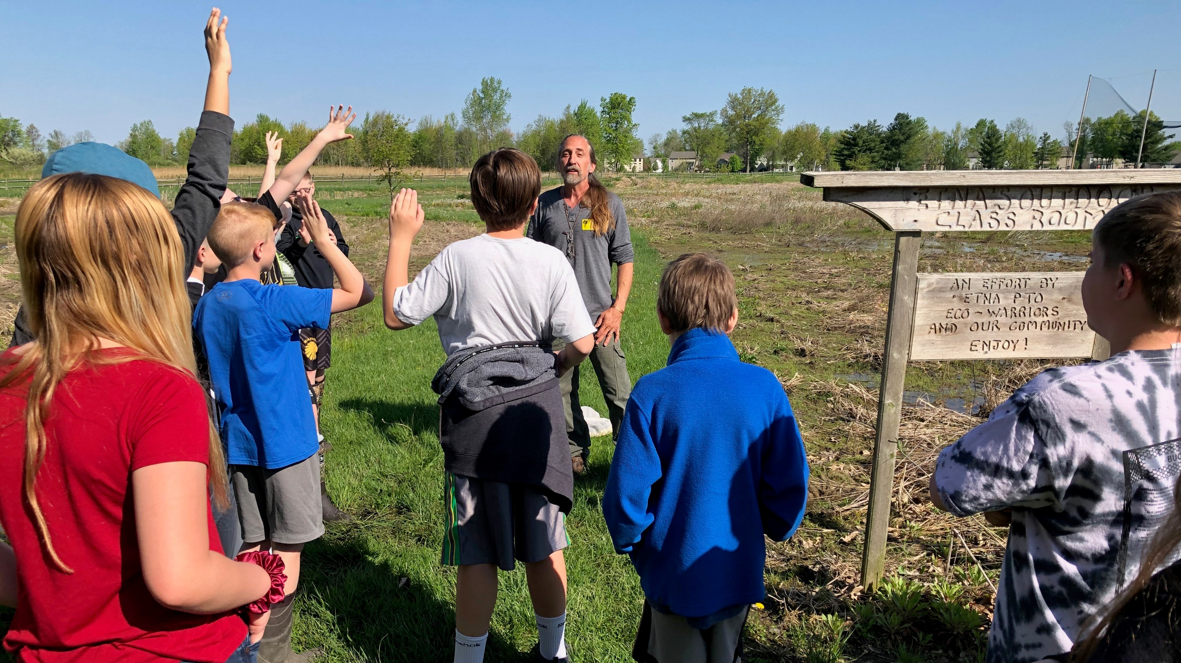
Inspiring the Next Generation of Naturalists Through Community Outreach
Notes:
Columbia Gas not only actively manages their rights-of-way to provide habitat for insect pollinators where and when they can, they’re also taking the message to the streets – working to support primary outdoor education programs by establishing pollinator gardens and providing support to collaborative groups.
By doing so, they are not only voluntarily providing for wildlife habitat on their rights-of-way, but they are working to inspire the next generation of naturalists that will inherit many of the complex problems of today’s world - linking non-linear natural systems to the legacy of linear human management.
If you’re a local educator, you may know Jim Embry of the Madison County Pollinator Group, and if you don’t, I recommend that you look him up. Columbia Gas is interested to expand outreach beyond direct vegetation management programming so they donated pollinator seeds to Jim so that he could champion pollinator gardens at 21 schools across Madison County. If you’re a local educator, Columbia Gas would be interested to talk with you about developing similar programs in Kentucky. In fact, I’m pleased to have Susan Murray and Tony Tipton, two key facilitators of Columbia Gas’s pollinator program, in the audience here this morning. I’m sure that they would be happy to speak to you about seed resources and pollinator programming, and I’ll provide Susan’s contact information on the closing slide and mine too if you’re shy or we don’t get a chance to connect.
These initial connections to nature cannot be understated because quantifying their long-term effect is so difficult. I spent three years in Ethiopia with the Peace Corps and I’m still unpacking the effect it had on me, let alone the impact that I had on my community, though I will maintain that the greatest benefit was mine. (17:20)

Slide 11
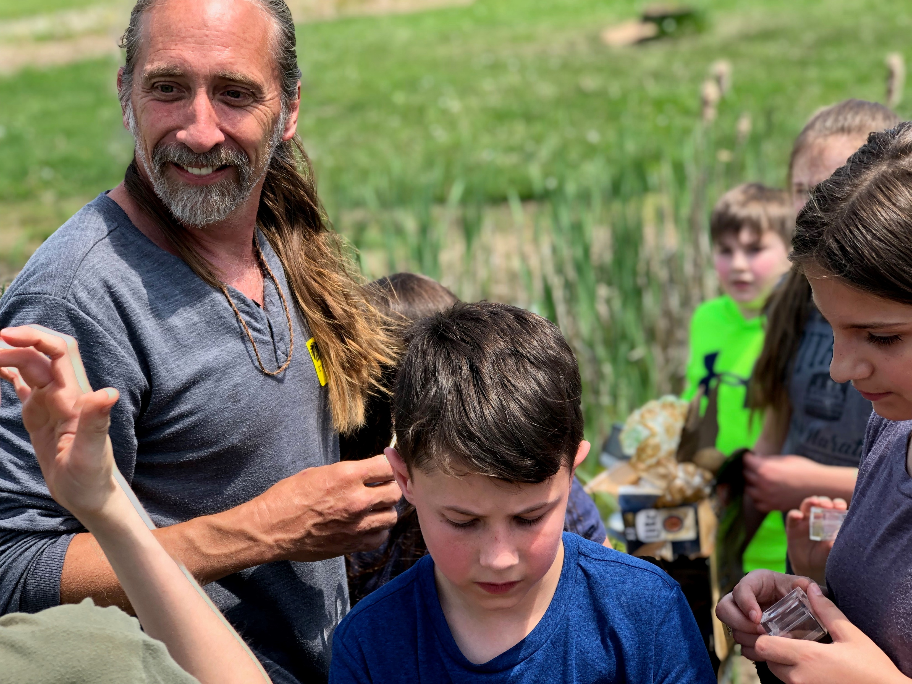
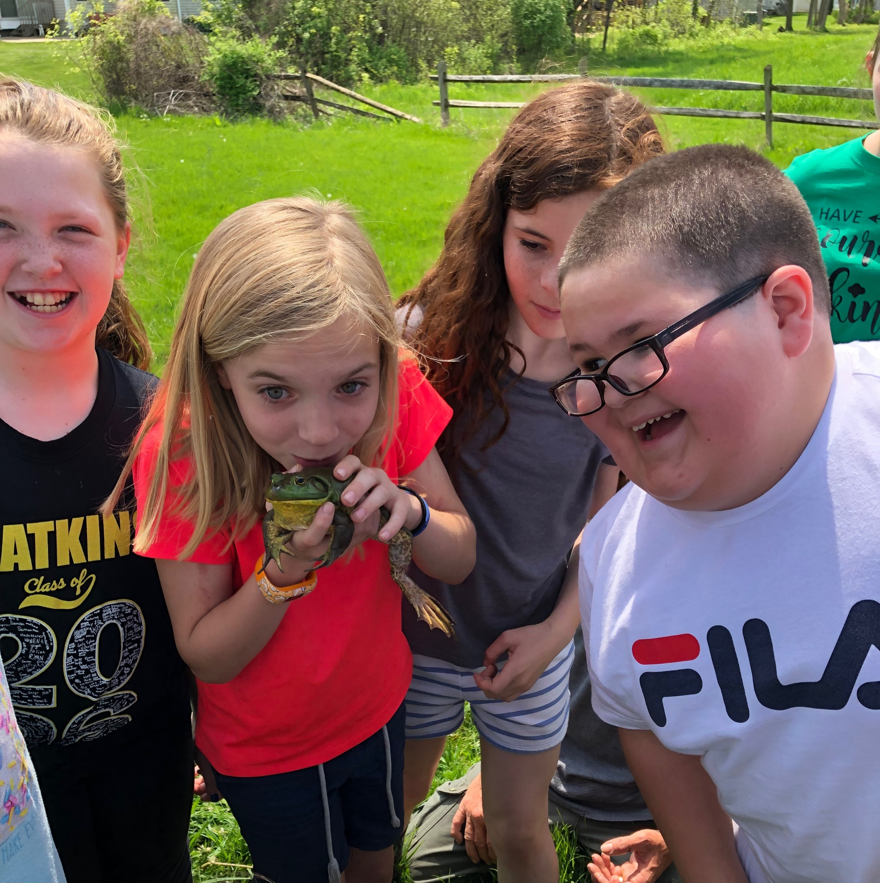
Cultivating Connections with Nature
“Hands on experience at the critical time, not systematic knowledge, is what counts in the making of a naturalist. Better to be an untutored savage for a while, not to know the names or anatomical detail. Better to spend long stretches of time just searching and dreaming.
Rachel Carson, who knew this well, used different words to the same effect in The Sense of Wonder in 1965: ‘If facts are the seeds that later produce knowledge and wisdom, then the emotions and the impressions of the senses are the fertile soil in which seeds must grow. The years of childhood are the time to prepare the soil.’”
- E.O. Wilson, Naturalist
Notes:
I came across this passage recently in E.O. Wilson’s Naturalist…
This is something that every educator knows, but to illustrate the point, I’m going to close with a short story about my connection to nature (depicted in tree form). (18:20)

Slide 12
Developing A Personal Connection to Nature (Depicted in Tree Form)
Seed Dispersal Paying Forward
Canopy Development Branching Out
Stem Elongation Developing Direction
Planted Seed Grounding
Rooting Exploring Resources
Notes:
I spent much of my childhood exploring the woods of central North Carolina – building forts, lighting leaf piles on fire, catching wildlife and bringing them home for show and tell…pretty standard kid stuff. Now, mind you, this was pre-cell phone and internet days, and I count myself lucky not to have been raised with a screen glued to my face.
My watershed moment came when I was 11 years old. My mother sent me away to an adventure camp in the mountains where I was exposed to the Appalachian Trail. This was my grounding – the moment that my seed of change was planted. There I met a thru-hiker that showed me it was possible to walk from Georgia to Maine. Right then and there, I decided, ‘oh, I’m going to do this.’
As a teen, my home life was not very solid. I was restless and I got in trouble a lot. Eventually, after 4 different high schools, I dropped out entirely. I worked in kitchens to save up enough money to buy backpacking gear, and at 19 I set out for a thru-hike. This was the beginning of my rooting phase (1) – where I began to explore my resources. After the AT, I hitch-hiked across the country, hiked the John Muir Trail in the California Sierras without food drops, traveled through Central America on my kitchen Spanish and developed the crazy idea to go to college. My explorations had set the stage for a degree in natural resources. So, at 24, GED in hand, I enrolled at the University of Montana’s College for Forestry and Conservation.
This marked my stem elongation (2) – where I began to develop direction. Fast forward, this GED graduated with high honors from UM. I worked as a timber cruiser and sawyer in Western Montana, Northern California and Wyoming before once again finding myself restless. I hadn’t had enough of government bureaucracy, so I applied to the Peace Corps. The Peace Corps, finding that I had hard skills and not just a liberal arts degree, quickly shipped me off to rural Ethiopia, where for two years I served as an agricultural volunteer in a UNESCO Biosphere Forest Reserve close to the South Sudanese Border. This marked my Canopy Development phase (3). It was here I learned that in order to manage natural resources, you have to start by influencing people. (This was a core lesson that I had failed to accept from my formal education.) I loved and hated those two years so much that I decided to extend for a third year with Catholic Relief Services out of the capital, Addis Ababa, working in USAID Development Food Assistance Programing and Disaster Risk Reduction. Now, my site conditions were rough, but it was the Eritrean refugee camps in northern Ethiopia that pushed me towards earning a masters degree upon my return to the states.
Returning to the US marked my Seed Dispersal phase (4). It was here that I found my way back into vegetation management and discovered my current path facilitating integrated vegetation management programming with utilities - programs that work towards managing vegetation more sustainably and for greater purpose than just the safe and reliable transmission and distribution of energy. From a high school to rucksack warrior, from strange happenstance to higher education, and today talking about uniting non-linear natural systems with linear human thought. And I can trace it all back to one day that I spent on the AT when I was 11 when a stranger planted a seed unknowingly.
To borrow words from one of the founders of the Peace Corps John F. Kennedy, I choose to work with utilities, not because it’s easy, but because it’s hard; and because I believe there is great potential to invite nature back from school gardens to energy companies.

Slide 13
Inviting Nature Back
From School Gardens to Energy Companies
North American Association for Environmental Education
October 18th, 2019
John Steelman
Grow With Trees
scion@growwithtrees.com
Susan Murray
Columbia Gas
susanmurray@nisource.com
Beyond Compliance
Notes:
I commend the leadership at Columbia Gas for having the courage to embrace behavior change as adults. Behavior change is one of the toughest challenges we can tackle, but it begins with a seed. Columbia Gas is truly making a difference managing their vegetation more sustainably and by inspiring the next generation of naturalists. And the changes I’ve seen continue to inspire me to work towards uniting disparate systems to serve multiple functions in an ever increasingly complex world.
So with that, I thank you for your attention. I believe we have a few minutes for questions.

