Slide 1
U.S. Student Research Symposia (SRS)
Slow and Steady Progress towards an
Inclusive Student Research Symposium
16 October 2019

Slide 2
What is a Student Research Symposium?
https://youtu.be/3ZFf1r32yGg
Video describing how a Student Research Symposium is different from a Science Fair.

Slide 3
Authors
Dixon M. Butler Youth Learning as Citizen Environmental Scientists
Jennifer Bourgeault Haley Wicklein University of New Hampshire

Slide 4
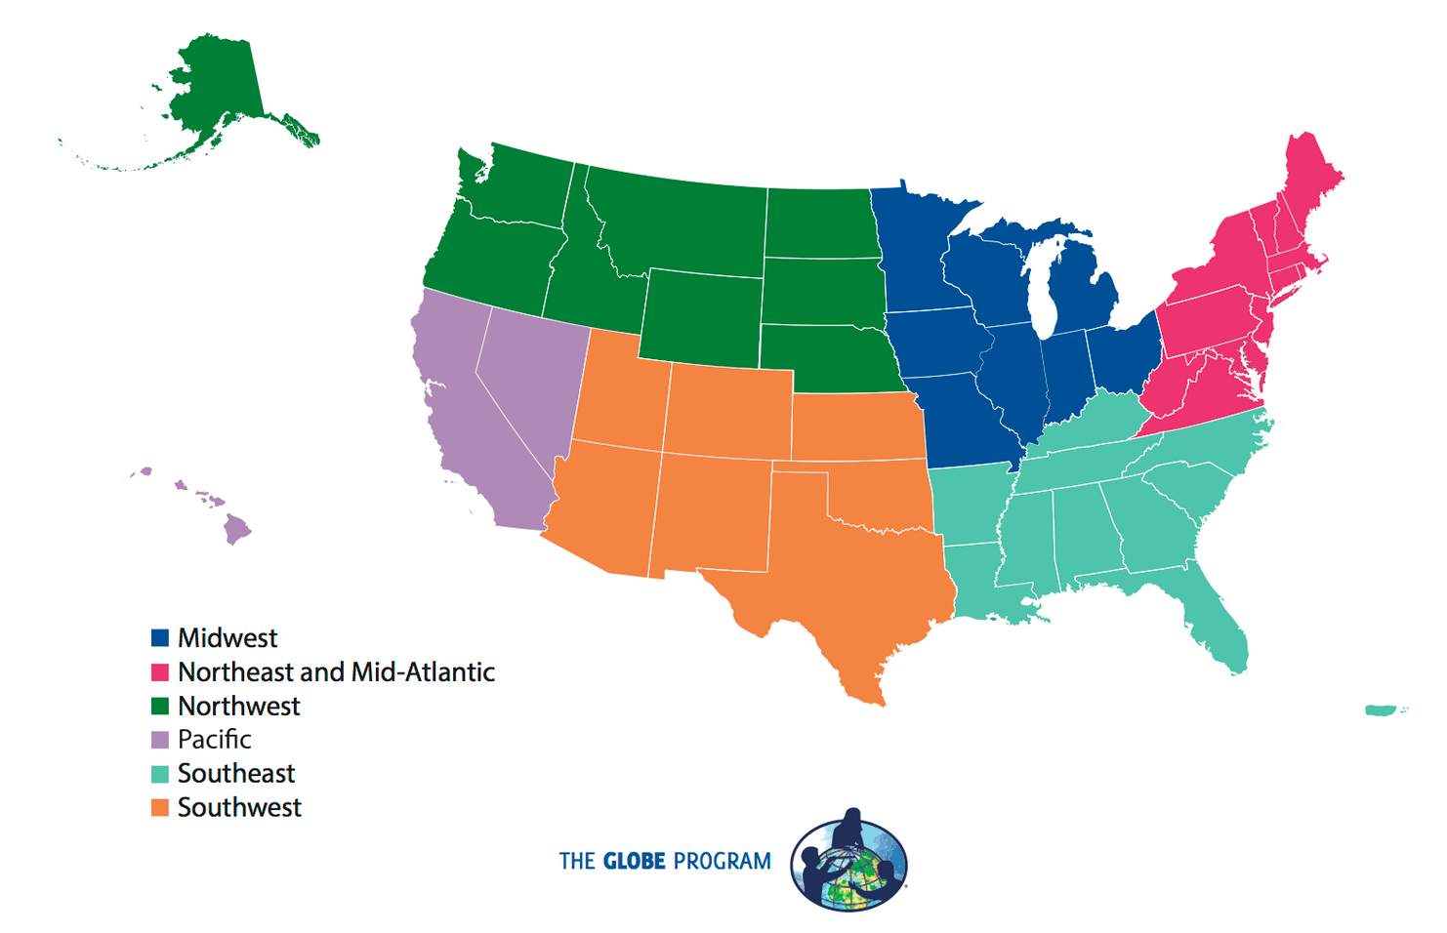
What are GLOBE Student Research Symposia (SRS)?
A series of student-centered events taking place in the six regional areas of GLOBE in the United States.

Slide 5
Student Research Symposia Video
https://stemforall2019.videohall.com/presentations/1546
Hyperlink to the video submitted to the “STEM for All” Showcase.

Slide 6
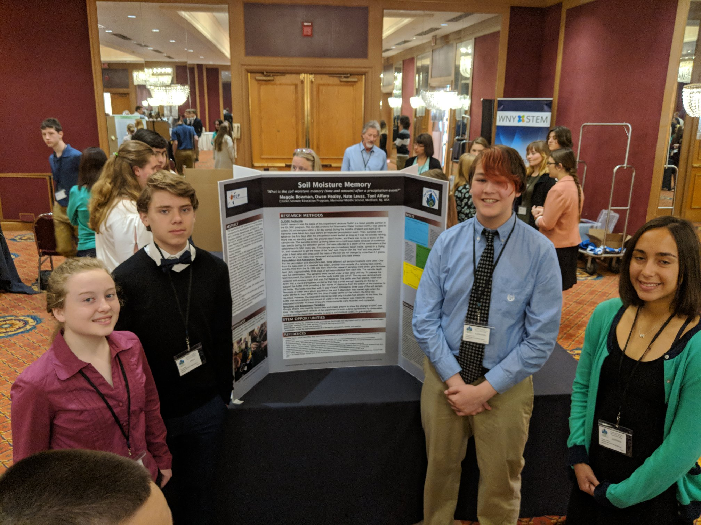
Students Being Researchers
Not a science fair
Not a talent search
Not a competition

Slide 7
What do students do at the GLOBE Student Research Symposia (SRS)?
Share their GLOBE research projects through posters and presentations.
Participate in peer-review of each other’s projects.
Meet and interact with STEM professionals (including NASA scientists) and other students through conversation and activities.

Slide 8
Participation in the Student Research Symposia 2016-2019

Slide 9
Student Research Symposia (SRS) Projects 2016-2019

Slide 10
Participants and Funding
All GLOBE students and teachers (grades 5 – 12) are invited to attend and participate.
GLOBE Partnerships mentor at least one team to attend and present.
Reviewers are members of the GLOBE International STEM Network and local STEM professionals.
The SRS events and participant travel have been supported by grants from NSF in 2016-2017 and NASA (grant # 80NSSC18K0135) and YLACES in 2018-2020.

Slide 11
Funded Attendance
Criteria:
underserved and underrepresented groups in STEM
high need districts – majority free and reduced lunch
never competed or participated in science fairs, science Olympiads, etc.

Slide 12
2019 Demographics* - Race/Ethnicity

Slide 13
2019 Demographics* - Language & Household Income
Language: 23% of students lived in households where languages other than English were spoken (Spanish, Arabic, Chinese, Hindi, Punjabi, Apache, and American Sign Language, among others).
Household Income:
72% between $25,000 - $149,999
15% reported the lowest household income category of $0 - $25,000, below the 2019 federal poverty guideline for a family of four.
*Reported by parents/guardians.

Slide 14
Agenda
Day 1
Registration & Outdoor event
Dinner with keynote speaker
Day 2
Set-up posters
Present posters to other students/teacher PD
STEM professionals review posters
Lunch/Evaluators choose outstanding middle and high school projects
Closing/every participant acknowledged

Slide 15
Challenge: Modeling Peer Review
How do we focus on the collaborative nature of science and model peer review?
Peer Review session occurs before review by STEM professionals.
Introductory PowerPoint with examples of critical but helpful comments.
Webinars and one-pager for STEM professional reviewers.
Recognition for excellence but no 1st, 2nd, or 3rd place.
Emphasis on the conversation between reviewers and presenters.
Feedback form.

Slide 16
Student Outcomes
Student Quotes
[The scientific process] doesn't seem scary or impossible anymore.
That there is no need to be nervous because everyone is here to support one another as we all learn something new.
There are lots of careers in science, and there are a lot of other people interested in it.
That science is more about learning and expanding information, rather than winning an award.
It is good to learn from other students that we don't already know and just meet and talk to people of different backgrounds.

Slide 17
Preliminary Evaluation Outcomes
Preliminary data suggest that these events increase:
students’ understanding of how science is conducted;
a student’s identity as a scientist; and,
a student’s interest in science.
The students realize that they can contribute to the scientific community and that their research is important. They feel part of ‘Science.’
- 2018 SRS Teacher

Slide 18
Student Feedback on the SRS:
Interaction with scientists were enjoyed the most.
Meeting scientists was selected most frequently (57%), followed by review from scientists (55%), and research presentations to the reviewers (53%).
Activities that involved sitting and listening to speakers rather than active participation were enjoyed the least.
Events involving interactions with other students fell in the middle.
Evening activities was selected as enjoyed the most by 46% and the least by 8%.

Slide 19
Other Evaluation Results:
In a post-SRS teacher survey (n=39), 92% of teachers were satisfied or very satisfied with the SRS for themselves, and 90% were satisfied or very satisfied with the SRS for their students.
Students reported a significant gain in their confidence, skills, and interest in science as a result of participation in the GLOBE SRS.
The summed score of survey items increased significantly, and nine individual items improved significantly, between pre-test and post-test.

Slide 20
Evaluation Data – Significant Improvements:
The items showing the most significant improvement were:
“I am able to learn new things in science,”
“I am able to ask good questions to do science research”
“I am able to interpret data in science research.”
Two of the relatively lower-scoring items at pre-test showed significant improvement between pre-test and post-test:
“I am able to conduct peer review of other students’ science research”
“I am able to construct scientific arguments.”

Slide 21
Overall:
After participating in the Student Research Symposia, there was increased student’ self-efficacy for the science practices.
Self-efficacy: a personal judgment of how well one can execute courses of action required to deal with prospective situations

Slide 22
Jennifer Bourgeault GLOBE U.S. Country Coordinator usglobecc@gmail.com https://www.globe.gov/srs Dixon M. Butler President, Youth Learning as Citizen Environmental Scientists (YLACES) dixon@ylaces.org www.ylaces.org

