Slide 1
Flexing the Guidelines
Trainer Bureau Model
Renee Strnad and Lauren Pyle, North Carolina
Ashley Hoffman, Kentucky
Katie Navin, Colorado
Alison Heimowitz and Jenna Mendenhall, Oregon

Slide 2
Session Outline
Recall general information about the Guidelines for Excellence
Examine the 2019 pilot program for Affiliate-NAAEE Guidelines Partnerships
Analyze four different Affiliate approaches
Share any questions/thoughts

Slide 3
What are the Guidelines?
Began in 1994
Partnership between NAAEE and the National Project for Excellence in Environmental Education
Tools for high quality programming
  Developed by a diverse team of backgrounds and organizations
  Drafts circulated to scholars and professionals in the
  field for comment
Peer reviewed and research based

Slide 4
Why the Guidelines
Each resource developed to respond to specific needs in the EE community
Synthesizes best practices across the field
Increase quality programming
Outlines a clear path for increasing overall environmental literacy from student to practitioner

Slide 5
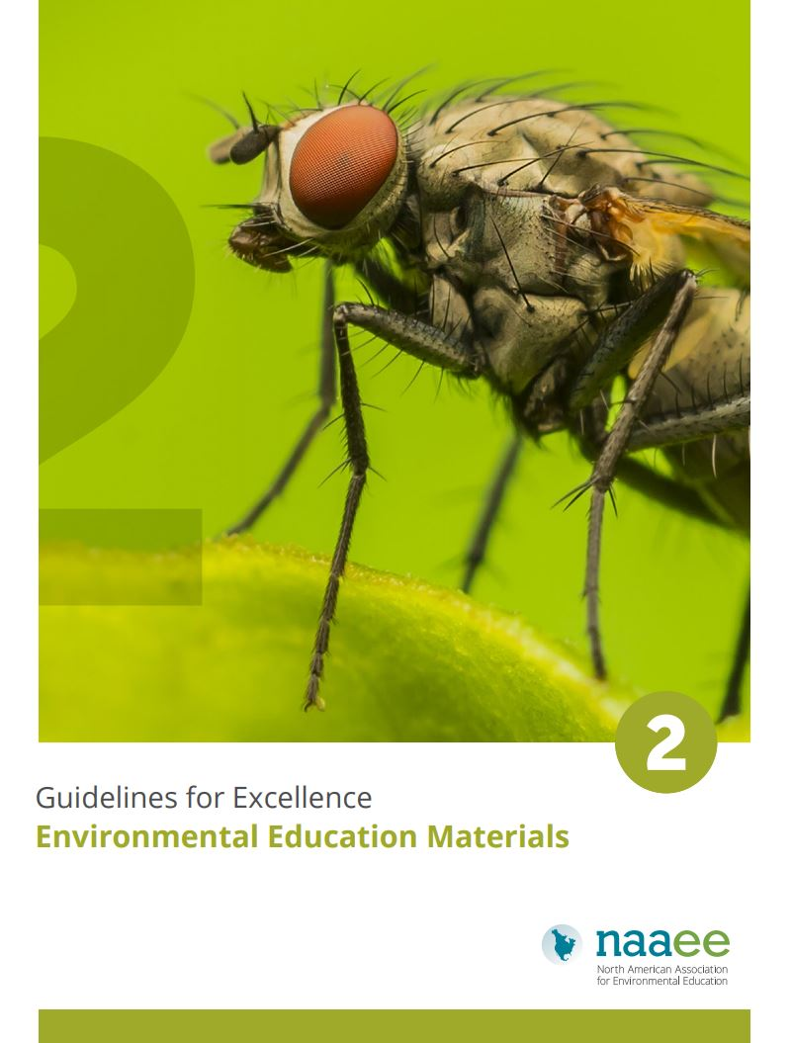

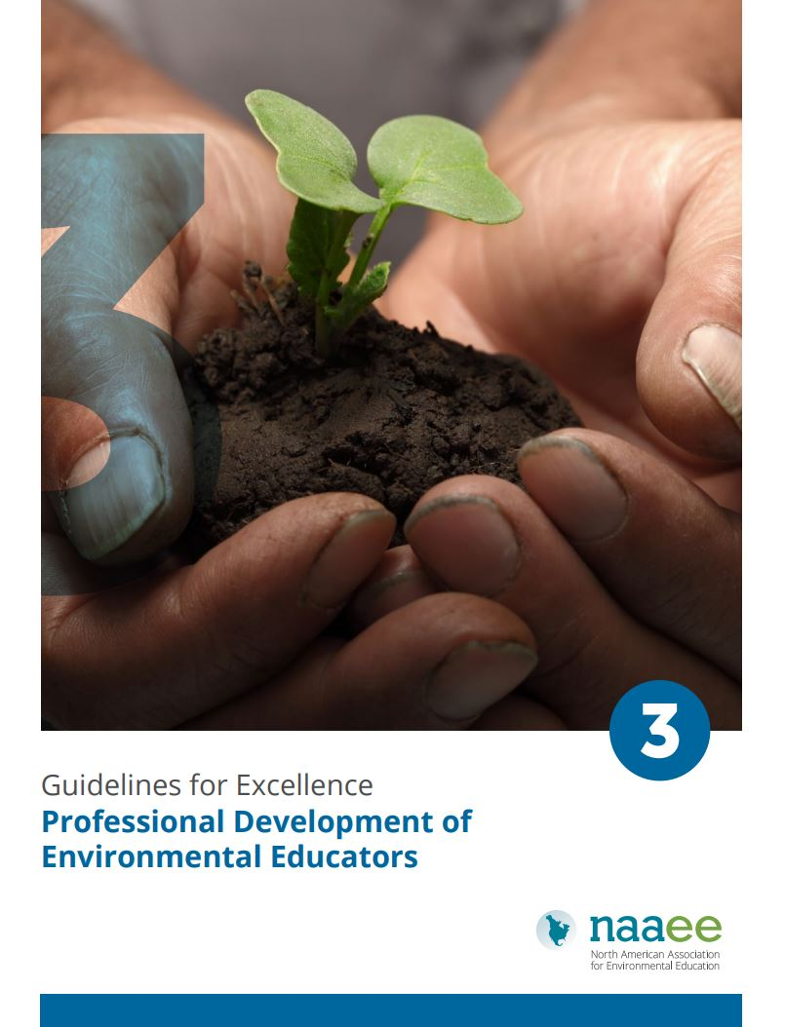
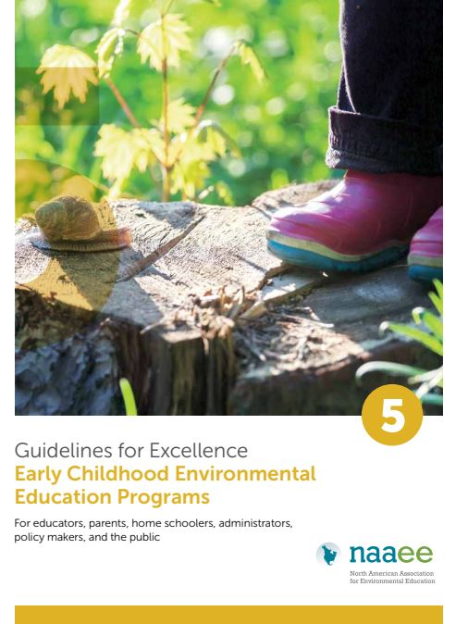

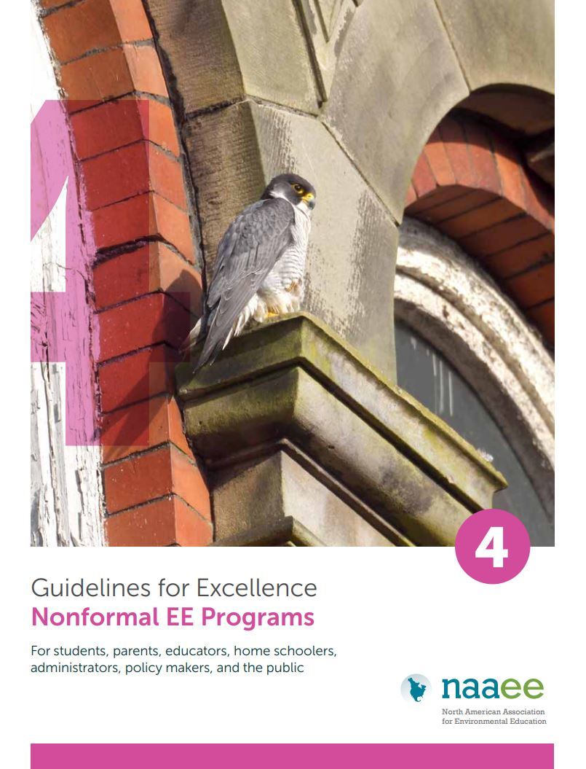
Six Total
EE Materials
Guidelines for Learning (K-12)
Preparation and Professional Development of Environmental Educators
Nonformal EE Programs
Early Childhood EE Programs
Community Engagement

Slide 6
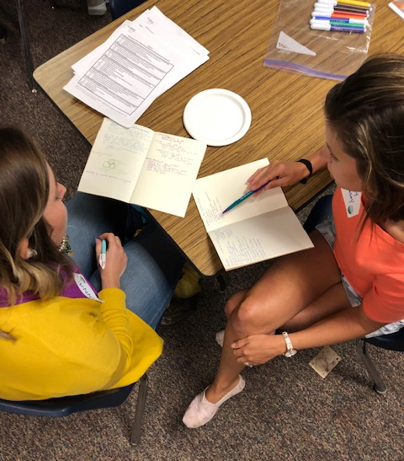
Traditional Training
Guidelines Trainer Bureau Members
Working through NAAEE / National Project for Excellence
  Serving as a national “coordinator” for trainings across the country
Notes:
Traditional model: Trained by Bora and became a GTB member. If someone wanted a workshop, they could reach out to Bora OR contact a GTB directly.

Slide 7

Flexing Traditional Model
What would be some of the best practices to the design and on-going sustainability of Affiliate-level Guidelines programs?
Benefits for both groups
Roles and responsibilities of both groups
Training and workshop requirements
Workshop/Program evaluation
Notes:
Based on the idea that other EE programs like PLT/WILD/Wet etc have a national sponsor and state coordinators - - what if we applied this model to the Guidelines? How could we create a standard structure of what a Guidelines program at the state/national level look like, but still allow flexibility for states to create a program that met their needs?

Slide 8
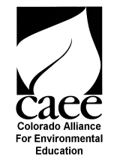



Pilot Program

Slide 9
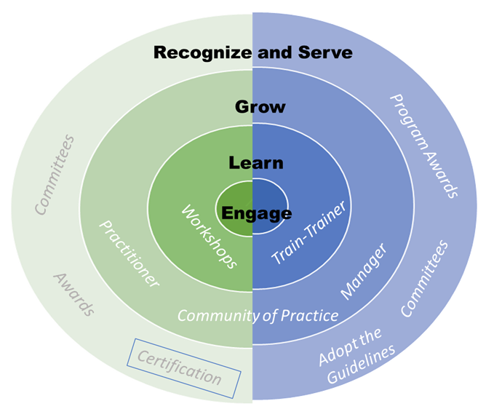
Colorado
Formalizing current Train-the-Trainer Network
New Emphasis on Training within Organizations
Communities of Practice
Recognition for Organizations

Slide 10
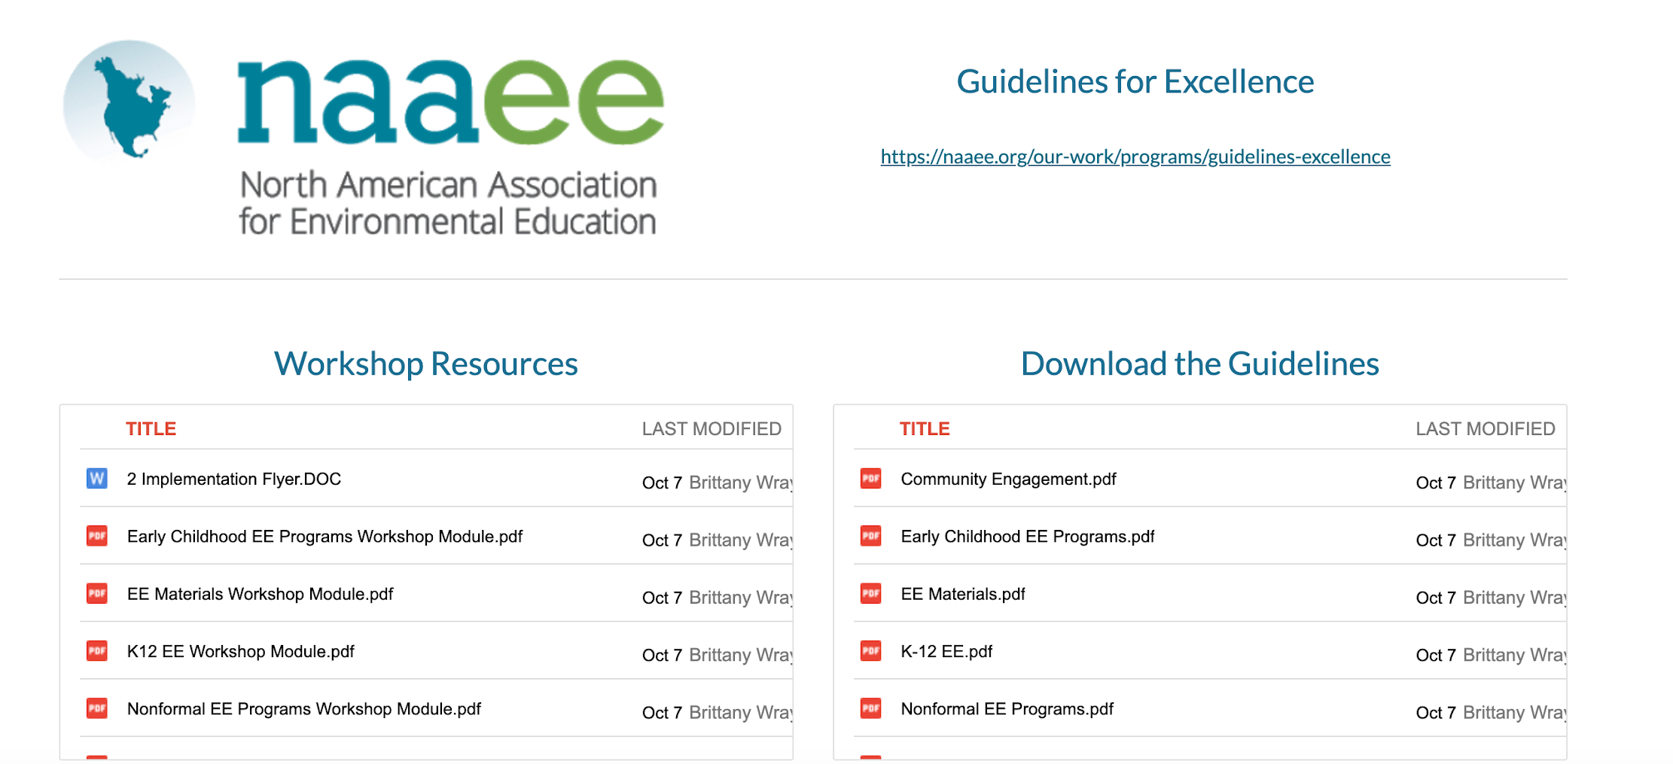
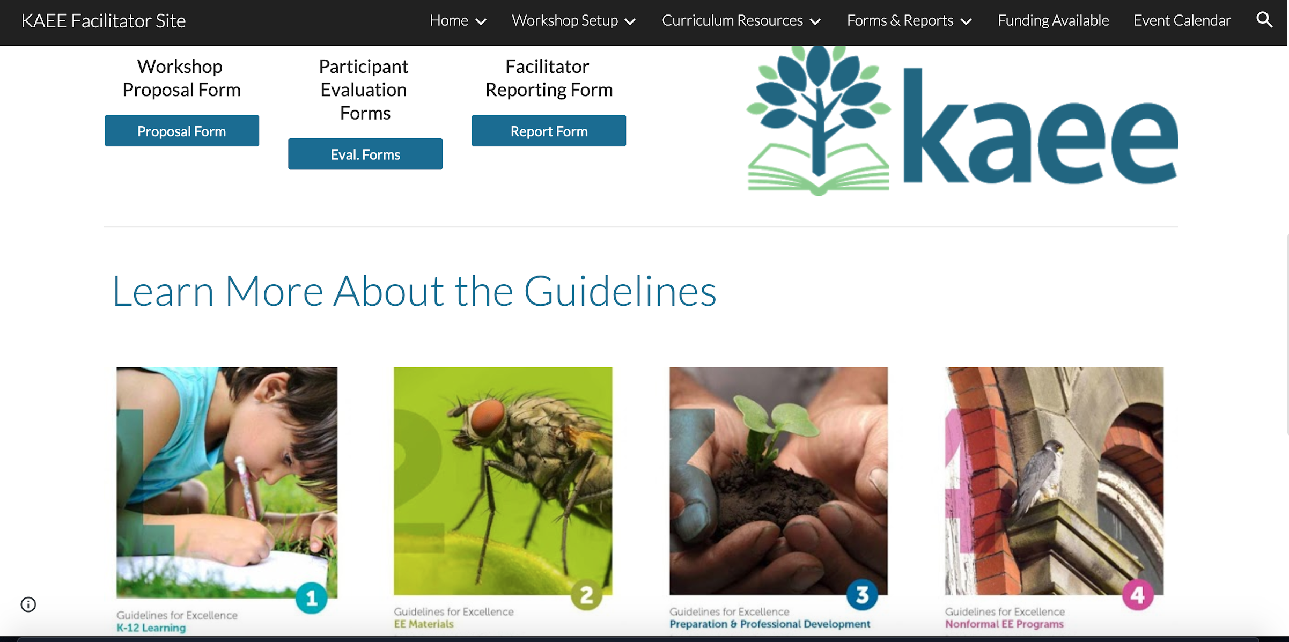
Kentucky
Microcredentials
Organizational Recognition
Continuing Education

Slide 11
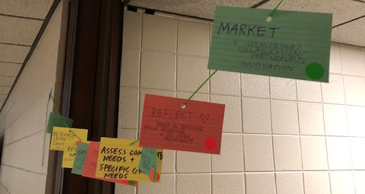
North Carolina
Incorporating the Guidelines into Certification:
Becoming a “Criteria I” workshop
Balancing structure and flexibility
Reactivating and adding trainers
Keeping Community
Engagement separate

Slide 12
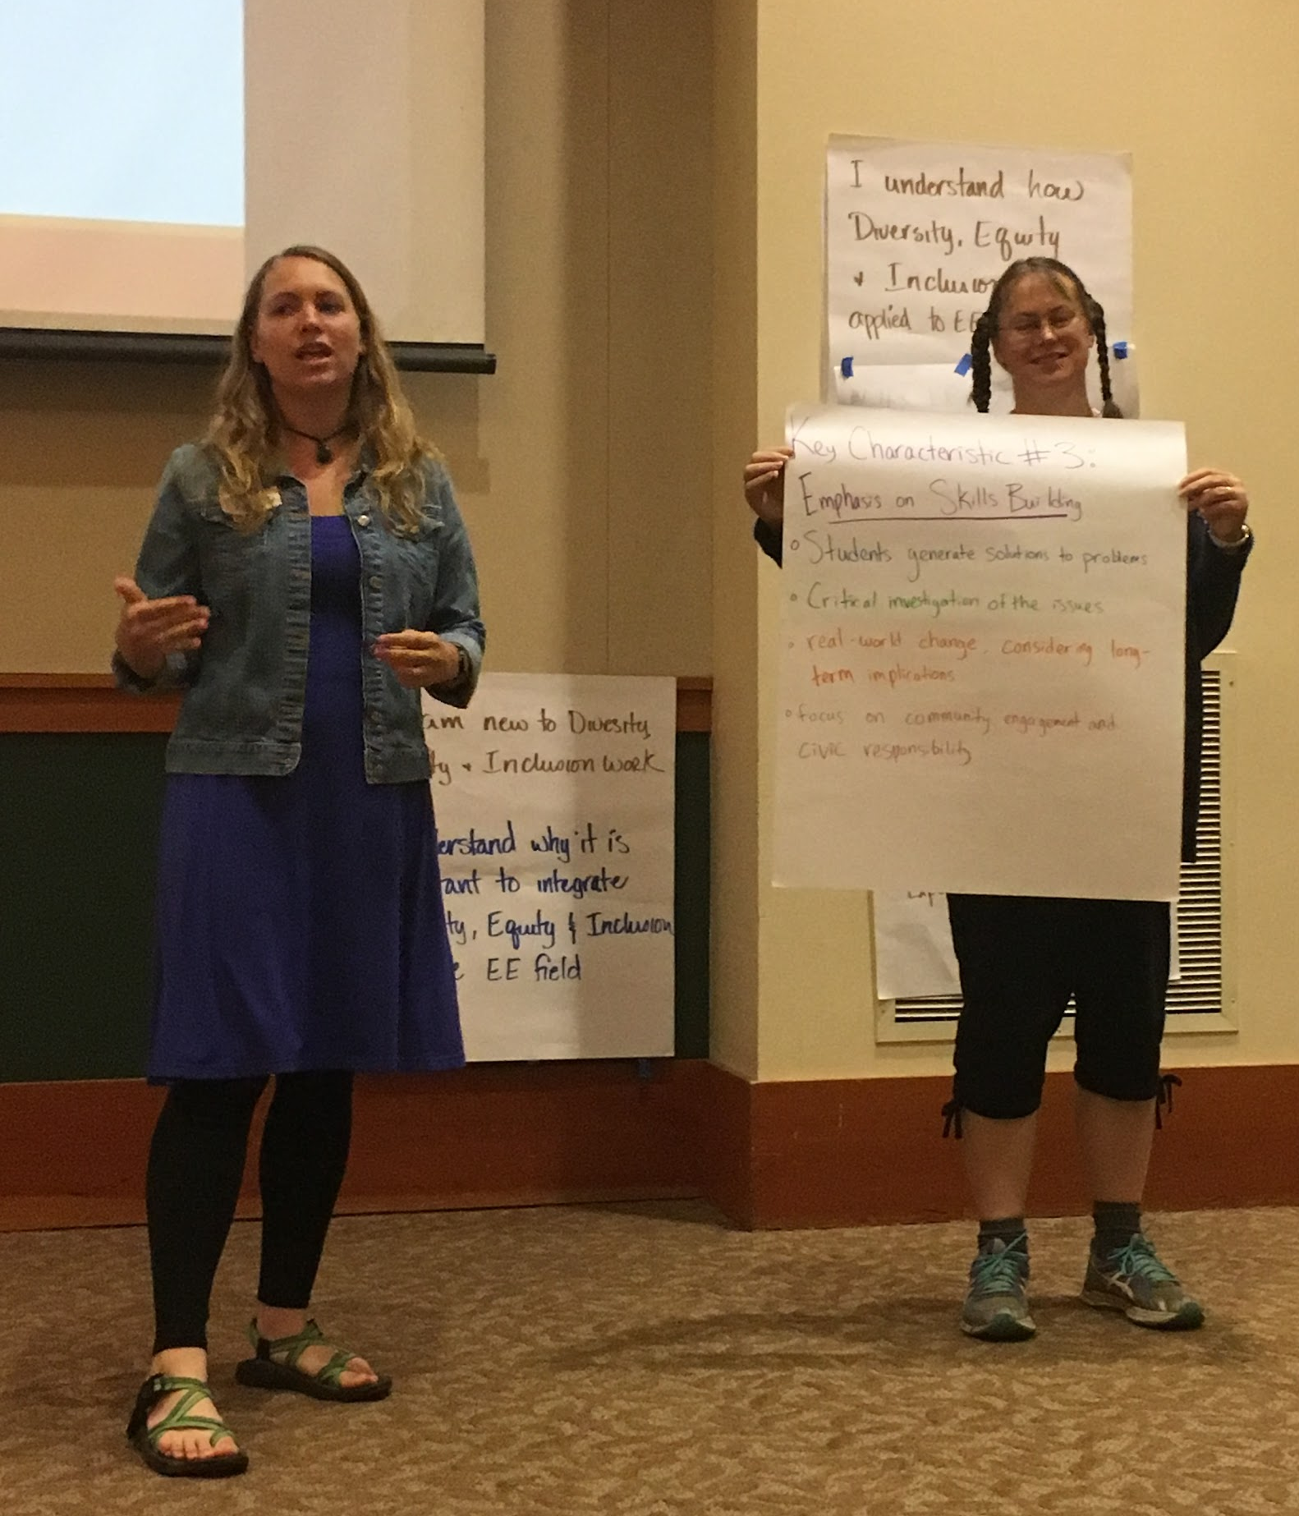
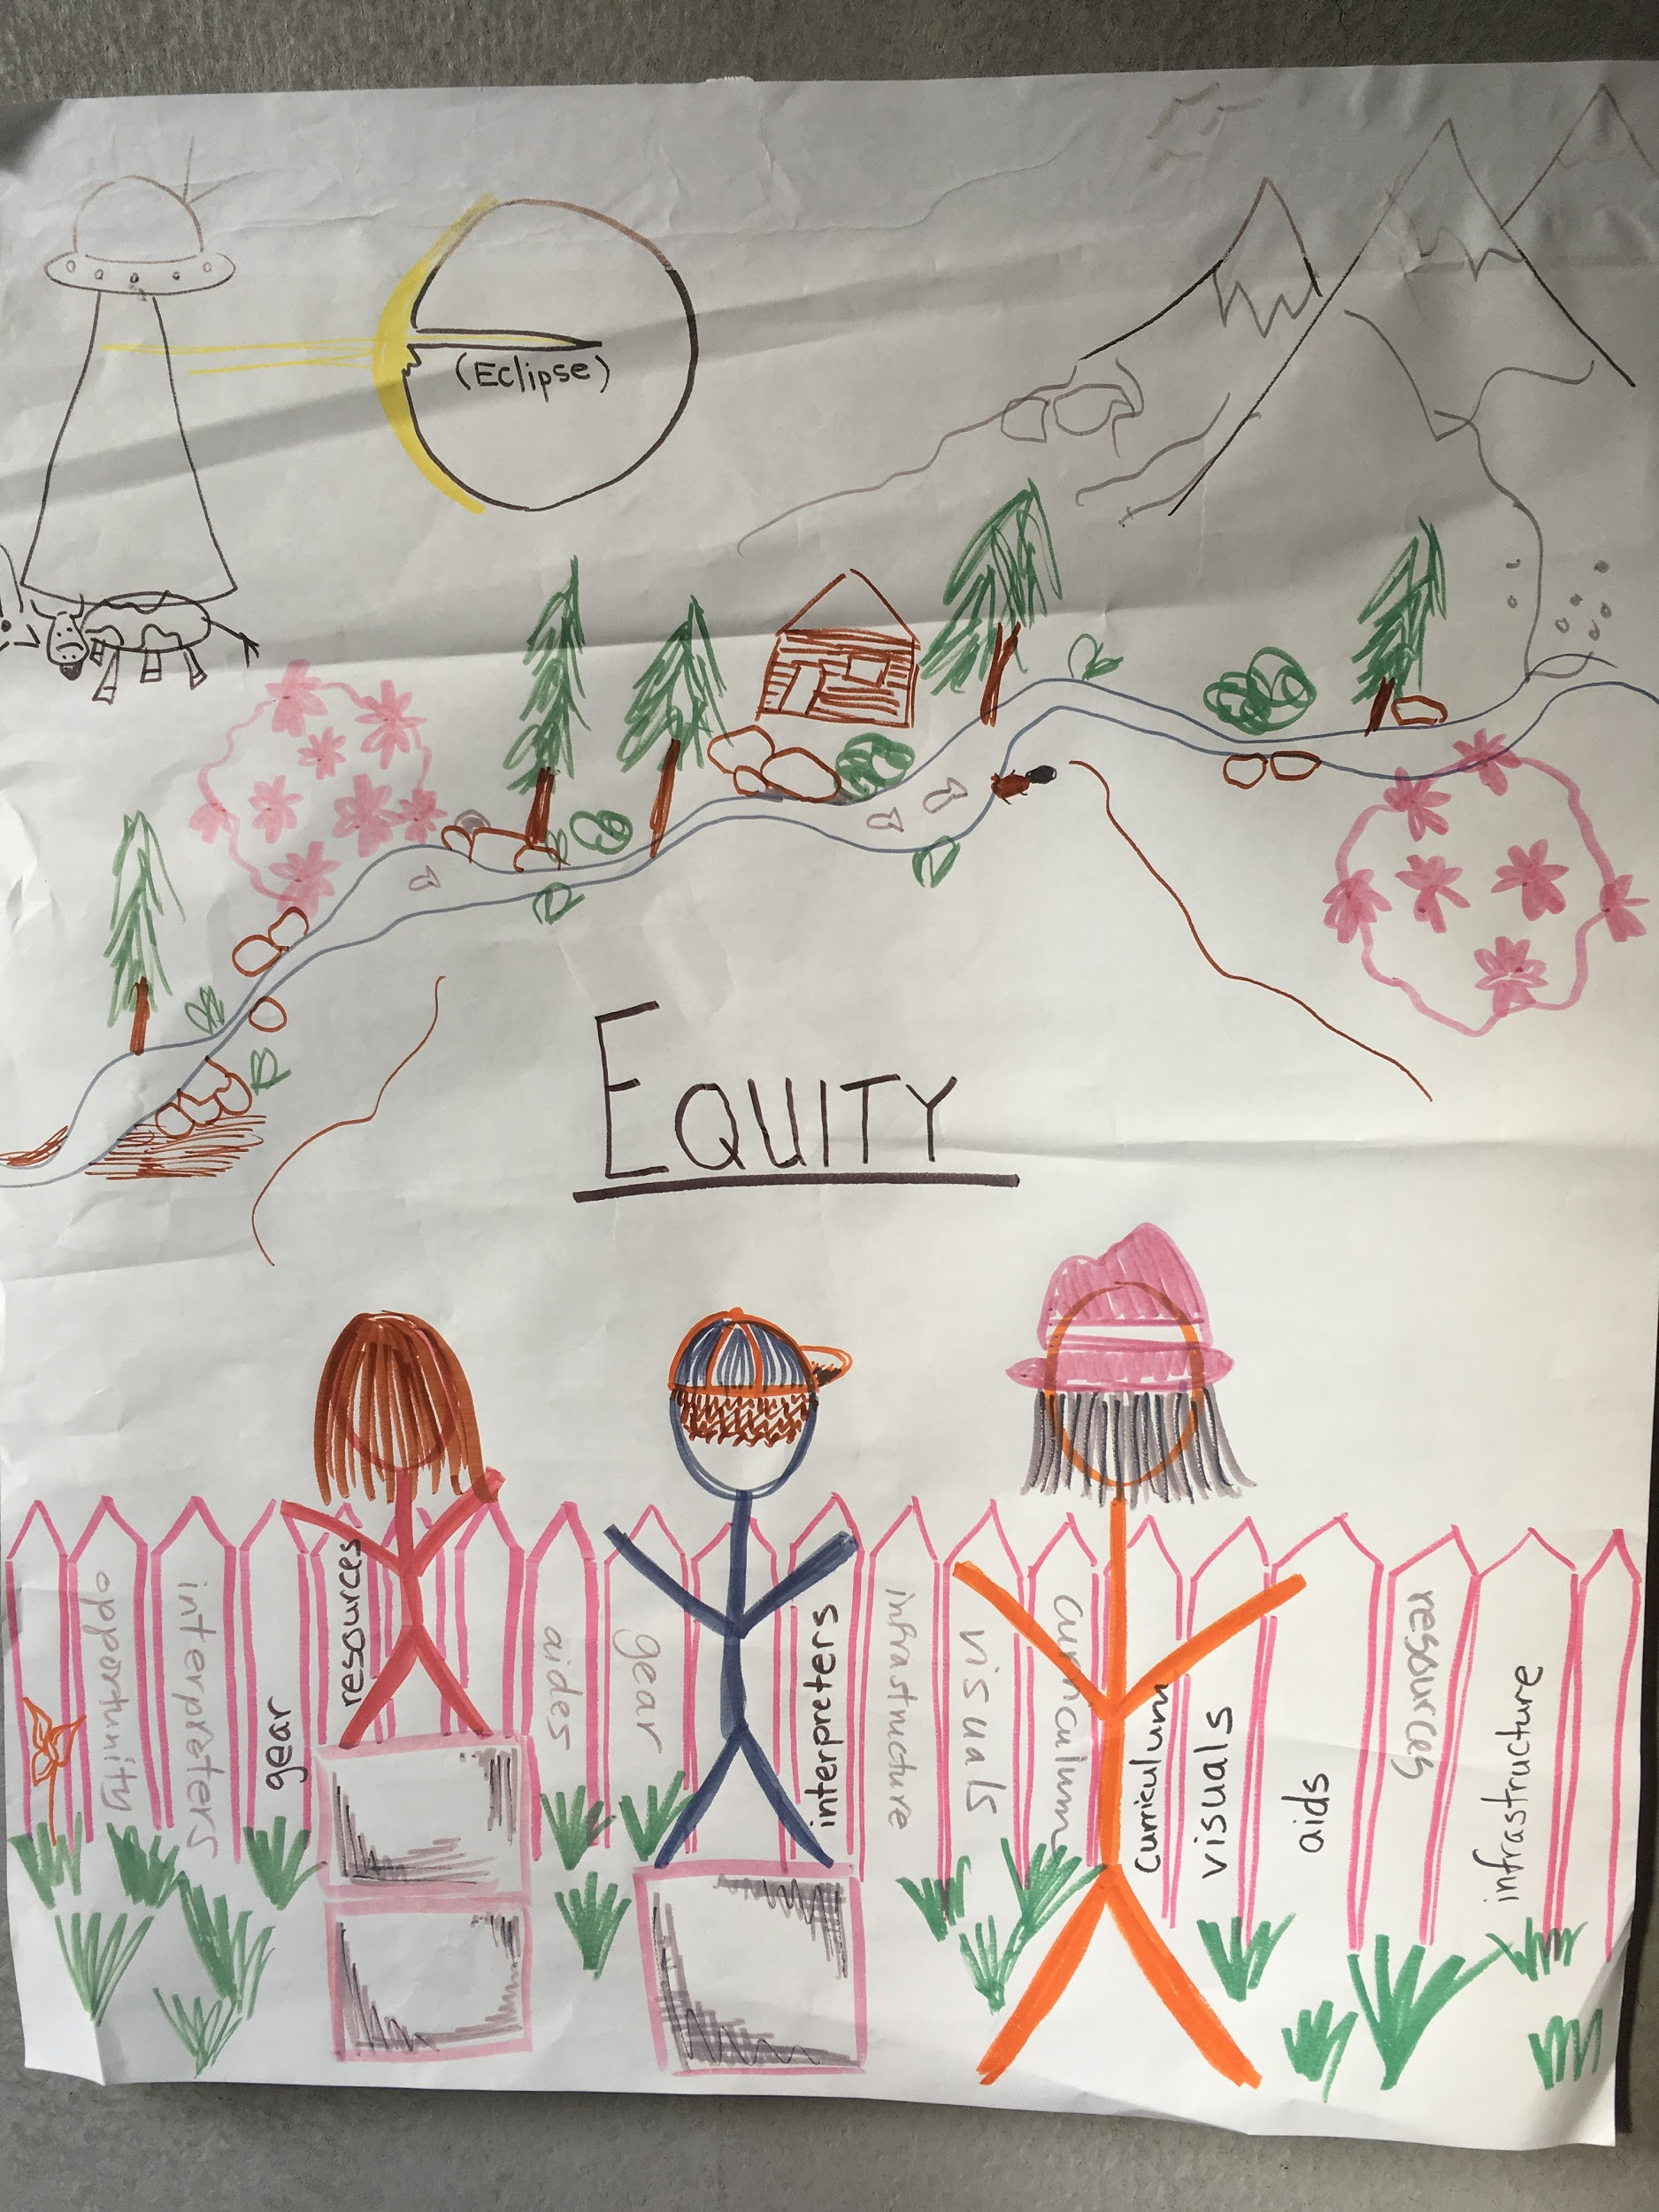
Oregon
Building a more inclusive EE movement in Oregon.
Partnership between Environmental Education Association of Oregon and Oregon Environmental Literacy Program.
Focus on Material Guidelines through an equity, diversity, and inclusion lens.
Facilitators represent the diverse communities found in Oregon.

Slide 13
Going Forward
How soon can I sign up my state affiliate?
Our state doesn’t have any GTB members, but our affiliate wants to partner with NAAEE to offer Guidelines training. What’s next?

