Slide 1
Exploring Literacy in School Gardens
Julia Colbert, Master of Arts Student
Dr. Eileen Merritt, Assistant Professor

Slide 2
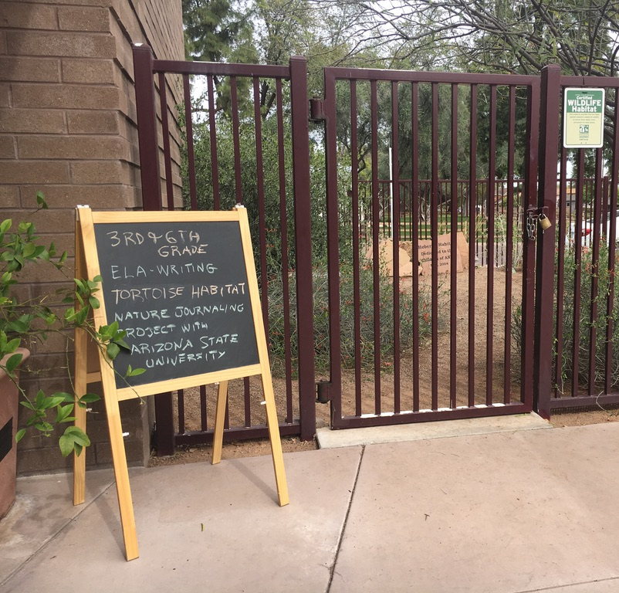
Project Background
Collaboration between Arizona State University and Echo Canyon School
Using nature journaling to connect the students more deeply to their school garden
Piloted nature journaling with third and sixth grade classes
Conducted empirical study for master’s thesis using interviews and nature journals

Slide 3
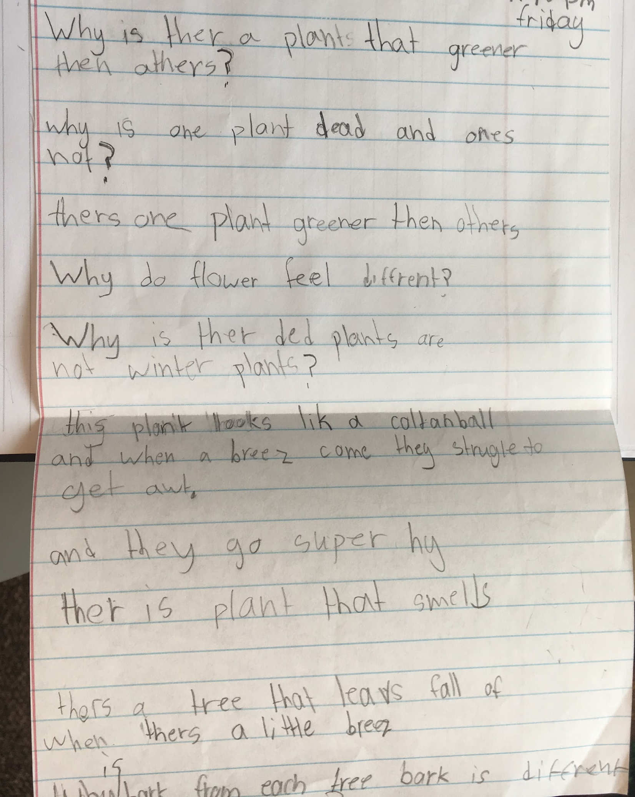
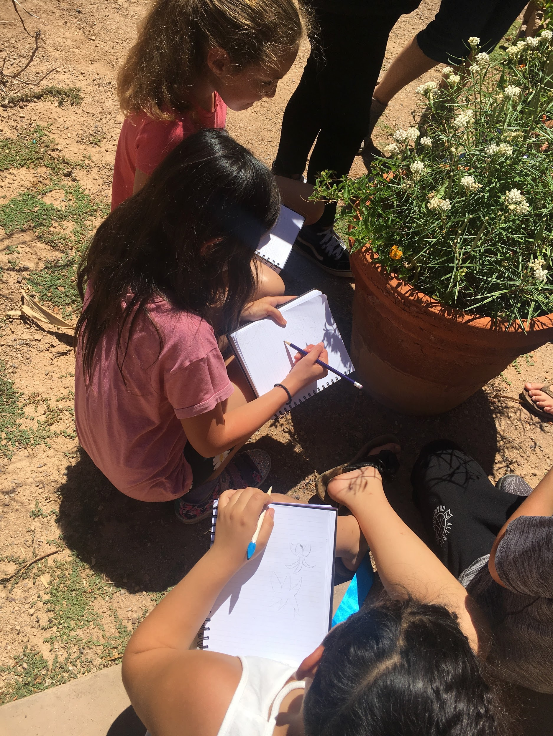
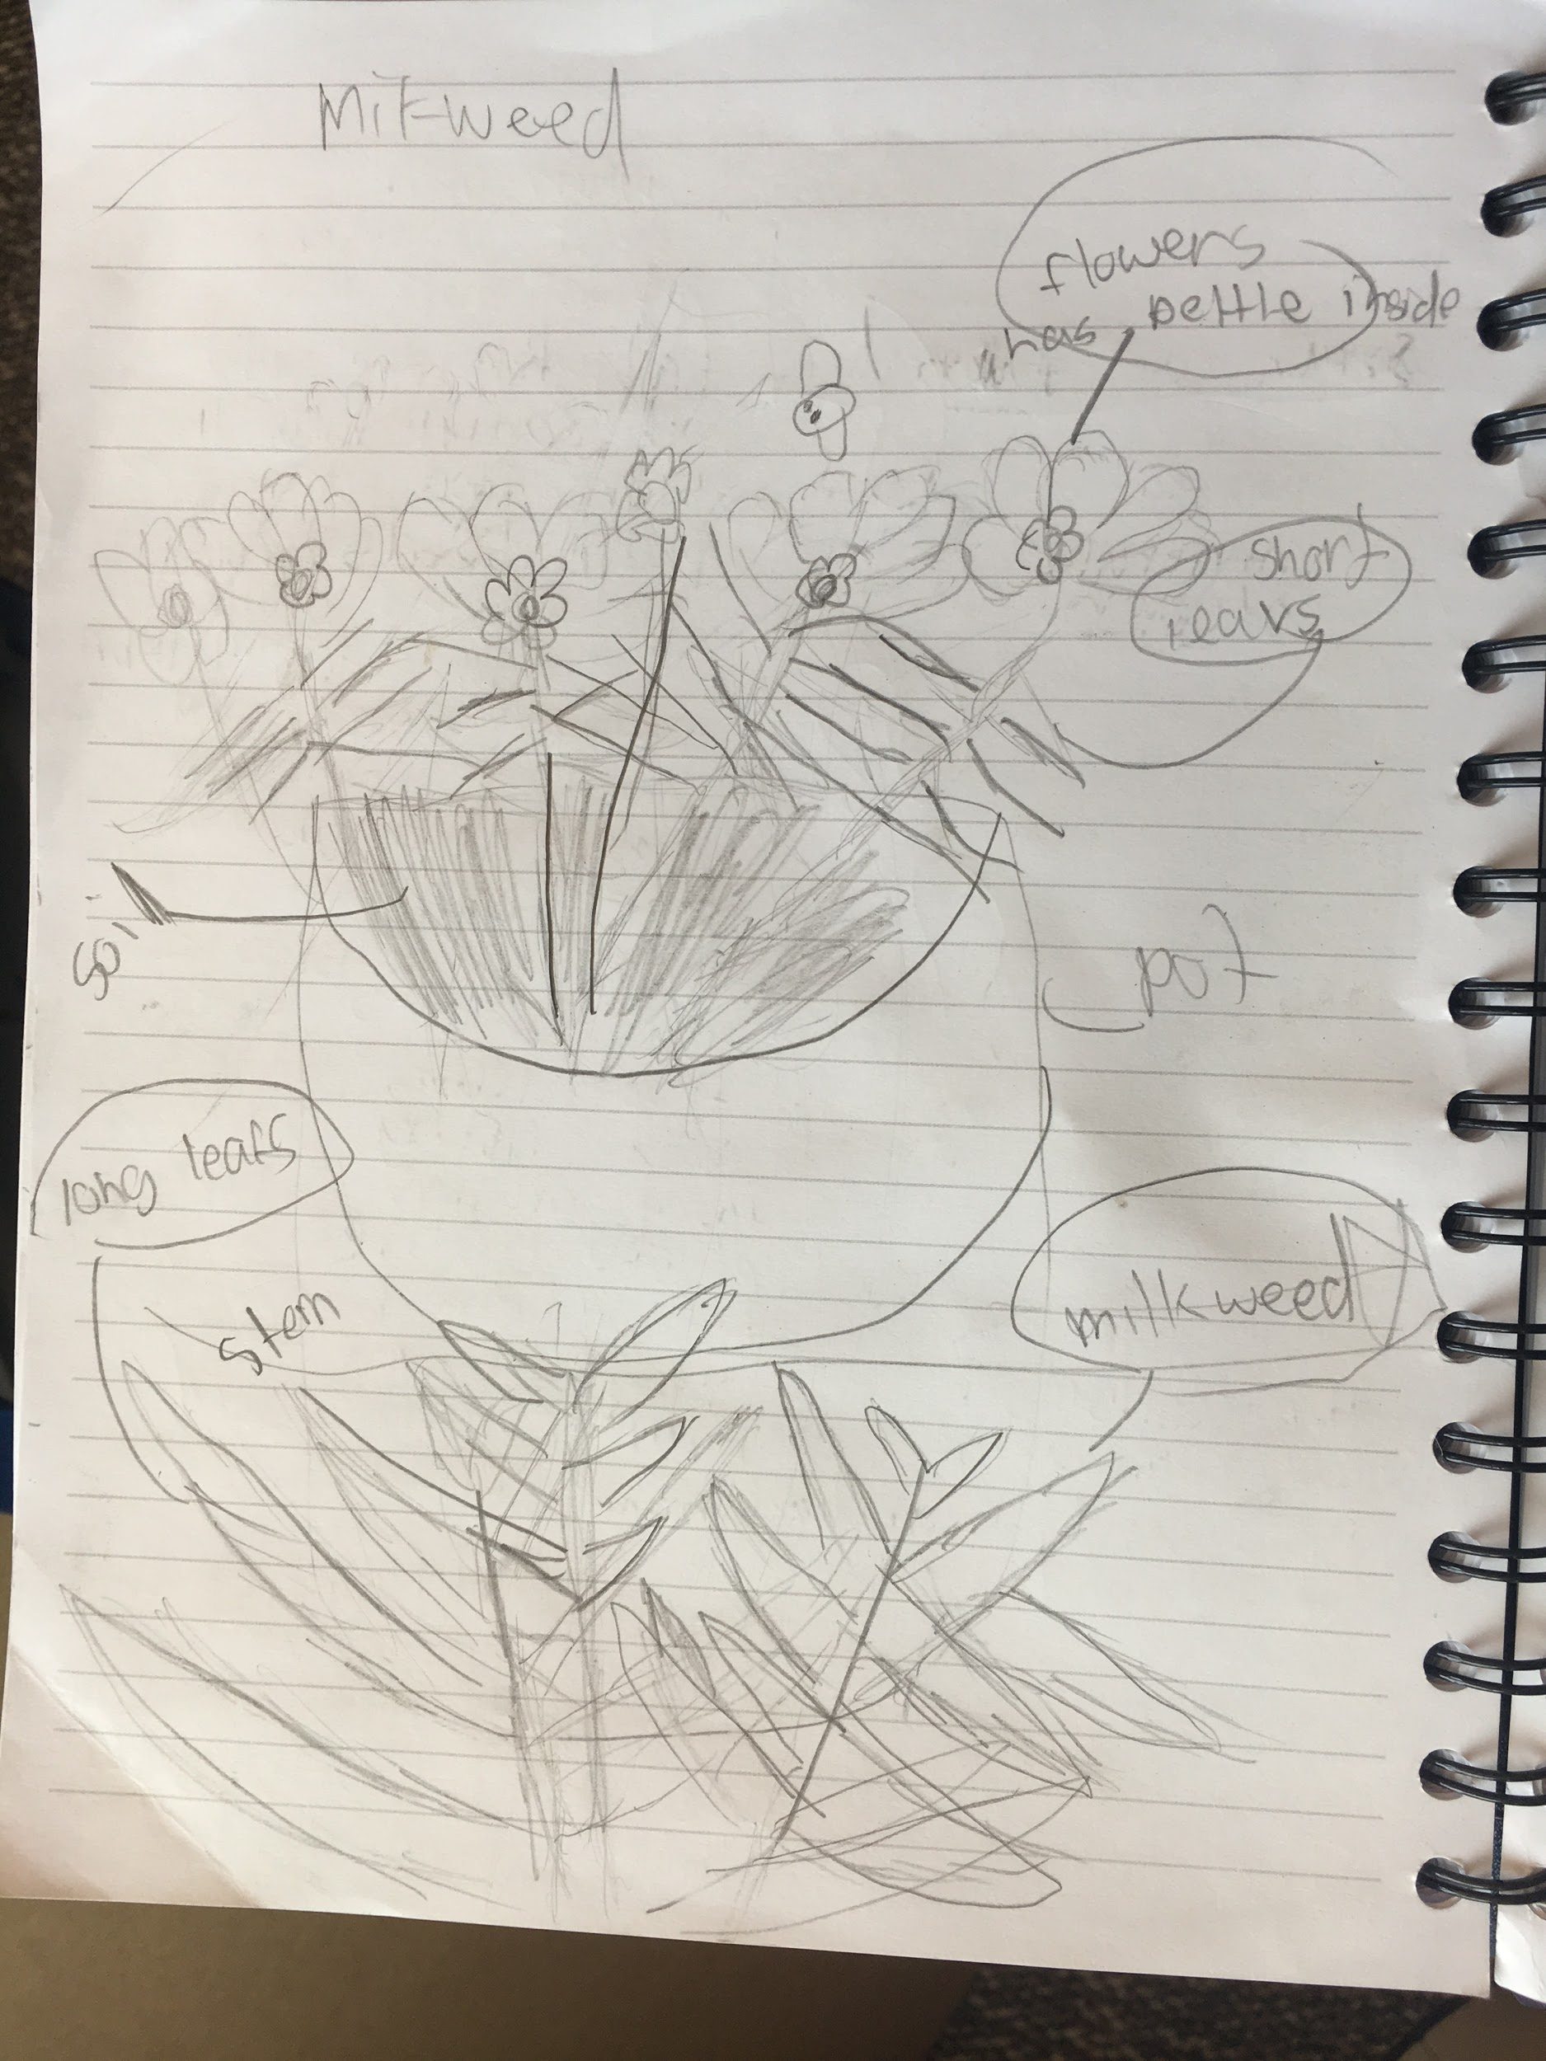
Experiencing Ecosystems
Prompt: What do I notice? What am I curious about?
Following nature’s lead on the way to the butterfly habitat
Practicing milkweed observation and drawing skills

Slide 4
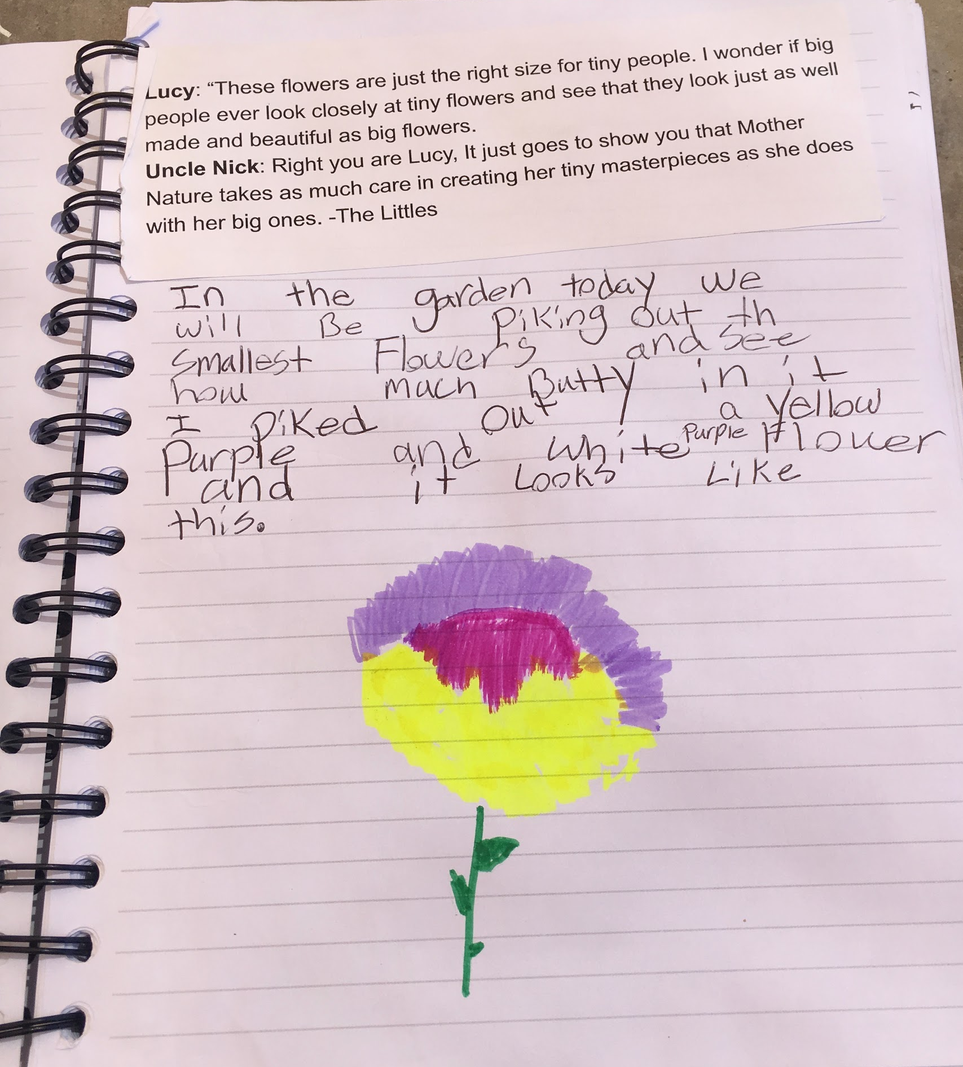
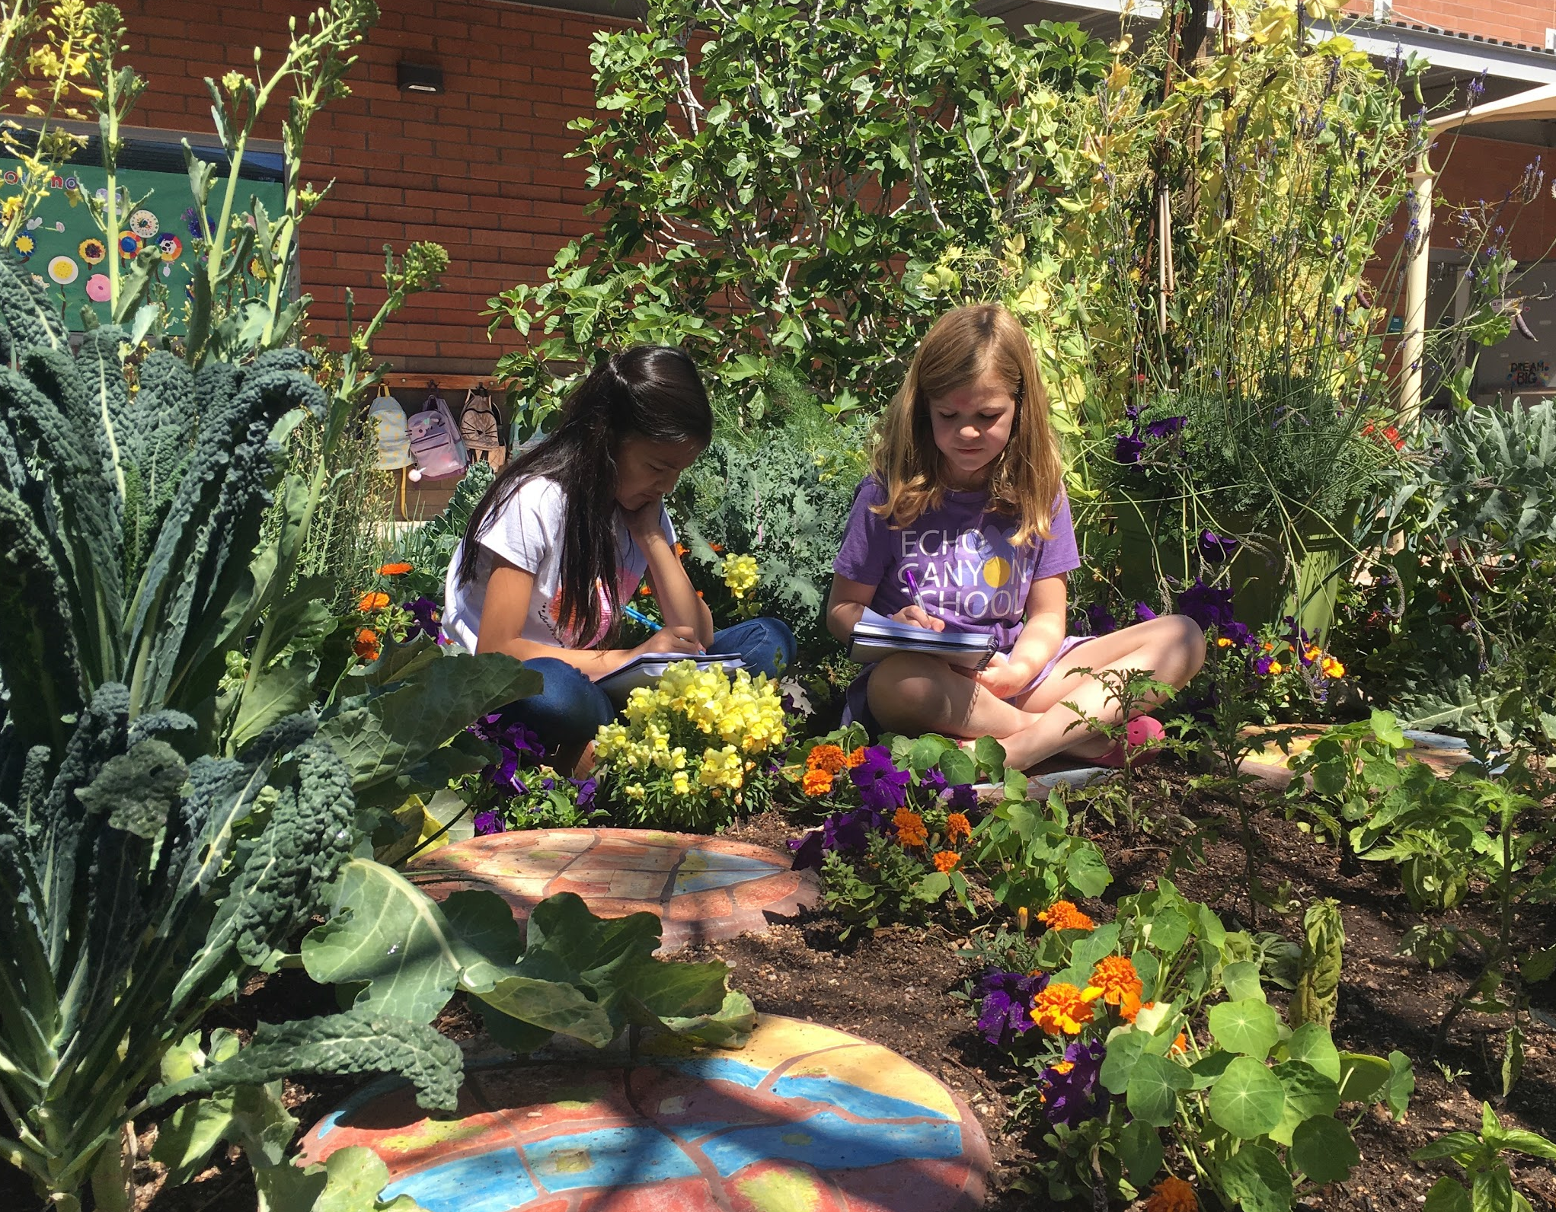
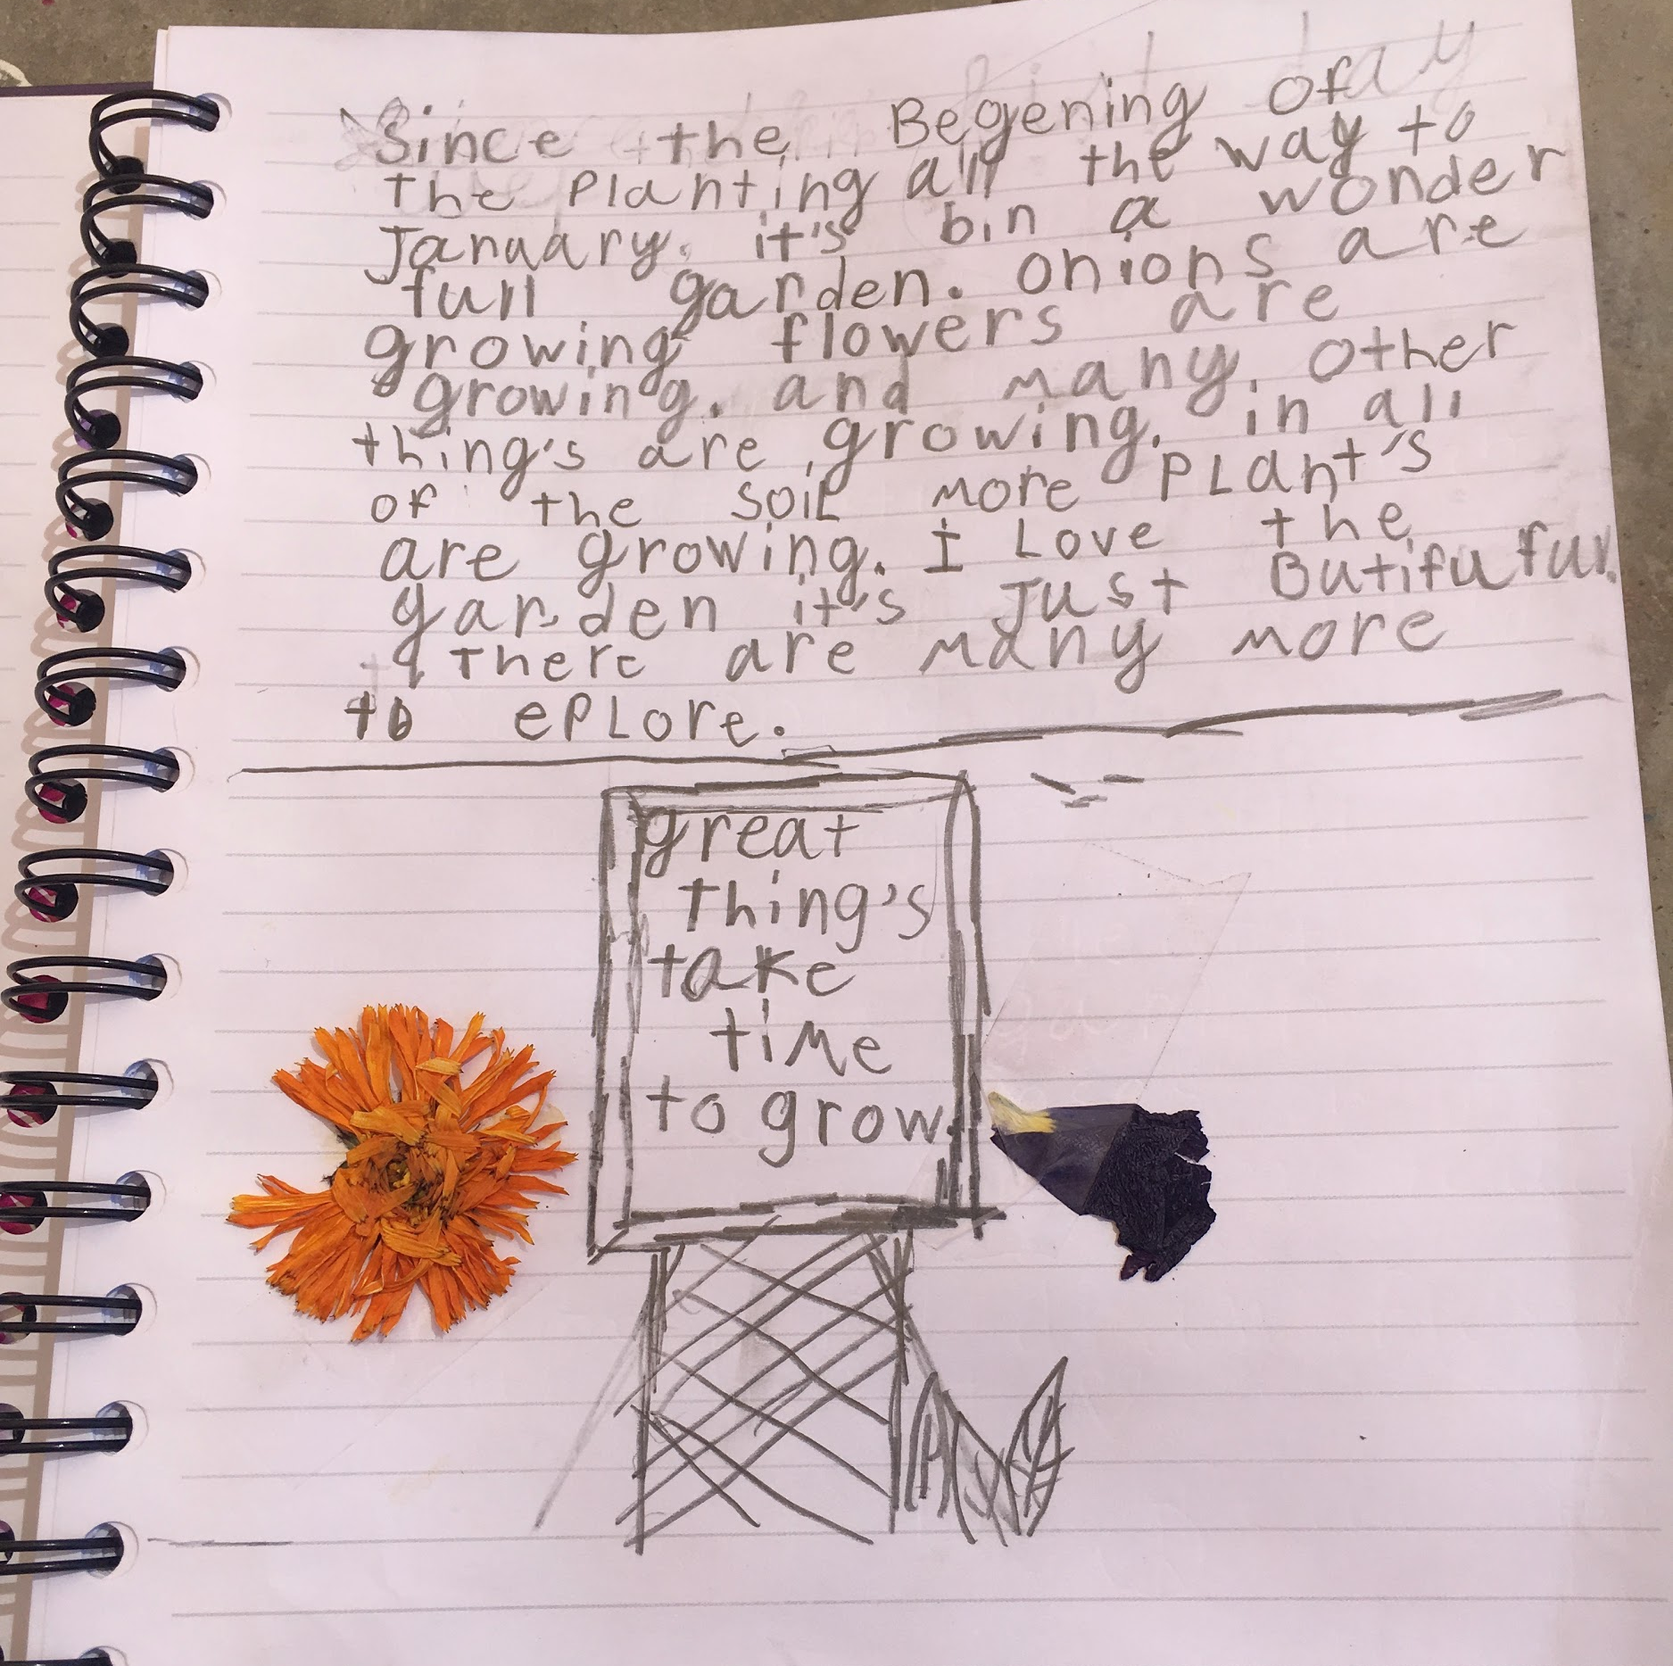
Fostering Creativity
Prompt: Based on the quote from The Littles, find, draw, and describe a tiny masterpiece in the garden
Students spending time journaling in the garden
Student describes an emotional connection to the garden while noticing change over time

Slide 5
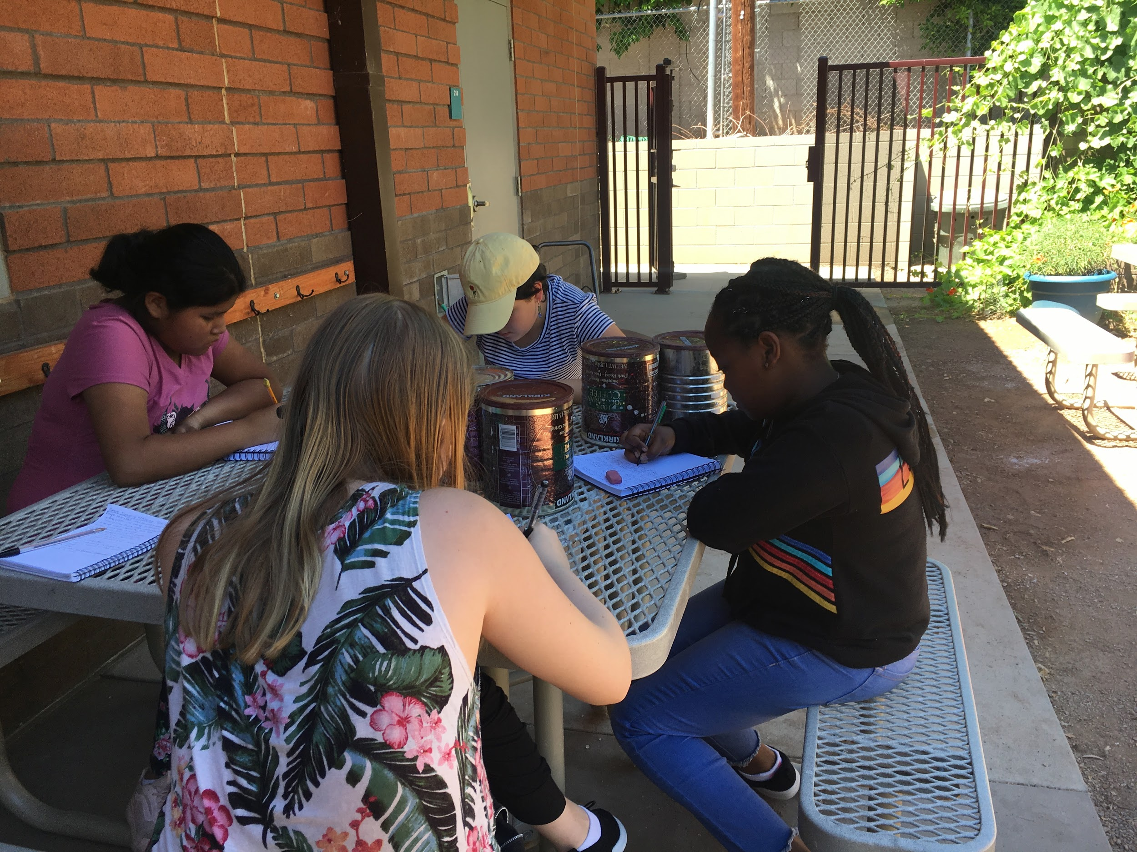
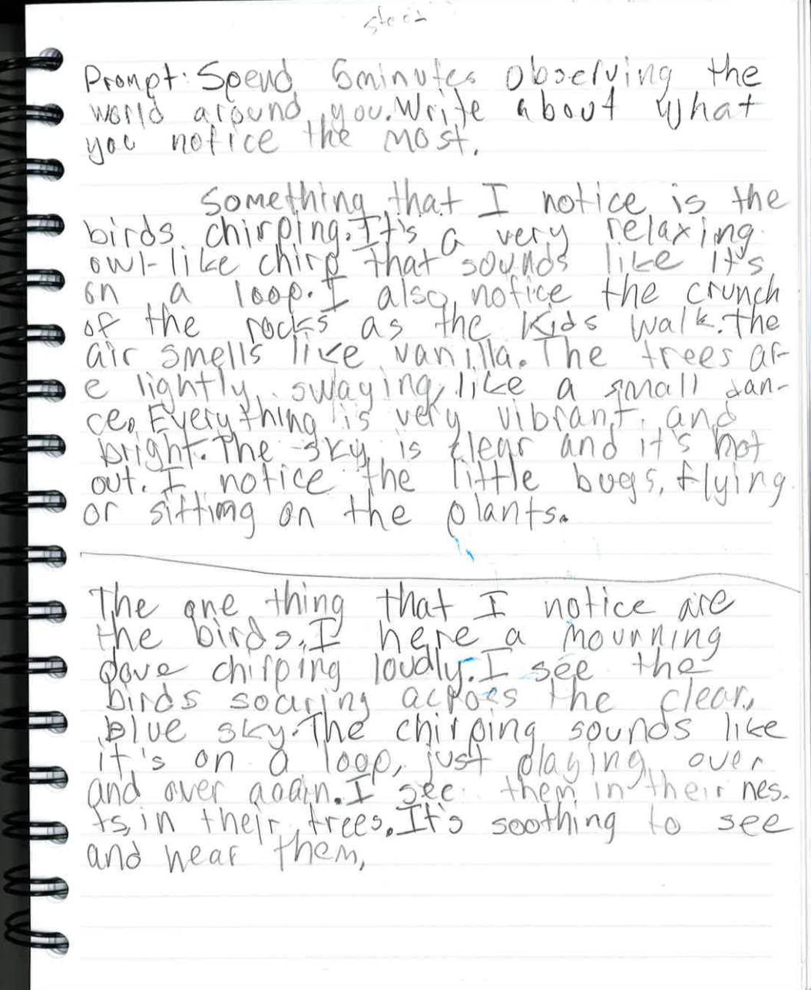
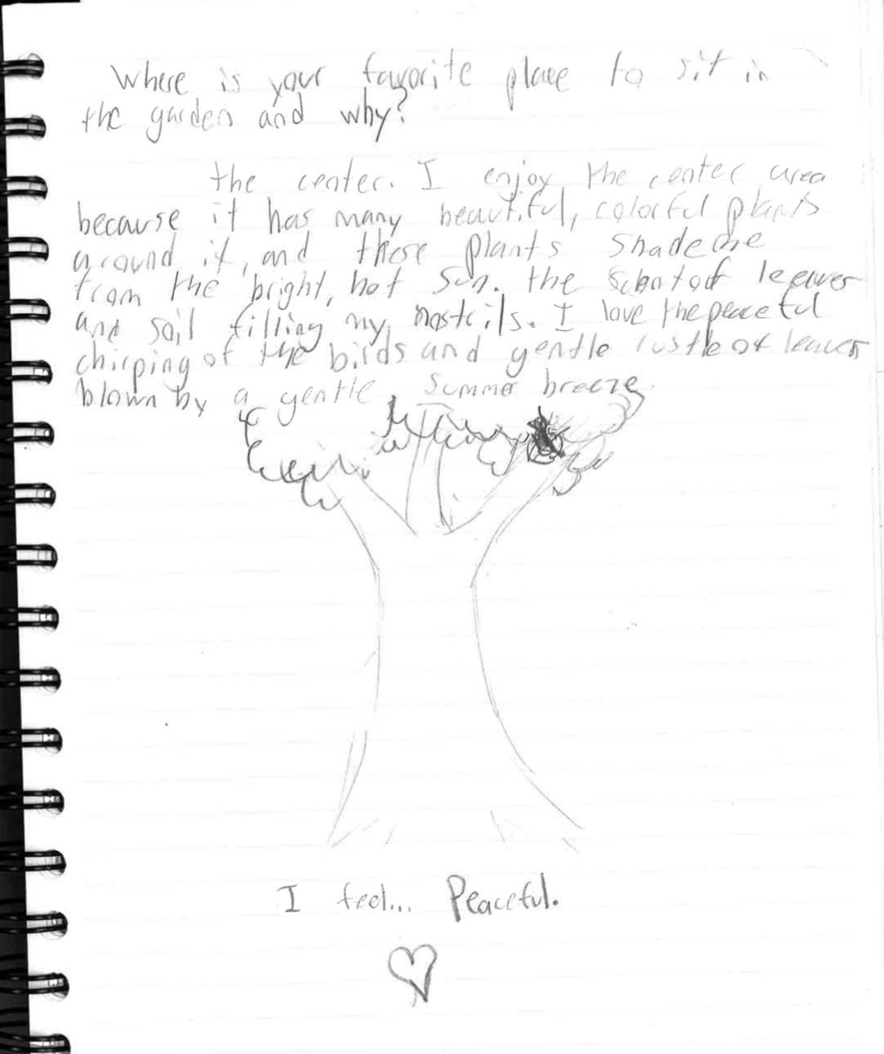
Improving Literacy
Prompt: Spend 5 minutes observing the world around you. Write about what you notice most.
Prompt: What is your favorite place in the garden and why?

Slide 6
Next Steps
Nature Journaling Resources
Entire school using nature journaling this academic year
Teacher-led professional development
Keeping a Nature Journal: Discover a Whole New Way of Seeing the World Around You by Clare Walker Leslie and Charles Roth
Opening the World through Journaling: Integrating art, science, and language arts by John Muir Laws

Slide 7
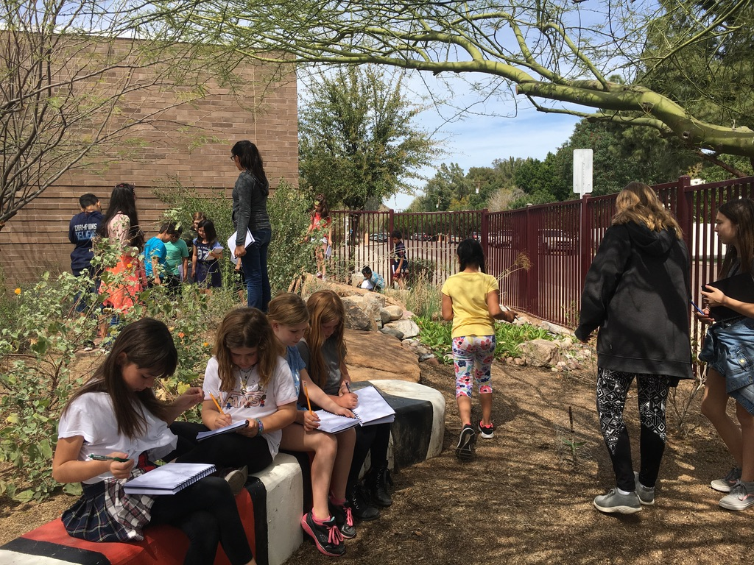
Nature Journaling Recommendations
Encourage students to decorate their journal
Develop nature journaling norms
Pick a prompt related to nature
Follow nature’s lead
Make grades optional
Be patient about sharing
Ask for help!

Slide 8
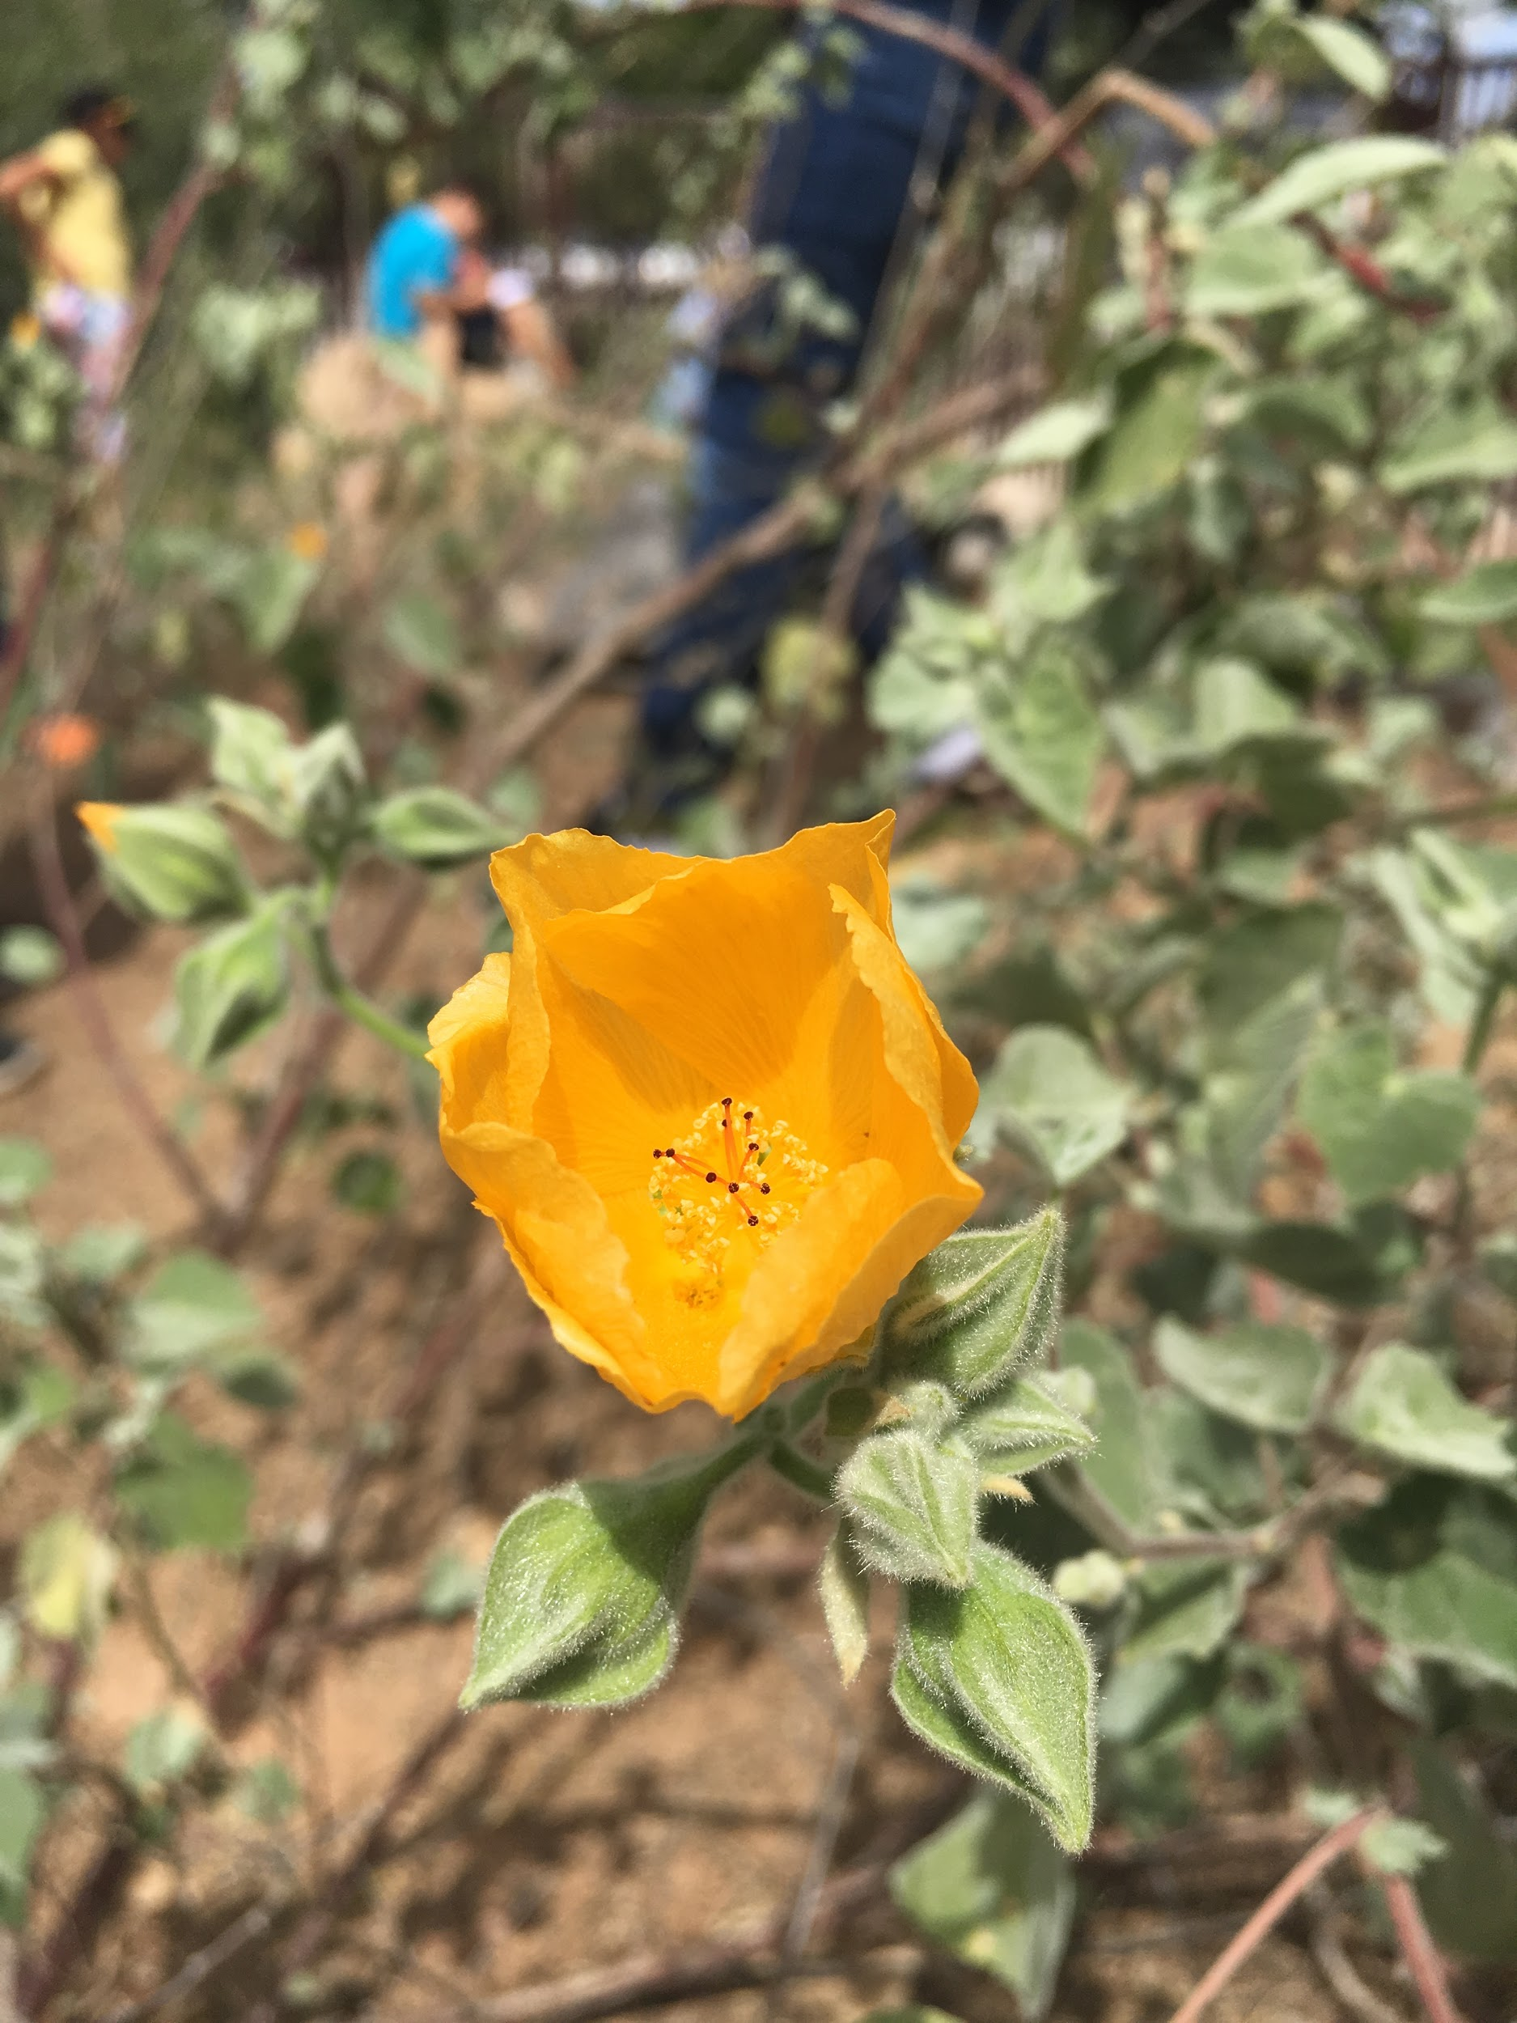
Acknowledgements
Thank you to the welcoming and wonderful educators at Echo Canyon School!
Lisa Espinosa
Sandra Abbott
McKensie Gation
Angelyn Chasse
Kat Hughes
Lou Rodarte
Ann Rodarte

Slide 9
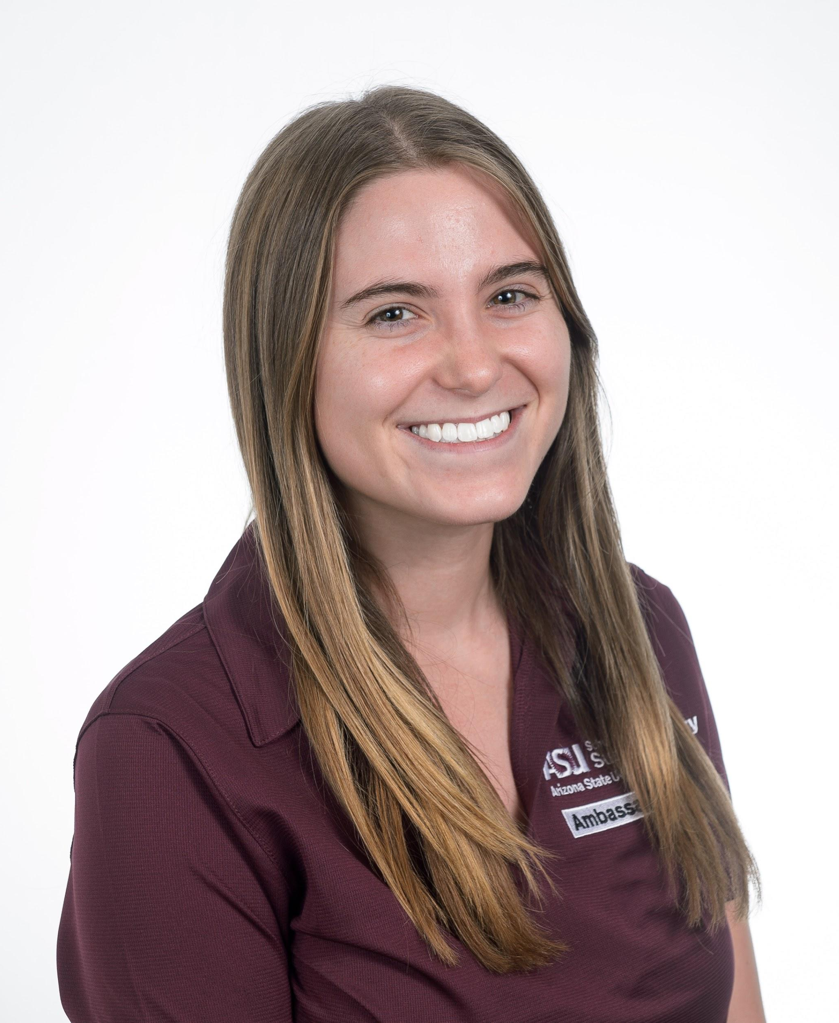
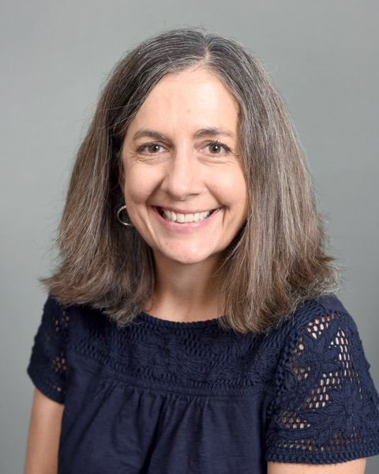
Thank You!
Julia Colbert
Master of Arts Student, School of Sustainability
jcolber5@asu.edu
Eileen Merritt
Assistant Professor, Mary Lou Fulton Teachers College
Eileen.Merritt@asu.edu

