Slide 1
Data Jam:
Cultivating Data Literacy with Creative Communication and Art
Ryan Pemberton & Shelly Forster

Slide 2
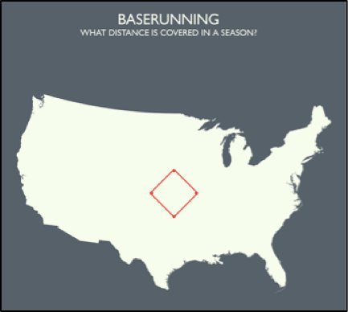
Inspiration for Desert Data Jam
Question: How many miles did 2006 MLB players run?
Fact: In the 2006 season, MLB players ran a total of 1,245 miles around bases.
(73,080 bases x 90 feet between bases)
Craig Robinson
www.flipflopflyball.com

Slide 3
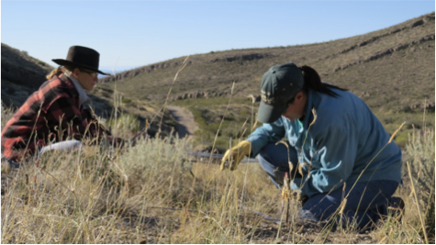
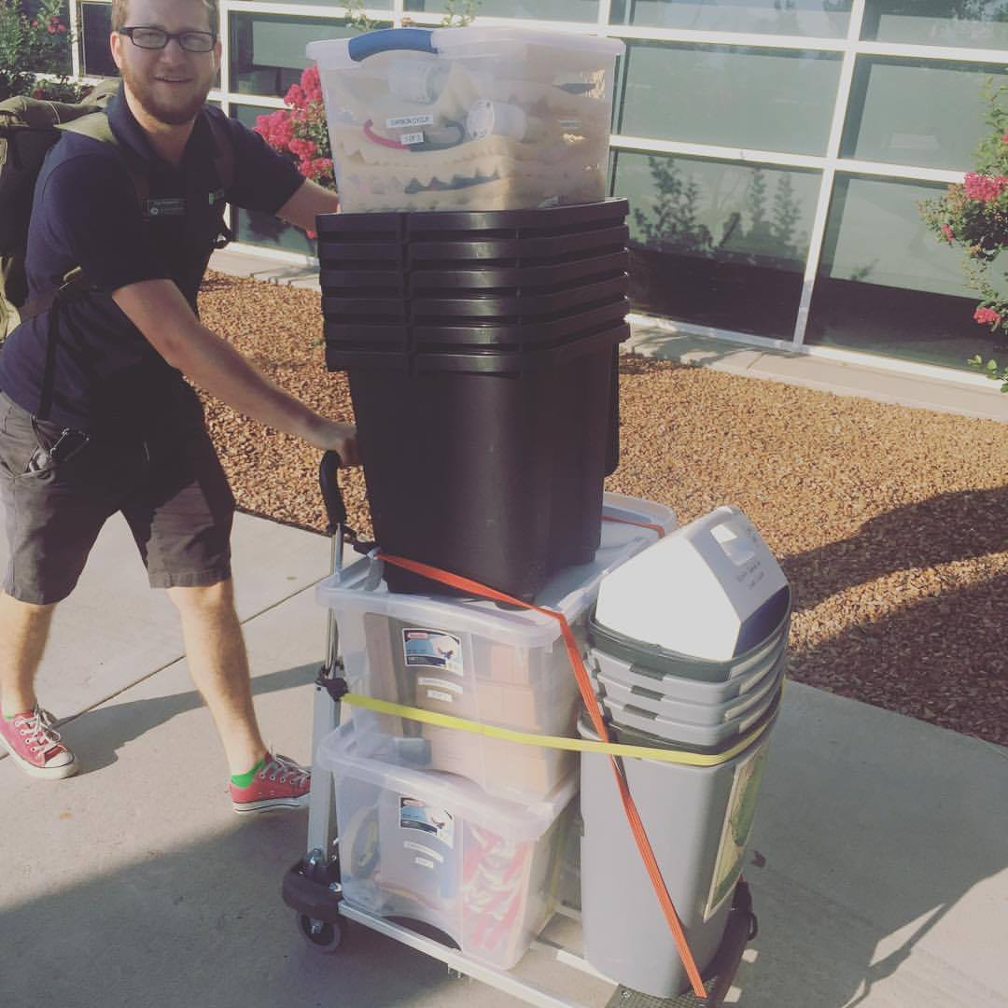
What is a “Data Jam?”
The Data Jam model includes 6 core components.
1.Local data
2.Scaffolded data exploration.
3.Students create a scientific
product that includes
claim-evidence-reasoning.

Slide 4
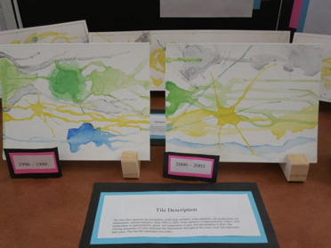
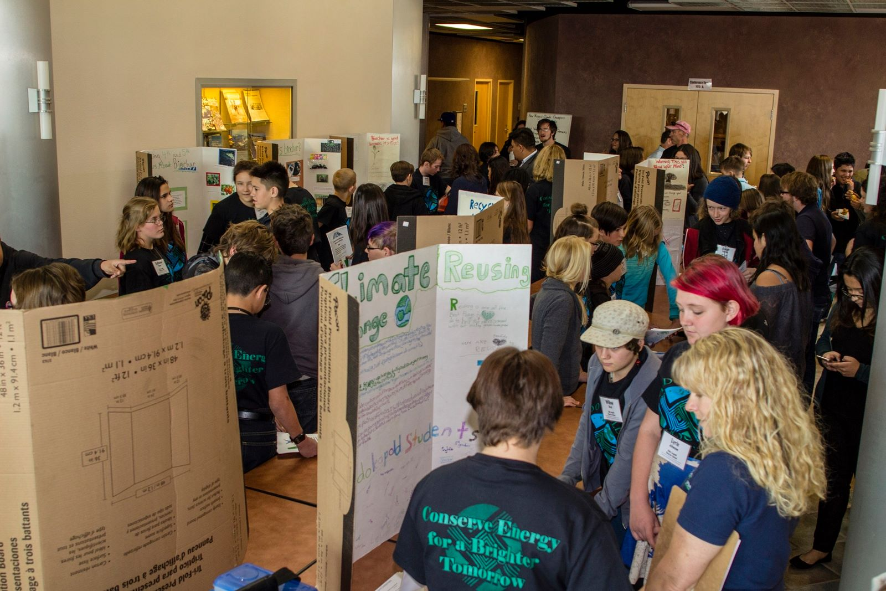
What is a Data Jam?
4. A major finding is communicated
through a creative medium.
5. Students share their Data Jam project.
6. Project assessment.

Slide 5
Goals of a Data Jam
•Increase middle and high school students’ knowledge of ecology.
•Exposing students to Jornada LTER research (or other associated data sets).
•Increase students’ data literacy.
•Enhance student’s abilities to creatively communicate the “story” of science data to non scientists.

Slide 6
Catching the Data Jam Fever
•Desert DJ - Jornada Basin LTER (2012)
•Baltimore DJ - Baltimore Ecosystem Study LTER (2014)
•Hudson DJ – Cary Institute of Ecosystem Studies (2014)
•Luquillo DJ – Luquillo LTER DJ (2015)
•Cedar Creek LTER DJ (2017)
•Northeast Shelf LTER DJ (2019)
•Data Literacy project through Rutgers for polar literacy (2019)
Notes:
Here’s the link to the Google map: https://drive.google.com/open?id=19YP7uOedPlZDEMu-WL-DSF0cFxUBWoxS&usp=sharing

Slide 7
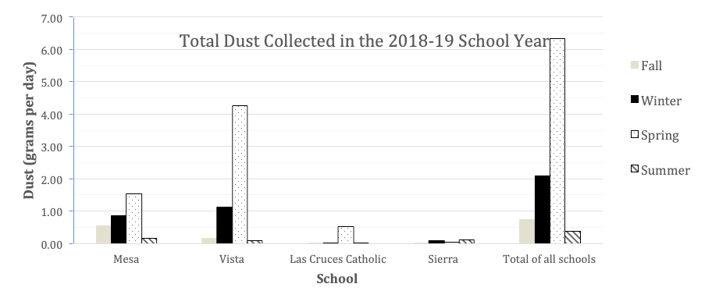
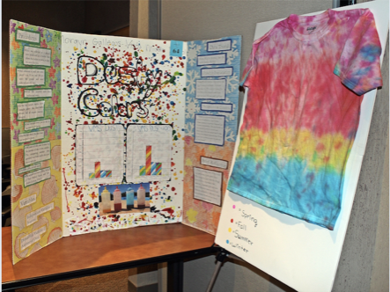
Desert Data Jam Student Work:
Seasonal Dust Collection at Las Cruces Schools

Slide 8
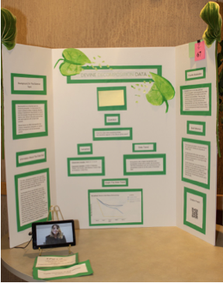
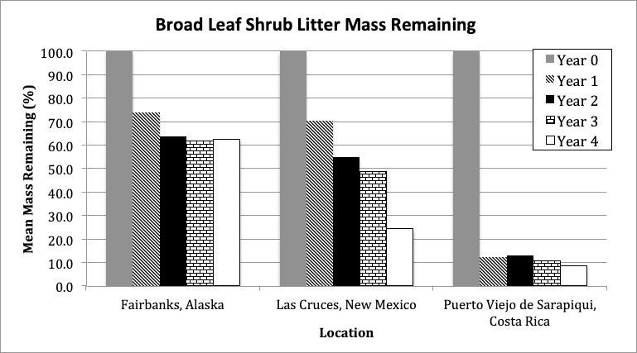
Desert Data Jam Student Work:
Litter Decomposition Rates in Different Climates

Slide 9
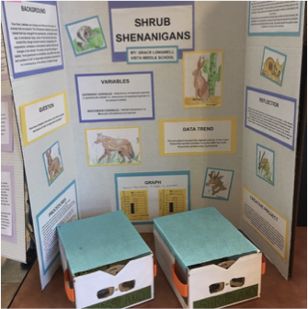
Desert Data Jam Student Work:
Mammal Photo Trapping Data in Grasslands vs Shrublands

Slide 10
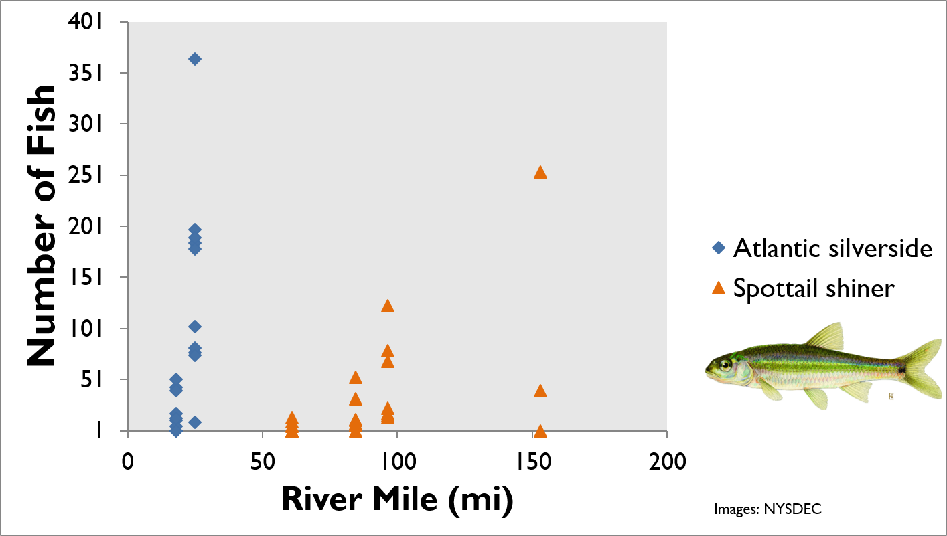
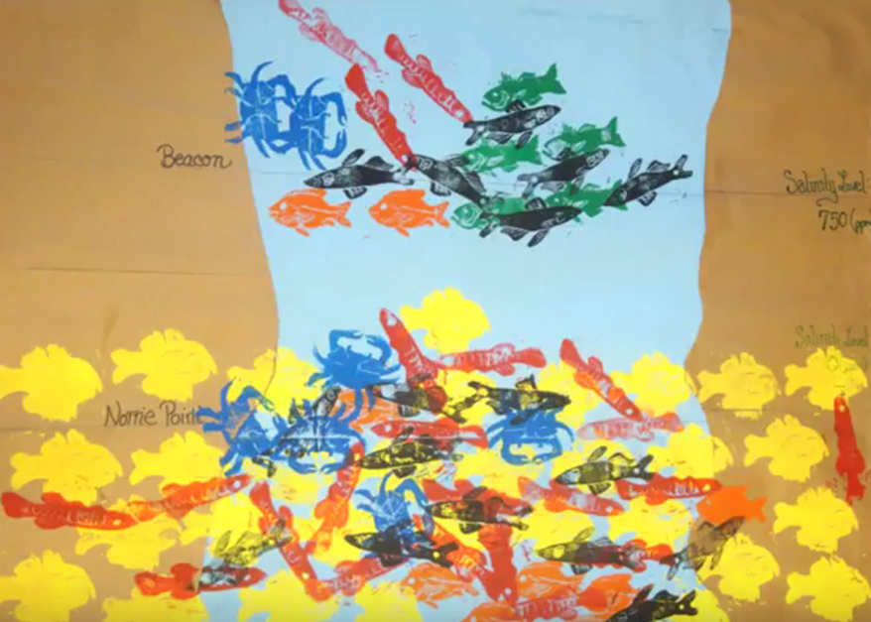
Hudson Data Jam Student Work:
Fish Populations Sampled in the Hudson River

Slide 11
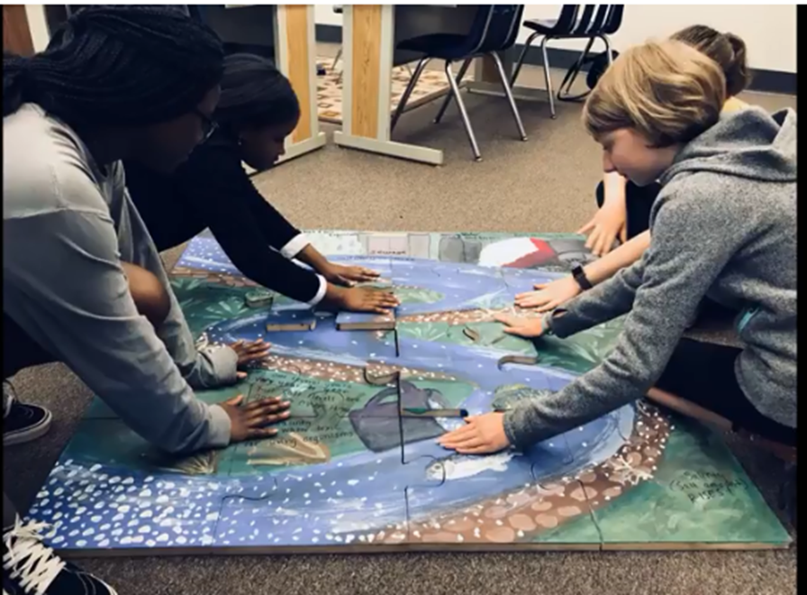
Hudson DJ Student Work:
Jigsaw Puzzle on Salt Pollution in Tributaries

Slide 12
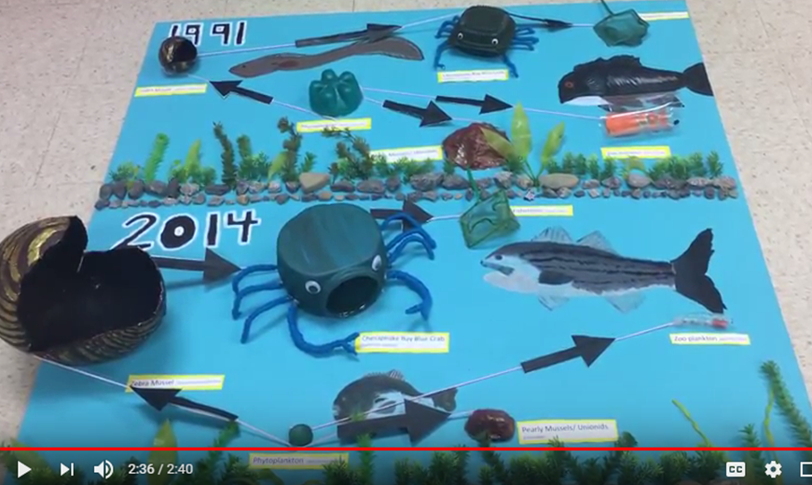
Hudson DJ Student Work:
River Populations Before/After Zebra Mussel Invasion

Slide 13
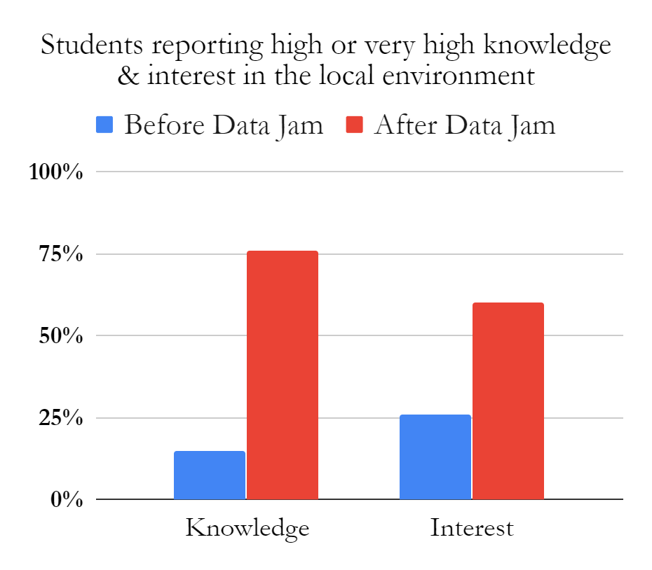
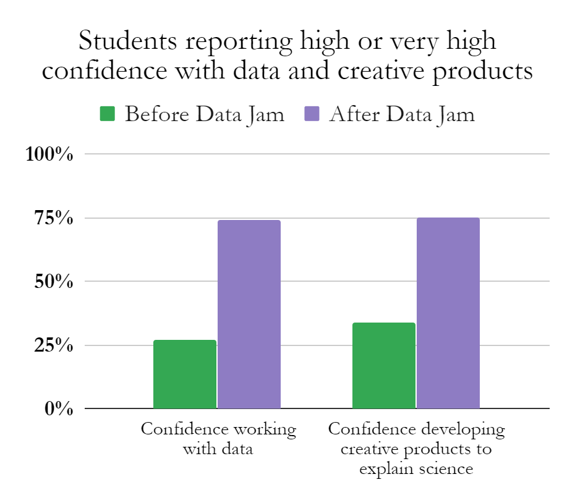
Results from 2018 student surveys in NM, NY, MD, PR (n=160)

Slide 14
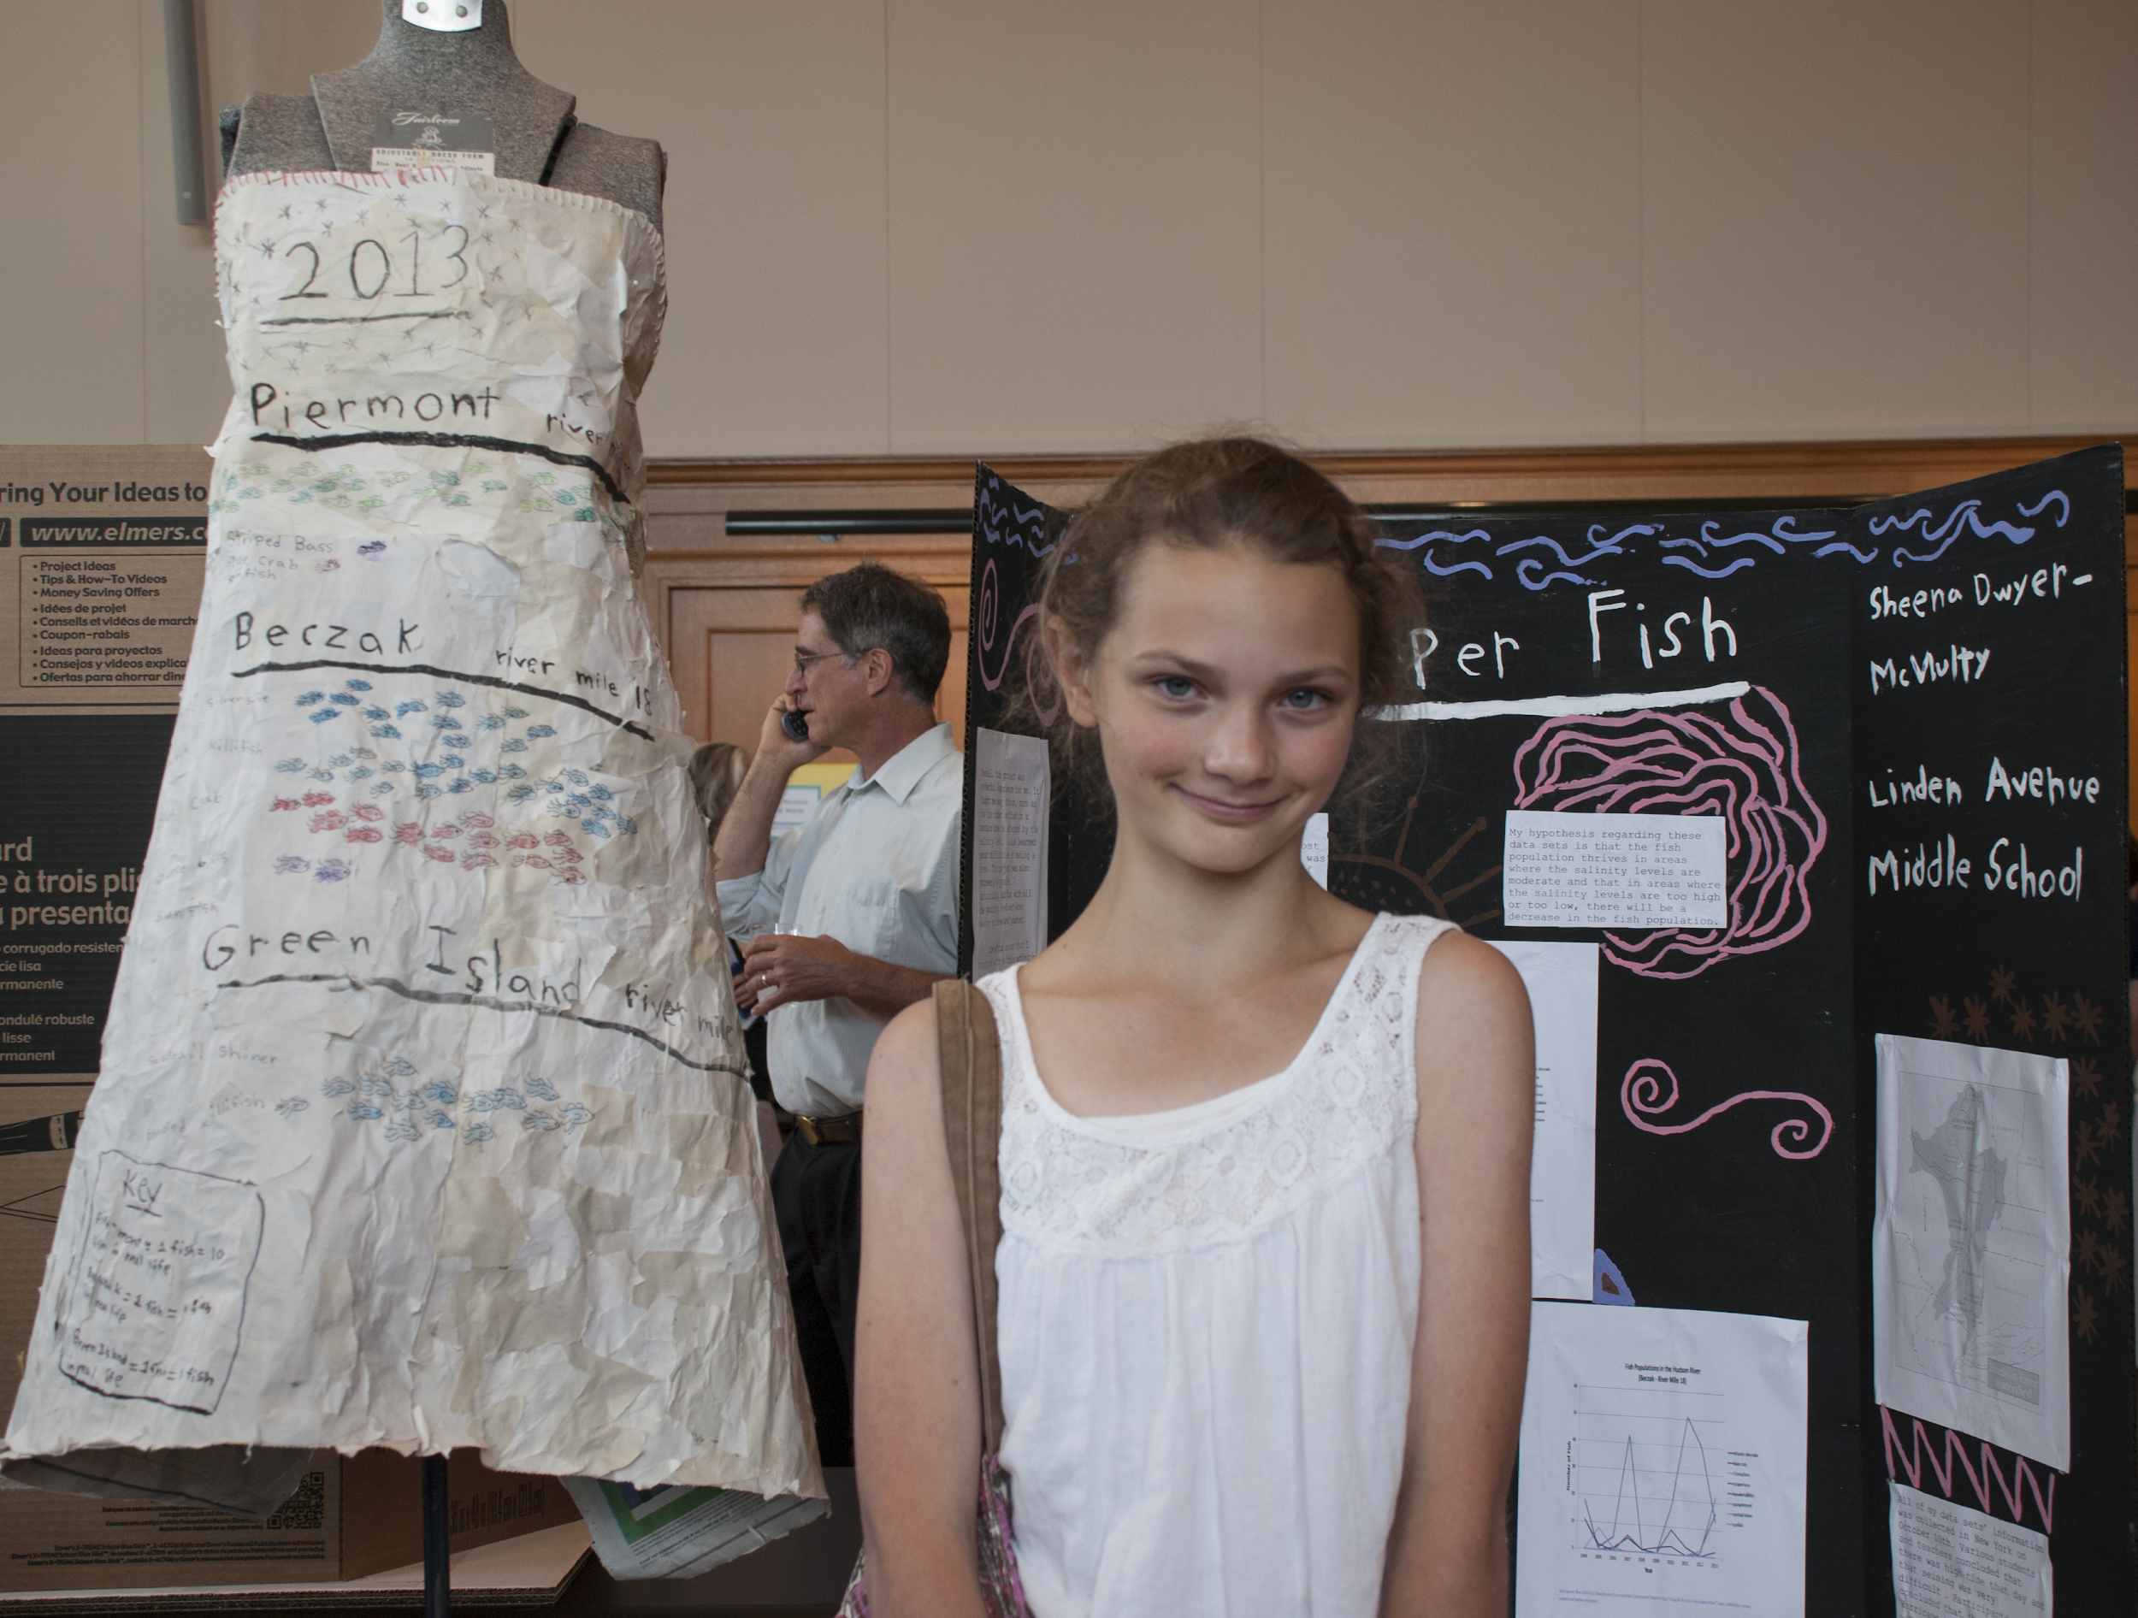
Top 5 DJ parts that students ranked most difficult
Coming up with a creative idea for showing my results
2. Completing the creative part of the project
3. Completing the report
4. Explaining science behind the data trend
5. Analyzing and interpreting data

Slide 15
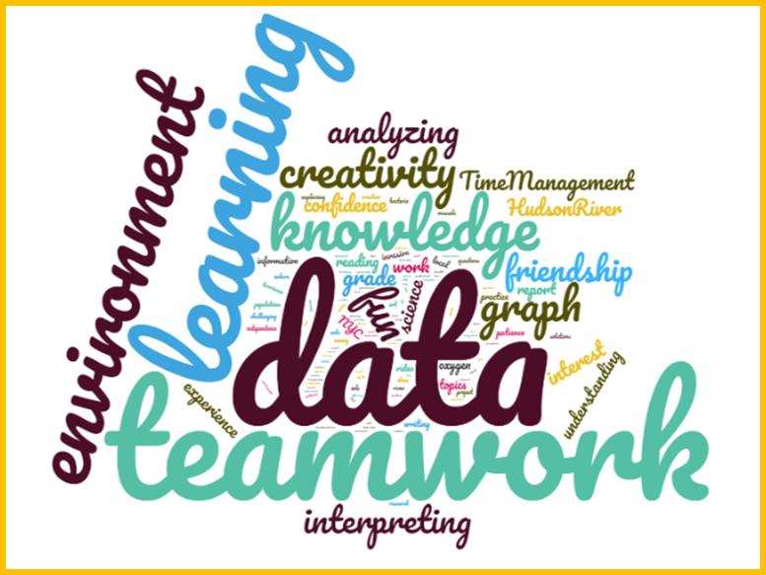
What do students get out of Data Jams?
51% of students increased interest in pursuing college studies and/or a science career

Slide 16
How can you get involved?
Start a Data Jam with your school or organization
Encourage and support data literacy with the students you serve
Read more about the DJ movement in The Science Teacher (Sept 2018)
Volunteer to judge projects online in Spring 2020
Connect with us:
Ryan Pemberton Science Education Program Leader: Elementary ryan@asombro.org | Shelly Forster Education Program Leader forsterm@caryinstitute.org

