Slide 1
Earth Day 2020:
The Power of the Teach-In
Earth Day Network
It’s not just a day, it’s a movement!

Slide 2
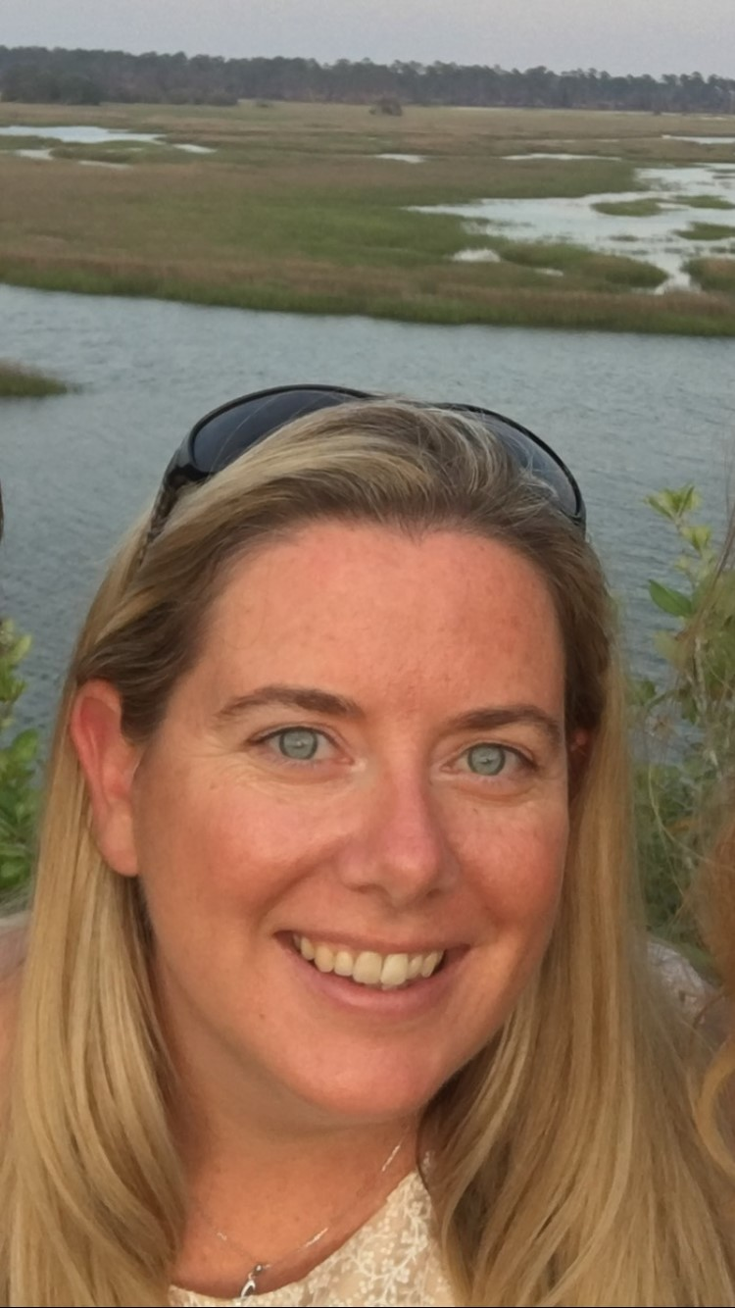
Introductions
Tracey Ritchie
Director of Education
Kira Heeschen
Education Coordinator

Slide 3
Today’s Agenda
History of Earth Day
2020 - Our 50th Anniversary!
Teach-In overview
Planning simulation
Group share

Slide 4
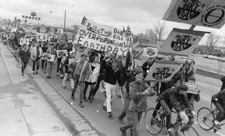
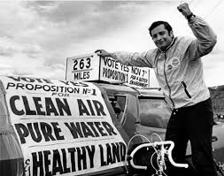
The First Earth Day
In what year was the first Earth Day?

Slide 5
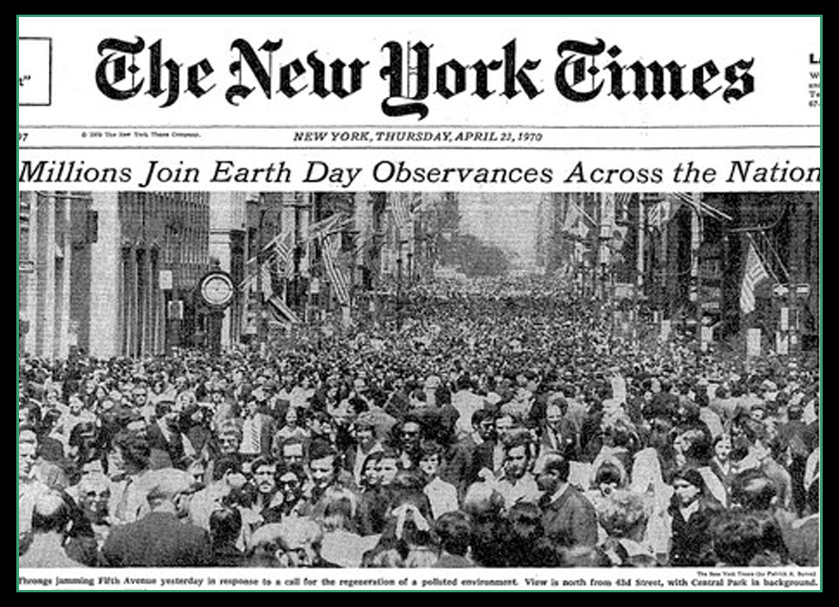
1970: The First Earth Day
Senator Nelson called for a National Teach-In on the environment

Slide 6
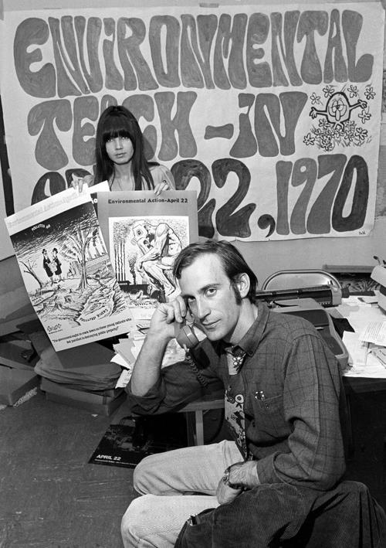
1970: The First Earth Day
Mobilized 20 million Americans
Birth of the modern environmental movement
Lead to policy changes in the US

Slide 7
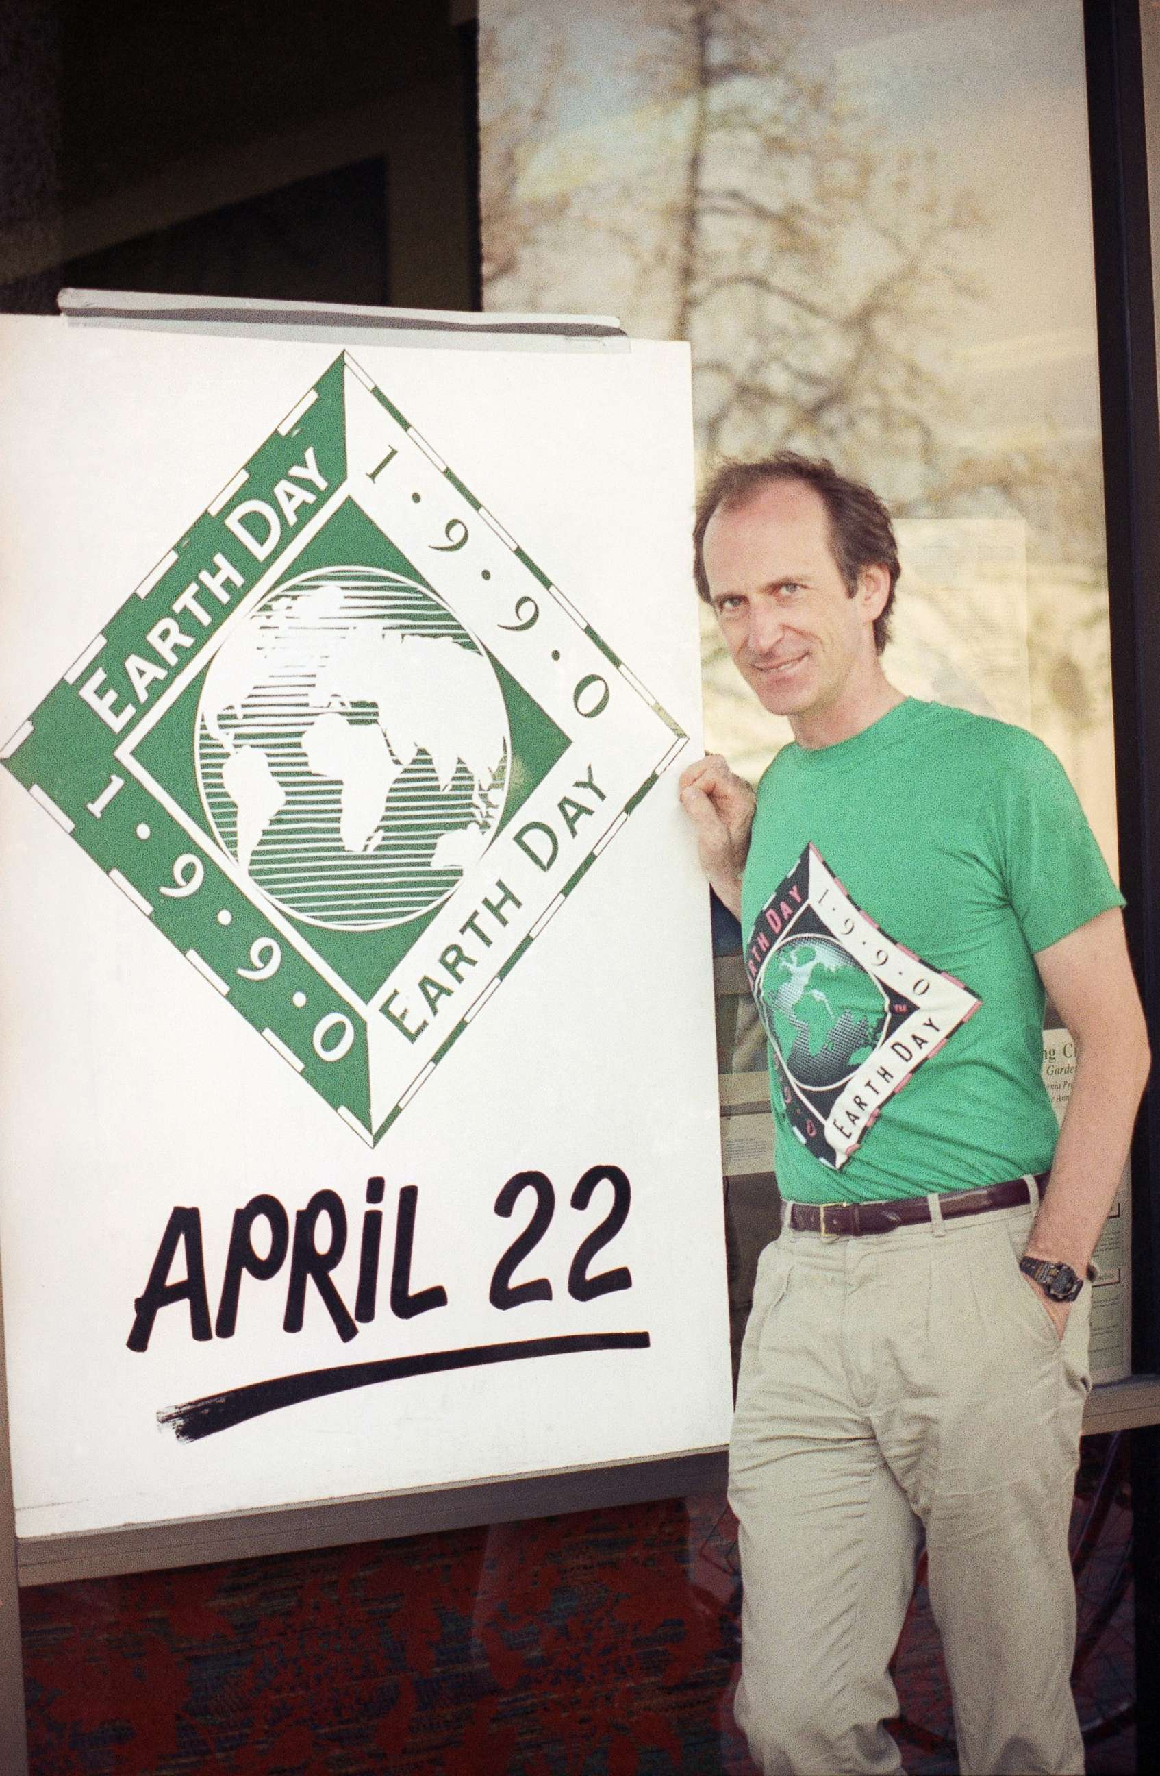
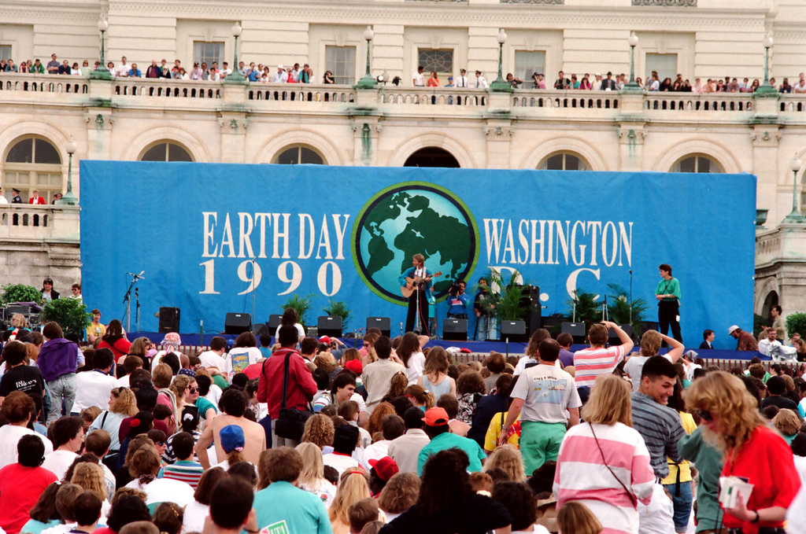
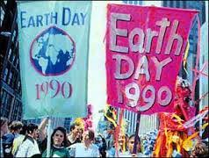
1990: We Go Global!
Mobilized 200 million people in 141 countries
Major focus on recycling
Paved the way for the 1992 UN Earth Summit in Rio

Slide 8
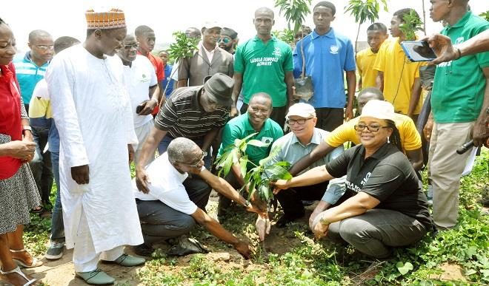
Earth Day Today!
Over 192 countries participate in Earth Day events
More than 1 BILLION people take part in some kind of Earth Day event
50,000 partners across the globe help contribute to the global movement!

Slide 9
Earth Challenge 2020 will be one of the largest citizen science initiatives ever attempted, strengthening the nexus between science, the environment, and people’s quality of life.
TOGETHER
WE WILL
S.A.V.E.
OUR EARTH
SCIENCE
Earth Day Events will mobilize, activate, and amplify commitments from millions of students around the world. These events will range from the schoolyard to the National Mall in DC.
ACTION
The 2020 plan promotes global engagement at every level of education, appealing to people from all walks of life, regardless of their race, creed, culture, social status, or economic standing.
The goal is to equip students with skills, knowledge, and a sense of purpose to enhance their ability to create meaningful change.
The Great Global Cleanup will be the world’s largest ever coordinated, environmental volunteer effort, engaging millions of students to clean up their schools, communities, and natural areas.
VOLUNTEER
The Global Teach-In will involve millions of students, educators, and individuals, sparking new ideas and opportunities to educate for action.
EDUCATE

Slide 10
Role of the Teach-In: Bringing it to the modern era
A Teach-In is an opportunity for students and community members to come together to learn about an issue and collaborate on how to address them.
Teach-Ins can cover a vast range of topics but the best topics are ones that directly impact your community.
ANYONE can host a Teach-In
Teach-Ins can be virtual too!

Slide 11
Earth Challenge: Teach-In Topics
?
What is the extent of plastic pollution?
How are insect populations changing?
How does air quality vary locally?
What are the local impacts of climate change?
What’s in my drinking water?
How secure and sustainable is my food?
?

Slide 12
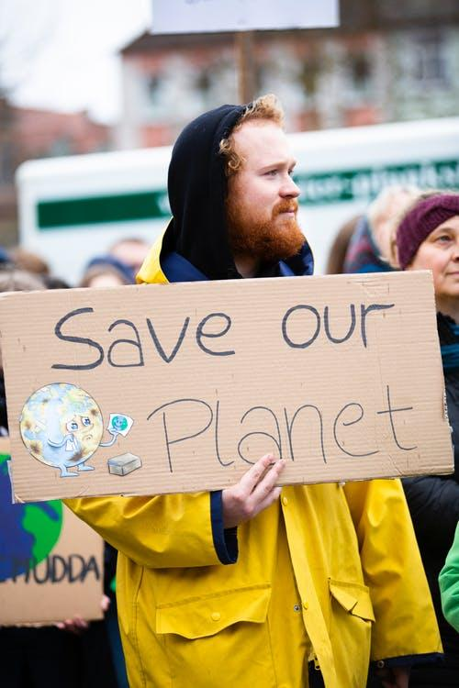
Hosting a Teach-In
Form a planning committee
Pick your topic
Come up with goals and takeaways
Secure speakers
Identify key stakeholders
Pinpoint potential partners
Plan logistics
Reach out to the community
End with a call to action
Follow-up!

Slide 13
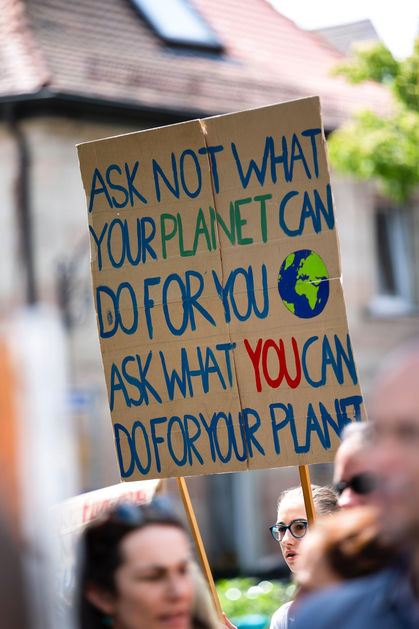
Time to plan your own Teach-In!!
Break into groups
Read your scenario
Fill out worksheet
Share out

Slide 14
What can we accomplish in 2020?

Slide 15
How to Join the Movement
Actions
Sign up as an Earth Day School
Sign a Partnership Agreement with us
Register your Teach-In, cleanup, or other Earth Day event at EarthDay.org (coming December 10th)
Resources
Teach-In Toolkit & Grab Bags
Earth Challenge Lesson Plans
Audience specific 2020 Menus
Educator Network newsletter
Map and database of Earth Day events around the world

Slide 16
Thank You! & Questions?
Contact
Ritchie@earthday.org
Heeschen@earthday.org
Connect
www.earthday.org
Subscribe to the Newsletter
Register your events- Billion Acts of Green!
Follow us on Social Media!

