Slide 1
Engaging with the US Forest Service
Youth Engagement Programs

Slide 2
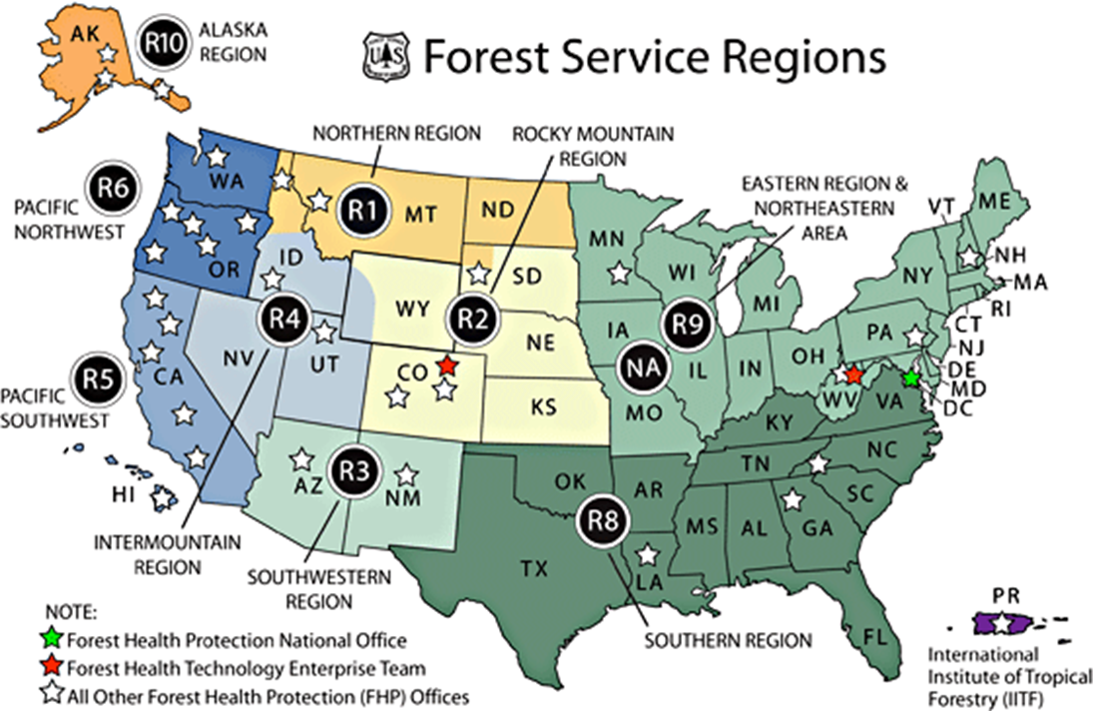
Forest Service
Regions include National Forest Systems and State and Private Forestry
Research Stations
Pacific NW=R6, 10
Pacific Southwest=R5
Northern=R9
Southern=R8
Rocky Mountain= R1,2,3,4
International Forestry
Notes:
Let’s start with how we’re organized.
The National Forest System mission is management of the National Forests
Region 5 includes Hawaii and the Pacific Island Territories
Puerto Rico, International Institute of Tropical Forestry and is part of region 8
State and Private Forestry works with the state agencies and other partners working with forest landowners, communities and others not, National Forests.
The Forest Health program area works with all land agencies, state and federal
Research Stations
International Forestry
Note that there is a certain amount of autonomy with each region and station. You may notice some inconsistencies of how different units operate.

Slide 3
Where do we fit?
Forest Service Strategic Plan Goal: Deliver Benefits to the Public Strategic Objective F: Connect People to the Outdoors Means and Strategy: Engage partners and educators in developing, distributing, and using high-quality conservation education programs and materials so that people of different ages and abilities can understand and appreciate our country’s natural and cultural resources and the need to manage them for present and future generations.
Notes:
How do conservation education fit into our scope of work?
The Forest Service manages 193 million acres of national forests and grasslands, comprising 30 percent of all Federal lands and including millions of acres of designated wilderness and thousands of miles of wild and scenic rivers.
More than 80 percent of Americans live in urban areas, and they have many opportunities to enjoy the outdoors on local open space and nearby national forests. Urban Americans benefit from the 100 million acres of urban forests, including urban parks, neighborhoods with shade trees, landscaped boulevards, public gardens, and more.

Slide 4
Youth Alliance
Comprised of national directors engaged in youth efforts across the agency
Goals
Emphasize partnerships and collaboration
Ensure conservation service and career pathways
Provide high-quality conservation education
Build connections with nature
Build capacity for youth engagement
Notes:
Who’s doing this?
The Forest Service staff areas that comprise the Youth Alliance are: National Partnership Office, Watershed, Fish, Wildlife, Air and Rare Plants (WFWARP), Job Corps, Recreation, Heritage and Volunteer Resources, Fire and Aviation Management, Conservation Education and Office of Communication

Slide 5
Vision
Our Nation’s forests and grasslands nurture every youth’s connection with nature and their understanding of natural resources, and provide opportunities for conservation service and employment to ensure the next generation cares for their public lands
Notes:
Youth Alliance vision statement

Slide 6
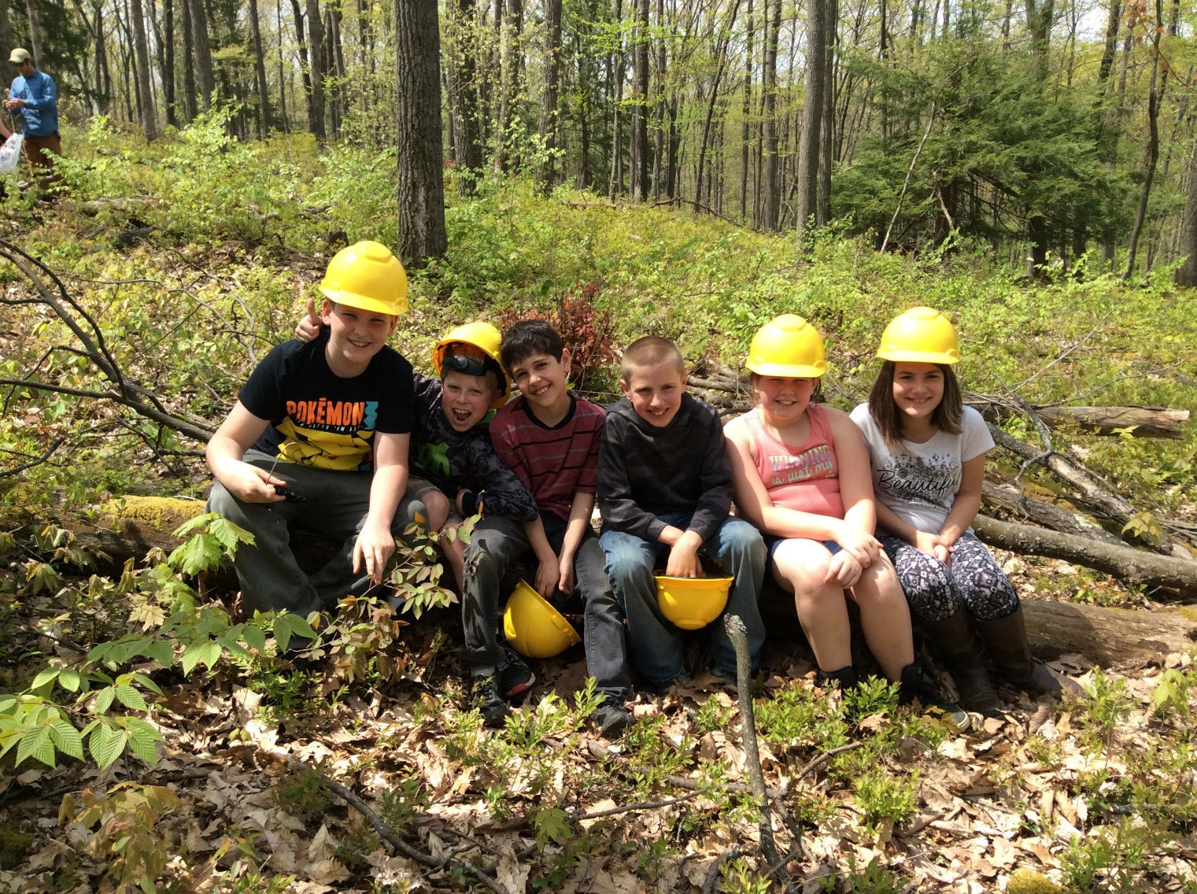
Strategy for Youth
Target all youth and educators
Experiences
Education
Recreation
Job skills
Short and long term
Continuum from discovery to action
Notes:
In FY19, we reported more than 4,350 events, reaching nearly 6.5 million people.
Our programs are designed for everybody – formal and nonformal educators and students, youth groups, families, and individuals at public events.
In this presentation, we’re going to give you a sample of programs across the country. They are loosely organized into online/digital products that you can access from anywhere; youth employment opportunities, and hands-on, in-the-dirt, education

Slide 7
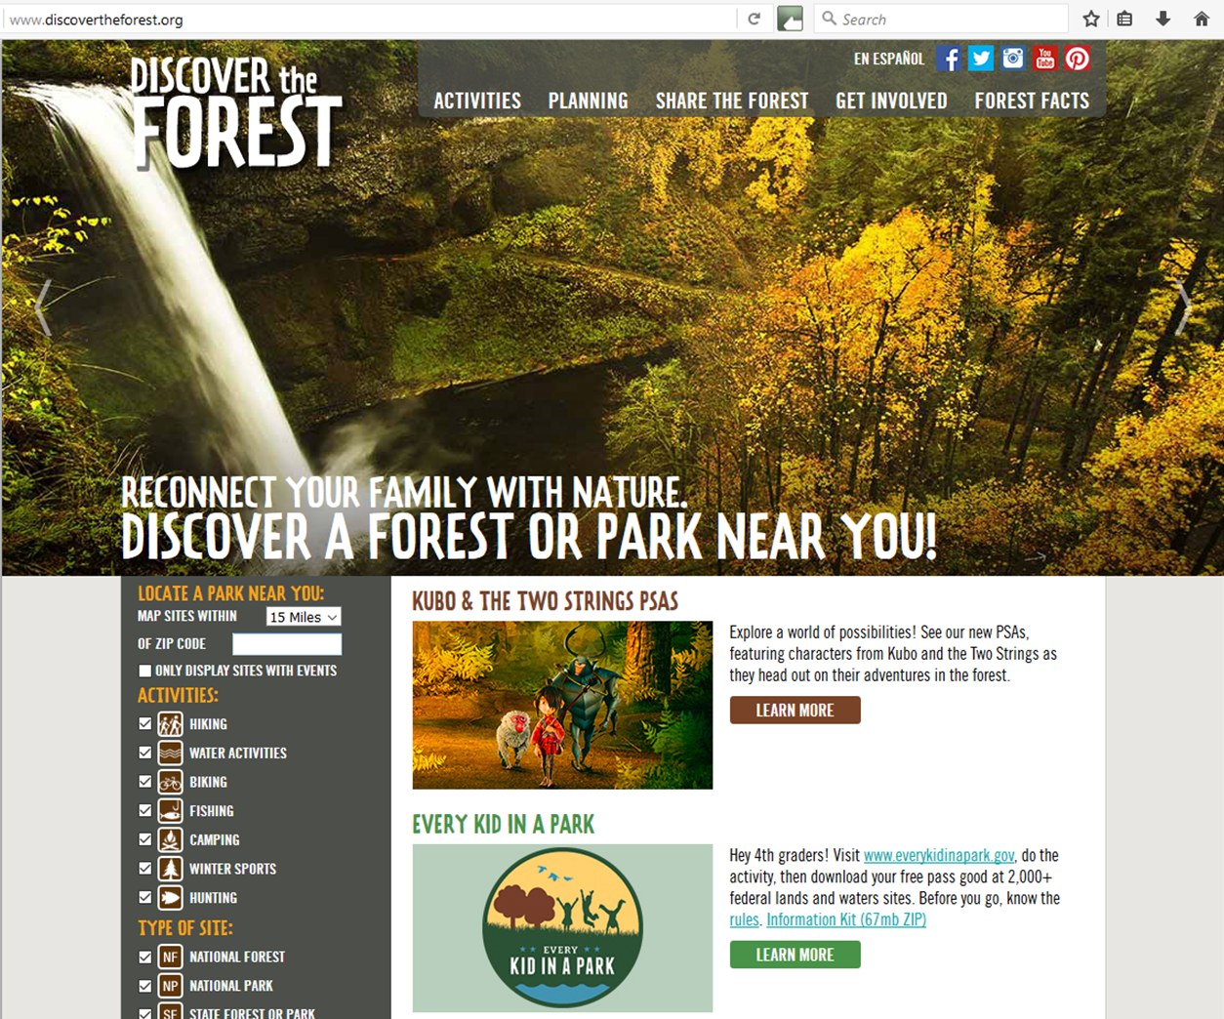
discovertheforest.org
National, state, and local parks and forests where you live
Parent guide and family activities
Planning your trip and sharing your photos
Forest facts
Notes:
Discovertheforest.org, available in both English and Spanish, is our online portal to public spaces everywhere. On this website, you can find:
National, state, and local parks and forests where you live
Family activities and helpful parent guides
Tips for planning your trips and sharing your photos, and
Forest facts
Our ongoing 5-year Challenge Cost Share Agreement with the U.S. Forest Service (USFS) supports education and community engagement among Latino and diverse communities focusing on initiatives highlighting programs, priorities, and activities of the USFS and partners
e.g. Spanish Discover the Forest event at Kenilworth Aquatic Gardens
e.g. Hispanic Heritage Month Healthy Parks, Healthy People event in Montgomery Parks (Maryland) with NEEF and Corazon Latino
CORAZÓN LATINO is a 501c3 non-profit organization focused on designing and implementing culturally relevant campaigns to inform, empower, and mobilize diverse communities around environmental, conservation, education, civic engagement, social justice, and health issues through strategic communications and outreach activities. We also support and advise organizations seeking to build capacity to implement internal and external diversity and inclusion programs.

Slide 8
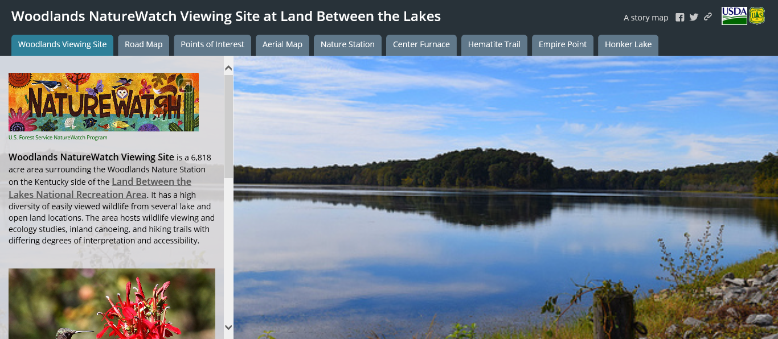
Notes:
Your guide to the best places to view nature on National Forests. Online, find story maps from across the country, destinations, maps, lists and photos of wildlife, and links to webcams and videos such as the Midewin Bison Cam, the Mendenhall Beaver Cam, and the watchable waters of Appalachia video.

Slide 9
FSNatureLIVE
https://www.fs.fed.us/naturewatch/
Videos
Live Q&A sessions with environmental experts
Lesson plans
Educator resources
Notes:
And FS NatureLIVE, our partnership with the Prince William Network and other partners that delivers school-year distance learning adventures on bats, butterflies, climate change, freshwater and more. This year we are hosting TWO adventures: Great OutdoorsLIVE, which launched in September and Smokey BearLIVE. Smokey Bear LIVE focuses on wildfire ecology and prevention, and highlights Smokey’s 75th birthday this year. The pre-taped program is available for viewing this month and there will be a live Q&A with experts November 7.
Also available in Spanish

Slide 10
Agents of Discovery
App-based, site-specific challenges
Missions created for sites, regions, or special events
Smokey Bear 75th Birthday Mission launches October 30, 2019
Notes:
This nature-based based app, similar to Pokémon Go, seeks to motivate young children and their families to get out and active by offering site-specific challenges that educate users about the unique environment that surrounds them.
Mission examples:
Site-specific challenges for national forests or other public lands
Regional Explorer Campaigns with many partners (DC, Southern California, Puget Sound)
National Public Lands Day 2018 (6 sites co-developed with NEEF) to celebrate 25th anniversary
The Agents of Discovery Smokey Bear 75th Birthday Mission uses mobile technology (i.e. the same smart phone already in your pocket) to go on an augmented-reality “scavenger hunt” to discover Smokey’s history and his wildfire prevention message. (Forest Service, Outdoor Recreation Roundtable, Agents of Discovery)
Agents of Discovery uses “triggers” (i.e., geo-tags, QR codes or Image Recognition triggers) to open fun and educational challenges that bring our places and our messages to life. Today, the Forest Service has more than 80 mission sites across the agency.
The app is free and doesn’t require wi-fi once a mission is downloaded.

Slide 11
Online Educational Materials
Natural Inquirer Program
Project Learning Tree
PreK-8 guide
Secondary modules
GreenSchools
NAAEE Guidelines and webinars
Notes:
The Natural Inquirer is a free science education journal written for middle and high school students. Created in partnership with the Cradle of Forestry, NI now produces science education products for preK-12, educators and families. (Samples on the table)
We have a long-standing partnership with Project Learning Tree, contributing to writing and revisions of their PreK-8 guide and secondary modules. We also support GreenSchools and have worked with PLT to develop very specific lesson plans and modules based on FS science, such as Climate Change in Southeastern Forests, and Teaching with i-Tree.
Teaching with i-Tree, published in March 2018, is the second most popular page on PLT’s curriculum website. More than 1,300 individuals from 34 countries have downloaded Teaching with i-Tree in just the past year. The English version is most popular, but it is also available in French, Chinese (Mandarin), and Spanish.
The Forest Service has also been a lead partner on development of the guidelines for excellence and NAAEE webinars

Slide 12
National Symbols Program
Smokey Bear
Woodsy Owl
Junior Forest Ranger/ Junior Snow Ranger
Notes:
Develops and distributes educational and promotional materials about conservation and wildfire prevention using Woodsy Owl, Smokey Bear and the Junior Ranger programs. This includes things like coordinating appearances, supporting the National Wildfire Prevention Program, and managing the social media and licensing programs for our national symbols.
In 2019 the National Garden Clubs, Inc. volunteers reached out to 12,094 children from which we received 4,429 official poster entries.

Slide 13
Youth Conservation Corps
Photo by MobilizeGreen
Notes:
The Forest Service has many opportunities for young people to work with us while learning about natural and cultural resources careers. Programs include Pathways, 21st Century Conservation Service Corps, Youth Conservation Corps, Resource Assistants Program, Job Corps, Presidential Management Fellows, and the Virtual Student Federal Service (the largest virtual internship program in the world -- 1,500 positions with 50+ federal agencies) The U.S. Youth Conservation Corps (YCC) is a summer youth employment program that engages young people, ages 15 to 18, in meaningful work experiences on national parks, forests, wildlife refuges, and fish hatcheries.
We have residential programs, where young people meet youth from around the country, live in the national forest community, work on a national forest with partners, gain a variety of job skills, and learn from professionals in many fields. These tend to last about 3 weeks. And we have non-residential, summer-long, programs, where students gain hands-on experience on a local forest for 6-8 weeks.
This summer, the Forest Service hosted more than 60 YCC crews on national forests. YCC gives 15- to 18-year-olds work experience on public lands as well AND helps forests get critical work done on the ground.
This summer, the Forest Service hosted more than 60 YCC crews on national forests. YCC gives 15- to 18-year-olds work experience on public lands as well AND helps forests get critical work done on the ground.
(Woodsy Owl Conservation Corps)

Slide 14
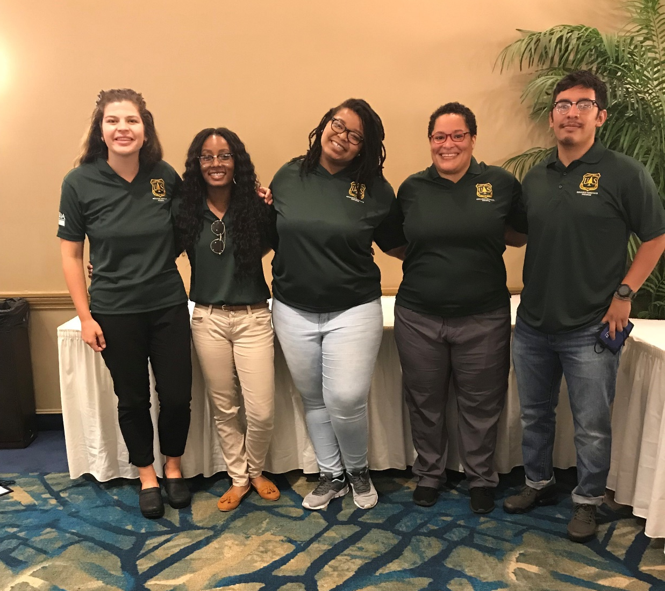
Resource Assistants Program
Photo by MobilizeGreen
Notes:
The Resource Assistants Program is a rigorous, immersive, paid internship for individuals interested in Forest Service careers. Resource Assistants work under the supervision of Forest Service staff to complete mission-critical work that demonstrates leadership, critical thinking, and strategic communication. Through direct training, experience, and exposure, Resource Assistants gain the tools to launch their natural and cultural resource careers.
Paid internship for 6-12 months for college students or grads
Great way to learn about the FS and variety of jobs
Given much responsibility to conduct programs, complete projects, build skills and find mentors
******after completion of 960 hours, eligible for special hiring authority for permanent jobs in the Forest Service!!!

Slide 15
Urban Connections Program
Boston
Detroit
Milwaukee
Minneapolis
Photo by MobilizeGreen
Notes:
Unique to the Eastern Region of FS, where more population than national forests
One employee in each city building partnerships with orgs that connect city residents to nature
Some partners have youth employment opportunities like YCC. Youth work in their neighborhoods building trails, removing invasive species, planting, etc. Great when the work teams can go to a national forest for a few days or week to work on similar projects and see how their skills can transfer to public lands

Slide 16
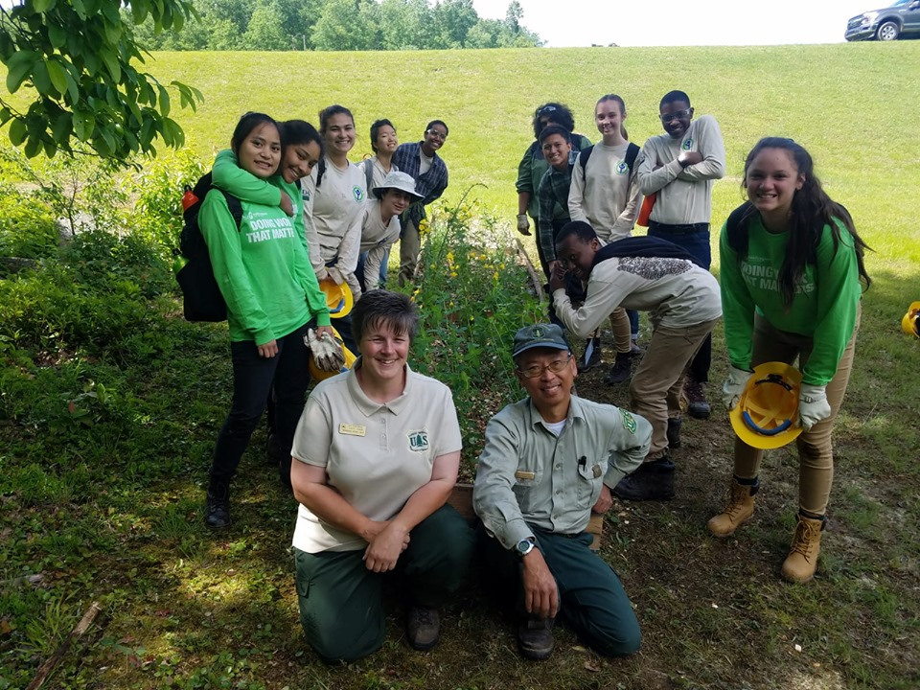
Photo by MobilizeGreen
Notes:
Connecting youth to nature and getting their hands dirty make memories. Even if they don’t end up in natural resources careers, they take those experiences with them into whatever they do. Hopefully, appreciation for nature and their interest in conservation is shared with family, friends, teachers, etc.
Susan will now share more opportunities for hands-on experiences for youth

Slide 17
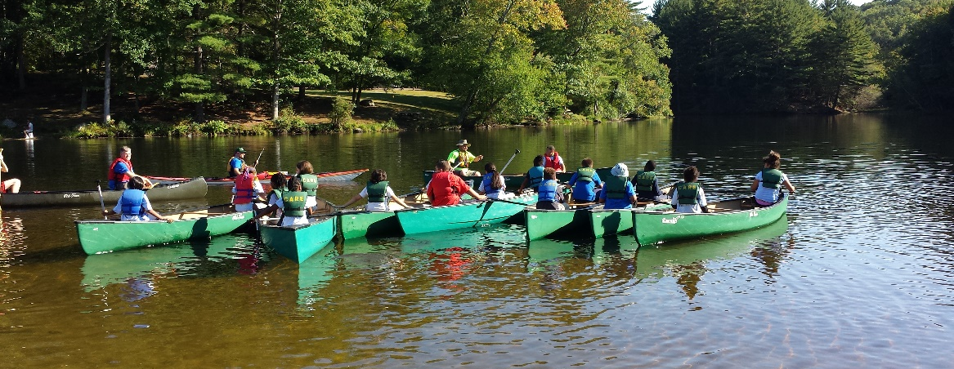
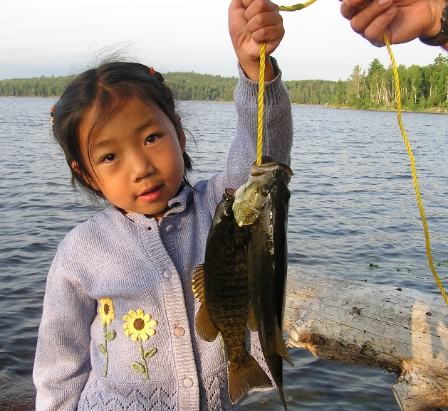
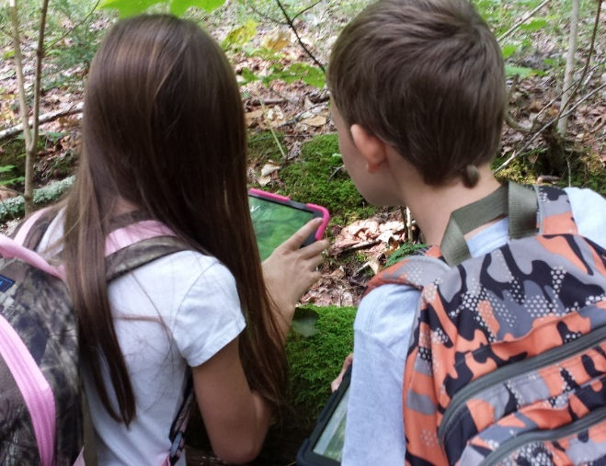
Hands-on
Every Kid Outdoors
Family fishing
Freshwater snorkeling
Special event days such as National Public Lands Day & National Get Outdoors Day
Citizen science
Bioblitz
Notes:
Depending on where you are and the opportunities available, there are several options for partnering with the Forest Service to provide quality conservation education.
There are a multitude of examples. I will go more in depth on a few.

Slide 18
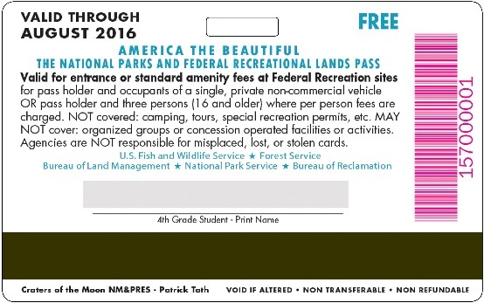
Every Kid Outdoors
Targeted to 4th grade level youth.
Partnership with other federal land agencies
Every Kid Outdoors focus days
September: National Public Lands Day and National Hunting and Fishing Day
October: Bat Week
November: Free holiday tree permits and live tree celebrations
January: Learn to Ski and Snowboard Month
April: Earth Month, Earth Day and Arbor Day
June: Great Outdoors Month and Get Outdoors Day.
Notes:
Formerly Every Kid in a Park it has now been rebranded and imbedded in out annual work.
4th graders are eligible to receive passes for federal lands. The passes are valid from Sept 1-August 31 and allows entry for that 4th grader along with siblings and up to 3 adults
As we shift our focus to partnerships to carry out mission critical work, we are working with partners such as the National Park Trust to develop school-year-long EKO partnerships, engage military families, and provide transportation funding to get students outdoors.
The FS has identified some focus days, but that doesn’t negate taking advantage of other opportunities to engage with us and provide meaningful nature experiences.

Slide 19
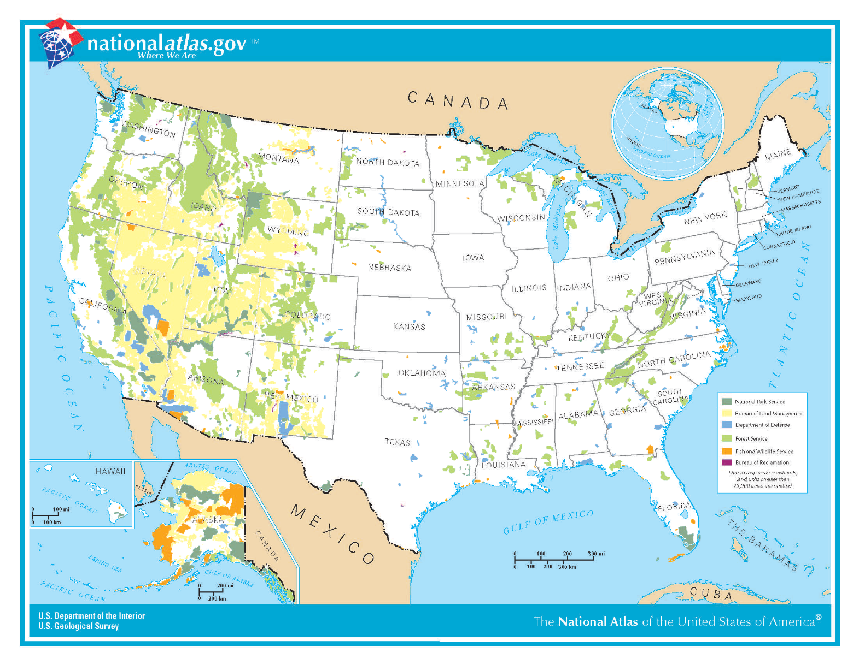
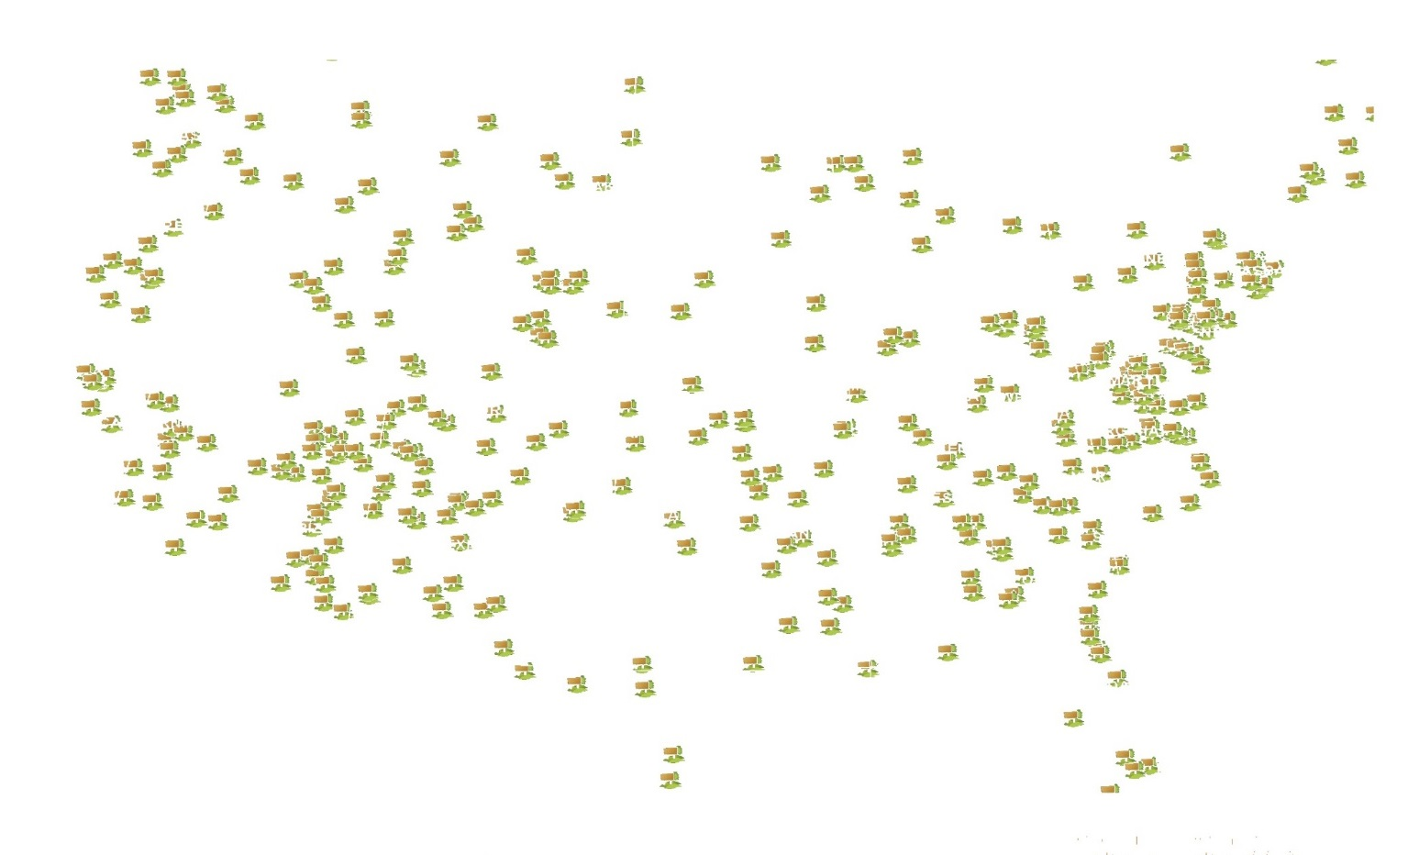
Bureau of Reclamation
Fish and Wildlife Service
Forest Service
Army Corps of Engineers
Bureau of Land Management
National Park Service
National Oceanic and Atmospheric Administration
Notes:
This is a partnership with other Federal land agencies:
USDA Forest Service, National Park Service, U.S. Fish and Wildlife Service, Bureau of Reclamation, Bureau of Land Management, U.S. Army Corps of Engineers, and National Oceanic and Atmospheric Administration.

Slide 20
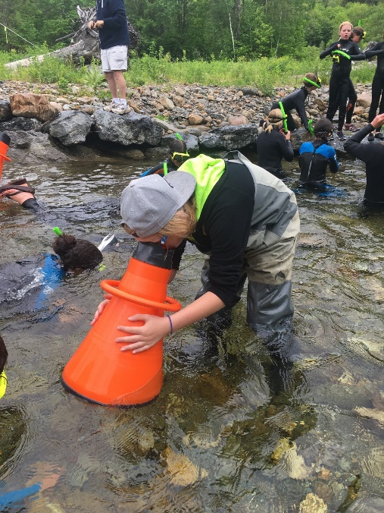
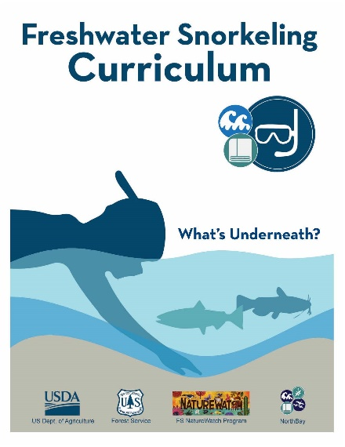
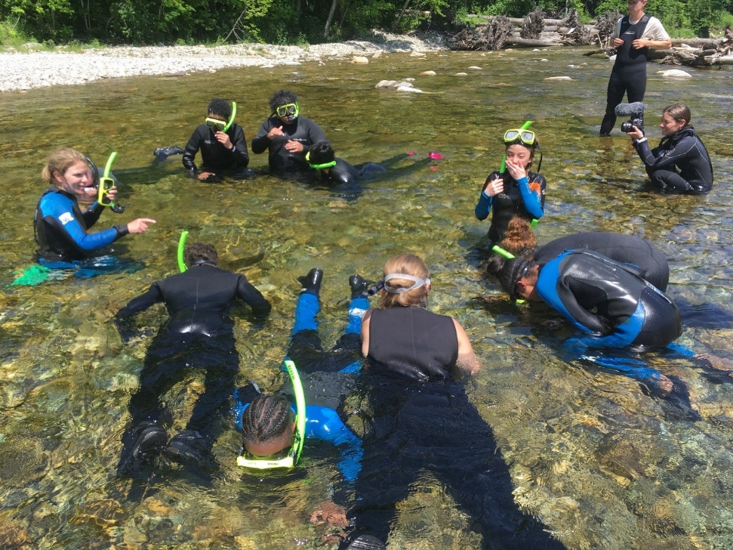
Freshwater Snorkeling
A way to engage youth in the biodiversity of rivers and streams
in partnership with our Naturewatch Program.
Toolkit and curriculum: https://www.fs.fed.us/naturewatch/fishwatch.php
Notes:
Snorkeling with students is something that has gained traction in the least few years. Different national forests have partnered with watershed groups, outdoor/environmental or experiential education organizations to provide opportunities for youth to experience life under the water and gain understanding of freshwater ecology.

Slide 21
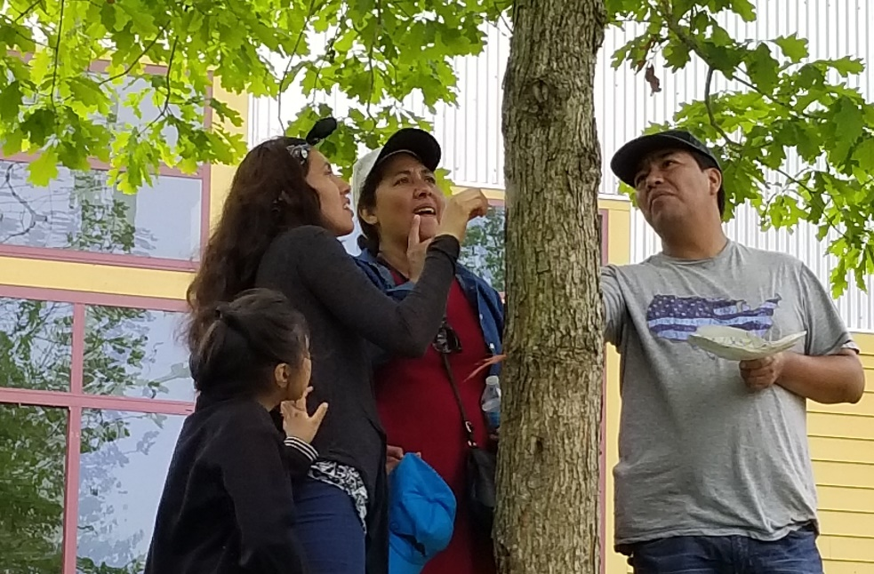
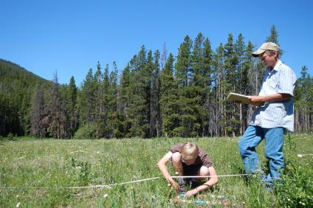
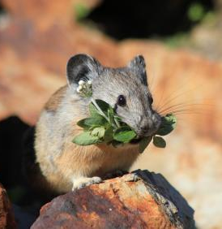
Citizen Science
Using sound science to guide our management and decision making
Connecting our work to the public that we serve
Grant opportunity due December 3, 2019: https://www.fs.fed.us/working-with-us/citizen-science/competitive-funding-program
https://www.fs.fed.us/working-with-us/citizen-science
Notes:
Citizen Science has become increasingly important in the work we do. We have citizen scientists from students to retired experts helping us do our work as well as engaging a population to help steward the land.
Examples include:
Youth Monitoring Program, where high school students have continuously collected data on permanent plots on the Helena NF, analyzed the data and report their findings and recommendations to decisionmakers on the forest and the community
Work with Cherokee Nation to develop citizen-science-based strategies for identifying and monitoring river cane ecosystems and creating a plan that can be implemented by tribes and other partners across the Southeastern United States. Citizen scientists will use their digital devices to document river cane locations. Data collected will contribute to analysis, restoration and modeling efforts, and monitoring of specific locations of interest.

Slide 22
Partnering with States
Utah Learn to Ski & Ride Program
Michigan Wheels to Woods
Western Governor’s Association Great Outdoors Month partnership
Notes:
All of our work is magnified through partnerships with states. The Forest Service has partnered with Ski Utah to get 4th graders out skiing; a program that supports both the Foundation’s Open OutDoors program and Every Kid Outdoors.
New York State is accepting the Every Kid Outdoors pass for entrance to all state forests They also rolled out half a million dollars for transportation grants in the 2016-2017 FY (April 1-March 31). 220,000 4th graders in NYS. In Michigan we have supported Wheels to Woods.

Slide 23
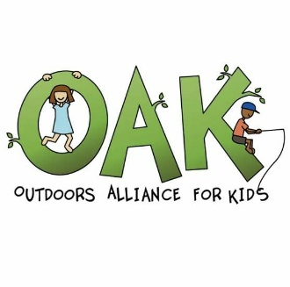
Notes:
We do all this work with partners. More than 3,400 partners listed in our database, just for one fiscal year.

Slide 24
Contacts
Susan Cox
State and Private Forestry, Eastern Region
susan.m.cox@usda.gov
603-868-7706
Lisa Myers
National Forest System, Eastern Region
lisa.j.myers@usda.gov
414-944-3590
Barbara McGuinness
Northern Research Station
barbara.j.mcguinness@usda.gov
814-563-1059

