Slide 1
Intro to Crowdfunding
EENC’s Strategies to raise $37K in 6 weeks

Slide 2
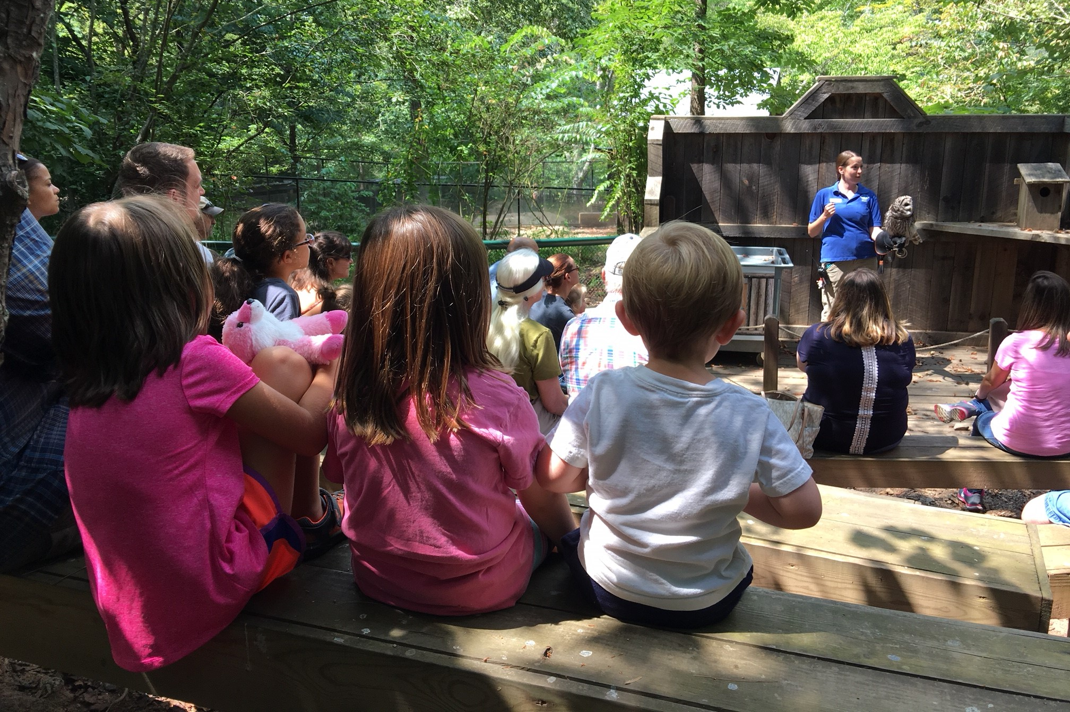
Introductions!

Slide 3
Spoiler! We didn’t do it in the first year
Crowdfunding is work, but it can be a great strategy to engage individual donors and bring in serious $$$$ for your affiliate.
Disclaimer: I’d like to thank the original creators of the vast majority of these memes (not me) for sharing them with the universe.

Slide 4
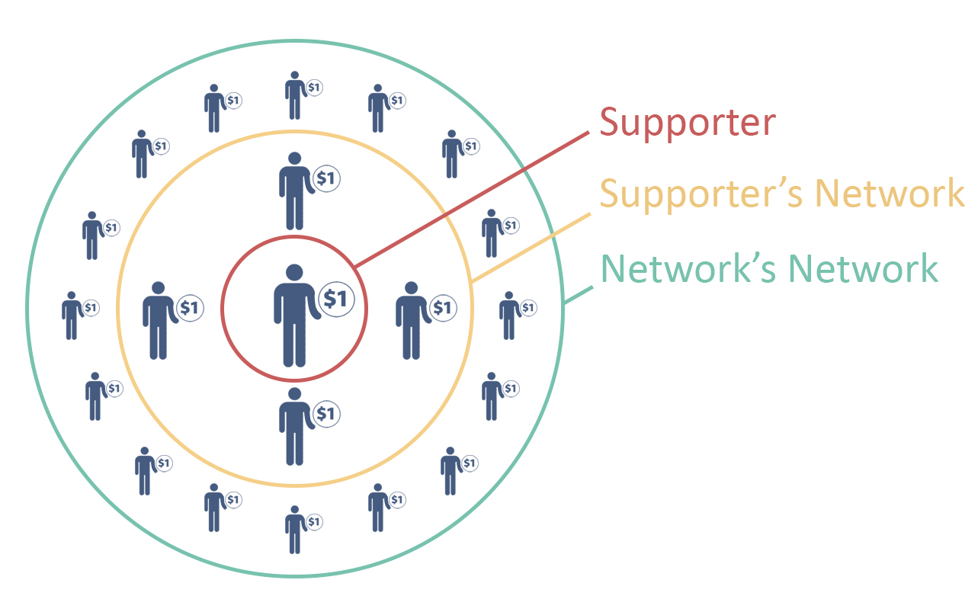
So what is crowdfunding?
“Crowdfunding is the practice of funding a project or venture by raising small amounts of money from a large number of people, typically via the Internet” Wikipedia
AKA Peer-to-peer or kickstarter campaigns
https://www.wildapricot.com/blogs/newsblog/2017/04/12/peer-to-peer-fundraising

Slide 5
EENC’s History
2015 - $2,382 $2K goal
2016 - $9,105 $7.5K goal
2017 - $20,296 $12K → $20K goal
2018 - $36,975 $20K → $35K goal
From 213 donations!
Notes:
Our average gift is about $100. Our median gift was $25.

Slide 6
Waaaaaay before your campaign
Develop a culture of philanthropy - because it’s not about “who knows rich people”

Slide 7
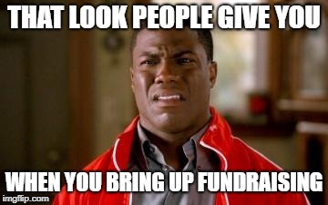
Let’s talk about money
Shift from transactional to transformational relationship building
If board and team can understand the value and importance of development, it’s easier for everyone to make an ask.
Follow a development blog (or four), read online articles, hire a consultant, read books – do what works for you and your team.

Slide 8
First, Know Thyself
How do you feel about fundraising?
Why?
How does your board feel?
Why?
What needs to happen to get everyone to the same place?

Slide 9
When did you give when you felt bad afterwards?
I was coerced
I gave because I felt guilty
I didn’t really care about the cause
I wasn’t thanked; didn’t feel appreciated
I didn’t see the impact of my gift
I felt it was just a drop in the bucket
I didn’t feel they really needed the money
Credit: Bloomerang’s How to Put Joy into Major Gift Solicitation and Philanthropy by Claire Axelrad

Slide 10
Now that you know what not to do
What do you think of when you hear the word “philanthropy”?
“The desire to promote the welfare of others, expressed especially by the generous donation of money to good causes.” (English Oxford Dictionary)
When did you give when you felt joyful afterwards?
Not asking donor prospects for gifts denies them the joy of giving.
Credit: Bloomerang’s How to Put Joy into Major Gift Solicitation and Philanthropy by Claire Axelrad

Slide 11
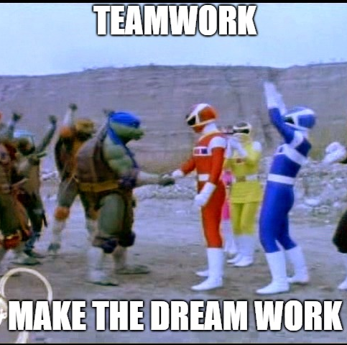
Get your board on board
Gather your team
The more teammates, the more people you have helping you toward your goal!
Strive for 100% board member participation
You do NOT need everyone to be super tech savvy – but you DO need them to be willing to ask.
Address “conflict of interest” concerns
OK, this one I made…

Slide 12
Setting Your Goals
What is realistic for your team?
How does that overall goal impact your individual team members?
How much do you need for your budget?
What specifically do you need to fund?

Slide 13
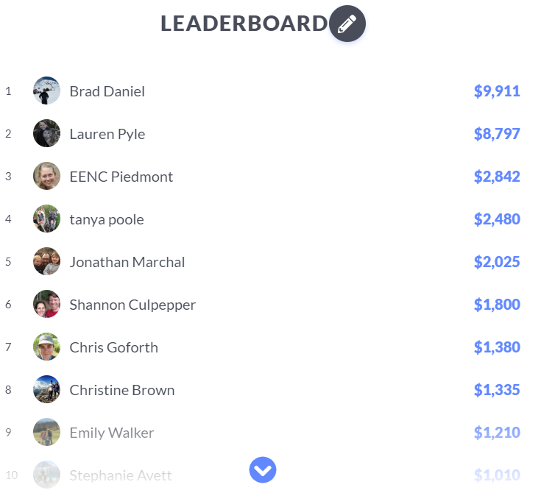
Before your campaign
Pick your platform
We have used MightyCause – but there are TONS of options. You can even just use Facebook.
Pay attention to: fees, how easy it is for donors to use, how easy it is for board members to use, what features do you actually need, how it looks
Find a match! - Individual or team
Pick your timeline – 6 weeks is a good length
Notes:
A book I recently read even included the step to stalk other successful campaigns! (number of backers, donor rewards, videos, emotional connection, timeline, etc.

Slide 14
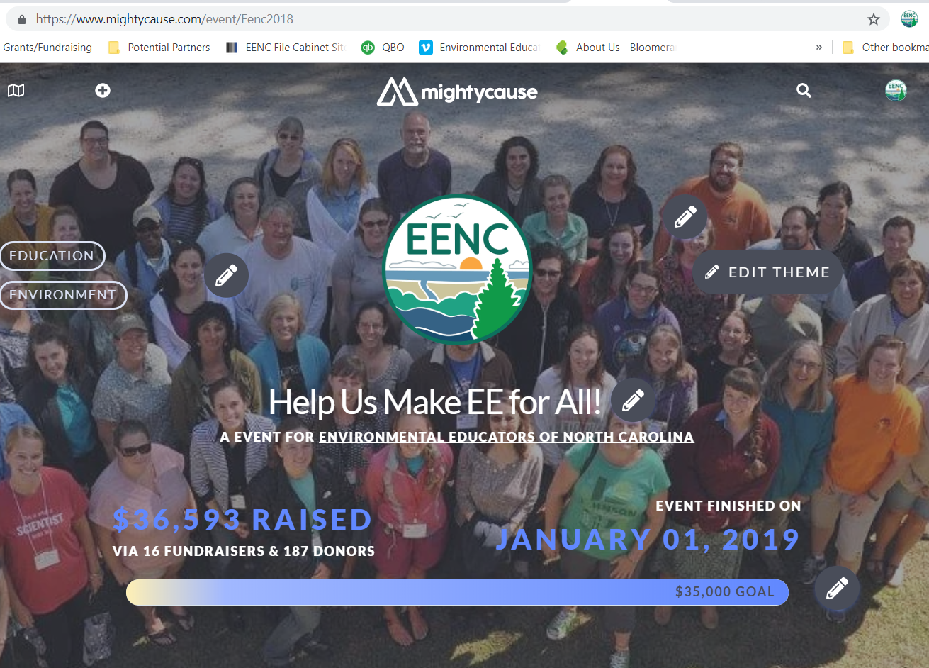

Slide 15
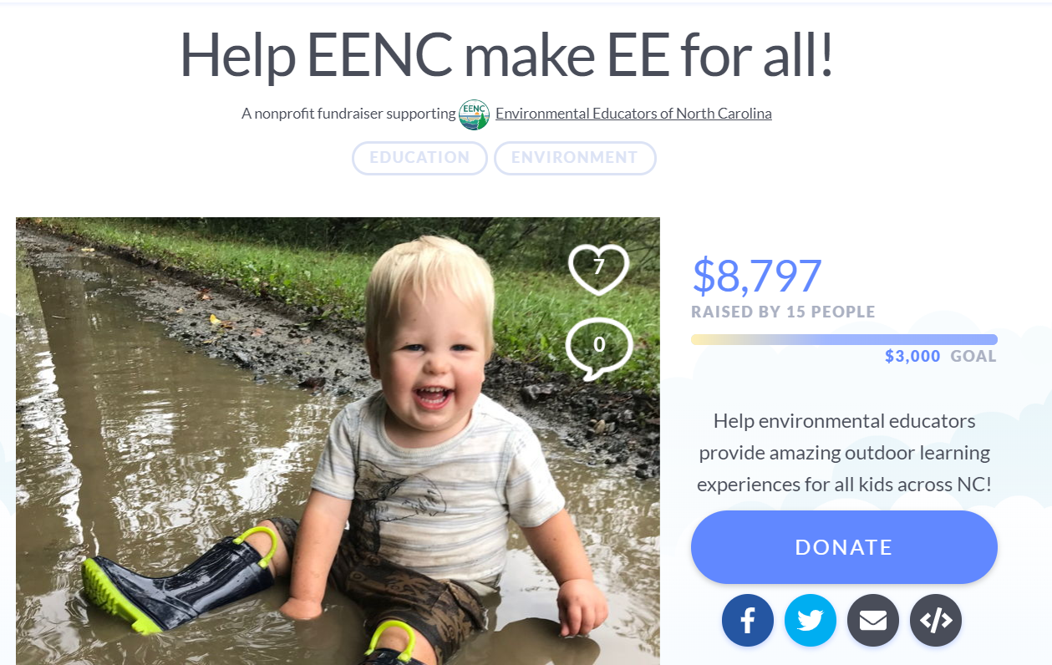
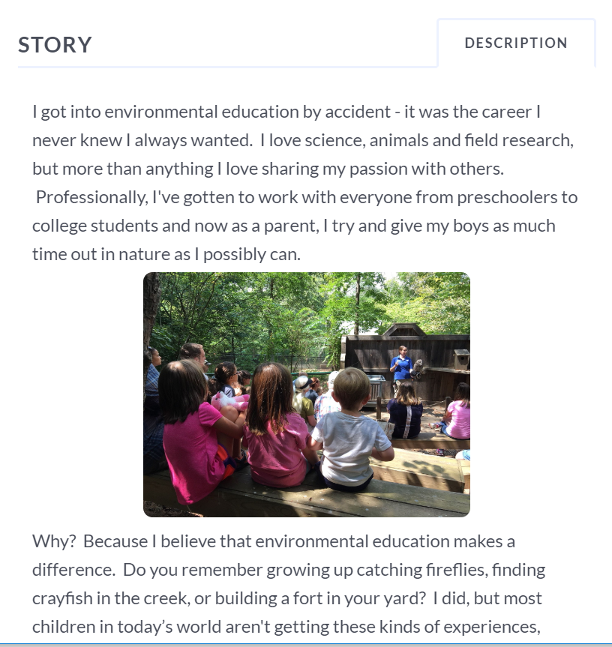
Build Your Page

Slide 16
Tell your story
Why it matters – to you!
3 things you accomplished last year
3 things you’ll do this year
Make personal asks. No “blanket” emails.
If you hit your goal(s) early, set the bar higher!

Slide 17
Get Excited for Your Kickoff!
The first week will be your biggest, so make it count!!
Hashtag/Consistent Messaging
Get the word OUT!
Social Media - “Like” each others posts
Email
Website

Slide 18
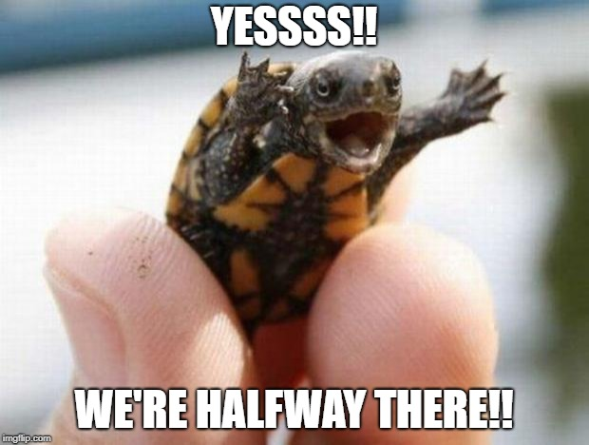
During the Campaign (Team)
Find a cheerleader!
Weekly emails, motivators, etc.
Set deadlines within the overall campaign.
Ex: 1 week for match, 2 weeks for vote
Celebrate your milestones
Keep finding something to draw in donors
And I did this one too…

Slide 19
During the Campaign (Individual)
Set your goal
If you make it, set it higher!
Commit to it.
Be ready to be engaged the. whole. time.
Who to ask? Everyone you know!
Friends, family, coworkers, previous donors to your org, etc. – NOT just “people with money”
EVERY gift is important!!
Notes:
EENC’s median gift:

Slide 20
Keep Asking. A Lot.
Again, and again, and again, and again, and again, and again, and…
People need to see things 3x before they respond.
Use the mode that works for your donors (text, phone, email, social media, etc.)
Can you provide a personal incentive? (ex: $25 donation gets you something crafty!)

Slide 21
Make it a team thing.
Prizes for most donors
Prizes for most money raised
Set a celebration for meeting individual AND team goals
Notes:
Can I get KY’s photos?

Slide 22
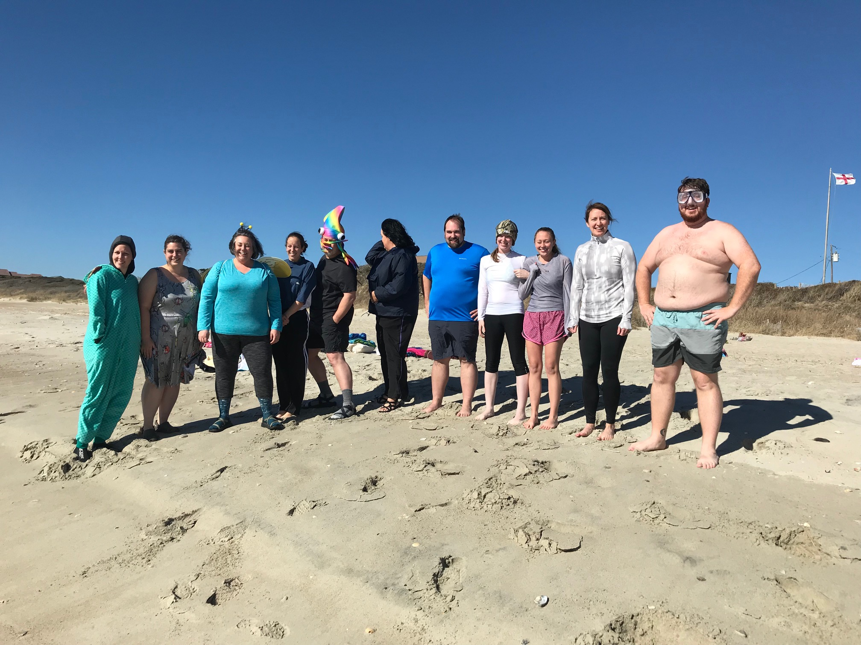
EENC’s “Big Thing”
2017: Polar Plunge
2018: Grey Squirrel Flash Mob
What makes it work?
Ridiculous (and fun for the board)
Makes a good video. We share it everywhere.
Donors love it. People will donate just to make you do it.
Reenactment potential?
Notes:
This year, we did a “donors choose” model for deciding – anyone who donated any amount got one vote per team member they donated to

Slide 23
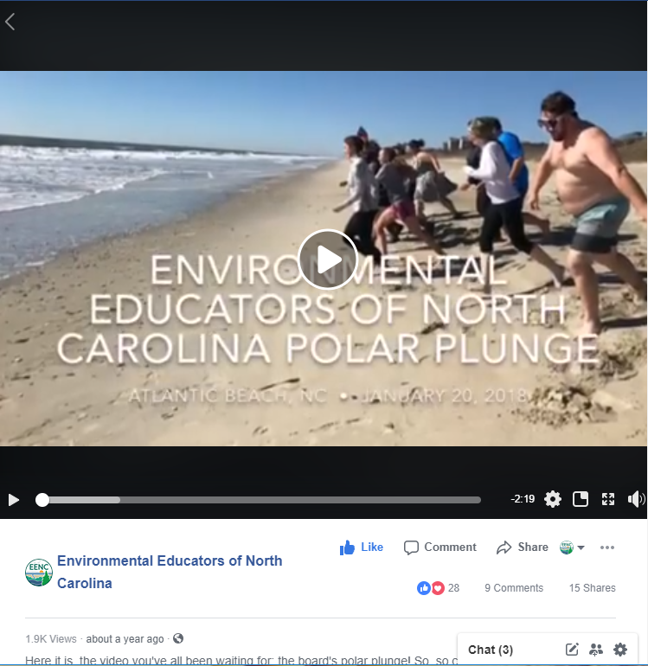
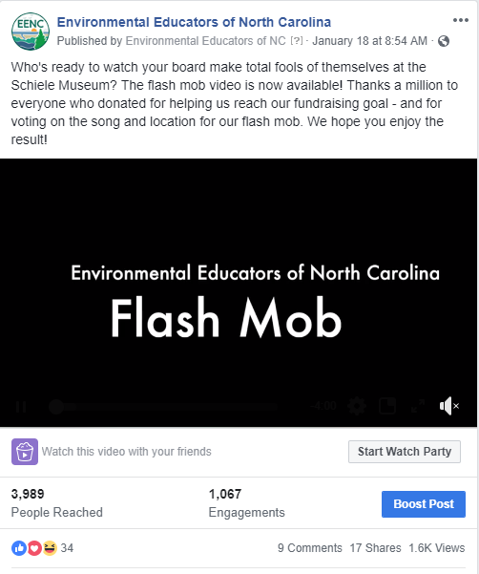

Slide 24
(video removed for file size ☺)
https://www.facebook.com/EENCfriends/videos/1986014271701105/

Slide 25
Say Thank You!
If they donate to your page, you thank them! ASAP.
Facebook thanks
Staff/board thanks
Digital – email, social media
Signed cards
Website, annual report, newsletters, etc.
Best practices: 7 times
Notes:
Make sure to respect donor anonymity

Slide 26
After the campaign
Celebrate with your team AND your donors!
Get to know your donors and what drives them
Try to connect people to the mission, not the person
DO NOT IGNORE THEM AFTER THE CAMPAIGN!!!!!!!!

Slide 27
Building momentum
Record keeping is key!!
Keep them engaged between campaigns (relational, not transactional)
Ask previous teammates to participate again
Email repeat participants their last year’s donors list

Slide 28
Thank you!
Lauren Pyle
EENC
eencexecdirector@gmail.com

