Slide 1
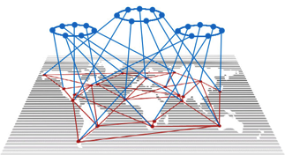
Transformative Learning Networks: Insights from Four Case Studies
ISSS2016, July 28, 2016, CU Boulder
Bruce Evan Goldstein, University of Colorado Boulder
Claire S. Chase, University of Colorado Boulder
Lee Frankel-Goldwater, University of Colorado Boulder
Jeremiah Osborne-Gowey, University of Colorado Boulder
Julie Risien, Oregon State University
Sarah Schweizer, University of Colorado Denver
Notes:
Hatitio! *give sign for hello*
Hello and good afternoon!
And thank you for joining us here today as we discuss insights from four case studies of transformative learning networks.
I am Jeremiah Osborne-Gowey, a PhD student here in the Environmental Studies and Environmental Design programs at CU Boulder.
Joining me today is Lee Frankel-Goldwater, also a PhD student in the ENVS program here.
Some of our co-authors that could not be here today include Claire Chase, Julie Risien, Sarah Schweitzer and Dr. Bruce Goldstein.
We all work with Bruce and this project was his brainchild designed to help each of us situate ourselves better in our dissertation research, theoretical framings and methodological approaches to Participatory Action Research.

Slide 2
Networks in a System
(Inter)National Scale Change Agents
(Inter)National Scale Actions
Network Members
Network Leadership & Netweavers
Institutional Practices
Change Agents & Netweavers
Collective
Action
Outcomes
Network
Facilitation
Role
Place Based
Notes:
In systems that are changing, networks can serve as sort of a middle man. They build capacity for organizations and institutions by infusing knowledge, capacity and energy.
They disrupt at national and international scales by advancing and organizing collective knowledge and stimulating action.
In that middle space they work to cultivate shared knowledge, identity and bring definition to the problems at hand so both place based institutions or organizations and national/international scale organizations can find a shared understanding of both problems and potential solutions.
They build community and connection between peers, who might not have otherwise found each other and between scales here previous mechanisms were limited or non existent. They organize and ease the flow of information using that light loose structure.
By breaking with hierarchical structures they can provide agency to actors across scales to support change.

Slide 3
Learning Networks: what and why
Network
What
Tricky and fragile
Tensions
Agency v. structure
Coherence v. autonomy
Desired conditions v. determinism
Incommensurability
Learning networks
Spring rigidity traps
Foster innovation
Knowledge dissemination
Notes:
Networks are one way to address transformation of complex social challenges that are neither singularly bottom-up nor top-down, but rather cross-scalar in nature, cutting across boundaries and institutional structures, differing geographies and social realities.
Networks are tricky and fragile, subject to many tensions: Agency vs. structure, coherence vs. autonomy, future desired conditions vs. system determinism, partial incommensurability across-scale.
These are but some of the realities often present in networks.
Learning networks can help spring rigidity traps, an inability to apply novelty and innovation in the midst of crisis, and can facilitate the development and dissemination of innovative approaches to complex social-ecological problems.
Through experimentation and innovation generated in the network, learning networks can foster change by influencing planning as well as policy.
Our work here builds on previous from Goldstein and other that suggest multiscalar collaborative planning networks, like the four examined here, can facilitate overcoming these rigidity traps that prevent established institutions from responding to complex cross-scalar social-ecological problems.
Here, we define learning networks as inter-organizational voluntary collaboratives that nurture professional expertise, and describe their potential to catalyze system change by disrupting old habits, fostering new relationships, and providing freedom to experiment.

Slide 4
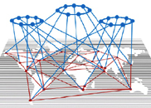
Learning Networks: what and why
Network
What
Characteristics
Intent to Transform
Voluntary and collaborative
Multi-sited and place-based
Multi-organizational and cross-jurisdictional
Intentionally organized and facilitated
Distributed authority with a coordinating core
Communities
of Practice
Transformative
Notes:
Transformative learning networks have a unique set of characteristics distinct from typical organizations.
They aim to be more than a mere network of connections.
They are often conceived using a community of practice framework, a concept that builds on the community of of interest (CoI) discussed earlier today in another ISSS talk by Louis Klein and others and in previous work from Peter Plastrik and others.
However, the ultimate goal is not just evolved practice which can be achieved through CoPs, but transformed systems that govern the domain.
As such, we were looking for TRANSFORMATIVE learning networks that had a set of particular characteristics, things like:
The Intent to Transform
Networks that were both voluntary and collaborative
Multi-sited and place-based
Multi-organizational and cross-jurisdictional
That were intentionally organized and facilitated
And in which authority was distributed but facilitated with a coordinating core

Slide 5
Study goals
Examine:
Network histories, design, structures,
Learning
Capacity-building
“Netweaving”
Cross-scalar integration
Transformation
Inform Network Practice
Approaches:
Participatory Action Research
Developmental Evaluation
Notes:
What we set out to do was explore how learning networks disrupt old habits and foster new collaborative relationships, reinforce participants’ shared ties and purpose while providing freedom to experiment. We settled on using a case study approach to each network.
Each case is similarly structured, first describing the network’s origin, design and approach to collaborative learning, and then focusing on how the network contributes to organizational learning, capacity-building, netweaving, cross-scalar integration and transformative capacity building.
I should mention that we have a forthcoming paper being published by the APLU (Association of Public and Land Grant Universities) that was part of the STEM and NSF-funded work. If you’re interested, drop any of us a line and we’ll be sure you get a copy. Our contact info is included in the last slide. You can also find our emails via the ISSS schedule website.
Anyhow, this report has an appendix that reviews and evaluates some novel approaches to network research and evaluation to inform development of a assessment strategy to support ongoing organizational learning, adaptive network design, and evaluation of network impact on transformation within the arena(s) in which these networks operate.

Slide 6
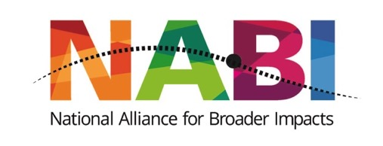
Case studies
National Alliance for Broader Impacts (NABI)
100 Resilient Cities (100RC)
Fire Adapted Communities Learning Network (FACLNet)
Global Change SysTem for Analysis, Research and Training (START)
Interviews
Notes:
Each network had system transformation whether implicit or explicit theory of change. Each proceeded with a similar network design – a learning network – intended to resolve the core tensions in their field/discipline/community/practice.
In each case, network weavers – “netweavers” – engaged in cross-scalar integration through facilitation and creating opportunities for network members to connect and learn.
In each case, transformative capacity building and transformation were manifest in particular ways – we’ll cover this in a bit.
In addition, each network demonstrated at least some evidence (or did not evidence) of the capacity for organizational learning.
These are the four networks on which we conducted the multi-case study each with their on overarching goals and each in different stages in the lifecycle.
National Alliance for Broader Impacts (NABI) – coalescing stage
100 Resilient Cities Network (100RC) – maturing stage
Fire Adapted Community Learning Network (FACNet) – maturing stage
START (Global Change SysTem for Analysis, Research & Training) – maturing/transforming stage
They vary in structure, funding mechanisms, activities.
To assess the networks, we examined internal and external documents produced by each network and conducted interviews with members, primarily netweavers, within each network.

Slide 7
Improving the connection between research and society, 2014 | Coordinated action for sustainability in municipalities, 2013 | New directions after 100 years of failed wildfire mgmt, 2013 | Science-based solutions to global challenges in the developing world, 1990
~450 self-identified members, most Univ. based BI brokers | 100 cities competitively selected, Each with CRO, liaisons & RF managers | Members invited. Flat w/ local, regional & nat. scale activities. | Int. Secretariat w/ distributed system of regional hubs.
NSF RCN $100K/Yr – 5 yrs | Rockefeller Foundation Grants 1 mil to each city | Multi-partner collab. funds logistical staff at an NGO | 1.5-3mil/yr from the US Global Change Research Program
An. meetings, mo. committee calls, listserv, advocacy, training subcommittee work. | Comm. between CROs and RF mediated by managers. CRO working at the city level. | Monthly check-in, quarterly regional meeting, annual conf. and working groups. | Grants, workshops, online training and platform, connections between members.
Goal
Structure
Funding
Activities
Notes:
We won’t spend much time on this slide other than to say that each network varied in structure, funding mechanisms, activities, yet each had a learning network framework and each were attempting to change the status quo within their fields of practice while attempting to bridge cultural, institutional, and geographic boundaries.
Each network had a fairly well distributed member network, some operating nationally – NABI and FACL Net – and others globally – 100RC and START.
National Alliance for Broader Impacts (NABI) – coalescing stage
100 Resilient Cities Network (100RC) – maturing stage
Fire Adapted Community Learning Network (FACNet) – maturing stage
START (Global Change SysTem for Analysis, Research & Training) – maturing/transforming stage

Slide 8
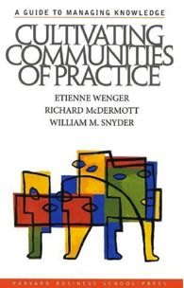
Design Challenges
Voluntary
Not recognized as part of member’s work responsibilities.
Operate at multiple scales
Different approaches to connection and dialogue
Promoting change in a turbulent institutional environment
Reliant on support from multiple sponsors
Notes:
Each of the networks we examined had fairly unique properties about it. Those unique characteristics come with the baggage of some difficult to overcome design challenges. These are strengths of the loose and light structure, but also require continuous assessment, reflection and adaptation to overcome.
Here is another way to look at the life cycle of a network, they can be somewhat ephemeral because if they succeed they are no longer necessary. But this timescale can be a few years to several decades. Ultimately the learning networks can turn into something else all together like and advocacy group or a professional society.
Stages of Community Development
Kezar and Gerhke 2015 (STEM report) adapted from Wenger et al. 2002
https://issuu.com/ukmats/docs/_etienne_wenger__richard_mcdermott_

Slide 9
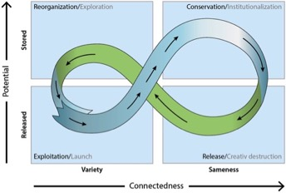
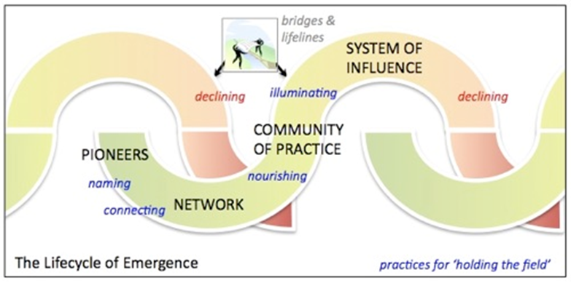
Notes:
Pollard’s version (2010) adapted from Wheatley and Frieze 2006. Both come from Gunderson and Holling’s 1986 ecosystem stages figure which may be familiar to many of you.
The case studies examined were at different stages along the lifecycle of emergence.
̈ Coalescing
¤ National Alliance for Broader Impacts (NABI)
̈ Maturing
¤ 100 Resilient Cities Network (100RC)
¤ Fire Adapted Community Learning Network (FACNet)
̈ Maturing/Transforming
¤ START (Global Change SysTem for Analysis, Research & Training)
We won’t spend much time on this other than to say that these works were helpful for framing our thinking about these networks, where they may be situated presently, and where they may be going.

Slide 10
Key Insights - netweaving
Netweaving
Differing understandings
Deft at operating at various scales, levels
Facilitate flow of info
Forging social ties
Promote shared identify
Spontaneous feedback
Flexibility of their role
Notes:
NETWEAVING
In participating and analyzing the networks, we noticed that the conceptualizations and duties of netweavers in each network varied.
Indeed, in the literature there are a variety of descriptions for what a netweaver is, what roles they play, and at what scales they operate.
Despite these differences, we identified some shared characteristics among netweavers in the four networks.
Netweavers who were more fluid in operating across the different network levels were more capable at facilitating information flow, forging social ties that enabled members to identify shared interests and challenges and engage in group learning, and promoting a shared professional identity.
Netweavers were fairly adept at soliciting and open to feedback from network members. Seemed to create a sense of confidence in network members and demonstrated effective cross-scalar integration.
For example, CROs in the 100RC can be thought of as netweavers in that they actively work in their cities to bridge gaps in resilience understanding and practice while developing relationships with city administrators, elected officials, and business entities. Similarly, hub leaders in FACNet communities are often referred to as the community “sparkplug” for their efforts at developing and fostering relationships with local officials and the public.
From the network-wide perspective, FACNet, START and NABI have network leaders that actively bridge connections between existing programs and people working in similar domains.

Slide 11
Key Insights – org. learning
Organizational learning
Multiple opportunities:
Communication
Feedback
Experimentation across scales
Flexible structure
Face-to-face interactions
Notes:
From an organizational learning standpoint, it was apparent the most effective networks created multiple opportunities for communication and feedback, both formalized and spontaneous.
For example, in the NABI network, even with formal feedback structures in place, observations indicate that open discussions between the steering committee and network members – which often includes directly asking how can NABI better serve the membership – are equally if not more influential in the network’s decision making process.
In three of the networks, there seemed to be an understanding that experimentation in how members address issues of the network and domain space was critical for developing shared identity and agency within network members to address network issues and to facilitate effective learning across the network. How various members and sites addressed issues relevant to the network seemed to be more effective where there was flexibility versus prescriptive courses of action.
It was also important to have regular, network-wide, face-to-face interactions as a way to address network coordination and governance issues but also to formalize learning within the network.

Slide 12
Key Insights – transformative capacity
Reflexive work, intentioned adaptation is necessary
Network identity requires thoughtful intention, action
Netweavers as linchipins, cross-scalar integrators
Notes:
In our cases, the most consistent transformative feature was how interaction between sites supported expression and adoption of a new professional identity.
In the NABI network, the emergence of a specialty in broader impacts, along with an expression of its moral purpose, enabled members to identify best practices and support collective efforts to influence national research funding and oversight. FACNet also engaged its members in ways that supported a common identity of community fire adaptation organizer, grounded in a social-ecological perspective on community and place. START’s focus on strengthening individual skills and capacities was notable for having an explicitly emancipatory component, addressing entrenched power dynamics and the political constraints on collective action.
In contrast to the other cases, we did not observe the potential for collective action and impact in the 100RC network, although there was an explicitly defined shared identity as Chief Resilience Officer (CRO). Members had less peer-to-peer connection than the other networks, and uncertainty about whether CRO’s will continue beyond an initial two year contract may have limited willingness to invest in cultivating relationships.
In each network we examined, there were designated netweavers who performed a crucial nucleating role by supporting individual members and promoting overall network health. Netweavers operated at different scales of network action, from site-based netweaving by the 100RC CROs and Relationship Managers, to learning exchanges in FACNet, to network-wide netweaving in NABI. Essentially, netweavers in these networks served as a sort of linchpin to the network.

Slide 13
Key Insights – transformative capacity
Transformation timescales are long, but…
Individual and organizational learning can be observed early on
Collective actions and incremental change can occur on the way to transformation
Notes:
ANALYZED THE networks, at different stages of development.
When considering transformative capacity, it is important to consider the age of the network and where it might fall along the “lifecycle of emergence”
The old adage of “hindsight being 20/20” may also pertain to looking for transformation in learning networks.
While it may be premature to say that broad-scale transformation of the status quo, at least within the communities of practice and social-ecological circles in which these networks operate, it is important to note that we CAN observe individual and organizational-level changes early on in the life of these networks and that collective actions and incremental change CAN occur on the way to transformation.
For each of the four networks we examined for this project, we observed some of these changes at various levels and scales within in the network. Thus, it seems each network has transformative CAPACITY present that may be fostering and facilitating changes across the network at different levels in and out of the network. Whether complete transformation occurs has yet to be seen.

Slide 14
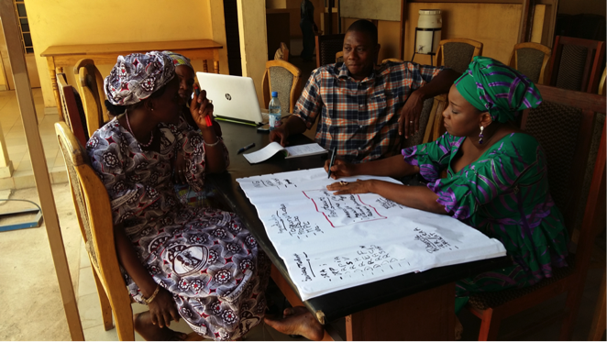
Conclusions
“Soft touch” is necessary
Loose, flexible network structure
Cross-scalar interaction itself enhances potential for transformation
Notes:
If there is a synthetic conclusion we can provide from this set of comparative case studies, it is that networks function best when they are designed and facilitated with a soft touch.
People participate in learning networks in order to bring about system change, so they are need to have the freedom to bound and define their system as it is, as well as how they think it ought to be. This sensemaking process is often more like storytelling than formal analysis, since network members not only define system parameters, they also define their place and purpose within it, and their role in bringing about a desired transformation. In a multi-sited and multi-level learning network, this is happening in many places at once, amidst many perspectives on how to bound a system in space and time and what actors and organizations to take into consideration, and these perspectives will not be entirely coherent with one another. Alternative system futures are co-constructed in different sites in ways that are grounded in real world conditions, informed by multiple epistemologies, and shaped by power-laden choices about what system, whose resilience, for what purpose and to what aim. Prescribing a specific approach to professional practice across network membership can only short-circuit this process of discovery.
Well-functioning learning networks do not rely on defining and enforcing a uniform perspective. A well-designed network is essentially heterogeneous – it encompasses multiple perspectives across site and across scale. From this perspective, good netweaving employs a soft touch by mediating between different ways of system knowing, being, and organizing without collapsing them into one perspective, and organizational learning enables ongoing adaptation, as needs and perspectives evolve and different participants come into the network. Transformative capacity is not just the sum of similar efforts at different sites and scales or a least common denominator between them, but rather is emergent from interaction between the partially-shared understandings within and between sites, and across scales of the learning network.
In closing, we want to reiterate that learning networks are but one way of approaching complex social-ecological issues. We’ve covered some reasons why learning networks may be well-situated for addressing these problems but want to encourage you to consider challenging your own underlying assumptions about the networks and organizations to which you belong in addressing systemic issues.
Learning networks stand as an interesting counter-point to other organizational structures for addressing these complex issues.

Slide 15
THANK YOU! Questions?
https://about.me/jeremiahosgo; Twitter: @JeremiahOsGo
Contact:
Jermiah.OsborneGowey@colorado.edu, Twitter: @JeremiahOsGo
Lee.FG@colorado.edu
http://www.brugo.org/

